Slide 1
Letters To Seven Church of Asia
(Rev. 2-3)
Some were good (Smyrna, Philadelphia)
Some were good / bad (Ephesus, Pergomas, Thyatira, Sardis)
One was bad (Laodicea)

Slide 2
Letters To Seven Church of Asia
(Rev. 2-3)
Good/
Bad
Good/
Bad
Good
Good
Good/
Bad
Good/
Bad
Bad
Most of us would like to be in GOOD church (no condemnation)
None of us would have anything to do with a BAD church (no commendation)
Reality: may be in a church that is GOOD / BAD (Some commendation & Some condemnation)

Slide 3
A Church Left Its First Love – Ephesus (Rev. 2:1-7)
A Church Under Pressure – Smyrna (Rev. 2:8-11)
A Church That Compromised – Pergamos (Rev. 2:12-17)
A Church That Tolerant – Thyatira
(Rev. 2:18-29)

Slide 4

The Church At Sardis (Rev. 3:1-6)
May have been shocked – To learn they were dead!
Yet – they had many desirable qualities
You Are Dead!

Slide 5
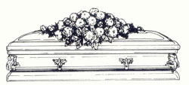
A Dead Church
Rev. 3:1-6

Slide 6
Rev 3:1-6
1 "And to the angel of the church in Sardis write, 'These things says He who has the seven Spirits of God and the seven stars: "I know your works, that you have a name that you are alive, but you are dead.
2 Be watchful, and strengthen the things which remain, that are ready to die, for I have not found your works perfect before God.
3 Remember therefore how you have received and heard; hold fast and repent. Therefore if you will not watch, I will come upon you as a thief, and you will not know what hour I will come upon you.

Slide 7
Rev 3:1-6
4 You have a few names even in Sardis who have not defiled their garments; and they shall walk with Me in white, for they are worthy.
5 He who overcomes shall be clothed in white garments, and I will not blot out his name from the Book of Life; but I will confess his name before My Father and before His angels.
6 He who has an ear, let him hear what the Spirit says to the churches."

Slide 8
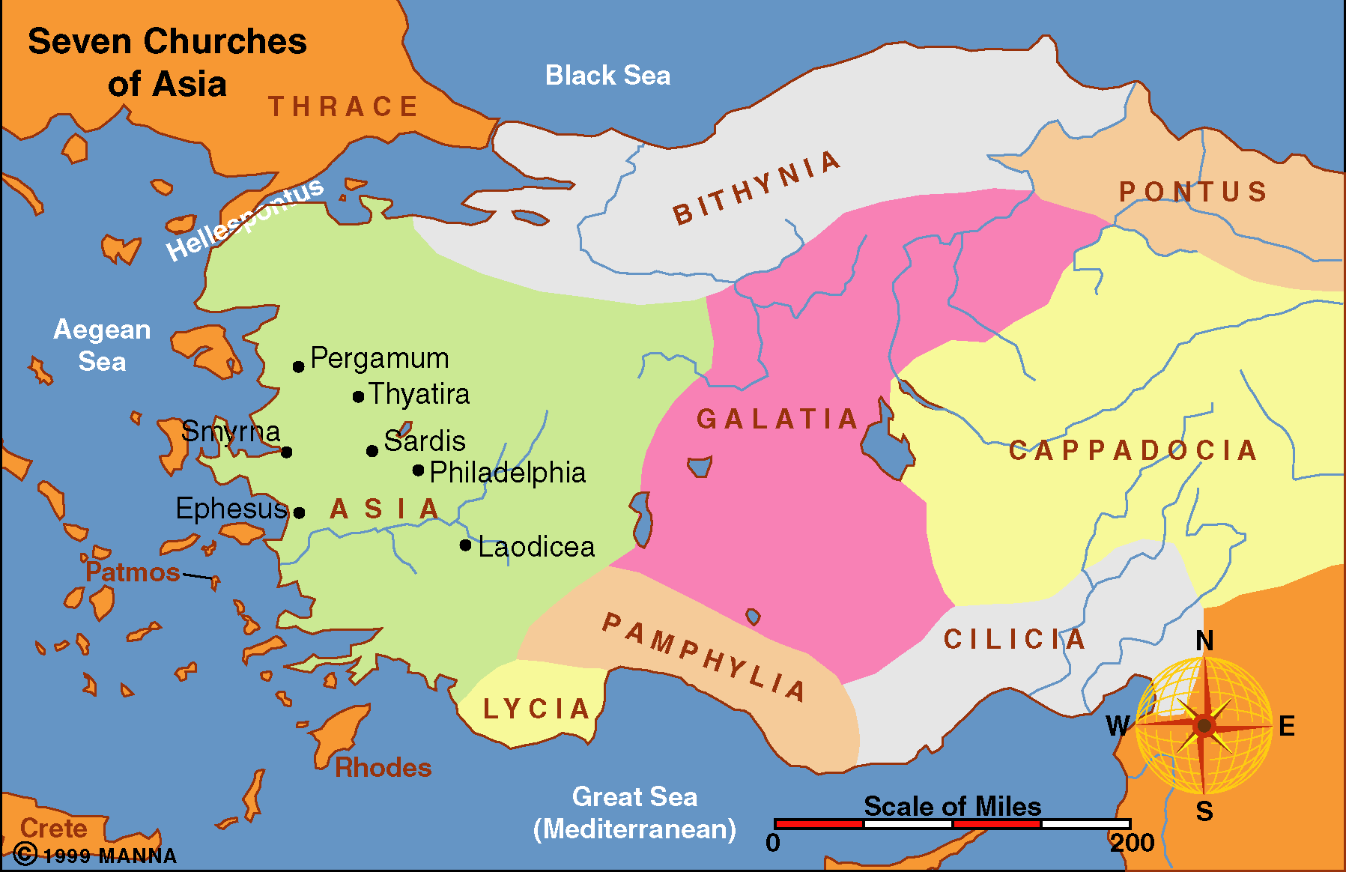

Slide 9
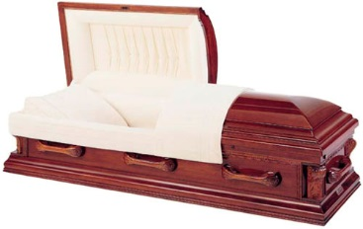
A Dead Church
I.
Good Qualities That Did Not Prevent Death

Slide 10
I.
Good Qualities That Did Not Prevent Death
Good Reputation (v. 1)
  Might be based on:
    Past stand
    Members that are known
    Preacher had or have
    How stood on one issue
  Some churches live on a name
    What they were in past
    Doctrinal stand on issue of the day
  Possible to have a lot that is right – still be wrong
  Possible that churches can change – they had
  Churches are not always as they appear!

Slide 11
I.
Good Qualities That Did Not Prevent Death
Good Reputation (v. 1)
An Active Program (v. 1)
  They had works – yet dead
  Not enough to be busy – must be lawful (Mt. 7:22-23)
  Not enough to be busy at just some things (v. 2)
    Matt. 23:23
    Good Bible class program – yet don’t withdraw
    Personal evangelism program – yet soft
    Support many preachers – yet have worldliness
    Building program – yet neglect spiritual

Slide 12
I.
Good Qualities That Did Not Prevent Death
Good Reputation (v. 1)
An Active Program (v. 1)
A Peaceful Atmosphere
  No evidence of division or strife
  Peace must not be toleration of sin (1 Cor. 5)
  Peace must not be toleration of error (2 Tim. 4:1-5)
  Peace must not be from indifference (Rev. 3:16-17)
    Sin is no problem to those who don’t care
    Error doesn’t matter to those who are apathetic
  Some love peace & harmony over truth!

Slide 13
I.
Good Qualities That Did Not Prevent Death
Good Reputation (v. 1)
An Active Program (v. 1)
A Peaceful Atmosphere
Some Good Members (v. 4)
  Good members will not answer for sins of others
  Good members will not remove the sins of others
  Good members at Corinth didn’t mean there were not serious problems (1 Cor. 5, 6)
  Good members can remain good – in spite of others
  Good members can change – as others influence them (1 Cor. 5:6)

Slide 14
I.
Good Qualities That Did Not Prevent Death
Good Reputation (v. 1)
An Active Program (v. 1)
A Peaceful Atmosphere
Some Good Members (v. 4)

Slide 15
A Dead Church
I.
Good Qualities That Did Not Prevent Death
II.
Preventing Death / Reviving Life

Slide 16
II.
Preventing Death / Reviving Life
Watchful (vv. 2-3)
  Lost their ground by carelessness – time to wake up!
  Take a look at where you are & where it will lead
  “Whenever we are off our watch, we lose ground, and therefore must return to our watchfulness against sin, and Satan, and whatever is destructive to the life and power of godliness.” (Matthew Henry)
  Be on guard – be alert to the dangers!
  Look back & see how we’ve changed!

Slide 17
II.
Preventing Death / Reviving Life
Watchful (vv. 2-3)
Strengthen Things That Remain (v. 2)
  Use & exercise the strength you have!
  May refer to people – warn & strengthen them lest they become like the rest
  More likely refers to deeds – love, faith, service you have – strengthen lest it die too
  Had started – had not continued
“In the lowest state of religion in a church there may be a few, perhaps quite obscure and of humble rank, who are mourning over the desolations of Zion, and who are sighing for better times.” (Albert Barnes)

Slide 18
II.
Preventing Death / Reviving Life
Watchful (vv. 2-3)
Strengthen Things That Remain (v. 2)
Remember & Repent (v. 3)
  Remember how they had embraced the gospel
    Perhaps with zeal & excitement – now gone
    Perhaps with joy – been lost
  Remember what you heard – the truth!
    Now have forgotten (cf. Heb. 5:12)
    Not practicing now
  Repent – change – go back!

Slide 19
II.
Preventing Death / Reviving Life
Watchful (vv. 2-3)
Strengthen Things That Remain (v. 2)
Remember & Repent (v. 3)

Slide 20
A Dead Church
I.
Good Qualities That Did Not Prevent Death
II.
Preventing Death / Reviving Life

