Slide 1
Letters To Seven Church of Asia
(Rev. 2-3)
Some were good (Smyrna, Philadelphia)
Some were good / bad (Ephesus, Pergomas, Thyatira, Sardis)
One was bad (Laodicea)

Slide 2
Letters To Seven Church of Asia
(Rev. 2-3)
Good/
Bad
Good/
Bad
Good
Good
Good/
Bad
Good/
Bad
Bad
Most of us would like to be in GOOD church (no condemnation)
None of us would have anything to do with a BAD church (no commendation)
Reality: may be in a church that is GOOD / BAD (Some commendation & Some condemnation)

Slide 3
A Church Left Its First Love – Ephesus (Rev. 2:1-7)
A Church Under Pressure – Smyrna (Rev. 2:8-11)

Slide 4

The Church At Pergamos (Rev. 2:12-17)
Get a letter – You live where Satan does & you have struck a compromise!
A Church
That Compromised

Slide 5
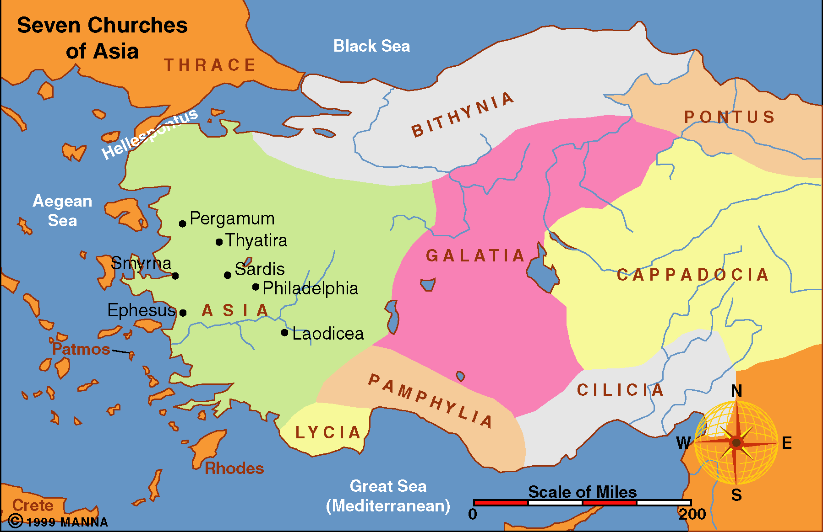
30 miles North of Smyrna
Northernmost of 7 churches
“Pergamos” – Feminine form and “Pergamum” Neuter form
190 BC with help of Rome expelled Antiochus, III (Syrian king) – King Attalus, III bequeathed the city & entire kingdom to Rome
29 BC temple erected to Roma (godess) & Augustus (divine)
Of all 7 cities
Pergamos
was worst!

Slide 6
Rev 2:12-17
12 "And to the angel of the church in Pergamos write, 'These things says He who has the sharp two-edged sword:
13 "I know your works, and where you dwell, where Satan's throne is. And you hold fast to My name, and did not deny My faith even in the days in which Antipas was My faithful martyr, who was killed among you, where Satan dwells.
14 But I have a few things against you, because you have there those who hold the doctrine of Balaam, who taught Balak to put a stumbling block before the children of Israel, to eat things sacrificed to idols, and to commit sexual immorality.

Slide 7
Rev 2:12-17
15 Thus you also have those who hold the doctrine of the Nicolaitans, which thing I hate.
16 Repent, or else I will come to you quickly and will fight against them with the sword of My mouth.
17 He who has an ear, let him hear what the Spirit says to the churches. To him who overcomes I will give some of the hidden manna to eat. And I will give him a white stone, and on the stone a new name written which no one knows except him who receives it." '

Slide 8
A Church That Compromised
Rev. 2:12-17
I. Its Strength

Slide 9
I. Its Strength
A. Works (v. 13)
1. Active
2. Busy
3. Do more than think, talk & plan

Slide 10
I. Its Strength
A. Works (v. 13)
B. Hold fast to my name (v. 13)
1. He is Lord of Lords (Rev. 14:17) – not acknowledge any other Lord (i.e. Ceasar)
2.Recognize his authority (Acts 4:7)

Slide 11
I. Its Strength
A. Works (v. 13)
B. Hold fast to my name (v. 13)
C. Did not deny my faith (v. 13)
1. The faith Jesus taught others to believe (Phil. 1:27; Jude 3) – Objective Faith
2. The faith Jesus taught others to have (Heb. 10:39 – 11:1) – Subjective Faith

Slide 12
I. Its Strength
A. Works (v. 13)
B. Hold fast to my name (v. 13)
C. Did not deny my faith (v. 13)
D. Faithful in spite of Martyrdom (v. 13)
1. Antipas was not a specific person
2. Perhaps stood for all who had died as martyrs
3. “Anti” = against / “pater” = father [One resisted authority of Rome)
4. Legend has that one named Antipas was roasted to death in a brazen bull
5. Even that didn’t shake them!

Slide 13
A Church That Compromised
Rev. 2:12-17
I. Its Strength
II. Its Temptation

Slide 14
II. Its Temptation
Where Satan Dwells
(v.13)
A. Surrounded by pagans, heathens & worldliness
B. Seat – Satan’s influence controlled the people of the city
C. Temptation to compromise

Slide 15
“Everyone has a choice to make. Either compromise faith and blend with the evil, or face the ridicule from the majority as foolish, fanatical, and too radical about faith.”
Harkrider, 36

Slide 16
II. Its Temptation
Where Satan Dwells
(v.13)
A. Surrounded by pagans, heathens & worldliness
B. Seat – Satan’s influence controlled the people of the city
C. Temptation to compromise
D. Could overcome & conquer!

Slide 17
“The principle of the Christian life is not escape, but conquest. It may be that we often feel it would be very much easier to be a Christian in some other place and in some other circumstances, amongst people who are more sympathetic…If in the early days Christians had run away every time they were confronted with an engagement very difficult, there would have been no chance of a world for Christ.”
Barclay, 112-113

Slide 18
A Church That Compromised
Rev. 2:12-17
I. Its Strength
II. Its Temptation
III. Its Weakness

Slide 19
III. Its Weakness
A. Those that hold the doctrine of Balaam (v. 14)
1. Numbers 25:1-8; 31:16 – Seduced Israel with harlots to cause them to sin – so would not be blessed.
2. 2 Peter 2:15 - wages of unrighteousness
3. Jude 11 – error of Balaam for profit
4. Stands for doctrine of compromise

Slide 20
III. Its Weakness
A. Those that hold the doctrine of Balaam (v. 14)
B. Those that hold the doctrine of Nicolaitans (v. 15)
1. Don’t know who they are
2. Some think it refers to the Gnostics (what flesh does is immaterial) – thus could compromise for safety
“The fault of the Nicolaitans was that they were seeking to adjust Christianity to the level of the world rather than lift the world to the level of Christianity. In other words, they were following a policy of compromise simply and solely to save themselves from trouble they were afraid and unwilling to face.” Barclay, 115

Slide 21
Doctrine of
Balaam
Doctrine of
Nicolatitans
Same Doctrine
“It is significant to mention here that the term Nicolaitane is the Greek equivalent of the name Balaam in the Hebrew, and they both meant ‘the destroyer of the people.’” Wallace, p 93
“Since the names mean the same, Jesus probably had the same error in mind.” Winkler, p. 23
Notes:
Dan Winkler, Spiritual Sword, Volume 29, No. 1; October 1997

Slide 22
III. Its Weakness
A. Those that hold the doctrine of Balaam (v. 14)
B. Those that hold the doctrine of Nicolaitans (v. 15)
C. Tolerating those who held this doctrine
1. Consider those being addressed
“It was not dictated to those preaching and practicing cultural relevance. It was sent to those who had remained true but were extending their fellowship to the participants of error.” - Winkler, p. 23

Slide 23
III. Its Weakness
A. Those that hold the doctrine of Balaam (v. 14)
B. Those that hold the doctrine of Nicolaitans (v. 15)
C. Tolerating those who held this doctrine
1. Consider those being addressed
2. As much a problem with toleration of those in error as the those in error themselves
3. There is no “statue of limitations” on error!

Slide 24
A Church That Compromised
Rev. 2:12-17
I. Its Strength
II. Its Temptation
III. Its Weakness
IV. Its Need

Slide 25
IV. Its Need
A. Repent (v. 16)
1. Change!
2. Change the way they thought & way they lived
3. Cease holding to the doctrine of compromise!
4. Cease tolerating those who are in error!
B. Do so quickly (v. 16)
1. God’s patience is running out
2. No time for delay
3. The need is urgent! Souls are at stake!

Slide 26
A Church That Compromised
Rev. 2:12-17
I. Its Strength
II. Its Temptation
III. Its Weakness
IV. Its Need
V. Its Motivation

Slide 27
V. Its Motivation
A. Authority & Power of Christ (vv. 12,16)
1. He is one with two-edged sword (v. 12)
2. He will fight against them with sword of mouth (v. 16)
“The power of Rome might be satanically powerful; the power of the Risen Lord was greater yet”
- Barclay, p. 111

Slide 28
V. Its Motivation
A. Authority & Power of Christ (vv. 12,16)
B. Knowledge of Christ – knows all (v. 13)
C. Blessing of Overcome (v. 17)
1. Hidden manna – supplies every need
“Kept either within or before the ark of the covenant (cf. Exod. 16:33; 1 Kings 8:9; Heb. 9:4), it was hidden from view.” – Hailey, p. 133

Slide 29
V. Its Motivation
A. Authority & Power of Christ (vv. 12,16)
B. Knowledge of Christ – knows all (v. 13)
C. Blessing of Overcome (v. 17)
1. Hidden manna – supplies every need
2. White stone - victory or acquittal

Slide 30

White Stone
1. Given to made man justly acquitted to prove he was free of the charge
2. Given to a slave that was freed – prove his citizenship
3. Given to winner of a race – prove he overcame opposition
4. Given to a warrior coming home from battle – for his victory over his enemy
Summers, p. 116

Slide 31
A Church That Compromised
Rev. 2:12-17
I. Its Strength
II. Its Temptation
III. Its Weakness
IV. Its Need
V. Its Motivation

