Slide 1
Col. 3:1-4
Set our affections on things above

Slide 2
What This Meant To The Colossians
Those whom Paul had been describing in the previous chapter sought for a higher mode of living, but it fell short of that which the Christian is to pursue. Their quest for mystical experiences was limited to the low level of such created existences as the principalities and powers, and their emphasis on asceticism (“touch not, taste not, handle not”) kept them bound to matters on the earth. The contrast is between things that are only subordinate and instrumental (things of earth) and things that are supreme and final (things of heaven).
  Walton Weaver, Truth Commentaries - Philippians, Colossians, 488

Slide 3
What This Means To Us
But there will be this difference - from now on the Christian will see everything in the light and against the background of eternity. He will no longer live as if this world was all that mattered; he will see this world against the background of the larger world of eternity.
  William Barclary, The Letters to the Philippians, Colossians, and Thessalonians, 177

Slide 4
Col. 3:1-4
Set our affections on things above
Col. 3:5-9
Put off the old man

Slide 5
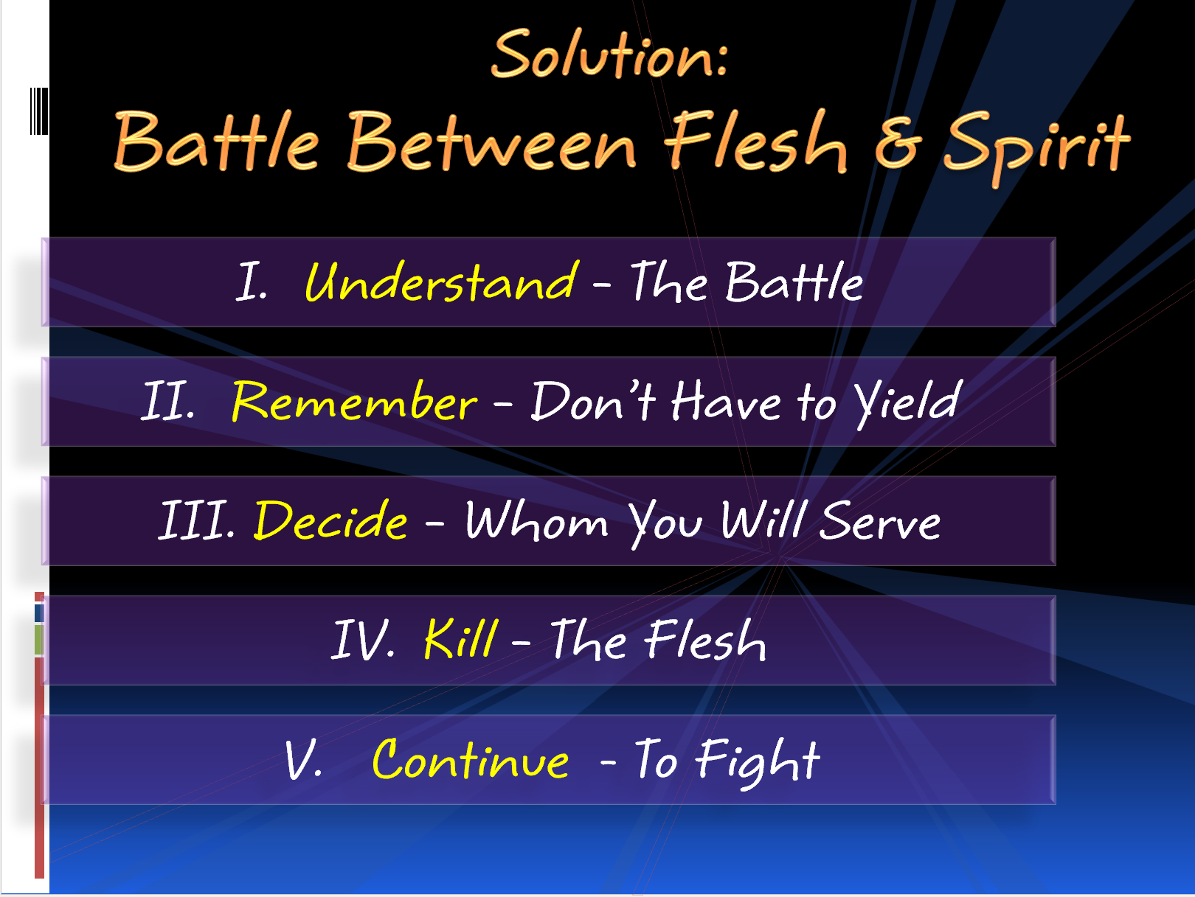
Last Week:

Slide 6
Put Off the Old Man
Put Off the Old Man
Colossians 3:5-9
Colossians 3:5-9

Slide 7
Colossians 3:5-9
5 Therefore put to death your members which are on the earth: fornication, uncleanness, passion, evil desire, and covetousness, which is idolatry.
6 Because of these things the wrath of God is coming upon the sons of disobedience,
7 in which you yourselves once walked when you lived in them.
8 But now you yourselves are to put off all these: anger, wrath, malice, blasphemy, filthy language out of your mouth.
9 Do not lie to one another, since you have put off the old man with his deeds,

Slide 8
Put Off the Old Man
Put Off the Old Man
What is to be Done With the Old Man (vv. 5, 8-9)?
Colossians 3:5-9
Colossians 3:5-9

Slide 9
What is to be Done With the Old Man (vv. 5, 8-9)?
“Therefore put to death your members… (v. 5)
“But now you yourselves are to put off all these” (v. 8)
“since you have put off the old man with his deeds” (v. 9)
Put to death (v. 5)
Put off (vv. 8-9)

Slide 10
Put Off the Old Man
Put Off the Old Man
What is to be Done With the Old Man (vv. 5, 8-9)?
What is the Old Man (vv. 5, 8-9)?
Colossians 3:5-9
Colossians 3:5-9

Slide 11
What is the Old Man (vv. 5, 8-9)?
Old Man (v. 9) = Old Life of Sin
Members: Physical bodies (instruments)
Sin

Slide 12
What is the Old Man (vv. 5, 8-9)?
Fornication (v. 5)
Uncleanness (v. 5)
Passion (v. 5)
Evil Desire (v. 5)
Put
Off

Slide 13
“If we desire to draw a distinction between the two, probably passion is somewhat narrower than desire, and the former represents the evil emotion as an affection which the mind suffers, while the latter represents it as a longing which it actually puts forth.”
J. W. Shepherd, Ephesians, Philippians and Colossians, 291.

Slide 14
It is passion and evil desire, or inordinate craving for sexual satisfaction, that lead to illicit sex relationships. This appears to be Paul’s main point in naming these two evils immediately following the first two (i.e., fornication and uncleanness) in his list of those things that must be put to death, but he does not mean to leave out evil desires for other things.
Walton Weaver, Truth Commentaries - Philippians, Colossians, 499.

Slide 15
What is the Old Man (vv. 5, 8-9)?
Fornication (v. 5)
Uncleanness (v. 5)
Passion (v. 5)
Evil Desire (v. 5)
Covetousness - Idolatry (v. 5)
Anger (v. 8)
Put
Off

Slide 16
Anger
“an abiding, settled, and habitual anger that includes in its scope the purpose of revenge.”
Kenneth S. Wuest, Ephesians And Colossians in the Greek New Testament, 220.
“a more settled and abiding condition of mind, frequently with a view to taking revenge.”
W. E. Vine, Expository Dictionary of New Testament Words, I: 55.

Slide 17
Anger
Christians need to have enough conviction about the truth of God, and they need to love God and his truth enough, that they will be stirred emotionally by wrongdoing. But a Christian must be careful that his anger is properly motivated, and rightly directed and controlled. A good test for the Christian is for him to ask himself how much of his anger arises from the fact that wrong is done, and how much from the fact that it is done to him?
Walton Weaver, Truth Commentaries – Philippians, Colossians, 505.

Slide 18
What is the Old Man (vv. 5, 8-9)?
Fornication (v. 5)
Uncleanness (v. 5)
Passion (v. 5)
Evil Desire (v. 5)
Covetousness - Idolatry (v. 5)
Anger (v. 8)
Wrath (v. 8)
Malice (v. 8)
Blasphemy (v. 8)
Filthy Language (v. 8)
Lying (v. 9)
Put
Off

Slide 19
Sexual / Sensual Matters
Attitude & Thoughts
Tongue
Desire Uncleanness Fornication
Anger Wrath Malice Blasphemy

Slide 20
Put Off the Old Man
Put Off the Old Man
What is to be Done With the Old Man (vv. 5, 8-9)?
What is the Old Man (vv. 5, 8-9)?
Why Put Off the Old Man (vv. 6-7)?
Colossians 3:5-9
Colossians 3:5-9

Slide 21
Why Put Off the Old Man (vv. 6-7)?
6 Because of these things the wrath of God is coming upon the sons of disobedience,
7 in which you yourselves once walked when you lived in them.
Old man stirs the wrath of God (v. 6)
Old man doesn’t fit with the new life (v. 7)

Slide 22
Put Off the Old Man
Put Off the Old Man
What is to be Done With the Old Man (vv. 5, 8-9)?
What is the Old Man (vv. 5, 8-9)?
Why Put Off the Old Man (vv. 6-7)?
Colossians 3:5-9
Colossians 3:5-9

