Slide 1
Is it a Sin?
Drink?
Dance?
Gamble?
Pre-marital sex?
Homosexuality?
Wear short attire?

Slide 2
Is it a Sin?
To Dance?

Slide 3

What Constitutes Sin?
Sin is a violation of God’s law
Sin is a violation of God’s law
1 John 3:4
Rom. 4:15
It does not have to be specifically stated

Slide 4
Is it a Sin to Dance?
Is it wrong to dance?
Is it wrong to go to the prom?

Slide 5
Why Can’t Christian Dance Or Go To The Prom?
How can we say it is wrong when no passage specifically forbids it?
Why some Christians see nothing wrong with dancing & encourage it?
World thinks it is an innocent thing.
Is it wrong to go to school prom?
Many know it is wrong – can’t prove it.

Slide 6
People Often Live Like They Want
Judges 21:25 (17:6)
In those days there was no king in Israel; everyone did what was right in his own eyes.
Isaiah 5:20
Woe to those who call evil good, and good evil;
Who put darkness for light, and light for darkness;
Who put bitter for sweet, and sweet for bitter!
Christians Are Not Exempt!

Slide 7
Is it a Sin to Dance?
What is Dancing?
What is the Appeal?
Principles that Condemn the Dance
Arguments to Justify

Slide 8

What is Dancing?
Defined
  Dance is an expression in rhythmic movement of an intensified sense of life, arising from an inner perception that stimulates both mind and body. -Grolier
  To move rhythmically to music, using prescribed or improvised steps and gestures. -American Heritage Dictionary

Slide 9
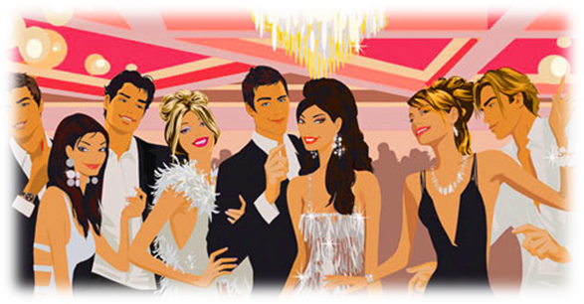
What is Dancing?
Defined
What is involved?
  Close bodily contact
  Moving in rhythm to the music
  Romantic atmosphere: lights, music, revealing attire

Slide 10
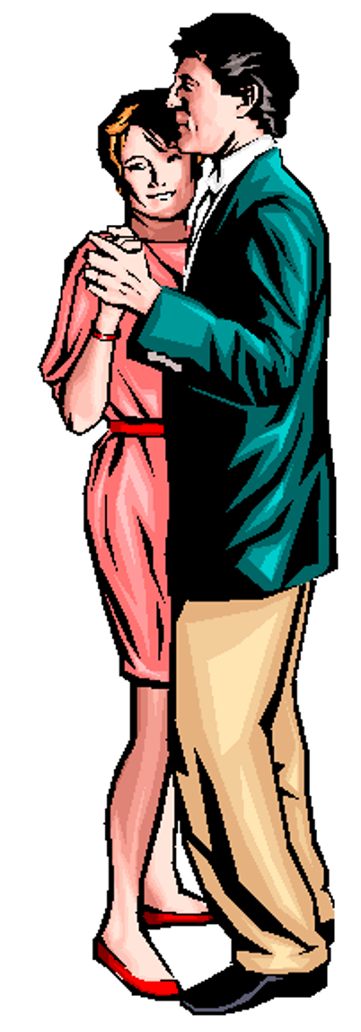
What is Dancing?
Defined
What is involved?
What we are not talking about:
  “Dance” = to leap or skip about with excitement
  “Dance” that is either approve or not condemned (Psa. 149:2-3; 150; 1 Sam. 18:6; Exo. 15:20-21; Luke 15:25)
What we are talking about:
  Close bodily contact
  Moving in rhythm to the music
  Romantic atmosphere: lights & music
  At times: dresses tight & revealing

Slide 11
Is it a Sin to Dance?
What is Dancing?
What is the Appeal?
Principles that Condemn the Dance
Arguments to Justify

Slide 12
What is the Appeal?
Sexual
J. Edgar Hoover: “Most juvenile crime has its inception in the dance hall, either public or private.”
Prof. W. C. Wilkerson of Chicago University: it is a “system of means, contrived with more than human ingenuity, to excite the instinct of sex action.”
T. A. Vogner, former supervisor of the Dancing Academy in CA: “No woman can waltz well and waltz virtuously.”

Slide 13
What is the Appeal?
Sexual
J. P. Gibson, MD: “Among those who dance it is noteworthy that very few girls spend much time dancing with other girls. Neither do men dance very much with own wives, nor brothers with their own sisters...the secret of the popularity of dancing (or is it a secret) is the exciting, sexual stimulation resulting from the close embrace of male and female whether it be with music in dancing or without music in petting and necking.”

Slide 14
What is the Appeal?
Sexual
"Another motive for the dance is the sexual motive - the dance has always been used as a means of expressing sexual desire and as a means of wooing...We find this same sex motive in the modern ballroom dance, which has now degenerated into dull and stupid forms, but it is a legitimate opportunity for contact."
- Dance We Must (1938, reprinted 1950), p. 6 (from a series of lectures given by Ted Shawn at George Peabody College For Teachers

Slide 15
What is the Appeal?
Sexual
Interview with Arthur Murray: “Why has ballroom dancing declined? Murray responds: ‘Since dancing is based on sexual flirtation and since young people have no problem with sexual flirtation; dancing has taken a back seat to the back seat’. This only confirms what we all know, dancing leads from the ballroom to the bedroom – L.A. radio host Ervin Edwards [Big E.].”
Mark Weisner, Ph.D. in his article “When the Answer is Not Tonight” – “Think about activities that lead to sex. A dark crowded room with whispers of delight, the dance floor, a proven place for the struggling couple. A romantic dinner with a band, candles, and ‘the right foods’.” –

Slide 16
What is the Appeal?
Sexual
“There can scarcely be any doubt that dancing came about as an adjunct of sexual stimulation” (Medical Review of America)
The drawing power of the discos attributed to its “progressive sexuality” and the promoters pin-pointing “sex-appeal” as the life-blood of the fad (The New York Times Magazine)
"I don't think ballroom dancing will ever return to popularity. People always thought it was a prelude to sex, but people don't need preludes anymore" (Arthur Murray, Chicago Tribune, "No Prelims, All Main Event")

Slide 17
What is the Appeal?
Sexual
“We are all men. We know the natural desires of youth. We know that sex is the strongest impulse Implanted in the human race. You can picture the effect on a boy or girl of eighteen or twenty, when this hunger is the keenest, when knowledge and experience are lacking in formation of judgment, of one of these dances which call for close abdominal contact and frequently brings the cheeks together and entwine the limbs ... There is left but one reason for the popularity of the dance, and that is sex appeal. I hasten to assure you that I do not believe the dancers are always conscious that this is the reason they enjoy this position and the steps that go with it. But this lack of consciousness is merely an added factor of danger ... when you are told that

Slide 18
What is the Appeal?
Sexual
youth of both sexes can survive this experience without mental, moral, or physical pollution, you know the teller lies ... If you can believe youth is the same after this experience as before, then God help your child or your charge, for you are not mentally fit for your responsibility. If you do not believe I have correctly described the modern dances and their effects, you either have not seen them performed or you are willfully blind to their true nature. “ – Louis Guyon, owner and operator of Chicago’s largest dance hall

Slide 19
What is the Appeal?
Sexual
If you removed the sexual – would kill the dance!
    Close bodily contact
    Lewd movements
    Boys with girls
If a young man takes your daughter to the prom – the parents are proud!
If they engaged in the same action in the living room (without the music) – they would send him home!

Slide 20
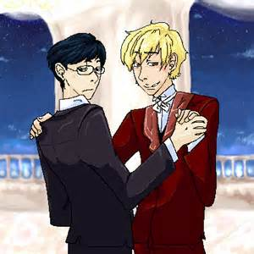
What is the Appeal?
Sexual
If you walked into a room and saw boys dancing with boys
what would you conclude?
Would you think they were gay?
Why?

Slide 21
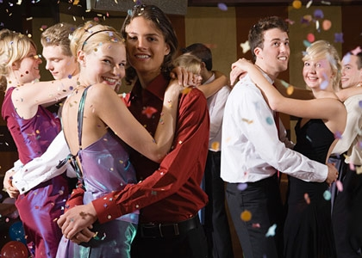
What is the Appeal?
Sexual

Slide 22
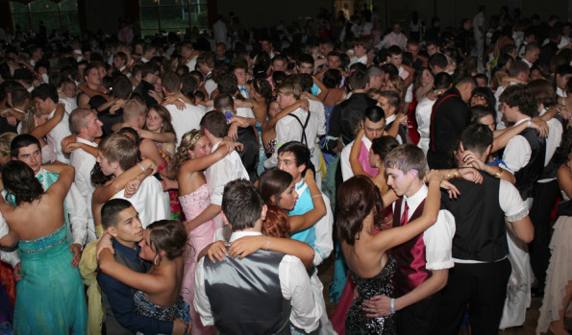
What is the Appeal?
Sexual

Slide 23
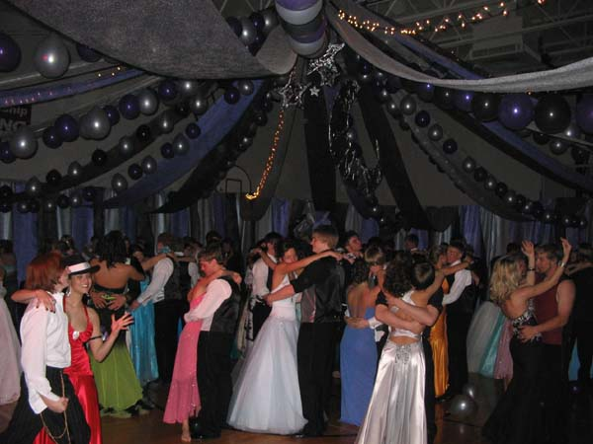
What is the Appeal?
Sexual

Slide 24
Is it a Sin to Dance?
What is Dancing?
What is the Appeal?
Principles that Condemn the Dance
Arguments to Justify

Slide 25
Luke 7:18-22
18 Then the disciples of John reported to him concerning all these things.
19 And John, calling two of his disciples to him, sent them to Jesus, saying, "Are You the Coming One, or do we look for another?"
20 When the men had come to Him, they said, "John the Baptist has sent us to You, saying, 'Are You the Coming One, or do we look for another?' "
21 And that very hour He cured many of infirmities, afflictions, and evil spirits; and to many blind He gave sight.
22 Then Jesus answered and said to them, "Go and tell John the things you have seen and heard: that the blind see, the lame walk, the lepers are cleansed, the deaf hear, the dead are raised, the poor have the gospel preached to them.
No Direct
Statement
Rather
Evidence
From
Which To
Draw
Conclusion
Question: “Are you coming one?”
Response: Worked Miracles!
Conclusion: He is the coming one!

Slide 26
Principles that Condemn the Dance
Lasciviousness

Slide 27
Lasciviousness
(aselgeia)
Passages:
Gal. 5:19
1 Pet. 4:3
Rom. 13:13
2 Pet. 2:7
Defined
“Unbridled lust…
wantoness
shamelessness…wanton
(acts or) manners, as
filthy words, indecent
bodily movements,
unchaste handling of
males and females, etc.
(Thayer, p. 79-80)
How Used
Sensuality
BDAG 114
NASV
That which
leads to lust

Slide 28
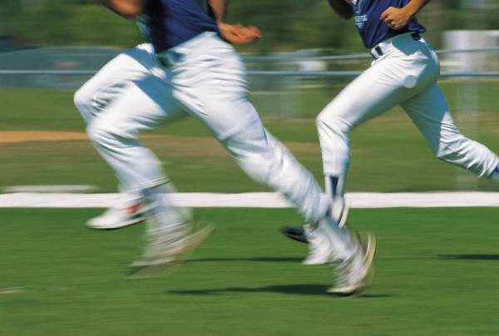
Principles that Condemn the Dance
Lasciviousness
Flee lust
  Passages:
    2 Tim. 2:22
    1 Thess. 4:3-6
    Col. 3:5
  “Flee”: to run away, shun or escape (Strong’s)

Slide 29
Principles that Condemn the Dance
Lasciviousness
Flee lust
Flee fornication
  1 Cor. 6:18
  Flee – run away from things that lead to it

Slide 30
Principles that Condemn the Dance
Lasciviousness
Flee lust
Flee fornication
Revelries
  Gal. 5:19-21; 1 Pet. 4:3
  Defined:
    “feast and drinking parties that protracted till late at night and indulge in revelry” (Thayer)
    “carousal, merrymaking, with music and dancing” (Liddell and Scott Greek Lexicon)
    Scott's Bible - "'Revelings' were such feasts, as were accompanied with music and dancing, and whatever could promote hilarity and sensual gratification."

Slide 31
Is it a Sin to Dance?
What is Dancing?
What is the Appeal?
Principles that Condemn the Dance
Arguments to Justify

Slide 32
Arguments to Justify
“Even if it excites others sexually, it doesn’t affect me that way – I can control my thinking”
  Doubt that is usually the case – we sometimes overestimate our strength
  Even if you are not so affected – what about the one you are with?

Slide 33
Arguments to Justify
“Even if it excites others sexually, it doesn’t affect me that way – I can control my thinking”
“I can’t control what others think”
  How far are you willing to go with that reasoning?
  We are responsible when we influence a person in the wrong direction (Matt. 18:6-ff)

Slide 34
Arguments to Justify
“Even if it excites others sexually, it doesn’t affect me that way – I can control my thinking”
“I can’t control what others think”
“Men and women danced in the Bible”
  Four categories of dancing in the Bible
    Religious dances of the OT (Ex. 15:20-21; 2 Sam. 6:14)
    Expression of rejoicing (1 Sam. 18:6)
    Playing of children (Luke 7:32; Job. 21:11)
    Dance of Salome (Matt. 14:6)
  First three do not resemble the dance we are talking about

Slide 35
Dancing in the Bible
"While the mode of dancing is not known in detail, it is clear that men and women did not generally dance together, and there is no real evidence that they ever did. Social amusement was hardly a major purpose of dancing, and the modern method of dancing by couples is unknown." - Zondervan Pictorial Encyclopedia Of The Bible, "Dancing“

Slide 36
Dancing in the Bible
"Women seemed generally to have danced by themselves... Of the social dancing of couples in the modern fashion there is no trace." – ISBE

Slide 37
Dancing in the Bible
"There is no evidence of couples dancing together, however; that was to happen much later, probably in Provence in the 12th Century." - Encyclopedia Britannica, "The Art Of Dance",

Slide 38
Is it a Sin to Dance?
What is Dancing?
What is the Appeal?
Principles that Condemn the Dance
Arguments to Justify

