Slide 1
Letters To Seven Church of Asia
(Rev. 2-3)
Some were good (Smyrna, Philadelphia)
Some were good / bad (Ephesus, Pergomas, Thyatira, Sardis)
One was bad (Laodicea)

Slide 2
Letters To Seven Church of Asia
(Rev. 2-3)
Good/
Bad
Good/
Bad
Good
Good
Good/
Bad
Good/
Bad
Bad
Most of us would like to be in GOOD church (no condemnation)
None of us would have anything to do with a BAD church (no commendation)
Reality: may be in a church that is GOOD / BAD (Some commendation & Some condemnation)

Slide 3
A Church Left Its First Love – Ephesus (Rev. 2:1-7)

Slide 4

The Church At Smyrna (Rev. 2:8-11)
Get a letter – Circumstances are Bad & Going to Get Worse!
A Church
Under Pressure

Slide 5
The Church At Smyrna (Rev. 2:8-11)
One of the two “good” churches – No condemnation
Shortest of the 7 letters
A Poor church (by world’s standards), but rich (faith, strength, etc.)
How the church began we are not told – May have been – gospel in Asia (Acts 19:10)

Slide 6
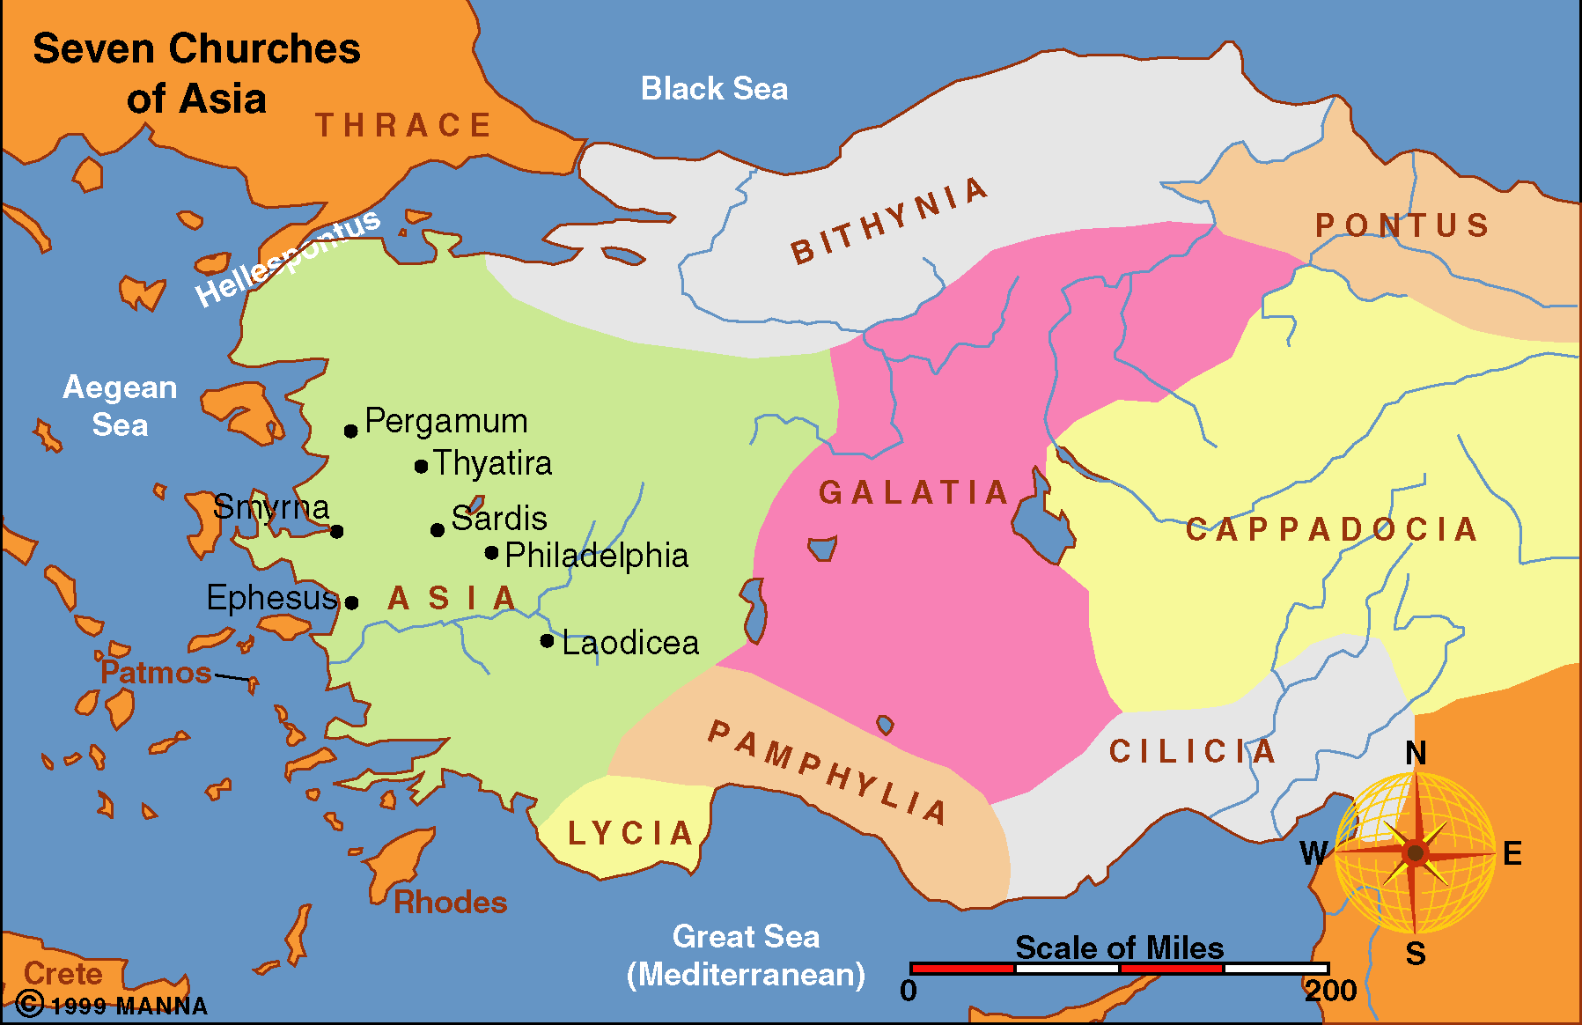
40 Miles North of Ephesus
Birthplace of Greek Poet: Homer
Known for its idolatry
Erected a shrine to Roma (Roman goddess) 195 B.C.
Chosen for site of Temple to Tiberius (under his reign 14- 37 A.D.)
Emperor worship compulsory under Domitian

Slide 7
Rev 2:8-11
8 "And to the angel of the church in Smyrna write, 'These things says the First and the Last, who was dead, and came to life:
9 "I know your works, tribulation, and poverty (but you are rich); and I know the blasphemy of those who say they are Jews and are not, but are a synagogue of Satan.
10 Do not fear any of those things which you are about to suffer. Indeed, the devil is about to throw some of you into prison, that you may be tested, and you will have tribulation ten days. Be faithful until death, and I will give you the crown of life.
11 He who has an ear, let him hear what the Spirit says to the churches. He who overcomes shall not be hurt by the second death." '

Slide 8
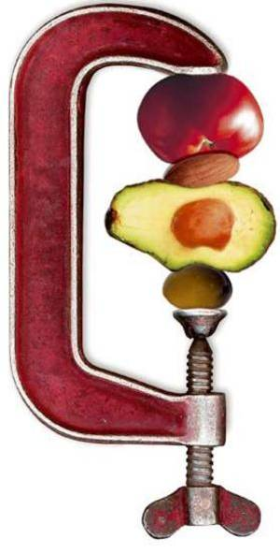
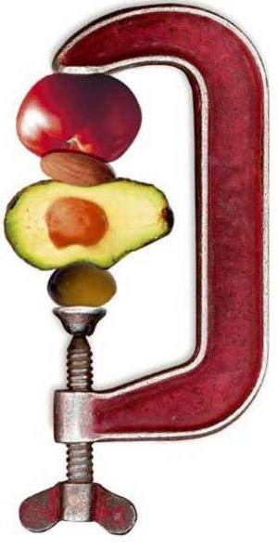
A Church Under Pressure
Rev. 2:8-11
I. Their Challenges

Slide 9
I. Their Challenges
A. Tribulation (v. 9)
1. Persecution – pressure
2. Alludes to grapes in winepress – crushed & trampled under feet.

Slide 10
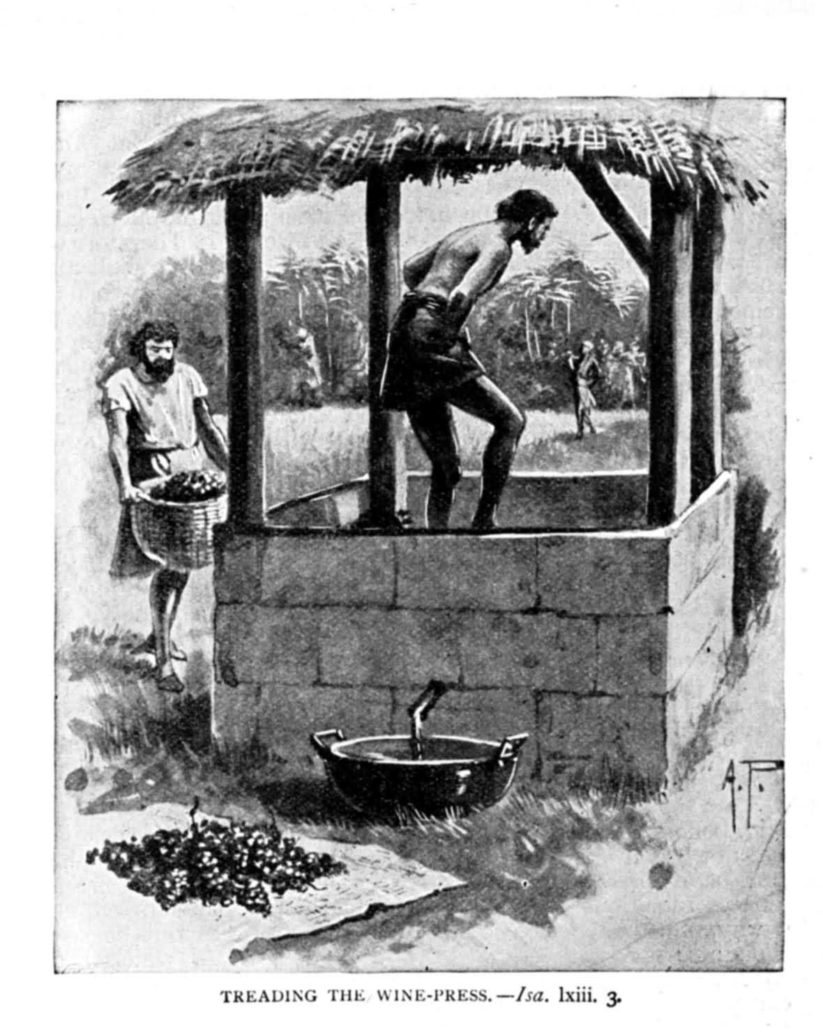
Crushed
Trampled
Pressure

Slide 11
I. Their Challenges
A. Tribulation (v. 9)
B. Poverty (v. 9)
1. Economic pressure from influential Jews
2. Confiscation of property by Domitian (Summers)

Slide 12
I. Their Challenges
A. Tribulation (v. 9)
B. Poverty (v. 9)
C. Blasphemy (v. 9)
1. Slander their character – name
2. Perhaps refers to Jews who escaped persecution through compromise

Slide 13
Compromise of Others Adds Pressure
Caesar worship – more political than religious
Could burn incense to Caesar saying, “Caesar is Lord” and worship how you may – as long as loyal to Rome
Apparently, some Jews (claim to believe in one true God) compromised – which was Blasphemy!
Since true Christian would not do same – labeled as “traitors” by compromising Jews!

Slide 14
I. Their Challenges
A. Tribulation (v. 9)
B. Poverty (v. 9)
C. Blasphemy (v. 9)

Slide 15
A Church Under Pressure
Rev. 2:8-11
I. Their Challenges
II. Their Strength

Slide 16
II. Their Strength
A. Works (v. 9)
1. Active – faith was not dead
2. Worked – didn’t merely talk the talk – they walked!
3. Apparently good – no condemnation
B. Rich (v. 9)
1. In what really mattered
2. Faith
3. Character

Slide 17
II. Their Strength
A. Works (v. 9)
B. Rich (v. 9)

Slide 18
A Church Under Pressure
Rev. 2:8-11
I. Their Challenges
II. Their Strength
III. Their Encouragement

Slide 19
III. Their Encouragement
A. Resurrection – Gives Hope (v. 8)
“The Lord’s victory over death and His present position should inspire confidence within a church that was about to suffer imprisonment and tribulation even unto death”
“For He who became dead is now alive and able to give victory over every obstacle, even death.”
Hailey, p 125, 127

Slide 20
III. Their Encouragement
A. Resurrection – Gives Hope (v. 8)
B. God Knows All (v. 8)
1. Knows the truth about you – what you really are at heart
2. Knows the truth about your enemy
C. Can Overcome (v. 11)

Slide 21
“The beauty of this city, which rivaled Ephesus, was the beauty of a resurrection. Seven hundred years before, old Smyrna had been destroyed, and had lain in ruins for three centuries. The city of John’s time was one which had risen from the dead. And resurrection was to be the experience of its church also.”
Michael Wilcock, The Message of Revelation, p. 45

Slide 22
III. Their Encouragement
A. Resurrection – Gives Hope (v. 8)
B. God Knows All (v. 8)
C. Can Overcome (v. 11)

Slide 23
A Church Under Pressure
Rev. 2:8-11
I. Their Challenges
II. Their Strength
III. Their Encouragement
IV. Their Test

Slide 24
IV. Their Test
V. 10
A. The Source: The Devil
B. The Treatment
1. Suffer
2. Prison (meaning: exile, trial, arrest, fine, death)
3.Tribulation

Slide 25
IV. Their Test
V. 10
A. The Source: The Devil
B. The Treatment
C. The Duration
1. 10 Days
2. Full, complete, and extensive
3. Will come to an end

Slide 26
IV. Their Test
V. 10
A. The Source: The Devil
B. The Treatment
C. The Duration
D. The Reaction
1. Faithful anyway – even when under pressure
2. Unto death – to the point of death
3. NCV – “even if you have to die”

Slide 27
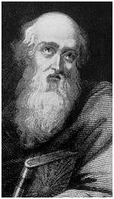
Polycarp
Lived 70 and 155 A.D
A direct pupil of the apostle John
Martyred on Saturday, Feb. 23, 155
Probably present when this letter was received
Charged to worship Caesar & renounce Christ.
"Eighty-six years I have served Christ, and He never did me any wrong. How can I blaspheme my King who saved me?"

Slide 28
Polycarp
Lived 70 and 155 A.D
A direct pupil of the apostle John
Martyred on Saturday, Feb. 23, 155
Probably present when this letter was received
Charged to worship Caesar & renounce Christ.
Threatened with fire
“Thou threatenest me with Fire which burns for an hour, and so is extinguished; but knowest not the Fire of the Future Judgment, and of that Eternal Punishment, which is reserved for the Ungodly. But why tarriest thou? Bring forth what thou wilt!”
Notes:
http://logosresourcepages.org/History/polycarp.htm

Slide 29
Polycarp
Lived 70 and 155 A.D
A direct pupil of the apostle John
Martyred on Saturday, Feb. 23, 155
Probably present when this letter was received
Charged to worship Caesar & renounce Christ.
Threatened with fire
Burned Alive At The Stake
Notes:
http://logosresourcepages.org/History/polycarp.htm

Slide 30
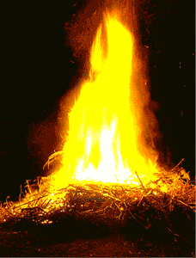
How Does This Compare?
Faithful unto Death Burned Alive
Half-hearted service
Miss lot of services
Casual / Carefree Spirit
Don’t Have Time to…
Lack of Spirituality

Slide 31
IV. Their Test
V. 10
A. The Source: The Devil
B. The Treatment
C. The Duration
D. The Reaction
E. The Result
1. Crown of life – Victory (heaven)
2. Not hurt in second death

Slide 32
D
E
A
T
H
Another
Death
HELL
Wicked
Ungodly
Unfaithful
Life
Eternal
HEAVEN
Righteous
Godly
Faithful

Slide 33
IV. Their Test
V. 10
A. The Source: The Devil
B. The Treatment
C. The Duration
D. The Reaction
E. The Result

Slide 34
A Church Under Pressure
Rev. 2:8-11
I. Their Challenges
II. Their Strength
III. Their Encouragement
IV. Their Test

