Slide 1
Is it a Sin?
Drink?
Dance?
Gamble?
Pre-marital sex?
Homosexuality?
Wear short attire?

Slide 2
Is it a Sin?
To Drink?

Slide 3

What Constitutes Sin?
Sin is a violation of God’s law
Sin is a violation of God’s law
1 John 3:4
Rom. 4:15
It does not have to be specifically stated

Slide 4
Is it a Sin to Drink?
The Question:
We all know drunkenness is a sin
But what about social drinking?
Drinking in moderation?
Occasional beer or wine?

Slide 5
Is it a Sin to Drink?
It Is Drunkenness
It Is Strong Drink
It Is Harmful
Drinking Is Condemned
Influences Others
Arguments Made To Justify

Slide 6
It Is Drunkenness
The Bible condemns drunkenness
  Eph. 5:18
  Gal. 5:19-21; 1 Cor. 6:9-11
Social drinking is drunkenness
  “Drunk” – “to make drunk, or to grow drunk” (an inceptive verb, marking the process or the state expressed in No. 1), “to become intoxicated” (Vines)
  Contrast: 1 Thess. 5:6-9

Slide 7
1 Thess 5:6-9
6 Therefore let us not sleep, as others do, but let us watch and be sober.
7 For those who sleep, sleep at night, and those who get drunk are drunk at night.
8 But let us who are of the day be sober, putting on the breastplate of faith and love, and as a helmet the hope of salvation.
9 For God did not appoint us to wrath, but to obtain salvation through our Lord Jesus Christ,
Sober: “to be free from the influence of intoxicants” (Vine’s)

Slide 8
Is it a Sin to Drink?
It Is Drunkenness
It Is Strong Drink
It Is Harmful
Drinking Is Condemned
Influences Others
Arguments Made To Justify

Slide 9
It Is Strong Drink
Strong drink in condemned
  Prov. 20:1
  Luke 1:15
Drinks today are strong by comparison
  Palestine wines: 5%-8%
  Distilled: 45% - 50%
  Malt: 4%-6%, 10%
  Wines: 10%-14%

Slide 10
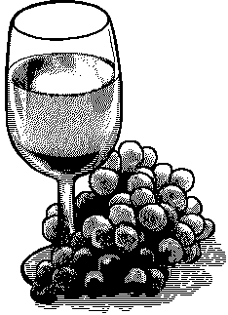
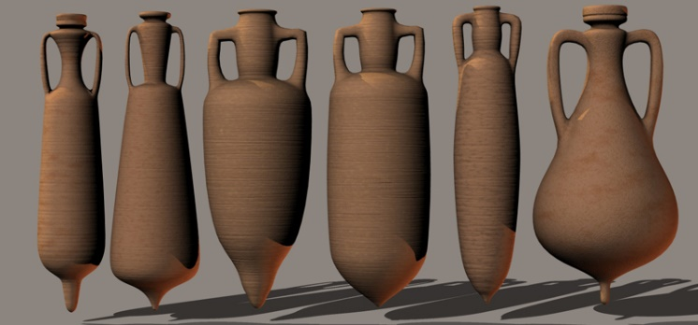
Bible Wines
“In ancient times wine was usually stored in large pointed jugs called amphorae. When wine was to be used it was poured from the amphora into large bowls called kraters, where it was mixed with water... What is important for us to note is that before wine was drank it was mixed with water.”
-- Robert Stein. Wine-Drinking In New Testament Times. Christianity Today, June 20, 1975. Pages 9-11.

Slide 11
Bible Wines
“Mixed wine is often spoken of in Scripture. This was of different kinds. Sometimes it was mixed with water to take it down (Isa 1:22); sometimes with milk (Song 5:1); and sometimes, by lovers of strong drink, with spices of various kinds, to give it a richer flavor and greater potency (Isa 5:22; Ps 75:8).”
-- McClintock and Strong Encyclopedia

Slide 12
Bible Wines
“When speaking of the ordinary drinking beverage, a writer simply said ‘wine’, for it was taken for granted that it was mixed water and wine. Only special circumstances was information given on the mixture”
-- Everett Ferguson. Wine As A Table-Drink In The Ancient World. Restoration Quarterly, 1970. Pages 141-153.

Slide 13
Bible Wines
The proportion of water was large, only one-third or one-fourth of the total mixture being wine.”
ISBE

Slide 14
Bible Wines
“Drinking wine unmixed... Was looked upon as a ‘Scythian’ or barbarian custom.”
-- Robert Stein. Wine-Drinking In New Testament Times. Christianity Today, June 20, 1975. Pages 9-11.

Slide 15
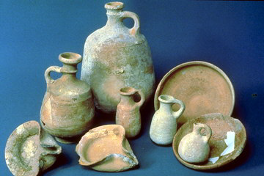
The Church Fathers
This Ratio of Water to Wine Seemed To Vary.
3-1 Hesiod
4-1 Alexis
2-1 Diocles
20-1 Homer
8-1 Pliny

Slide 16

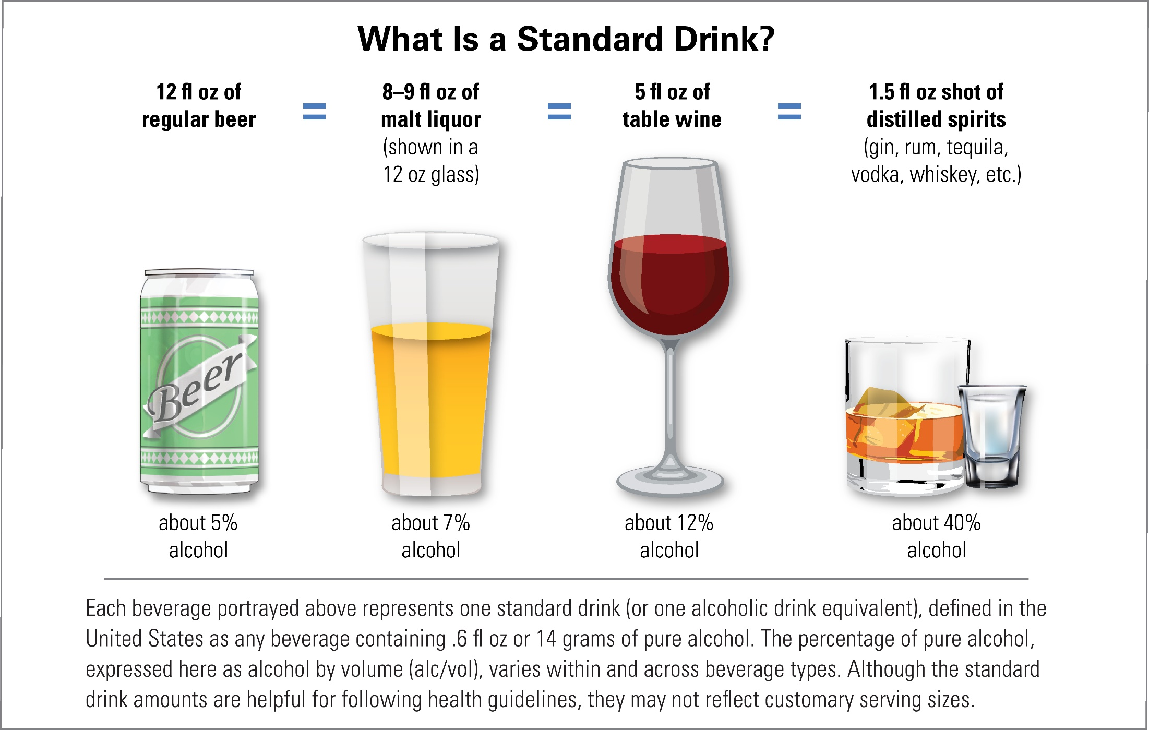
Today’s Drinks are Strong by Comparison

Slide 17
Is it a Sin to Drink?
It Is Drunkenness
It Is Strong Drink
It Is Harmful
Drinking Is Condemned
Influences Others
Arguments Made To Justify

Slide 18
It Is Harmful
Harms the body
  Alcohol is poison
  Narcotic – drug
  Does damage to the brain
It is sinful to harm the body
  1 Cor. 6:19-20
  We are stewards – to care for the body that belongs to God

Slide 19
Is it a Sin to Drink?
It Is Drunkenness
It Is Strong Drink
It Is Harmful
Drinking Is Condemned
Influences Others
Arguments Made To Justify

Slide 20
Drinking Is Condemned
1 Pet. 4:3
“For we have spent enough of our past lifetime in doing the will of the Gentiles—when we walked in lewdness, lusts, drunkenness, revelries, drinking parties, and abominable idolatries.”

Slide 21
Drinking Is Condemned
1 Pet. 4:3
  “Banqueting” (KJV) “drinking parties” (NKJV) “drinkings” (Darby)
  “The drinking bout, the banquet,… not of necessity excessive.” (R. C. Trench, Synonyms of the New Testament 225)
  Potos (4224): “from the alt. of 4095; a drinking-bout or carousal: - banqueting.” [4095: pino – to imbibe – drink] –Strong’s

Slide 22
NET “drinking bouts”
tn = translators note
NET tn “According to BDAG 857 s.v. πότος the term refers to a social gathering at which wine is served, hence “drinking parties” (cf. TEV, NASB). However, the collocation with the other terms in v. 4 suggests something less sophisticated and more along the lines of wild and frenzied drinking bouts.”
Biblical Studies Press. (2005).

Slide 23
BDAG
“a social gathering at which wine was served, drinking party”
  Arndt, W., Danker, F. W., Bauer, W., & Gingrich, F. W. (2000). A Greek-English lexicon of the New Testament and other early Christian literature (3rd ed., p. 857). Chicago: University of Chicago Press.

Slide 24
A. T. Robertson
Carousings (ποτοις [potois]). Old word for drinking carousal (from πινω [pinō], to drink), here only in the N. T. In the light of these words it seems strange to find modern Christians justifying their “personal liberty” to drink and carouse, to say nothing of the prohibition law.
  Robertson, A. T. (1933). Word Pictures in the New Testament (1 Pe 4:3). Nashville, TN: Broadman Press.

Slide 25
Arichea & Nida
Drunkenness may be rendered as “frequently getting drunk” or “constantly drinking too much,” but in this type of context, a term for “drinking” must indicate the drinking of intoxicating liquors.
  .
Arichea, D. C., & Nida, E. A. (1980). A handbook on the first letter from Peter (p. 130). New York: United Bible Societies.

Slide 26
Drinking Is Condemned
1 Pet. 4:3
1 Pet. 5:8
  “Sober”
  “Free from the influence of intoxicants” (Vine’s)
  Means to abstain (Strong’s; Donnagan’s Lexicon)

Slide 27
Is it a Sin to Drink?
It Is Drunkenness
It Is Strong Drink
It Is Harmful
Drinking Is Condemned
Influences Others
Arguments Made To Justify

Slide 28
Influences Others
Moderate social drinking
  Major cause of recruiting new drinkers
  Not the drunk or alcoholic
Matt. 18:6-7

Slide 29
Is it a Sin to Drink?
It Is Drunkenness
It Is Strong Drink
It Is Harmful
Drinking Is Condemned
Influences Others
Arguments Made To Justify

Slide 30
Arguments Made To Justify
Jesus turned water to wine (John 2)
  No evidence that it is fermented

Slide 31
“Wine”
(Greek: Oinos)
Fermented
(Alcohol Content)
Eph. 5:18
“drunk with wine”
Unfermented
(No Alcohol Content)
Matt. 9:17
Mark 2:22
“new wine in new
bottles”

Slide 32
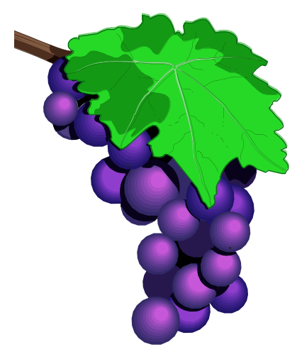
“Wine”
(Hebrew: tirosh)
Thus says the LORD:
"As the new wine is found in the cluster,
And one says, 'Do not destroy it,
For a blessing is in it,'
So will I do for My servants' sake,
That I may not destroy them all.
(Isa. 65:8)

Slide 33
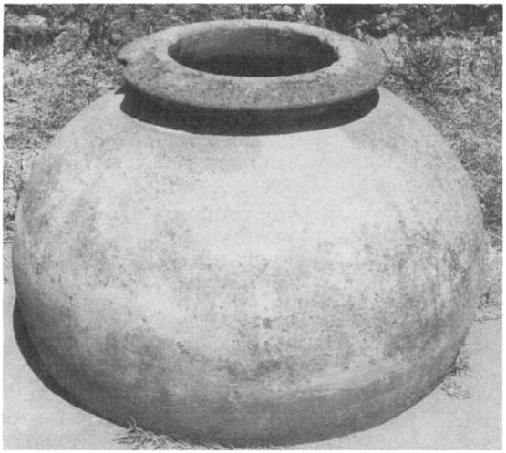
Arguments Made To Justify
Jesus turned water to wine (John 2)
  No evidence that it is fermented
  If justifies moderate drinking – justifies exessive
6
Waterpots
20-30
Gallons ea.
120-180
Gallons
X
=

Slide 34
Arguments Made To Justify
Jesus turned water to wine (John 2)
  No evidence that it is fermented
  If justifies moderate drinking – justifies excessive
Timothy told to drink a little wine (1 Tim. 5:23)
  Wine does not mean fermented
  For medicinal purposes
Deacons are not to be given much wine (1 Tim. 3:8)
  Assumes can have a little
  Forbidding excess does not justify less
Ancients had no way to prevent fermentation

Slide 35
Ancients had no way to prevent fermentation
  Actually were four methods
    Filtration (Pliny the Elder, Plutarch & Babylonian Talmud)
    Boiling (Aristotle, Mishnah)
    Dilution (Pliny, Plato,& Homer)
    Storage (Cato the Elder (234 BC – 149 BC) claimed that “must” stored in an amphora coated with pitch and stored thirty days in a water tank could be removed and kept as “must” for the whole year (Cato, De Re Rustica 120)
Kyle Pope (ECI Conference, 2015)
William Patton, Bible Wines

Slide 36
Ancients had no way to prevent fermentation
  Actually were four methods
  Kyle Pope’s Experiment
“..what I did was hand squeeze 11 ½ pounds of black grapes and test two of the common methods the ancients talked about: Filtering and boiling.
In May of the same year produced six test samples from the grapes I hand squeezed.
The first was pure grape juice.
The second was juice filtered through a muslin cloth.
The third was juice filtered and brought to a boil.
The remaining samples were juice filtered, boiled, and reduced to 1/3, 1/5, and 1/10 of their original volume.
Kyle Pope (ECI Conference, 2015)

Slide 37
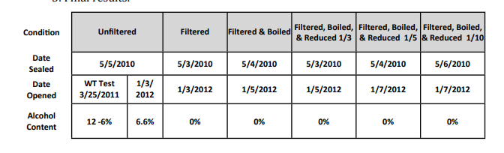
Test Results:
These samples were stored in my office under temperatures that could easily have been reproduced in Bible lands. The first testing was done at West Texas A & M University in Canyon Texas with the help of Dr. Pat Goguen (a deacon at Olsen Park at the time who holds a PhD in Chemistry) and a professor at the university.
The final testing was done some months later with the help of Pat Goguen, with equipment supplied by Eddie Prock (a science teacher at a neighboring congregation in Amarillo).
Kyle Pope (ECI Conference, 2015)

Slide 38
Is it a Sin to Drink?
It Is Drunkenness
It Is Strong Drink
It Is Harmful
Drinking Is Condemned
Influences Others
Arguments Made To Justify

