Slide 1
Letters To Seven Church of Asia
(Rev. 2-3)
Some were good (Smyrna, Philadelphia)
Some were good / bad (Ephesus, Pergomas, Thyatira, Sardis)
One was bad (Laodicea)

Slide 2
Letters To Seven Church of Asia
(Rev. 2-3)
Good/
Bad
Good/
Bad
Good
Good
Good/
Bad
Good/
Bad
Bad
Most of us would like to be in GOOD church (no condemnation)
None of us would have anything to do with a BAD church (no commendation)
Reality: may be in a church that is GOOD / BAD (Some commendation & Some condemnation)

Slide 3

The Church At Ephesus (Rev. 2:1-7)
Get a letter – says lost what once had!
Your Fire Is Gone!
You Left
1st Love

Slide 4
A Church That
Left Its First Love
When the Fire is Gone

Slide 5
Rev 2:1-7
1 "To the angel of the church of Ephesus write, 'These things says He who holds the seven stars in His right hand, who walks in the midst of the seven golden lampstands:
2 "I know your works, your labor, your patience, and that you cannot bear those who are evil. And you have tested those who say they are apostles and are not, and have found them liars;
3 and you have persevered and have patience, and have labored for My name's sake and have not become weary.
4 Nevertheless I have this against you, that you have left your first love.

Slide 6
Rev 2:1-7
5 Remember therefore from where you have fallen; repent and do the first works, or else I will come to you quickly and remove your lampstand from its place--unless you repent.
6 But this you have, that you hate the deeds of the Nicolaitans, which I also hate.
7 He who has an ear, let him hear what the Spirit says to the churches. To him who overcomes I will give to eat from the tree of life, which is in the midst of the Paradise of God." '

Slide 7
Lord Sees & Knows It All
1 "To the angel of the church of Ephesus write, 'These things says He who holds the seven stars in His right hand, who walks in the midst of the seven golden lampstands:
What is said (good / bad) is stated by one who hold the destiny of the church in his hand
Lord has full knowledge of the inter-workings of this church!

Slide 8
A Church That Left Its First Love
When the Fire is Gone
I. Its History

Slide 9
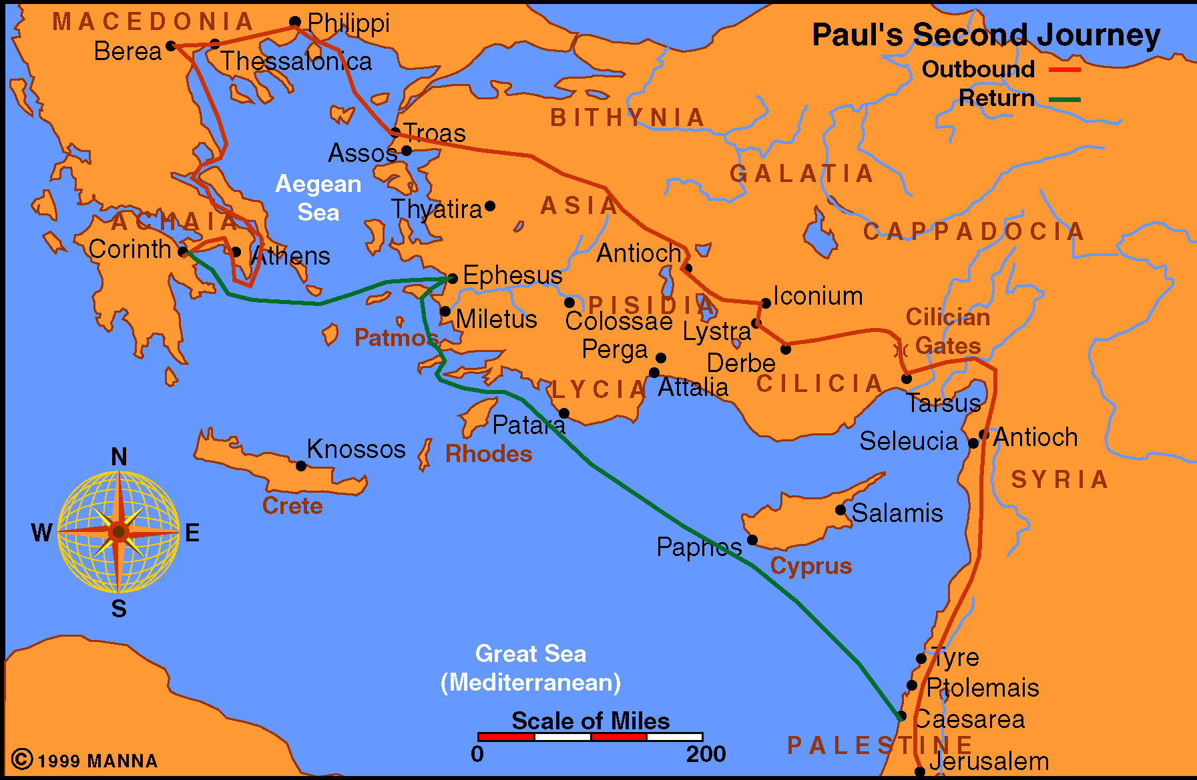
4th Largest city of Roman world
Population: 250,000

Slide 10
I. Its History
A. Paul Visited Ephesus Briefly on 2nd Journey (Acts 18:18-21)
B. Aquila & Priscilla’s Correction of Apollos (Acts 18:24-28)
C. Conversion of 12 Previously Baptized (Acts 19:1-7)
D. Many Converted on 3rd Journey (Acts 19:8-20)
1. In midst of controversy (vv. 8-16)
2. Burned their books (vv. 18-19)
3. Stayed three years (Acts 20:31)

Slide 11
I. Its History
A. Paul Visited Ephesus Briefly on 2nd Journey (Acts 18:18-21)
B. Aquila & Priscilla’s Correction of Apollos (Acts 18:24-28)
C. Conversion of 12 Previously Baptized (Acts 19:1-7)
D. Many Converted on 3rd Journey (Acts 19:8-20)
E. Idol Craftsman Caused a Riot (Acts 19:21-41)
F. Paul Met with Elders at Melitus (Acts 20:13-38)
G. May have Visited Again after Prison (1 Tim. 1:3)
H. Paul Wrote a Letter to Church at Ephesus (Ephesians)
I. Timothy Worked with the Church (1 Tim. 1:3)

Slide 12
A Church That Left Its First Love
When the Fire is Gone
I. Its History
II. Its Strong
Qualities

Slide 13
II. Its Strong
Qualities
A. Works (v. 2)
1. What they do in service to the Lord
2. “Works may be either good or bad; here they appear to be good” (Hailey)
3. This is an active congregation

Slide 14
II. Its Strong
Qualities
A. Works (v. 2)
B. Labor (v. 2)
1. “Toil” (ASV)
2. Strenuous, wearying labor
3. “Toil lies deeper than works. The word translated toil has reference to the effort that produces work at the cost of pain” (Ray Summers)
4. This is an aggressive church.

Slide 15
II. Its Strong
Qualities
A. Works (v. 2)
B. Labor (v. 2)
C. Patience (vv. 2, 3)
1. Persistence in the toil - staying when the burden is heavy.
2. Didn’t “give up when things went bad, or when someone criticized, mocked, or ridiculed them” (Harkrider)
3. This is a determined church.

Slide 16
II. Its Strong
Qualities
A. Works (v. 2)
B. Labor (v. 2)
C. Patience (vv. 2, 3)
D. Doctrinally Correct (vv. 2, 6)
1. Cannot bear evil men (v. 2)
“The evil men were detected, convicted and expelled” (Foy E. Wallace, Jr)
2. Exposed false apostles (v. 2)
3. Hated deeds & doctrine of Nicolaitans (v. 6, 15)

Slide 17
II. Its Strong
Qualities
A. Works (v. 2) – An Active church
B. Labor (v. 2) – An Aggressive church
C. Patience (vv. 2, 3) – A Determined church
D. Doctrinally Correct (vv. 2, 6) – A Sound Church
What could be wrong with such a church?

Slide 18
What could be wrong with such a church?
“This entire commendation leaves one inclined to question if there could be anything wrong in such a church. It carried on its service in the face of difficulties; it rejected false teachers; it hated sin; it did not grow weary in the Lord’s work.”
Ray Summers

Slide 19
A Church That Left Its First Love
When the Fire is Gone
I. Its History
II. Its Strong
Qualities
III. Its Problem

Slide 20
III. Its Problem
“left your first love”
A. Place of Love
1. Love is essential
a. Love God (Matt. 22:37)
b. Love Truth (2 Thess. 2:10-12)
c. Love One Another (Rom. 13:8)

Slide 21
III. Its Problem
“left your first love”
A. Place of Love
1. Love is essential
2. Love produces action
a. Context (vv. 4-5)
b. Gal. 5:6 – faith works by love
c. 1 John 5:3 – love of God – keep comm.

Slide 22
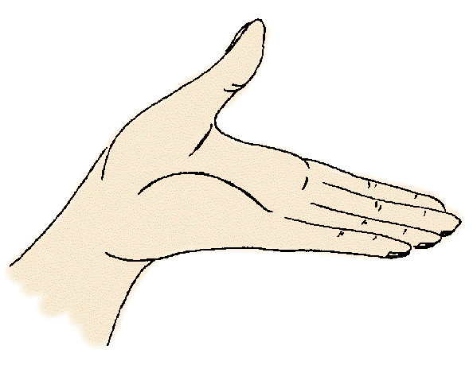
III. Its Problem
“left your first love”
A. Place of Love
1. Love is essential
2. Love produces action
3. Without love – are nothing (1 Cor. 13:1ff)
4. Love & hate should be balanced (vv. 4, 6)
Hate
Error
Love
Truth

Slide 23
III. Its Problem
“left your first love”
A. Place of Love
B. First Love – left behind
1. “Honeymoon is over” – Summers
2. “Loyal but lacking” – Summers
3. “In form, this was still a ‘sound church’ which fended off false doctrine, but the fire had gone out. There is more to serving God than adherence to mechanical, traditional routine” – Harkrider
4. Their fire is gone!
5. Love, enthusiasm, excitement – vanished!

Slide 24
III. Its Problem
“left your first love”
A. Place of Love
B. First Love – left behind
C. Common Problem
1. Not excited about being Christians
2. Not enthused about worshipping God
3. Not fervent in our actions
4. Not zealous for learning & growing

Slide 25


Strong
Weak
Opposing
Sin / Error
Love for
Right / Truth

Slide 26
We Are Often Stronger In Our Opposition To Wrong Than Our Love For What Is Right!
Not enough to abhor evil – must cleave to what is good (Rom. 12:9)
“They had set out to be defenders of the faith, arming themselves with the heroic virtues of truth and courage, only to discover that in the battle they had lost the one quality without which all others are worthless…[Z]eal for Christian truth may obliterate the one truth that matters, that God is love. John is a rigorist who shares the hatred of heresy which he attributes both to the church of Ephesus and to the church’s Lord; but he recognized the appalling danger of a religion prompted more by hate that by love.” - C. B. Caird, A Commentary on the Revelation of St. John the Divine, p.31)

Slide 27
Stronger Here
Than Here
Against Worldliness
Opposing Sin
Against Inst. Music
Exposing a brother
Against Divorce
Women’s Lib
Forsaking is sin
Developing Godliness
Saving Sinners
For Singing
Restoring erring
For Marriage
For Keeper at Home
Worship of God

Slide 28
A Church That Left Its First Love
When the Fire is Gone
I. Its History
II. Its Strong
Qualities
III. Its Problem
IV. Its Future

Slide 29
IV. Its Future
At a Crossroads
A. About the lose identity
1. If don’t change – remove lampstand (v. 5)
2. Soon – no longer be the “Lord’s church”
3. It is decision time!
4. Can’t stay in the this lull / rut.

Slide 30
IV. Its Future
At a Crossroads
A. About the lose identity
B. Problems are Curable
1. Could be fixed
“Surely in this milder denunciation we may see a proof that the evil in Ephesus was curable…But the cooling of the first Ephesian enthusiasm was a failing that lies in human nature. The failing can be corrected, the enthusiasm may be revived.”
W.M. Ramsay, The Letters to the Seven Churches of Asia, p. 244

Slide 31
IV. Its Future
At a Crossroads
A. About the lose identity
B. Problems are Curable
1. Could be fixed
2. Must Repent (v. 5)
a. Prompted by memory (v. 5) - “The lever of repentance is memory” (Harkrider)
b. Change your mind
c. Do first works – do what used to do!
Remember
Repent
Return

Slide 32
A Church That Left Its First Love
When the Fire is Gone
I. Its History
II. Its Strong
Qualities
III. Its Problem
IV. Its Future

