Slide 1

Let Us
Pray
God’s People Pray
Why God’s People Pray
What God’s People Pray
How God’s People Pray
Satan Hinders Prayers of God’s People

Slide 2
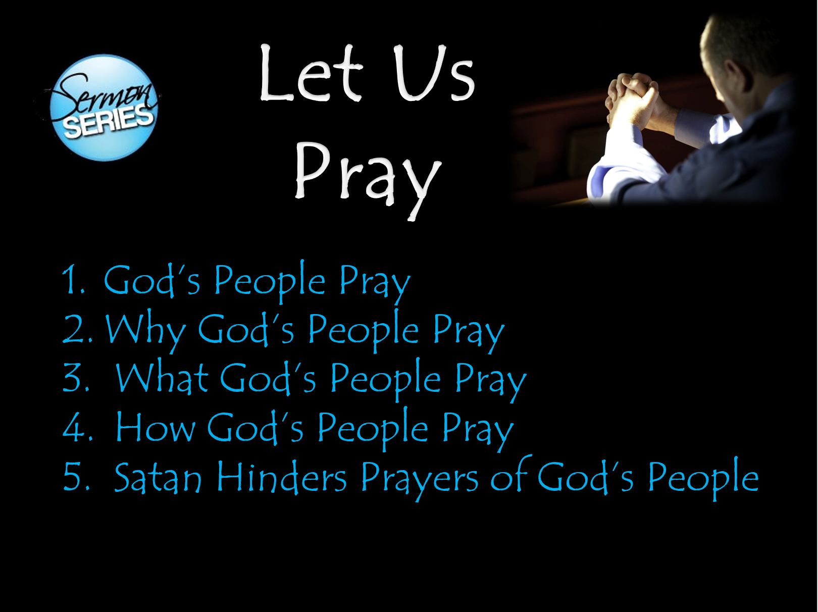
Objective:
When Series is Over:
More committed to praying
Praying more
More fervent
Praying for more things

Slide 3
God’s People Pray
Review – Lesson 1
Privilege of Prayer Belongs to God’s People
Assurance that God Hears & Answers Their Prayer
Examples of God’s People Praying

Slide 4
Why God’s People Pray
Review – Lesson 2
The Need to Pray
The Power of Prayer

Slide 5
What God’s People Pray
Review – Lesson 3
Supplications
Prayers
Intercession
Thanks

Slide 6
Let Us
Pray
God’s People Pray
Why God’s People Pray
What God’s People Pray
How God’s People Pray
Satan Hinders Prayers of God’s People

Slide 7
How God’s People Pray
“Teach us to pray” (Luke 11:1) – include the how
“After this manner” (Matt. 6:9) – shows the way
It is not mere prayer that pleases God, but prayer offered how God directs

Slide 8
How God’s People Pray
The Manner

Slide 9
The Manner
With a prepared mind
  Prayer is expressing our heart’s desire to God (Rom. 10:1)
    Thus, it comes from the heart
    Must prepare our minds – be in proper frame of mind
  Hard to pray
    When mad / full of hate
    When thinking on other matters
    With distractions all around
  Anything done for God – deserves preparation

Slide 10
The Manner
With a prepared mind
With sincerity
  Jesus contrasted sincere prayer with those offered out of hypocrisy (Matt. 6:5-6)
  Insincere prayers would include those:
    Offered as a show before men
    Used as a means to ease conscience (not living right)
    Offered out of habit, ritual or rote.
  It is possible to honor God with lips & not heart (Isa. 29:13)
  Our cry must not be from deceitful lips (Psa. 17:1)

Slide 11
The Manner
With a prepared mind
With sincerity
With humility
  The fact that we are approaching God – should humble us
  Pharisee & Publican were a contrast (Luke 18:10-14)
    Pharisee – arrogant / self righteous
    Publican – humble
      Knew – spiritual poverty & sinful condition
      Recognized - need for divine help
      Cast himself upon the mercy of God
      Strong sense of personal unworthiness
      Dependent upon God
      Attitude of a servant
  God is gracious to the humble (Jas. 4:6, 10)

Slide 12
The Manner
With a prepared mind
With sincerity
With humility
With fervency
  Prayer should not be half-hearted, lifeless & lethargic – but passionate, earnest & offered with zeal
  Elijah prayed fervently (Jas. 5:17)
  Epaphras was striving in prayer (Col. 4:12)

Slide 13
The Manner
With a prepared mind
With sincerity
With humility
With fervency
Watchful
  Jesus tied watching & praying together (Mark 13:33; 14:38; Luke 21:36)
  Sober unto prayer (1 Pet. 4:7)
  Means: constant mental and spiritual alertness
  Watching for temptation, avenues of allurement
  Chrysostom: “The devil knoweth how great a good prayer is.”

Slide 14
The Manner
With a prepared mind
With sincerity
With humility
With fervency
Watchful
In faith
  Must ask in faith – no doubting (Jas. 1:4-6)
  Prayer should be without wrath and doubting (1 Tim. 2:8)
  Apostles were to pray (about miraculous) believing (Matt. 21:22)
  Do you pray really expecting an answer?
  Faith and prayer are connected (Luke 18:1, 5)

Slide 15
The Manner
With a prepared mind
With sincerity
With humility
With fervency
Watchful
In faith
In the spirit - thinking
  Pray with spirit & understanding (1 Cor. 14:15)
    Talking about – pray in way – others understand
    If important for others to understand – more so I understand
  All worship to be in spirit (John 4:24)
    Means from the heart (cf. Rom.2:28-29)
    Thinking about what saying

Slide 16
The Manner
With a prepared mind
With sincerity
With humility
With fervency
Watchful
In faith
In the spirit – thinking
In the name of Christ
  Not what we say – but something we do
  All things are to be in the name of Christ (Col. 3:17)
  Means: by his authority (cf. Acts 4:7)

Slide 17
The Manner
With a prepared mind
With sincerity
With humility
With fervency
Watchful
In faith
In the spirit – thinking
In the name of Christ
According to God’s will
  If according to will of God – he hears us (1 Jno. 5:14-15)
  Jesus prayed that God’s will be done (Matt. 26:39-44)

Slide 18
How God’s People Pray
The Manner
The Place

Slide 19
The Place
Can pray anywhere
  Not something that can only be done in a special or “sanctified” place (cf. John 4:20-24)
  Can pray anywhere – in any place
  Part of beauty of prayer: God’s people pray at home, at work, in the car, on the plane, in a crowd & by themselves….
A quiet, solitary place is conducive for prayer
  Jesus often went to garden to pray (Luke 22:39)
  Jesus prayed in a solitary place (Mark 1:35)
  Jesus went to the mountain pray (Luke 6:12)

Slide 20
How God’s People Pray
The Manner
The Place
The Time

Slide 21
The Time
Make time for prayer
  Difference in having time and making time
  Jesus made – scheduled time for prayer (Mark 1:35)
  Often too busy in morning / too tired in evening

Slide 22
The Time
Make time for prayer
Daily
  David (Psa. 55:16-17)
  Daniel (Dan. 6:10)

Slide 23
The Time
Make time for prayer
Daily
When most alert – can clearly think
  Remember – prayer is hearts desire – expressed (Rom. 10:1)
  Should find a time – when can be alert and fervently pray

Slide 24
The Time
Make time for prayer
Daily
When most alert – can clearly think
Always
  Men ought always to pray (Luke 18:1)
  Pray without ceasing (1 Thess. 5:17)
  Praying always (Eph. 6:18)

Slide 25
How God’s People Pray
The Manner
The Place
The Time

