Slide 1
We often forget the real importance of our soul
We often give emphasis / priority to matters less important (worthless in comparison to the soul)
We need a renewed awareness of the value of the soul
It is high time that someone ask, “What about his soul?”

Slide 2
What About
His Soul?

Slide 3
What About
His Soul?
The Value of the Soul

Slide 4
The Value of the Soul
The nature of man – more than this life
  Man is a triune being (1 Thess. 5:23)
1 Thess. 5:23
And the very God of peace sanctify you wholly; and I pray God your whole spirit and soul and body be preserved blameless unto the coming of our Lord Jesus Christ.

Slide 5
Body
Body
(Material)
Soul
Spirit
Soul
(Life)
Spirit
(Immortal)

Slide 6
The Value of the Soul
The nature of man – more than this life
  Man is a triune being (1 Thess. 5:23)
  Soul is immortal

Slide 7
Spirit
“The spirit (heb. Ruach, Gr. Pneuma) is the principle
of man’s rational and immortal life, which involves
conscience and will, and which enables man to be
sensitive to the divine” (Smith’s 366).
Soul
“The soul (Heb. Nephesh, Gr. Phyche) is the
principle of animal life, which man possesses
in common with the brutes…This part
of a man ceases to exist at death.” (Smith’s 366)
Soul
“The soul is not an entity with a separate nature
from the flesh and possessing or capable of a life
of its own. Rather it is the life animating the flesh”
(Hastings 932).

Slide 8
Spirit - (Immortal)
1 Cor. 5:5
Heb. 4:12
Soul - (Life)
Matt. 2:20; 6:25

Slide 9
The Value of the Soul
The nature of man – more than this life
  Man is a triune being (1 Thess. 5:23)
  Soul is immortal
  “Soul” and “Spirit” are used interchangeably

Slide 10
Spirit
Soul
Life
(Rev. 13:15 KJV)
Life
(1 Thess. 5:23)
Immortal
(1 Cor. 5:5)
Immortal
(1 Pet. 1:9)

Slide 11
The Value of the Soul
The nature of man – more than this life
  Man is a triune being (1 Thess. 5:23)
  Soul is immortal
  “Soul” and “Spirit” are used interchangeably
  Our soul makes us distinct from animals

Slide 12


Different
Made In
the
Image
of
God
(Gen. 1:26)
Body
Body
Life
Life
Soul

Slide 13
The Value of the Soul
The nature of man – more than this life
Value of the soul – all that matters
  It is all you really have that you will keep

Slide 14
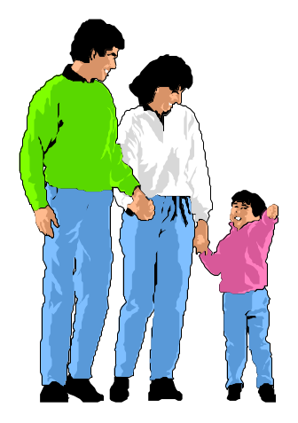



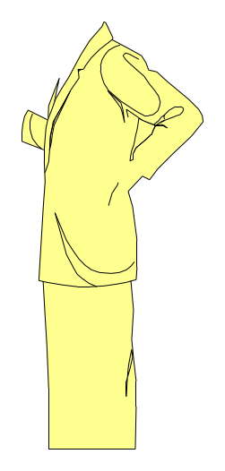






Body
Family
Friends
Spirit
Soul
Soul
(Spirit)
Your
Health

Slide 15
Body
Family
Friends
Spirit
Soul
Soul
(Spirit)
Your
Health

Slide 16
Soul
(Spirit)

Slide 17
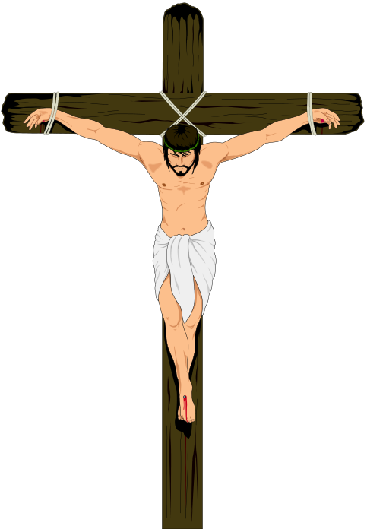
The Value of the Soul
The nature of man – more than this life
Value of the soul – all that matters
  It is all you really have that you will keep
  Jesus died to save your soul
    Matt. 26:28
    Acts 20:28
    1 Pet. 1:18-19
    Heb. 2:9, 10

Slide 18

The Value of the Soul
The nature of man – more than this life
Value of the soul – all that matters
  It is all you really have that you will keep
  Jesus died to save your soul
  Worth more than whole world
Your
Soul
Matt. 16:26

Slide 19
The Value of the Soul
The nature of man – more than this life
Value of the soul – all that matters
Life beyond the grave
  Ecc. 12:7 – body turns to dust – spirit to God
  Phil. 1:21-24 – spirit lives beyond the body
  2 Cor. 5:1-6 – spirit is temporarily in the body
  Matt. 10:28 – body can die – spirit lives on

Slide 20
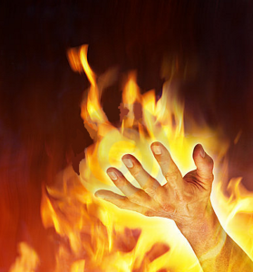
The Value of the Soul
The nature of man – more than this life
Value of the soul – all that matters
Life beyond the grave
What it means to lose your soul
  Matt. 16:26 – “forfeit” (ASV, ESV, NASV)
  Means losing all you have – the only thing of value!
  Miss heaven (1 Cor. 6:19)
  Spend eternity in hell (Mark 9:43)

Slide 21
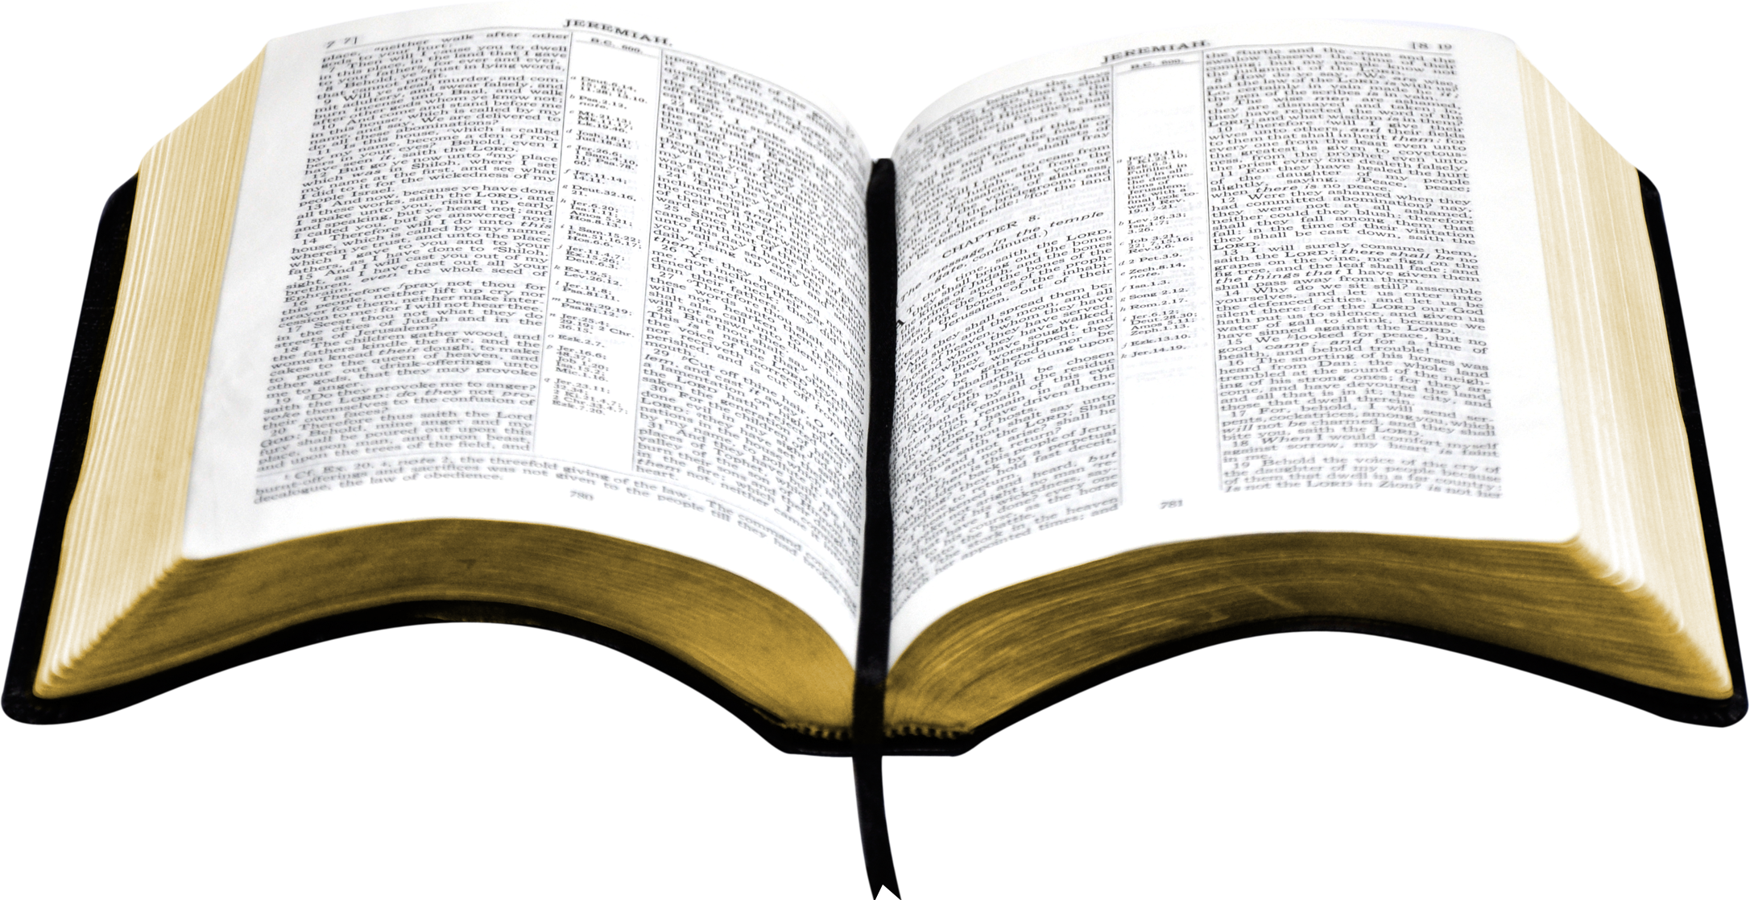
The Value of the Soul
The nature of man – more than this life
Value of the soul – all that matters
Life beyond the grave
What it means to lose your soul
Gospel is a message of redemption
  Rom. 1:16-17 – God’s plan for saving man found in the gospel
  1 Cor. 15:1-4 – Saved by the gospel

Slide 22
What About
His Soul?
The Value of the Soul
The Emphasis on this Life

Slide 23
The Emphasis on this Life
Danger that we could get wrapped up in the here and now
  Adam and Even focused on the now (Gen.3:1-6)
  Israel was warned of the danger (Deut. 6:12)
  Cares of the world can choke the word (Lk. 8:14)
  Demas was distracted by present world (2 Tim. 4:10)

Slide 24
The Emphasis on this Life
Danger that we could get wrapped up in the here and now
Reason this is easily done
  The spiritual involves the unseen (2 Cor. 4:17-18)
  This life we enjoy now – vs – hope for what really matters (Rom. 8:25)

Slide 25
What About
His Soul?
The Value of the Soul
The Emphasis on this Life
The Application of our Question

Slide 26
The Application of our Question
When sin is involved – first concern should be about the soul
  Sin separates from God (Rom. 5:12)
  Sin will keep us out of heaven (John 8:21; Rom. 6:23)

Slide 27
The Application of our Question
When sin is involved – first concern should be about the soul
Times we forget to ask – “What about his soul?”

Slide 28
Raise our children
Give emphasis to school and grades
Encourage them in sports
Proud of their degree, job and success
May not have obeyed the gospel
May have quit serving the Lord
May be a part of an erroneous church
What About
His Soul?

Slide 29
Married to a Non-Christian
Focus on the fact the mate is good and kind
Proud of them as a parent
Want what is best for them
What About
His Soul?

Slide 30
One Becomes Unfaithful in Marriage
Focus on the damage that the adultery creates
Talk about how the children are affected
Ask whether it will end in divorce or be resolved
Heart aches for the pain the family endures
What About
His Soul?

Slide 31
Have a Family Member Turned to Sin
May turn to alcohol or drugs
May be involved in a perverted form of immorality
May cover for them – hide it from others – embarrassed
The sin continues – no correction is seen
We go on acting as if all is normal and well
What About
His Soul?

Slide 32
Family Member – Unscriptural Divorce
Get a divorce for a cause other than fornication
We feel sorry for them – marriage was a struggle
We say nothing to them about whether it fits the Bible
What About
His Soul?

Slide 33
Children Move Away
Identify with a Looser Church
Focus on fact that it is a friendly group
Delighted that it is an active group
Yet, error may be tolerated (at least not refuted)
Some matters of doctrine & worldliness will not be addressed
Ignore where this may lead
What About
His Soul?

Slide 34
What About
His Soul?
The Value of the Soul
The Emphasis on this Life
The Application of our Question

