Slide 1

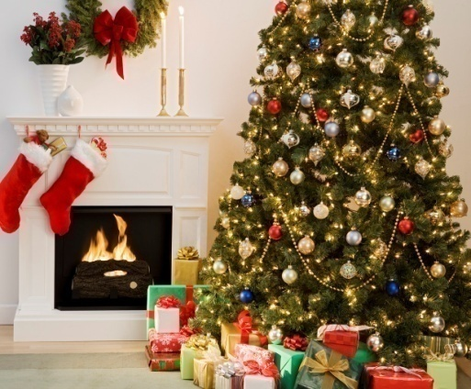

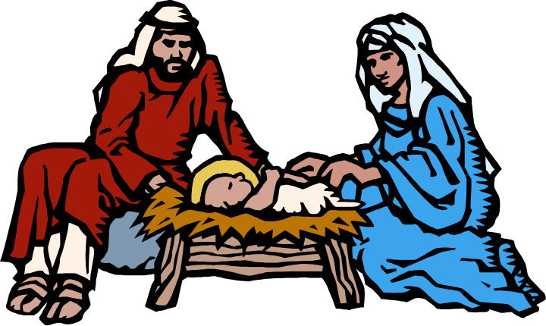

We are now in the Christmas season
Mixture of Religious & National Holiday Celebration
Is this the birth of Christ?
Why do we not celebrate this religiously?

Slide 2
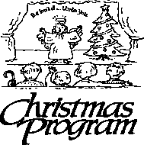
Many Churches
Are Having Their
Christmas Programs
Play or manger scene
Songs about the birth of Christ
Christmas trees & decorations
Party with fun & food

Slide 3
Christmas
Is December 25 the birthday of Christ?
Are we told in the Bible to celebrate the birth of Christ?
If this is not the birth of Christ – then can Christians celebrate Christmas?

Slide 4
Not Told When Jesus Was Born
Origin & History of Christmas
Why Don’t Observe It Religiously
Non-Religious Observance
Supporting Salvation Army

Slide 5
Not Told When Jesus Was Born
Origin & History of Christmas
Why Don’t Observe It Religiously
Non-Religious Observance
Supporting Salvation Army

Slide 6
Not Told When Jesus Was Born
A. Don’t know the year
Born between 7 BC and 4 BC
Problem with the calendar:

Slide 7
Why Christ was born 4 years "Before Christ"
When Christ was born time was reckoned in the Roman Empire from the founding of the city of Rome. When Christianity became the universal religion over what had been the Roman world, a monk named Dionysius Exiguus, at the request of the Emperor Justinian, made a calendar, 526 AD, reckoning time from the Birth of Christ, to supersede the Roman calendar. Long after the Christian Calendar had replaced the Roman Calendar it was found that Dionysius had made a mistake in placing the birth of Christ in year 753 A U C. (From the founding of Rome.) It should have been 749 or a year or two earlier. So, the reason we say that Christ was born 4 B C is merely because the maker of the Christian Calendar made a mistake of 4 or 5 years in coordinating it with the Roman Calendar which it replaced.
- Halleys Bible Handbook, 436

Slide 8
Not Told When Jesus Was Born
A. Don’t know the year
B. Don’t know the month or day
Bible doesn’t say
Most likely not December 25
Luke 2:8
Now there were in the same country shepherds living out in the fields, keeping watch over their flock by night.

Slide 9
The climate was mild, and, to keep their flocks from straying, they spent the night with them. It is also a fact that the Jews sent out their flocks into the mountainous and desert regions during the summer months, and took them up in the latter part of October or the first of November, when the cold weather commenced. While away in these deserts and mountainous regions, it was proper that there should be someone to attend them to keep them from straying, and from the ravages of wolves and other wild beasts. It is probable from this that our Saviour was born before the 25 th of December, or before what we call "Christmas." At that time it is cold, and especially in the high and mountainous regions about Bethlehem. But the exact time of his birth is unknown; there is no way to ascertain it. By different learned men it has been fixed at each month in the year. Nor is it of consequence to "know" the time; if it were, God would have preserved the record of it. Matters of moment are clearly revealed; those which "he" regards as of no importance are concealed.
-Albert Barnes Comments on Luke 2:8

Slide 10
The exact date of Jesus' birth is unknown; the legendary date of December 25 cannot be traced back farther than the fourth century.
- (The Wycliffe Bible Commentary)

Slide 11
It was a custom among the Jews to send out their sheep to the deserts, about the passover, and bring them home at the commencement of the first rain: during the time they were out, the shepherds watched them night and day. As the passover occurred in the spring, and the first rain began early in the month of Marchesvan, which answers to part of our October and November, we find that the sheep were kept out in the open country during the whole of the summer. And as these shepherds had not yet brought home their flocks, it is a presumptive argument that October had not yet commenced, and that, consequently, our Lord was not born on the 25 th of December, when no flocks were out in the fields; nor could he have been born later than September, as the flocks were still in the fields by night. On this very ground the nativity in December should be given up. The feeding of the flocks by night in the fields is a chronological fact, which casts considerable light upon this disputed point.
(Adam Clarke's Commentary)

Slide 12
The Cyclopedia Of Ecclesiastical Literature by McClintock and Strong, says "The observance of Christmas is not of divine appointment, nor is it of New Testament origin. The day of Christ's birth cannot be ascertained from the New Testament, or indeed, from any other source. The (church) fathers of the first three centuries do not speak of any special observance of the nativity (birth) of Christ .... The institution may be sufficiently explained by the circumstance that it was the taste of the age to multiply festivals .... at the same time the heathen winter holidays (Saturnalia, Juvenalia Brumalia) were undoubtedly transformed, and so to speak, sanctified by the establishment of the Christian cycle of holidays; and the heathen customs .... were brought over into Christian use" (Vol.2, p.276).

Slide 13

Yet Some Suggest That It Is Possible
But recent travelers tell us that in the end of December, after the rains, the flowers come again into bloom, and the flocks again issue forth. The nature of the seasons in Palestine could hardly have been unknown to those who fixed upon the present Christmas-period: the difficulty, therefore, is perhaps more imaginary than real.
- (Jamieson, Fausset, and Brown Commentary)
If so, just pure guess

Slide 14
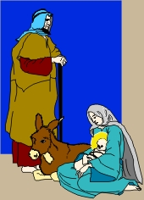
Dates Suggested For The Birthday of Christ
January
6
March
25
May
20
January
10
December
25
Every month of year!

Slide 15
Not Told When Jesus Was Born
A. Don’t know the year
B. Don’t know the month or day
C. What we do know

Slide 16
What We Know About Birth of Christ
Birth of Jesus (Mt. 1:25; Lk 2:1-7)
Visit of the Shepherds – same night (Lk 2:8-20)
Jesus circumcised 8th day (Lk. 2:21)
Jesus’ presentation 40 days after birth (Lk 2:22; Lev. 12:2-6)
Visit of wise men (Mt. 2:1-12)
  Not told how many
  Came to house – not manger (v. 11)
Journey to Egypt (Mt 2:13-15)
Male children killed (Mt 2:16-18)
Return to Nazareth (Lk. 2:39; Mt. 2:19-23)

Slide 17
Not Told When Jesus Was Born
Origin & History of Christmas
Why Don’t Observe It Religiously
Non-Religious Observance
Supporting Salvation Army

Slide 18
Not Because of the Bible
No record in the Bible
“Christmas was not among the earliest festivals of the church” (Catholic Ency. Vol. 3, 724)
Origen (245) repudiated the idea of keeping the birthday of Christ as if he were a king Pharoah (Ency. Brit. 1975, Vol. 5, 642)
Clement of Alex. (ca 200) mentioned several speculations on the date of Christ’s birth and condemned them as superstitious (ibid.)
Why Was December 25 Chosen?

Slide 19
Not Because of the Bible
Pagan Background
“The Christmas date, December 25, is first met with in the West in the 4th century (the eastern date was January 6), and was then possibly borrowed from a pagan festival.” (ISBE, 3:1628)
Roman Saturnalia – 7 day Pagan Festival (Dec. 17-24) honor of Saturn
  25th was day of worship of Sun-God Mathra
  Celebration of victory of light over darkness
Why Was December 25 Chosen?

Slide 20
The Encyclopedia Britannica reports that "The traditional customs connected with Christmas have developed from several sources as a result of the coincidence of the celebration of the birth of Christ with the pagan agricultural and solar observations at midwinter. In the Roman world the Saturnalia (December 17) was a time of merrymaking and exchange of gifts. December 25 was also regarded as the birth date of the Iranian mystery god Mithra, the Sun of Righteousness."
Why Was December 25 Chosen?

Slide 21
Not Because of the Bible
Pagan Background
Catholic Background
Why Was December 25 Chosen?
Liberius, Bishop of Rome (Pope) changed the date from January 6 (in 353) to December 25 (in 354). Arrived at date saying conception was March 25. Then added 9 months.

Slide 22
Grolier Interactive: “Despite the beliefs about Christ that the birth stories expressed, the church did not observe a festival for the celebration of the event until the 4th century. The date was chosen to counter the pagan festivities connected with the winter solstice; since 274, under the emperor Aurelian, Rome had celebrated the feast of the ‘Invincible Sun’ on December 25.”
Colliers Encyclopedia agrees. Quote: "After the triumph of Constantine, the church at Rome assigned December 25 as the date for the celebration of the feast, possibly about A.D. 320 or 353. By the end of the fourth century the whole Christian world was celebrating Christmas on that day, with the exception of the Eastern churches, where it was celebrated on January 6. The choice of December 25 was probably influenced by the fact that on this day the Romans celebrated the Mithraic feast of the Sun-god (natalis solis invicti), and that the Saturnalia also came at this time."
Why Was December 25 Chosen?

Slide 23
Not Because of the Bible
Pagan Background
Catholic Background
Customs Associated With Christmas

Slide 24


Customs Associated With Christmas
Survival of pagan tree worship
Christmas Tree
From pagan emphasis on light
From bon-fires – of Sun worship
Lights
Notes:
American Ency. Vol. 5, p. 62

Slide 25
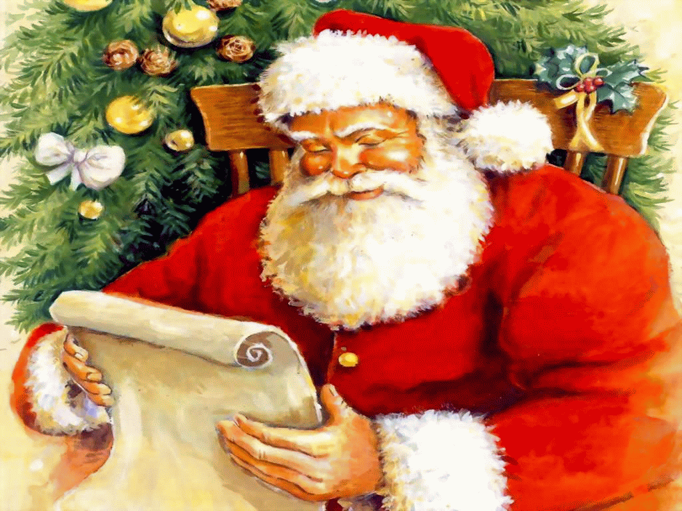
Customs Associated With Christmas
Saint Nicholas – Catholic Bishop
Lived in 4th century (b. 352) of Myra in Asia Minor
Wore red Bishop suit
Honored by Greeks, etc. on Dec. 6
Special friend to children – gave gifts (secret gifts to impoverished citizens)
Tradition: after death children could pray to him and still get gifts
Dutch brought custom to America
Santa Claus
Notes:
American Ency. Vol. 5, p. 62

Slide 26

Customs Associated With Christmas
First used in 1224
Nativity Scene
Italian custom
Jan. 6 good children get gifts, candy – bad children ashes
Stockings
Notes:
American Ency. Vol. 5, p. 62

Slide 27

Customs Associated With Christmas
“X” is not English X
Abbreviation – In Greek Xristos is name “Christ” / Greek Chi = X
Not irreverent as some think
X-Mas
Invention of Montgomery Ward Department Stores (1938)
Sales promotion
Notes:
American Ency. Vol. 5, p. 62

Slide 28
Not Told When Jesus Was Born
Origin & History of Christmas
Why Don’t Observe It Religiously
Non-Religious Observance
Supporting Salvation Army

Slide 29
Why Don’t Observe It Religiously
No Bible Authority
  Observance of birth of Christ – religious act
  Must have authority (Col. 3:17; 2 John 9)
  There is no authority!
Forbidden to observe special days (Gal. 4:8-10)
Why do what not authorized and fail to do what is authorized?
  Some only attend church at Christmas & Easter
  Told to observe his death every week (Acts 20:7)

Slide 30
Not Told When Jesus Was Born
Origin & History of Christmas
Why Don’t Observe It Religiously
Non-Religious Observance
Supporting Salvation Army

Slide 31
Non-Religious Observance
A. There are some who oppose it – cannot at all
Think it always carries religious / pagan significance
Violates conscience
Thus, would be wrong for them
Romans 14 would apply

Slide 32
Non-Religious Observance
There are some who oppose it – cannot at all
Like any other holiday – Thanksgiving, July 4th, Memorial Day
Many things Pagan in origin – lost Pagan significance
Monday – Moons day
Tuesday – Tiwes (Pagan god of war)
Wednesday – Wodens day
Thursday – Thor’s day – Scandinavian god of thunder
Friday – Frigu (goddess of marriage)
Saturday – Saturn’s day
Sunday – Sun’s day
January – Janus (Latin Deity)
March – Mars (god of war)
May – Maia (goddess of increase and growth)

Slide 33
Non-Religious Observance
There are some who oppose it – cannot at all
Like any other holiday – Thanksgiving, July 4th, Memorial Day
Many things Pagan in origin – lost Pagan significance
Does Jer. 10 prophecy of X-mas Tree?
This tree was used as an idol (vv. 6, 10, 11, 15)
No one today worships x-mas tree or decorations

Slide 34
Non-Religious Observance
There are some who oppose it – cannot at all
Like any other holiday – Thanksgiving, July 4th, Memorial Day
Many things Pagan in origin – lost Pagan significance
Does Jer. 10 prophecy of X-mas Tree?
We all celebrate in one way or another
Time off
Bonus Pay
Spend time with family
Travel

Slide 35
Non-Religious Observance
There are some who oppose it – cannot at all
Like any other holiday – Thanksgiving, July 4th, Memorial Day
Many things Pagan in origin – lost Pagan significance
Does Jer. 10 prophecy of X-mas Tree?
We all celebrate in one way or another
What it has come to mean – is neither Pagan or Religious
Family togetherness (food, gifts, etc.)
Shopping
Expression of love
Relaxation – Company – Parties, etc.

Slide 36
Not Told When Jesus Was Born
Origin & History of Christmas
Why Don’t Observe It Religiously
Non-Religious Observance
Supporting Salvation Army

Slide 37
Supporting the Salvation Army
It is a church – a religious organization

Slide 38
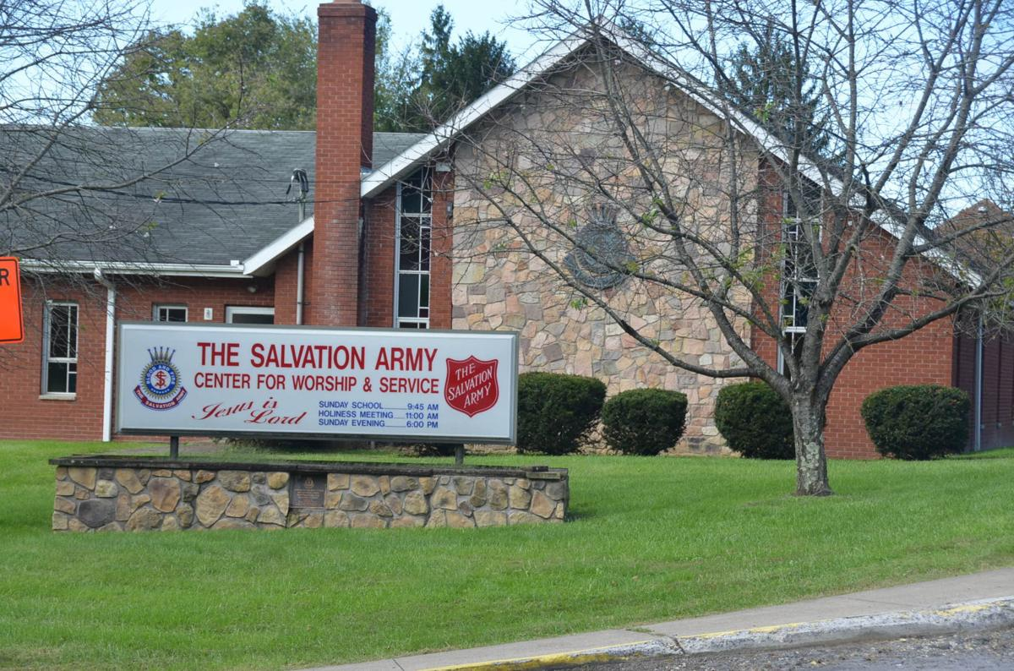

Slide 39
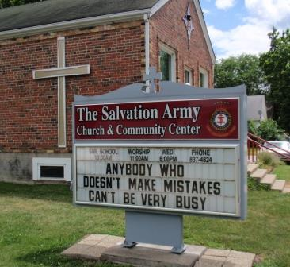

Slide 40
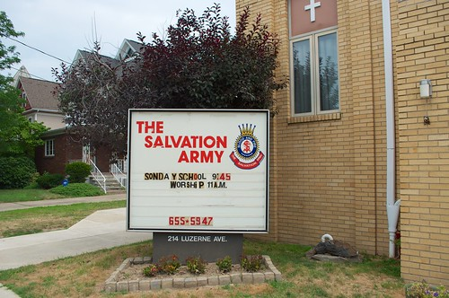

Slide 41
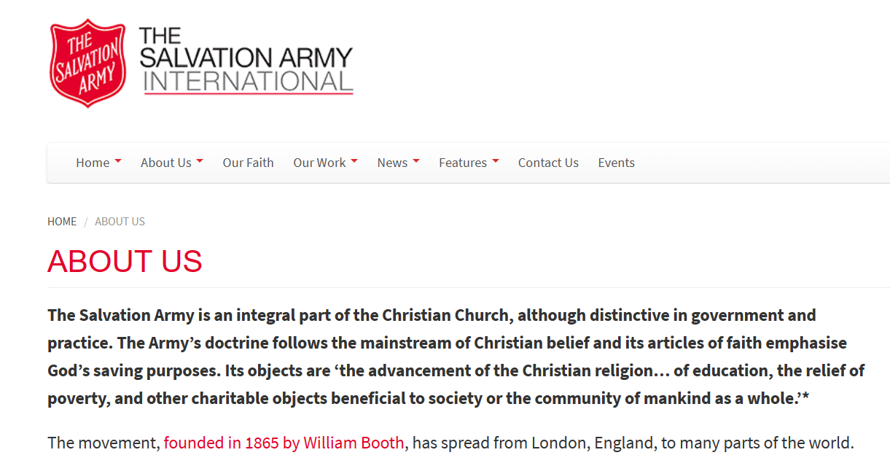

Slide 42
Supporting the Salvation Army
It is a church – a religious organization
Have worship services

Slide 43
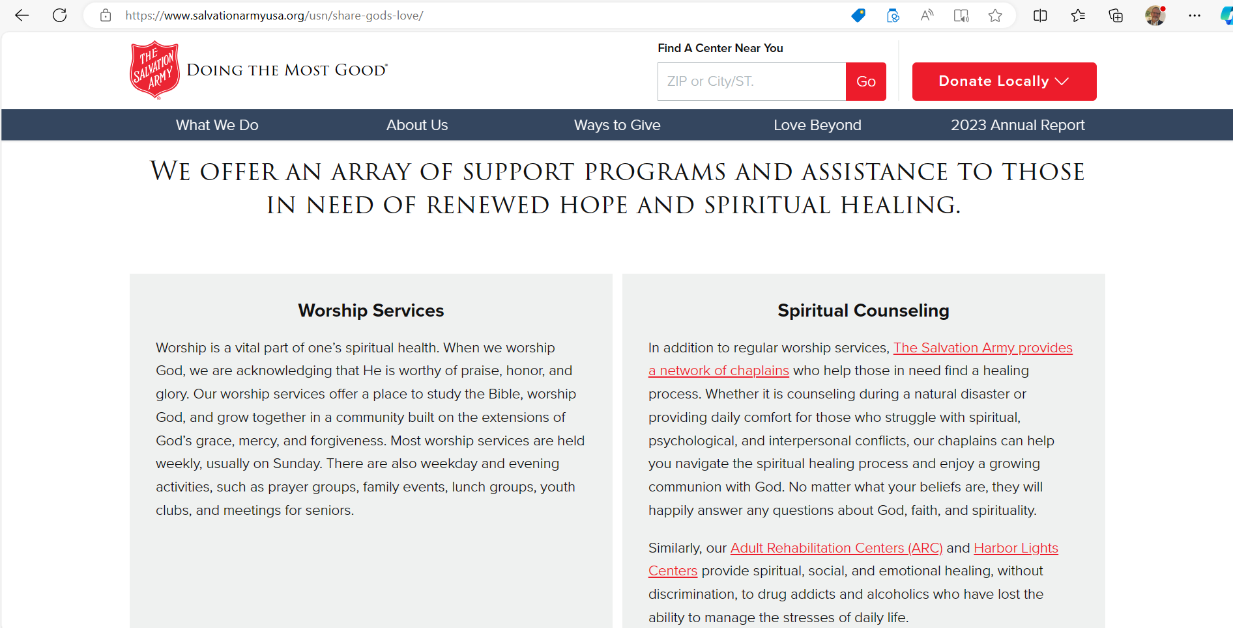

Slide 44
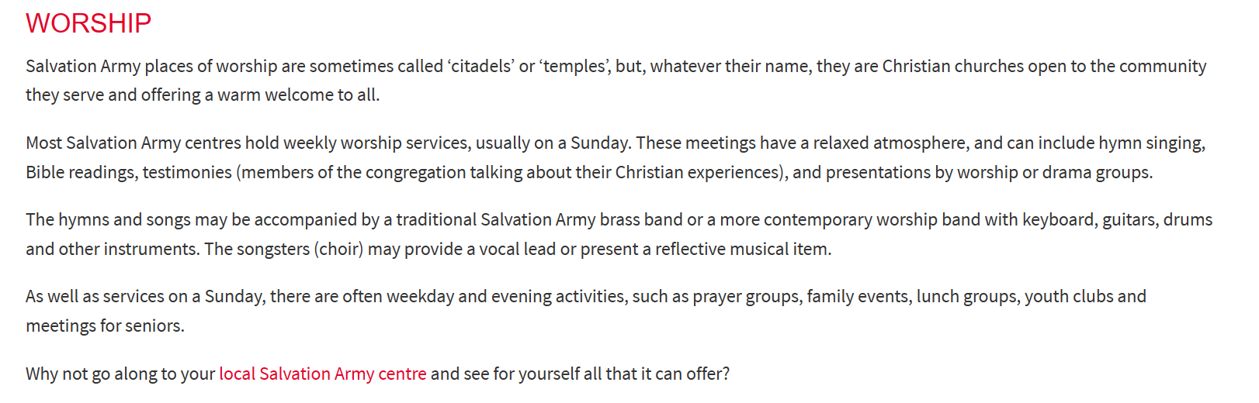

Slide 45
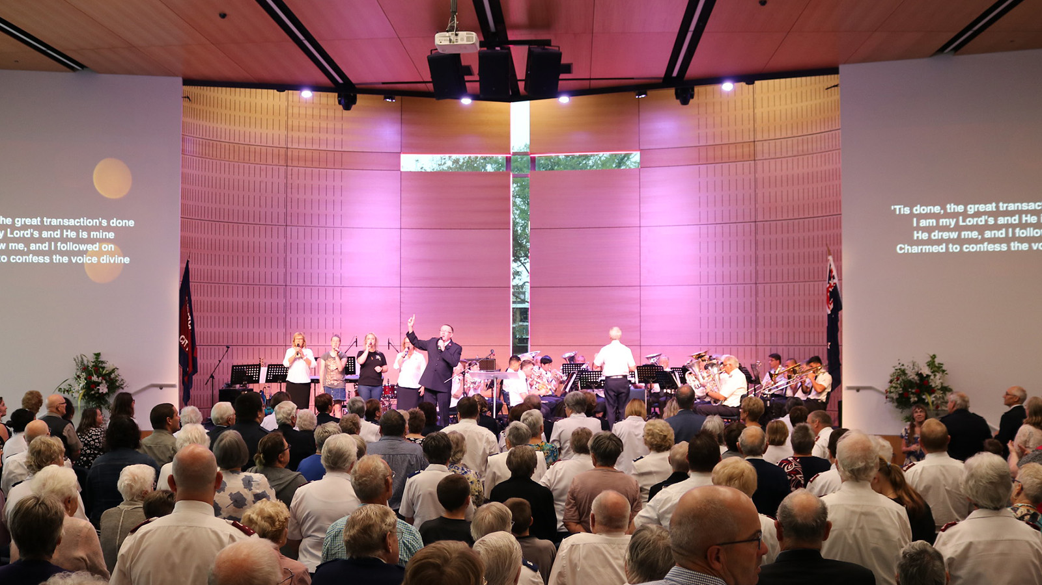

Slide 46
Supporting the Salvation Army
It is a church – a religious organization
Have worship services
Teach false doctrine

Slide 47
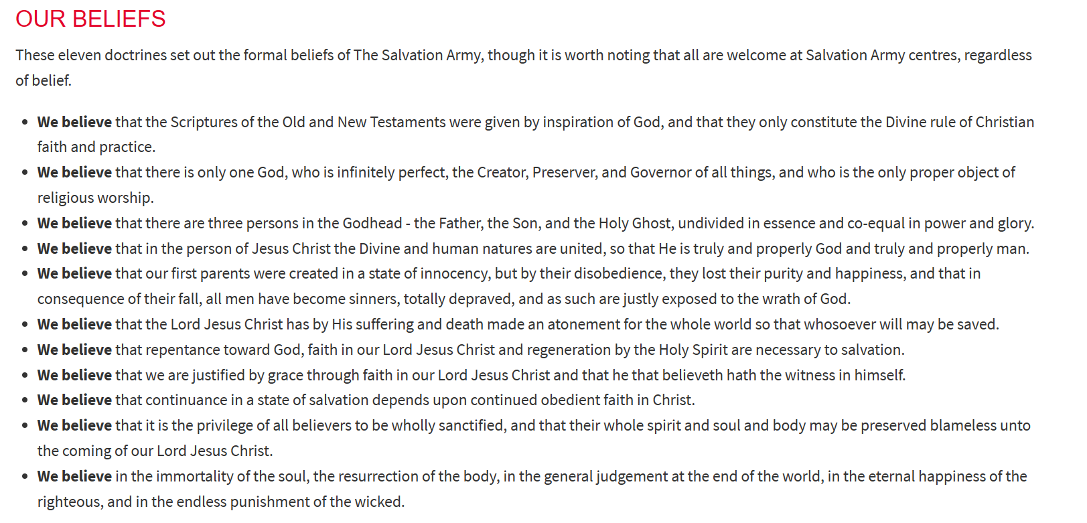

Slide 48
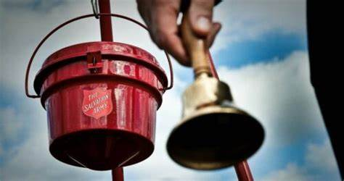
Can I Give to the Salvation Army’s Red Kettle?
Can I Volunteer to Ring Their Bell?
It would be supporting an erroneous church
It would be supporting false doctrine
It would be supporting false worship
Could I give to or help raise money for the Catholic church?

Slide 49
Not Told When Jesus Was Born
Origin & History of Christmas
Why Don’t Observe It Religiously
Non-Religious Observance
Supporting Salvation Army

