Slide 1





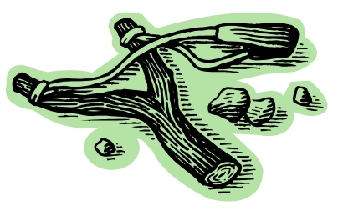
One of life’s greatest treasures
Childhood Memories

Slide 2
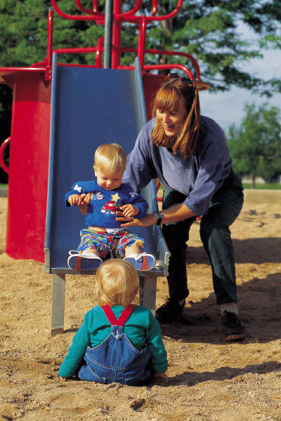
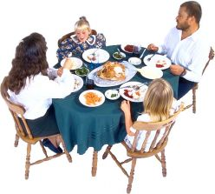
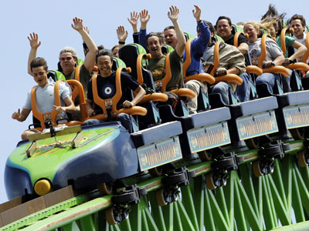

To many, have memories of a home filled with
Love, laughter & a close family bond
Family gathered around supper table
Time spent together (reading a book, playing with toys, etc.)
Promises mom/ dad made – the sacrifice it took to fulfill
Family traditions – little moment to anyone else – very special to them
Family vacations – special fun had
Discipline, spankings – how both they and parents cried!

Slide 3
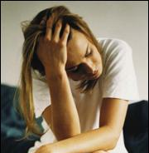
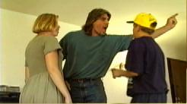
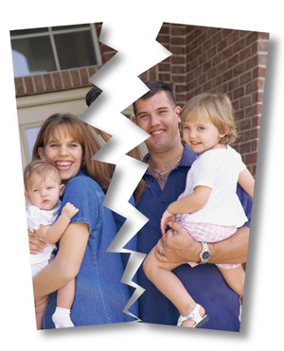

Too many, have memories – not so fond
Memories are painful
Some remember miserable home
  Family dysfunctional
  Verbal, physical & sexual abuse
  Alcohol
  Divorce
Some – not misery – but void of “bond”
  Dad working all time
  No time to play, help with problem
  Mom not at home
  Kids raising themselves
  Complaints – never measure up…

Slide 4
How can we have the families that create great memories?
The kind of home that a child will look back upon with fond memories
Building the kind of childhood memories that you would not be ashamed for your child to have

Slide 5
Memories
of
Home

Slide 6
Memories of Home
Unconditional Love

Slide 7
Unconditional Love
Parents are to love their children
  Titus 2:4
  Prov. 3:12
  1 Thess. 2:11

Slide 8
Unconditional Love
Parents are to love their children
Children remember expressions of love
  Being told, “I love you”
  Hearing, “I’m proud of you”
  Hugs & kisses
  Being shown tenderness, care & affection
  Knowing could talk to parents [if made mistake – or messed up – were not going to yell]

Slide 9
Unconditional Love
Parents are to love their children
Children remember expressions of love
Children need to know they are important to their parents
  More important than money, jobs or friends
  More important than other people & their demands
  Assured of such – by ending each day telling them good night, that love them, and proud of them

Slide 10
Unconditional Love
Parents are to love their children
Children remember expressions of love
Children need to know they are important to their parents
Children who are loved – learn to show affection themselves

Slide 11
Children Learn What They Live
Dorthy Law Nolte
If a child lives with criticism, he learns to condemn.
If a child lives with hostility, he learns to fight.
If a child lives with ridicule, he learns to be shy.
If a child live with shame, he learns to be guilty.
If a child lives with tolerance, he learns to be patient.
If a child lives with encouragement, He learns confidence.
If a child lives with praise, he learns to appreciate.
If a child lives with fairness, he learns justice.
If a child lives with security, he learns to have faith.
If a child lives with approval, he learns to like himself.
If a child lives with acceptance and friendship, he learns to find love in the world.

Slide 12
Unconditional Love
Parents are to love their children
Children remember expressions of love
Children need to know they are important to their parents
Children who are loved – learn to show affection themselves
Sad if child’s memory is:
  “I can’t remember mom or dad ever telling me “I love you”
  “I don’t think I have had my dad give me a hug”
  “I would never have told my dad if I messed something up – he would have just yelled or hollered at me.”
  “I felt unwanted at home – like I was ‘in the way’”
Very common
According to counselors

Slide 13
Memories of Home
Unconditional Love
Family Time

Slide 14
Family Time
Children should be treated as a “blessing” – not a “curse”
  Psa. 127:3-5
  Prov. 23:24-25

Slide 15
Family Time
Children should be treated as a “blessing” – not a “curse”
Children will remember parents who had regular family time
  Time to eat supper together
  Time to read a Bible story
  “Play time”
  Sacrificed – things were canceled to have family time
  Riding bikes, throwing ball, playing with dolls, etc.
  Working together as well as play

Slide 16
Family Time
Children should be treated as a “blessing” – not a “curse”
Children will remember parents who had regular family time
Family time builds communication lines
  Creates a bond
  Casual conversations – opens doors to feelings, ideas, needs, and goals
  Allows parents & children to build a relationship where they can talk through problems and disagreements
  Child who trust their parents on daily matters, will turn to them in a real crisis.

Slide 17
Family Time
Children should be treated as a “blessing” – not a “curse”
Children will remember parents who had regular family time
Family time builds communication lines
Families that are together are not always “together”
  Activities engaged in – not where they can interact with each other
  One or both parents are preoccupied
  Always including others (friends & other family) so that little bonding with parents

Slide 18
Family Time
Children should be treated as a “blessing” – not a “curse”
Children will remember parents who had regular family time
Family time builds communication lines
Families that are together are not always “together”
Sad if childhood memories:
  Dad / mom was always “too busy”
  “We never did anything together”
  “I don’t remember taking any family trips or vacations”
  Told, “Just leave me alone” / “go away”

Slide 19
One of These Days
When The Children Have Grown Up
We may wish we had more time!

Slide 20
Memories of Home
Unconditional Love
Family Time
Careful Concern

Slide 21
Careful Concern
Children will remember discipline, restrictions & rules
  Prov. 22:6 – suggests careful concern
  Eph. 6:4 – implies restrictions & rules
  Prov. 13:24 - discipline
  Prov. 19:18 - discipline
  Prov. 22:15 - discipline

Slide 22
Careful Concern
Children will remember discipline, restrictions & rules
Children will remember parents who used caution
Eph 5:15-16
15 See then that you walk circumspectly, not as fools but as wise,
16 redeeming the time, because the days are evil.
Use wisdom
Walk carefully
Reason: days are evil
The more evil the environment, the more necessary it is to be careful / cautious

Slide 23
Careful Concern
Children will remember discipline, restrictions & rules
Children will remember parents who used caution
Discipline, restrictions & rules will be interpreted as parental care, concern & love
  Children look for the boundaries – when hit them, comforted (James Dobson, Dare to Discipline)
  Heb. 12:9 – children later respect strict parents
  Looking back, they will be glad you said “No”, set rules, and would not allow….
  Restrictions & rules = love and care

Slide 24
Careful Concern
Children will remember discipline, restrictions & rules
Children will remember parents who used caution
Discipline, restrictions & rules will be interpreted as parental care, concern & love
Sad when child’s memories:
  “My parents were pretty tolerant”
  “Don’t remember them forbidding much…”
  “Don’t recall them filtering my music, TV or movies at all”
  “Mom & Dad didn’t show much concern about who my friends were.”
  “I was allowed to sit anywhere at church – mom and dad never knew when I was talking, passing notes, paying no attention.”

Slide 25
Memories of Home
Unconditional Love
Family Time
Careful Concern
Conviction & Service

Slide 26
Conviction & Service
Children will remember their parents’ faith
  Genuine / real faith (1 Pet. 1:7)
  Strong faith (Rom. 4:19-20)
  Know & see if parents are sincere or are hypocrites
  Understand when decisions are made based upon faith (2 Cor. 5:7)
  Remember “never missing a service”
  Respect for God’s order (authority in home, eldership, church discipline, divorce & remarriage, etc.)

Slide 27
Conviction & Service
Children will remember their parents’ faith
Children will remember having parents who made serving God the center of their life
  Attitude: “we belong to & we serve God” (Acts 27:23; cf. Dan 3:16-17)
  What a memory: everything is worked around / based upon serving God.
  Never a question of whether we are going to church!
  Such service:
    Builds faith
    Develops genuine character
    Strengthens relationship

Slide 28
Conviction & Service
Children will remember their parents’ faith
Children will remember having parents who made serving God the center of their life
Sad when memoires are:
  Parents whose faith was weak
  Service was spasmodic
  Dad was not what he tried to appear to be to others
  Mom allowed so many little things to hinder her attendance

Slide 29
Memories of Home
Unconditional Love
Family Time
Careful Concern
Conviction & Service
Example & Instruction

Slide 30
Example & Instruction
Children will remember their parents’ sterling character
  As a rule, children turn out to be just like parents (Ezek. 16:44; 2 Chron. 20:32)
  See & will later appreciate:
    Calm, steady leadership – who will discuss, listen to & value the child’s opinion
    Exercise self control (2 Pet. 1:6)
    Good self-image (confidence, happy)
    Emphasis on family, honor, Bible, being right

Slide 31
Example & Instruction
Children will remember their parents’ sterling character
Children will remember parents who taught them
  Parents are teachers (Prov. 22:6; Eph. 6:4; Deut. 6)
  Much in which to instruct:
    Word of God
    Right and wrong, basic morals, honesty
    Behavior & wisdom (appropriate & what is not)
    Treat others
    Work hard (Col. 3:23)
    About life:
      Fix, build, take care of an animal, share with others
      Sew, cook, clean, do crafts, handle their money
  Remember that parent took time to allow them to do & learn – make mistakes – not take it away & do it for them

Slide 32
Example & Instruction
Children will remember their parents’ sterling character
Children will remember parents who taught them
Sad when children remember:
  Tempers that flared
  Language that was colorful
  What they learned - someone else took time to show them & teach them
  Emphasis on TV, sports, material things, & school

Slide 33
Memories of Home
Unconditional Love
Family Time
Careful Concern
Conviction & Service
Example & Instruction

Slide 34
“What have they seen in your house?”
( 2 Kings 20:14)

