Slide 1

Heaven

Slide 2
Hope to Accomplish
See how great & wonderful Heaven is
Make it real in our minds
Stir a greater desire to go

Slide 3
Things I Know About Heaven
It is a real place (John 14:3)
We will be like Christ (1 John 3:2)
Our bodies will be changed (1 Cor. 15:50-54)
We will be conscious (Luke 16:19-31)

Slide 4
Heaven
Types & Analogies of Heaven

Slide 5

Eden
(Rev. 22:1-5; 2:7)
Sinless / Holiness
Beauty / Splendor
Paradise
Lost in Eden – Gained…
All provisions supplied

Slide 6
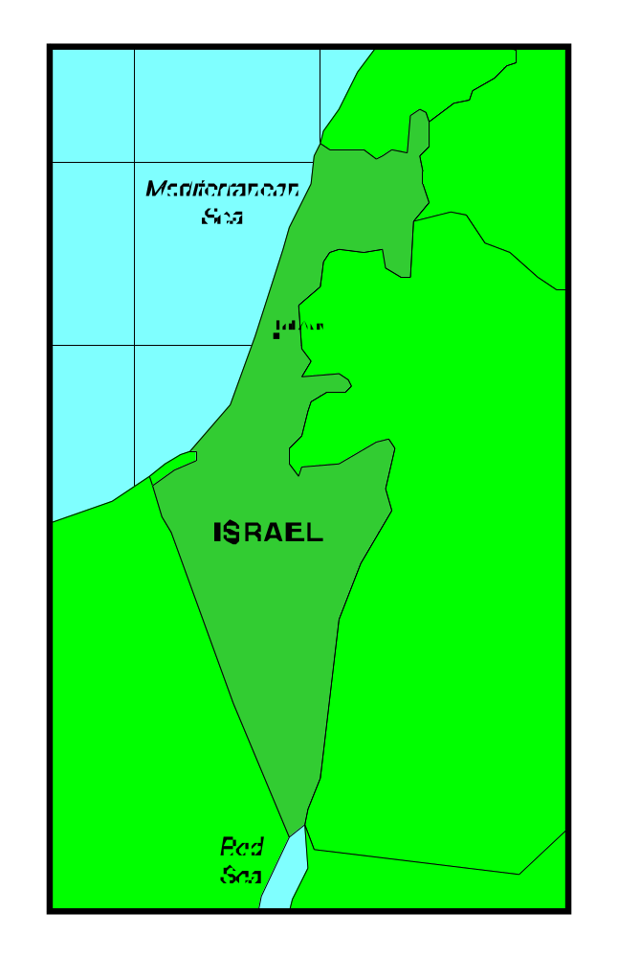
Canaan
(Heb. 3-4)

Slide 7
Bondage
(Egypt)
Wondered
(in wild.)
Canaan
(rest)
Bondage
(Sin)
Pilgrims
(now)
Heaven
(rest)

Slide 8
Canaan
(Heb.3-4)
Promise land
Land of rest
Land - milk & honey
Dream – anticipation
Inheritance

Slide 9
Bondage
(Egypt)
Wondered
(in wild.)
Canaan
(rest)
Temporary
Could Fall
Bondage
(Sin)
Pilgrims
(now)
Heaven
(rest)

Slide 10
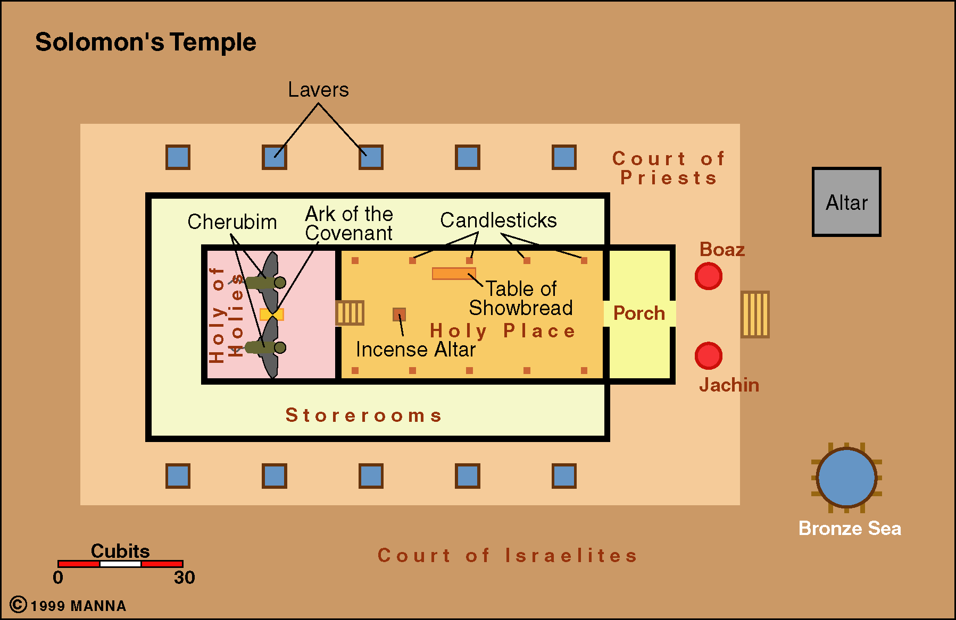
Holy of Holies
(Heb. 9:24)

Slide 11
Jerusalem
(Rev. 21:2, 10)
The greatest city of all
Zion
City of beauty, wealth, glory
City of God

Slide 12
Sabbath Rest
(Heb. 4:4, 9-11)
Work / Labor
Rest

Slide 13
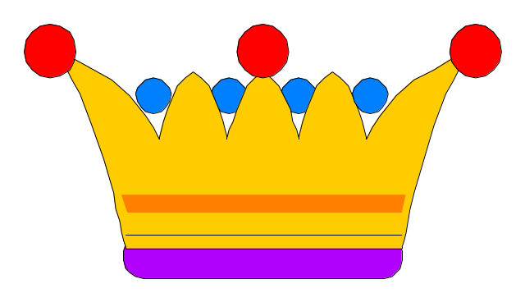
Crown
(Rev. 2:10)
Prize / Reward
Conquer / Win / Victory

Slide 14
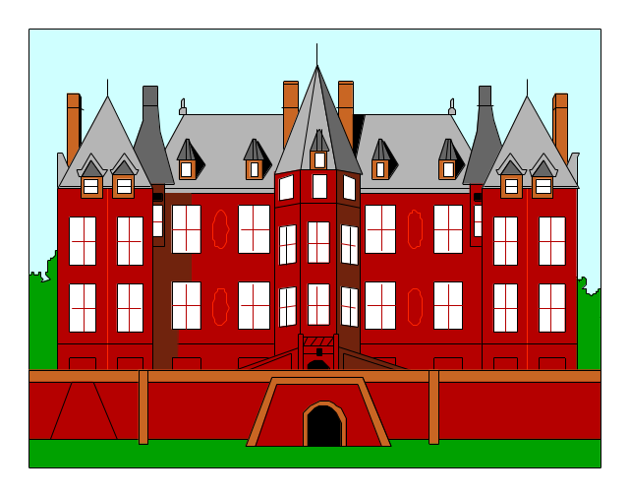
Mansion
(John 14:1; 2 Cor. 5:1-2)
Beauty
Wealth – no expense spared
Spacious

Slide 15

Security
(Rev. 21:12)
Protection / Safety
No fears / worries
No temptation / sin
All enemies gone

Slide 16
Eden
Canaan
Holy of Holies
Jerusalem
Sabbath Rest
Crown
Mansion
Security

Slide 17
Heaven
Types & Analogies of Heaven
Descriptions of Heaven’s Glory

Slide 18
No Pain or Sorrow
(Rev. 21:4)

Slide 19

A Great City
(Rev. 21:10)
Heavenly (Heb. 11:16)
Continuing (Heb. 13:14)
Righteous (2 Pet. 3:13)
Spacious City (Rev. 21:10-17)
Glory Unequaled (Rev. 21:18-ff)
No night there (Rev. 21:23, 25; 22:5)

Slide 20
Life That Has No End
(Matt. 25:46; Rev. 22:5)

Slide 21
Something Far Better
(Heb. 10:34)

Slide 22
No Pain or Sorrow
A Great City
Life That Has No End
Something Far Better

Slide 23
Rev. 21
10 And he carried me away in the Spirit to a great and high mountain, and showed me the great city, the holy Jerusalem, descending out of heaven from God,
11 having the glory of God. Her light was like a most precious stone, like a jasper stone, clear as crystal.
12 Also she had a great and high wall with twelve gates, and twelve angels at the gates, and names written on them, which are the names of the twelve tribes of the children of Israel:

Slide 24
Heaven
Types & Analogies of Heaven
Descriptions of Heaven’s Glory
What Will We Do in Heaven?

Slide 25

Sing & Praise God
(Rev. 5:8-9; 14:2-3)

Slide 26
Heaven
Types & Analogies of Heaven
Descriptions of Heaven’s Glory
What Will We Do in Heaven?
Heaven is a Compelling Force

Slide 27
“And everyone who has this hope in Him purifies himself, just as He is pure”
(1 John 3:3).
Obey the gospel
Worship God
Live faithful
Preach & teach
Correct & rebuke
Change – give up some things

Slide 28
Heaven
Types & Analogies of Heaven
Descriptions of Heaven’s Glory
What Will We Do in Heaven?
Heaven is a Compelling Force
Heaven is the Home of:

Slide 29

God (Rev. 4)
Angels (Matt. 24:36)
Great Bible Char. (Heb. 11)
Obedient (Rev. 22:14)
Faithful (Rev. 2:10)

Slide 30
Heaven
Types & Analogies of Heaven
Descriptions of Heaven’s Glory
What Will We Do in Heaven?
Heaven is a Compelling Force
Heaven is the Home of:
Our Attitude Toward Heaven

Slide 31
Rom. 8:17-19; Heb. 13:14; Phil. 1:21-23
Joyous Anticipation
Think about it
Seek it - aim
Can’t wait

Slide 32
Heaven
Types & Analogies of Heaven
Descriptions of Heaven’s Glory
What Will We Do in Heaven?
Heaven is a Compelling Force
Heaven is the Home of:
Our Attitude Toward Heaven

Slide 33

Is Your Name
Written In Heaven?
Luke 10:20
“Nevertheless do not rejoice in this, that the spirits are subject to you, but rather rejoice because your names are written in heaven.”

