Slide 1

Let Us
Pray
God’s People Pray
Why God’s People Pray
What God’s People Pray
How God’s People Pray
Satan Hinders Prayers of God’s People

Slide 2
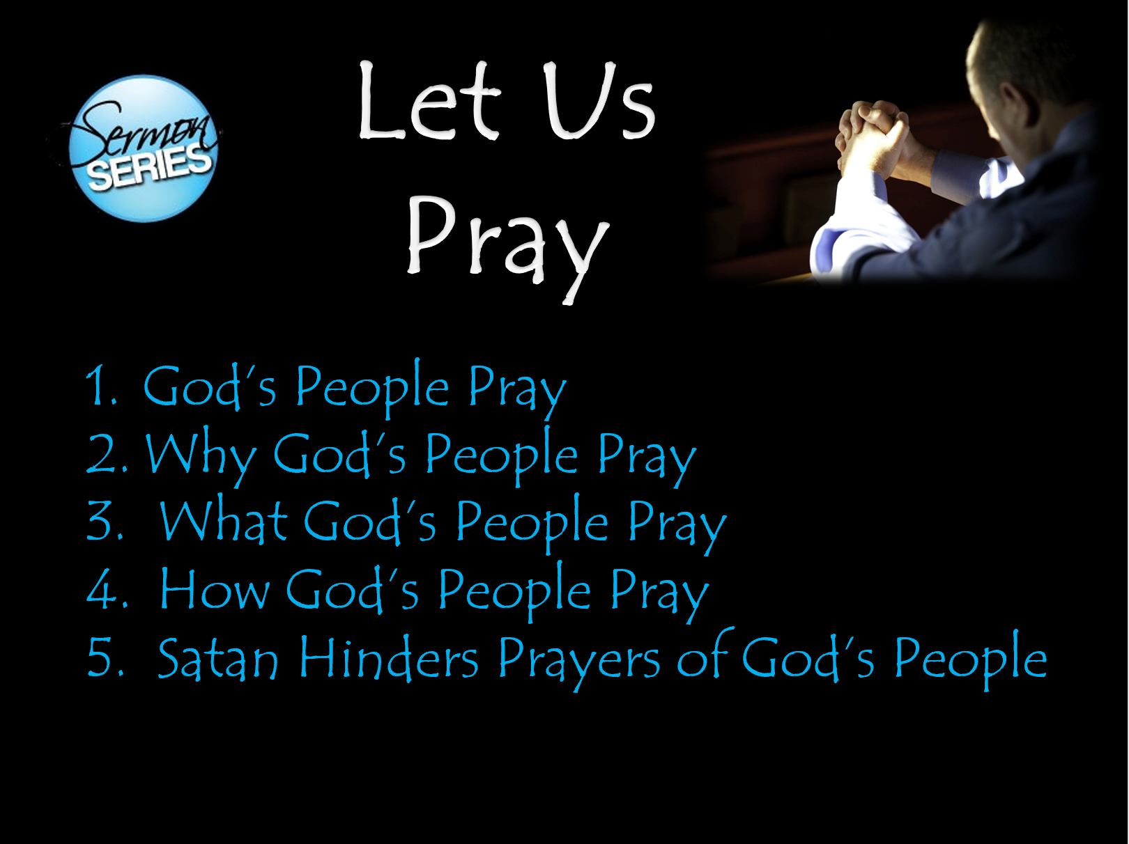
Objective:
When Series is Over:
More committed to praying
Praying more
More fervent
Praying for more things

Slide 3
God’s People Pray
Review – Last Week
Privilege of Prayer Belongs to God’s People
Assurance that God Hears & Answers Their Prayer
Examples of God’s People Praying

Slide 4
Let Us
Pray
God’s People Pray
Why God’s People Pray
What God’s People Pray
How God’s People Pray
Satan Hinders Prayers of God’s People

Slide 5
Why God’s People Pray
The Need to Pray

Slide 6
The Need to Pray
It is a Command
  Pray without ceasing (1 Thess. 5:17)
  Men pray everywhere (1 Tim. 2:8)
  Ought to always pray (Luke 18:1)
  Jesus instructed his disciples to pray (Matt. 6:9-13)

Slide 7
The Need to Pray
It is a Command
God is Concerned with Our Wants & Needs
  If man graciously gives – how much more so God gives (Matt. 7:9-11)
  God is not so removed from man that he doesn’t care about our struggles
  Even the very hairs of our head are numbered (Luke 12:7)

Slide 8
The Need to Pray
It is a Command
God is Concerned with Our Wants & Needs
To Find Grace to Help With Our Struggles
  Come to the throne of grace (Heb. 4:16)
    Because we are human, we are weak and frail
    We are dependent upon the assistance of Divine power
    Stand in continual need of God’s protection and care
  Pray without ceasing – implies continual need (1 Thess. 5:17)
  We cannot make it without God’s help
    We are mere branches – He is the vine (John 15:5)
    Our strength is through Christ (Phil. 4:13)
    Cure for our anxieties ( Phil. 4:6)

Slide 9
The Need to Pray
It is a Command
God is Concerned with Our Wants & Needs
To Find Grace to Help With Our Struggles
God is the Almighty
  Almighty God (Rev. 4:8)
  With God all things are possible (Matt. 19:26)
  Has the power to do more than we ask (Eph. 3:20)
  Means:
    Has the power to do something about my concerns / needs
    He knows all and controls all
    If I pray for some sickness / disease, has power over that
    If I pray for rulers of world, has power over them all!

Slide 10
The Need to Pray
It is a Command
God is Concerned with Our Wants & Needs
To Find Grace to Help With Our Struggles
God is the Almighty
God is Willing to Grant Us Good Things
  Ask and receive (Matt. 7:7-8, 11)
  Grants what is best for us – even the answer “No”

Slide 11
The Need to Pray
It is a Command
God is Concerned with Our Wants & Needs
To Find Grace to Help With Our Struggles
God is the Almighty
God is Willing to Grant Us Good Things
Express Love & Adoration
  Prayer involves praise (Matt. 6:9)
  Prayer involves thanksgiving (1 Tim. 2:1)
  Opportunity to tell of our love, gratitude and our awe!

Slide 12
The Need to Pray
It is a Command
God is Concerned with Our Wants & Needs
To Find Grace to Help With Our Struggles
God is the Almighty
God is Willing to Grant Us Good Things
Express Love & Adoration
We Need Forgiveness
  Times we need to beg for forgiveness (Acts 8:22-24)
  We need prayer for we need mercy!

Slide 13
The Need to Pray
It is a Command
God is Concerned with Our Wants & Needs
To Find Grace to Help With Our Struggles
God is the Almighty
God is Willing to Grant Us Good Things
Express Love & Adoration
We Need Forgiveness
To Follow the Examples of Christ & Others
  Be followers of Christ (1 Pet. 2:21)
  Follow Paul as he followed Christ (1 Cor. 11:1)

Slide 14
The Need to Pray
It is a Command
God is Concerned with Our Wants & Needs
To Find Grace to Help With Our Struggles
God is the Almighty
God is Willing to Grant Us Good Things
Express Love & Adoration
We Need Forgiveness
To Follow the Examples of Christ & Others
Prayer Does Good – It is Powerful!
  Avails much (Jas. 5:16)
  Must not lose faith in its power (Luke 18:1,5)

Slide 15
Why God’s People Pray
The Need to Pray
The Power of Prayer

Slide 16
The Power of Prayer
God Answers Prayer
  Promise & a fact
    Jas. 5:16
    1 Pet. 3:12
    1 John 5:14-15

Slide 17
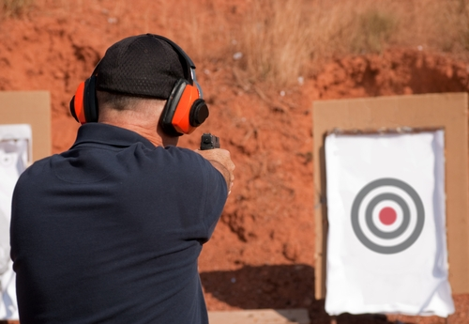
The Power of Prayer
God Answers Prayer
  Promise & a fact
  Pray does good - effective
    Jas. 5:16 – “avails much”
      Doesn’t mean it accomplishes what we want
      Doesn’t mean will be granted what we ask
      Means: has power – does good
    Has force – whether it hits our target or not

Slide 18
The Power of Prayer
God Answers Prayer
  Promise & a fact
  Pray does good – effective
  Every prayer receives an answer
    God’s ears are open – (1 Pet. 3:12) assures us that he answers our prayers!
    Doesn’t mean that every prayer is answered immediately or the way we want
    May be “yes” or “No” or “Wait a while”

Slide 19
The Power of Prayer
God Answers Prayer
  Promise & a fact
  Pray does good – effective
  Every prayer receives an answer
  Sometimes the answer is “no”
    Paul prayed three times for thorn (2 Cor. 12:7-9)
    David prayed that his child would not die (2 Sam. 12:16-23)

Slide 20
The Power of Prayer
God Answers Prayer
God Is In Control
  God is personally involved in the operation of the universe now

Slide 21
God Is Personally Involved in the Operation of the Universe Now
Acts 17:24-28
  God gives breath to all
  God determines the times of the people
  God controls the bounds of their habitation
  In him we live and move

Slide 22
God Is Personally Involved in the Operation of the Universe Now
Acts 17:24-28
Col. 1:17 – By him all things consist
Heb. 1:3 - Universe functions by God’s power
Neh. 9:6-8
  God created world (v. 6)
  He preserves it (v. 6) – involves providence
  He carries out his purpose (vv. 7-8)

Slide 23
God Is Personally Involved in the Operation of the Universe Now
Acts 17:24-28
Col. 1:17 – By him all things consist
Heb. 1: 3- Universe functions by God’s power
Neh. 9:6-8
Dan. 4:25 – God rules in kingdoms of men
Rev. 1:5 – prince of the kings of the earth
Rev. 4:11 – all was created for God’s will – his purpose

Slide 24
The Power of Prayer
God Answers Prayer
God Is In Control
  God is personally involved in the operation of the universe now
  God is concerned for man
    Matt. 6:25-32 – if clothes grass – cares for us
    Matt. 10:29-31 – if notices every sparrow – cares for us

Slide 25
The Power of Prayer
God Answers Prayer
God Is In Control
  God is personally involved in the operation of the universe now
  God is concerned for man
  God’s will (intent) can be altered
    Abraham’s plea for Sodom (Gen. 18:23-33)
    Moses’ plea for Israel (Exo. 32:9-14)
    Jonah & Ninevites’ plea for Nineveh (Jonah 3)

Slide 26
The Power of Prayer
God Answers Prayer
God Is In Control
How God Answers Prayer
  It is not necessary to know HOW God does it – just the FACT that he does!
  Does not do for man what man can do for himself
    Can’t pray for food – then do nothing (2 Thess. 3:10)
    Pray for sickness - but need to seek a doctor
    Pray for knowledge & understanding - but must study (2 Pet. 3:18)

Slide 27
The Power of Prayer
God Answers Prayer
God Is In Control
How God Answers Prayer
  It is not necessary to know HOW God does it – just the FACT that he does!
  Does not do for man what man can do for himself
  Does not violate human will
    Man is still a free moral agent (Rom. 6)
    May pray for someone to obey gospel (Rom. 10:1) – yet God will not cause it to happen contrary to own desire

Slide 28
The Power of Prayer
God Answers Prayer
God Is In Control
How God Answers Prayer
  It is not necessary to know HOW God does it – just the FACT that he does!
  Does not do for man what man can do for himself
  Does not violate human will
  Does not violate natural law
    To do otherwise would be a miracle!
    God can & does operate within realm of natural laws

Slide 29
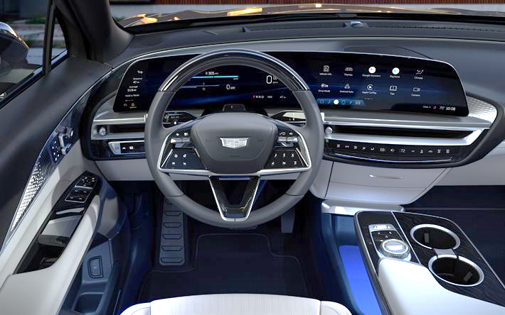
Can Be in Control – Yet Operate Within Confines of Certain Laws

Slide 30
The Power of Prayer
God Answers Prayer
God Is In Control
How God Answers Prayer
  It is not necessary to know HOW God does it – just the FACT that he does!
  Does not do for man what man can do for himself
  Does not violate human will
  Does not violate natural law
  May simply bless us with the means
    Pray for needs – yet bless me with health to work (Eph. 4:28)
    Pray for patience – yet allow trouble to built it (Jas. 1)
    Pray for wisdom – yet use an older person says to give it

Slide 31
Why God’s People Pray
The Need to Pray
The Power of Prayer

