Slide 1
Conversion of
the Jailer
Acts 16:25-34

Slide 2
Conversion of the Jailer
The Background

Slide 3
The Background
Time
  50-54 AD
  During Paul’s 2nd missionary journey

Slide 4
The Background
Time
Worked in the city many days (v. 18)
  Preached by the river
  Converted others (Lydia & family)
  Many took note – proclaiming salvation (v. 17)
  Called before magistrates - taken through city (v. 19)
  Charged on basis of their teaching (vv. 20-21)
  Beaten (v. 23)
  All the city knew something about their work!
Notes:
40 stripes common

Slide 5
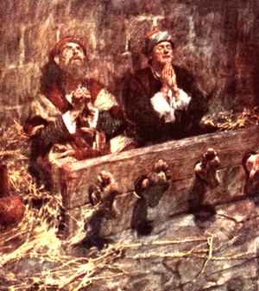
The Background
Time
Worked in the city many days (v. 18)
Imprisoned (vv. 23-24)
  Reason: what they taught & casting out evil spirit
  Inner prison (v. 24)
    Maximum security
    Possibly underground / dungeon
  In stocks (v. 24)
Notes:
40 stripes common

Slide 6
The Background
Time
Worked in the city many days (v. 18)
Imprisoned (vv. 23-24)
Conviction & attitude of messengers
  Situation: Arrested, beaten, thrown in dungeon, & confined to stocks
  Not: bitter, gripping, filled with self pity, complaining, or crying “Why me?”
  Lack of despair shows what faith will do:
    Singing & praying (v. 25)
    Christianity was real to them
    Practicing what preached (Phil. 4:6, 11)
Notes:
40 stripes common

Slide 7
The Background
Time
Worked in the city many days (v. 18)
Imprisoned (vv. 23-24)
Conviction & attitude of messengers
  Situation: Arrested, beaten, thrown in dungeon, & confined to stocks
  Not: bitter, gripping, filled with self pity, complaining, or crying “Why me?”
  Lack of despair shows what faith will do:
  Impressed others (v. 25)
  How I handle my faith has everything to do with reaching others (cf. Rom 2:24)
Notes:
40 stripes common

Slide 8
The Background
Time
Worked in the city many days (v. 18)
Imprisoned (vv. 23-24)
Conviction & attitude of messengers
Prospect
  Gentile (no evidence of being a believer – thus turned from paganism)
  Honest (took his job & their message seriously)
  Government official
  Family man
  Humble – willing to submit to God’s will
  Interested in salvation of his soul
Notes:
40 stripes common

Slide 9
The Background
Time
Worked in the city many days (v. 18)
Imprisoned (vv. 23-24)
Conviction & attitude of messengers
Prospect
Earthquake
  Caused by God
  Opened the doors & loosed the chains
Notes:
40 stripes common

Slide 10
Conversion of the Jailer
The Background
The Question

Slide 11
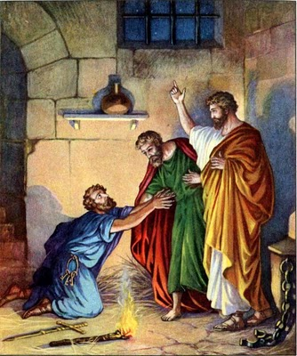
“Sirs, what must I do to be saved?” (v. 30)

Slide 12
The Question
What prompted the question
  Must have had some knowledge of their work
  Notes the faith of Paul & Silas
  Great earthquake – made to realize that what these men believe and teach is real

Slide 13
The Question
What prompted the question
Sincere question
  Not to tempt, ensnare or trap
  Asked out of fear

Slide 14
The Question
What prompted the question
Sincere question
Recognized the need
  Realized he was lost (Eph. 2:12)
  Many don’t realize they have need
    Jews didn’t - until told (Acts 2:23)
    The treasurer didn’t – until told (Acts 8:34-ff)
    Saul didn’t – until told (Acts 23:1)
  At this point – Jailer recognized – had a need!

Slide 15
The Question
What prompted the question
Sincere question
Recognized the need
Recognized something must do
  Else why ask such a question
  Understood – obedience necessary
    Matt. 7:21
    1 Pet. 1:22
    Heb. 5:8-9
  Certainly, didn’t think – all a matter of grace – had nothing to do

Slide 16
The Question
What prompted the question
Sincere question
Recognized the need
Recognized something must do
In search of the most important thing – salvation of the soul (Matt. 16:26)

Slide 17
Conversion of the Jailer
The Background
The Question
The Answer

Slide 18
The Answer
Believe (v. 31)
  Salvation was conditioned upon faith (Rom. 5:1)
  Not by faith alone
    Text says, “not by faith only” (Jas. 2:24)
    Would mean repentance not essential
    Term “faith” / “believe” can be used to include obedience

Slide 19
Call
(v. 13)
Romans 10:13, 16
Obey
(v. 16)
Believe
(v. 16)

Slide 20
1 Peter 2:6-8
6 Therefore it is also contained in the Scripture, “Behold, I lay in Zion A chief cornerstone, elect, precious, And he who believes on Him will by no means be put to shame.”
7 Therefore, to you who believe, He is precious; but to those who are disobedient, “The stone which the builders rejected Has become the chief cornerstone,”
8 and “A stone of stumbling And a rock of offense.” They stumble, being disobedient to the word, to which they also were appointed.

Slide 21
31 So they said, "Believe on the Lord Jesus Christ, and you will be saved, you and your household."
32 Then they spoke the word of the Lord to him and to all who were in his house.
33 And he took them the same hour of the night and washed their stripes. And immediately he and all his family were baptized.
34 Now when he had brought them into his house, he set food before them; and he rejoiced, having believed in God with all his household.
Believed
Repented
Baptized

Slide 22
The Answer
Believe (v. 31)
Not expected without evidence
  So speak word to him (v. 32)
  No one is expected to believe without reason
  What was content of sermon?
    Not told here
    Other sermons contained evidence of resurrection
    Must have contained commands of what he was to do:
      That is what he asked about (v. 31)
      That is what he did (v. 33)

Slide 23
Conversion of the Jailer
The Background
The Question
The Answer
The Response

Slide 24
The Response
Believed what he heard
  Else why take the actions he took?
  He saw evidence and accepted

Slide 25
The Response
Believed what he heard
Repented
  Required for remission of sins (Acts 2:38)
  Commanded of all (Acts 17:30-31)
  Washed their stripes (v. 33)

Slide 26
The Response
Believed what he heard
Repented
Baptized
  Immediately was baptized (v. 33)
  For the remission of sins (Acts 2:38)
  To be saved (Mark 16:16)
  Did exactly what every other converts did
    3000 Jews - Acts 2:41
    Samaritans – Acts 8:12
    Treasurer – Acts 8:38
    Saul – Acts 22:16
    Corinthians – Acts 18:8

Slide 27
Conversion of the Jailer
The Background
The Question
The Answer
The Response
The Urgency

Slide 28
The Urgency
Same hour of the night (vv. 25, 33)
  Past midnight
  Didn’t wait till morning

Slide 29
The Urgency
Same hour of the night (vv. 25, 33)
Other cases
  Same day (Acts 2)
  Immediately (Acts 8)

Slide 30
The Urgency
Same hour of the night (vv. 25, 33)
Other cases
Why?
  Life is so uncertain – could die (Psa. 144:4; Jas. 4:14)
  Day of the Lord could come (2 Pet. 3:10)
  Heart could be hardened (Heb. 3:7)

Slide 31
Conversion of the Jailer
The Background
The Question
The Answer
The Response
The Urgency

