Slide 1
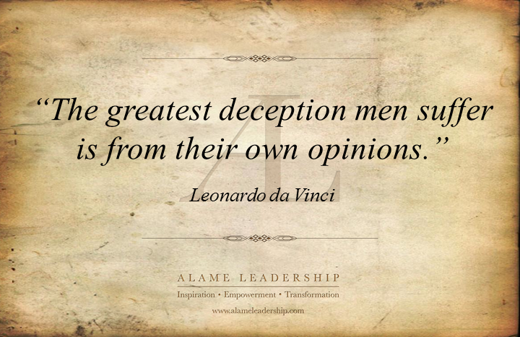

Slide 2
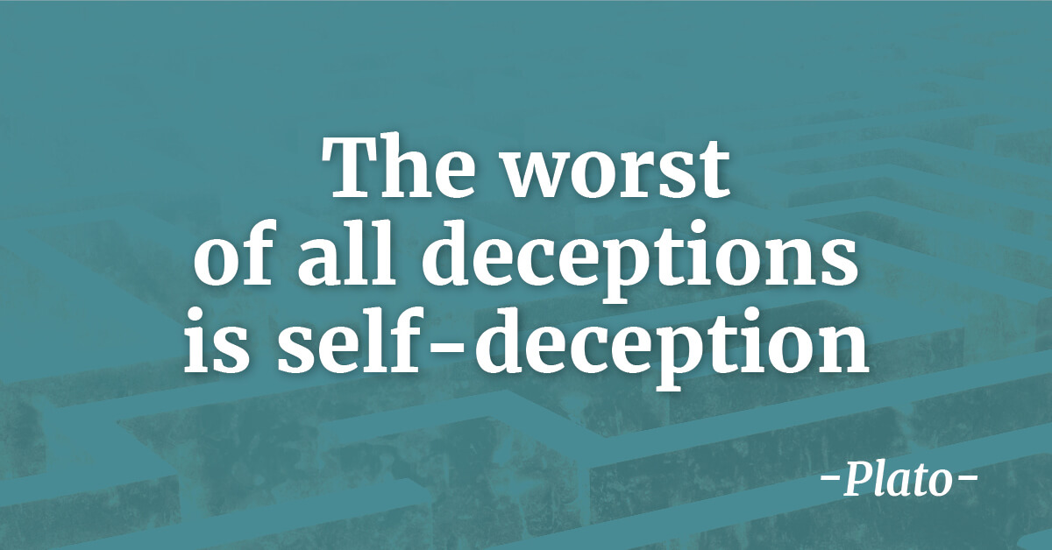

Slide 3
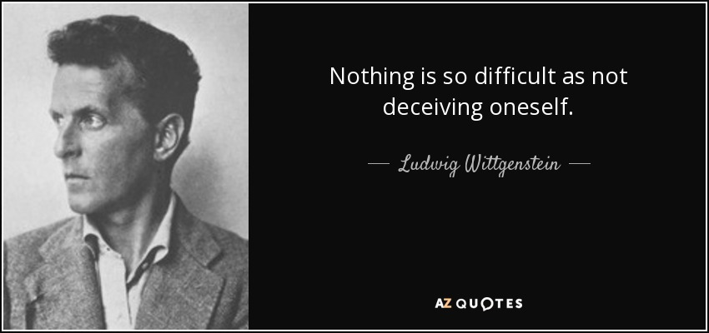

Slide 4
The Bible Warns About
Deceiving Self
1 Cor. 3:18-23
Gal. 6:3
Jas. 1:22
Jas. 1:26
1 John 1:8

Slide 5
Deceiving
Self

Slide 6
Deceiving Self
Own Thinking
  (1 Cor. 3:18-23)

Slide 7
Own Thinking
  (1 Cor. 3:18-23)
Situation at Corinth
  Conflicts & party spirit rested upon human wisdom (3:3-4)
  “Self-deception is the common fate of those who mistakenly fancy themselves wise” (C. K. Barrett, The First Epistle to the Corinthians, 93)
  It was a problem of pride (4:6)
  Answer: to become fools (v. 18) – let him view all his human wisdom as valueless

Slide 8
Own Thinking
  (1 Cor. 3:18-23)
Situation at Corinth
Today
  Attribute too much to our own knowledge or education. Think we really know it…
  Think we know more than we really know (overconfident)
  Think our own reasoning and thinking is just as good – we don’t seek the revelation of God
    Prov. 3:5-7
    1 Chron. 15:13
    Jer. 37:9-10
  So we reason: “I don’t see anything wrong with…”

Slide 9
Deceiving Self
Own Thinking
  (1 Cor. 3:18-23)
Own Strength
  (Gal. 6:3)

Slide 10
Own Strength
  (Gal. 6:3)
Context
  Restoring the erring (vv. 1-5)
  The “spiritual” are to help (v. 1)
  Humility is needed (cf. 5:26)
  Point: Little help if he thinks himself to be more spiritual than he is
    Thinks he is more mature – than he really is
    Thinks he is stronger – than he really is

Slide 11
Own Strength
  (Gal. 6:3)
Context
Warning about Overconfidence
  1 Cor. 10:12
  2 Cor. 10:12 – false basis for security
  Mark 14:27-31

Slide 12
Own Strength
  (Gal. 6:3)
Context
Warning about Overconfidence
Can overestimate our Strength & Ability to Resist
  Attitude: “I would never do what you did.”
  Think of self as a strong faithful member – yet miss half of services
  Think that exposure to sin will not affect me (cf. 1 Cor. 15:33)

Slide 13
Deceiving Self
Own Thinking
  (1 Cor. 3:18-23)
Own Strength
  (Gal. 6:3)
Own Conformity
  (Jas. 1:22)

Slide 14
Own Conformity
  (Jas. 1:22)
God Requires Conformity – by Obedience
  Doers of word (Jas. 1:22)
  Obey to enter kingdom (Matt. 7:21)
  Obey to have eternal life (Heb. 5:8-9)
  If Jesus is our “Lord” – do what says (Luke 6:46)
  Faith alone will not save (Jas. 2:24)

Slide 15
Own Conformity
  (Jas. 1:22)
God Requires Conformity – by Obedience
Think we Conform – by Hearing
  Think if we hear sound teaching – have conformed
  Think if we agree & commend sound teaching – have conformed
  Think if we acknowledge that we were rebuked by sound teaching – have conformed
  Think if we attend where sound doctrine is demanded – have conformed

Slide 16
Deceiving Self
Own Thinking
  (1 Cor. 3:18-23)
Own Strength
  (Gal. 6:3)
Own Conformity
  (Jas. 1:22)
Own Words
  (Jas. 1:26)

Slide 17
Own Words
  (Jas. 1:26)
Thinks he is Religious
  Word “religious” (used only here) – “careful of the externals of divine service” (Vines)
  Lenski: “…one who observes the cultus exterior. There is no doubt that the man does this, he is religious in this sense, James does not deny it.”
  He thinks of himself as pious, devout & in a good relationship with God

Slide 18
Own Words
  (Jas. 1:26)
Thinks he is Religious
Not Control is Tongue
  May not view that is part of his “religion”
  May think what he is doing is “control” – at least as compared to others
  So feels no guilt when:
    Uses profane or obscene words (Eph. 5:29)
    Tells crude / off-color jokes
    Slanders another
    Ugly or harsh with others

Slide 19
Own Words
  (Jas. 1:26)
Thinks he is Religious
Not Control is Tongue
Learn: Can think I’m Religiously Right & Not Live the Lifestyle
  Deceived self about what is self control – think we are exercising self control
  Reason in own mind that __________ is not a part of being religious (right with God)
  If Jesus is your Lord – you do what he says (Lk. 6:46)!
What I Drink
What I watch
How I Dress
Language

Slide 20
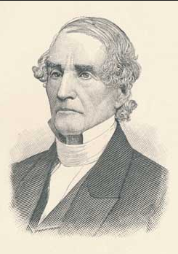
“A man may undoubtedly have many things in his character which seem to be evidences of the existence of religion in his heart, and yet there may be some one thing that shall show that all those evidences are false. Religion is designed to produce an effect on our whole conduct; and if there is any one thing in reference to which it does not bring us under its control, that one thing may show that all other appearances of piety are worthless.”
Albert Barnes, Notes on the New Testament: James to Jude, 32

Slide 21
Deceiving Self
Own Thinking
  (1 Cor. 3:18-23)
Own Strength
  (Gal. 6:3)
Own Conformity
  (Jas. 1:22)
Own Words
  (Jas. 1:26)
Own Sin
  (1 John 1:8)

Slide 22
Own Sin
  (1 John 1:8)
By Thinking We Don’t Sin
By Thinking that What I’m Doing is Not Sin
  Justify our actions to self – saying I’m just….
  “I’m not gossiping / slandering… I’m just telling you…”
  “I’m not stealing, I’m just using this money and will pay it back…”
  “I’m not forsaking … I just had something….”
  “I’m not really lusting, I’m just looking because…”
  “I’m not being unkind, I’m just telling it like it is…”

Slide 23
Own Sin
  (1 John 1:8)
By Thinking We Don’t Sin
By Thinking that What I’m Doing is Not Sin
By Thinking we Can Get Away With it
  Harlot thinks she can hide (Prov. 30:20)
  God is not mocked (Gal. 6:7-9)
  Sins will find you out (Num. 32:23)

Slide 24
Deceiving Self
Own Thinking
  (1 Cor. 3:18-23)
Own Strength
  (Gal. 6:3)
Own Conformity
  (Jas. 1:22)
Own Words
  (Jas. 1:26)
Own Sin
  (1 John 1:8)

