Slide 1

Let Us
Pray
God’s People Pray
Why God’s People Pray
What God’s People Pray
How God’s People Pray
Satan Hinders Prayers of God’s People

Slide 2
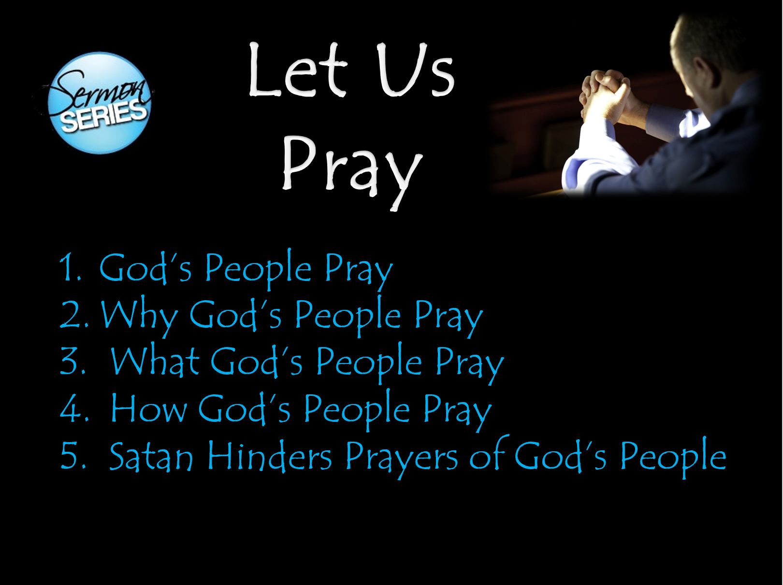
Objective:
When Series is Over:
More committed to praying
Praying more
More fervent
Praying for more things

Slide 3
God’s People Pray
Review – Lesson 1
Privilege of Prayer Belongs to God’s People
Assurance that God Hears & Answers Their Prayer
Examples of God’s People Praying

Slide 4
Why God’s People Pray
Review – Lesson 2
The Need to Pray
The Power of Prayer

Slide 5
Let Us
Pray
God’s People Pray
Why God’s People Pray
What God’s People Pray
How God’s People Pray
Satan Hinders Prayers of God’s People

Slide 6
What God’s People Pray
Bible says very little about what NOT to pray about
  1 John 5:16 – one who sinned unto death
  Jer. 7:16 – idolatrous Judah
Can & should pray “in everything” (Phil. 4:6)
  Every situation should be viewed as an occasion for prayer
  Not just that we can pray for “just anything”
  It is true – that in many ways prayer is unlimited

Slide 7
Some Beginning Principles
According to God’s will (1 John 5:14-15)
With the right motive (Jas. 4:3)
Prayer can vary in length
  Can be long (Luke 6:12)
  Can be short (Matt. 26:39, 42)
Pray for definite / specific things
  Often, we pray in general terms (request & thanks)
  Elijah made specific request (Jas. 5:17-18)
  Jesus prayed especially for Peter (Luke 22:31-32)

Slide 8
1 Tim 2:1
“Therefore I exhort first of all that supplications, prayers, intercessions, and giving of thanks be made for all men”
Supplications
Prayer
Intercession
Thanks

Slide 9
What God’s People Pray
Supplications

Slide 10
Supplication
Defined
  “A petition” (Strong’s)
  “A seeking, asking, entreating, entreaty” (Thayer)
  “Urgent request to meet a need” (BDAG)
  “Prayers for averting evils of every kind” (Clarke)

Slide 11
Supplication
Defined
Includes praying about:
  Temptation (Matt. 6:13; Mark.14:38; 2 Cor. 13:7)
  Strength to overcome weakness (Heb. 4:16)
  Physical problems (Matt. 24:20; Jas. 5:13; Acts 12:5)
  Protection and care (Matt. 24:20)
  Faith not fail (Luke 22:31-32)

Slide 12
What God’s People Pray
Supplications
Prayers

Slide 13
Prayers
Defined
  “Prayer addressed to God” (Thayer)
  “Petition addressed to deity, prayer” (BDAG)
  “Prayers for obtaining the good things, spiritual and temporal, which ourselves need” (Clarke)

Slide 14
Prayers
Defined
Includes
  Praise
    Model prayer begins & ends with praise (Mt. 6:9, 13)
    Examples of praise:
      1 Chron. 29:11
      Jer. 32:17
      Psa. 104:1
      Isa. 40:12, 15-16
      Rev. 4:8, 11

Slide 15
Prayers
Defined
Includes
  Praise
  Request
    Wisdom (Jas. 1:5)
    Furtherance of gospel (2 Thess. 3:1; Col. 4:3)
    Forgiveness of sins (Acts 8:22)
    Temporal –daily needs (Matt. 6:9-13)
    God will be done (Matt. 6:10; 26:39)
    Opportunities (Col. 4:3)
    Convenient conditions (Matt. 24:20; Mark 13:18)

Slide 16
What God’s People Pray
Supplications
Prayers
Intercession

Slide 17
Intercession
Defined
  Plea to God on behalf of others
  “to speak to someone on behalf of someone else” (Louw-Nida)
  Same root word used reference to Christ (Rom. 8:34)

Slide 18
Intercession
Defined
Can be more specific
  Rather than
    Pray for all for whom it is our duty to pray
    Pray for all the sick
  Lord prayed for Peter (Luke 22:31-32)
  Paul prayed for brethren specifically
    For brethren at Rome (Rom. 1:8-10)
    For brethren at Corinth (1Cor. 1:4)
    For brethren at Ephesus (Eph. 1:16-17)
    For brethren at Philippi (Phil. 1:3-7)
    For brethren at Colossae (Col. 1:3-4; 9-10)
    For brethren at Thessalonica (1 Thess. 1:2-3)

Slide 19
Intercession
Defined
Can be more specific
Include:
  Brethren
    Growth & development (Phil. 1:9; Col. 1:9; 4:12; 2 Thess. 1:11)
    When they have sinned (Jas. 5:16; 1 John 5:16; Acts 8:18-24)
  Enemies (Matt. 5:44-46; Acts 7:60; Luke 23:34)
  Rulers (1 Tim. 2:2)
  Sinners (Rom. 10:1)
  Sick (Jas. 5:13; 3 John 2)
  Elders & Preachers (2 Thess. 3:1-2; Heb. 13:18)

Slide 20
What God’s People Pray
Supplications
Prayers
Intercession
Thanks

Slide 21
Thanks
Defined
  Expressing of thanks
  For spiritual & material (Col. 3:17; Phil. 4:6)
  God’s people are thankful (1 Chron 16:8; Psa. 107:1)

Slide 22
Thanks
Defined
Includes:
  Spiritual
    God’s love (John 3:16)
    Sacrifice of Christ – Blood (Matt. 26:28)
    Remission of sins (Acts 2:38)
    Hope of eternal life (Titus 2:1)
    Clear conscience (1 Pet. 3:21)
    Privilege of prayer (1 Pet. 5:7)
    Mediator to plead our cause (Heb. 7:25)
    Revelation of word (2 Tim. 3:16-17)

Slide 23
Thanks
Defined
Includes:
  Spiritual
  People
    Brethren (1 Cor. 1:4; 1 Thess. 1:2)
    Family (parents, children, mates, etc.)
    Friends
    Elders, Deacons, Teachers, Preachers

Slide 24
Thanks
Defined
Includes:
  Spiritual
  People
  Material / Physical
    Food (Matt. 15:36; Luke 24:30; Acts 27:35)
    Clothing – Shelter – Health
    Money – Cars – Household furnishings
    Modern conveniences: (hot water; heat & air; electric lights; appliances; electronics – communication, etc.)
    Country – Freedoms we have

Slide 25
Thanks
Defined
Includes:
  Spiritual
  People
  Material / Physical
  Troubles
    Mature us
    Help us develop patience
    Learn & grow…

Slide 26
What God’s People Pray
Supplications
Prayers
Intercession
Thanks

