Slide 2
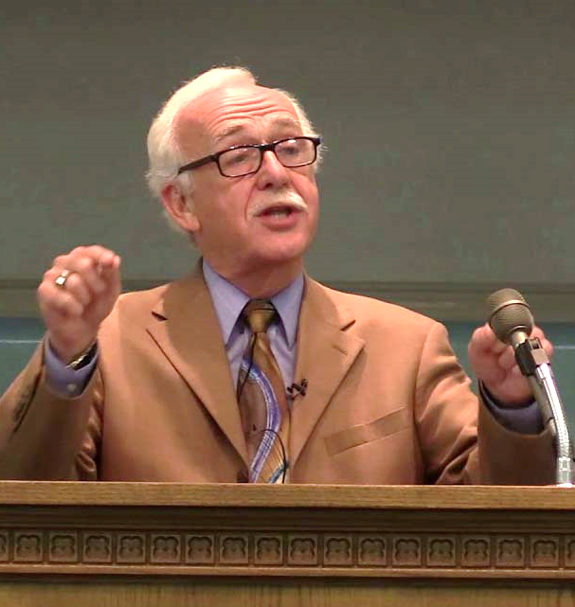
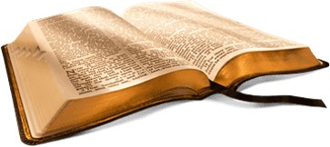
Gospel Meeting
1 ½
Weeks
Away
October 5-9, 2022
Jesus, Who Can This Be?
(Mark 4:41)
Wednesday – Saturday 7:00 PM
Sunday 9:00 AM
Sunday 9:50 AM
Sunday 5:30 PM
J. R. Bronger
El Bethel Church of Christ
1801 Highway 41-A North ♦ Shelbyville, TN 37160
www.elbethelchurchofchrist.com

Slide 3


Quiet Please
Let us all prepare to worship the Almighty God!

Slide 5

The First Principles
The first principles are the foundation we build upon (Heb.6:1; cf. 5:12)
We are in danger if we neglect or forget the basics (Heb. 5:12-14)
Irven Lee once advised me: “Remember, that in school we teach first grade every year.”

Slide 6
John 3:3, 5
3 Jesus answered and said to him, "Most assuredly, I say to you, unless one is born again, he cannot see the kingdom of God."
5 Jesus answered, "Most assuredly, I say to you, unless one is born of water and the Spirit, he cannot enter the kingdom of God.

Slide 7
“Must be born again”
Most of “Christianity” claims to be born again
Much confusion about what it means:
  Holy Spirit baptism
  Work of purification by the Spirit to change our will
  Natural / physical birth
  Water = Spirit
What is the new birth? Can we understand?

Slide 8
The
New Birth
The
New Birth
John 3:3, 5

Slide 9
The New Birth
The New Birth
A Teacher from God Demands New Birth

Slide 10
A Teacher From God Demands New Birth
Nicodemus comes to Jesus (vv. 1-2)
  Pharisee, religious, & probably of Sanhedrin
  Teacher (v. 10), a rabbi
  Came to Jesus by night. Why? (Not sure)
    John 7:50-52 – defended Jesus – not committed
    John 19:38-39 - possible parallel
  Concluded: teacher from God – since miracles

Slide 11
A Teacher From God Demands New Birth
Nicodemus comes to Jesus (vv. 1-2)
Jesus teaches on the New Birth (vv. 3-7)
  Born again – to enter kingdom (v. 3)
2. Nicodemus questions: how can be born when old (v. 4)?
3. Born of water & Spirit – to enter kingdom (v. 5)
4. This is a spiritual birth (vv. 6-7)

Slide 12
A Teacher From God Demands New Birth
Nicodemus comes to Jesus (vv. 1-2)
Jesus teaches on the New Birth (vv. 3-7)
Explanation of the New Birth (vv. 8-12)
1. This is not a fleshly birth (v. 8)

Slide 13
“8. The wind blows where it wishes, and you hear the sound of it, but cannot tell where it comes from and where it goes. So is everyone who is born of the Spirit."
Comparison:
  Not: new birth & the wind
  Is: wind & one born again
Nicodemus had objected on basis that he didn’t understand
  Ought not object – can’t see where….
Refutes the idea that this is physical birth
  Unseen part of man that is born
  Don’t see physical changes – see only effects

Slide 14
A Teacher From God Demands New Birth
Nicodemus comes to Jesus (vv. 1-2)
Jesus teaches on the New Birth (vv. 3-7)
Explanation of the New Birth (vv. 8-12)
  This is not a fleshly birth (v. 8)
  Nicodemus asked how this could be (v. 9)
    Seems perplexed – how could he (a ruler) not be in kingdom
    Jews felt that being a Jew = child of God (Jno. 8:33f; Rom 9:6)

Slide 15
A Teacher From God Demands New Birth
Nicodemus comes to Jesus (vv. 1-2)
Jesus teaches on the New Birth (vv. 3-7)
Explanation of the New Birth (vv. 8-12)
  This is not a fleshly birth (v. 8)
  Nicodemus asked how this could be (v. 9)
  Jesus answers (vv. 10-12)
    Being a teacher ought to know (Deut. 18:18; Jer. 31:31f)
    Credible witnesses – yet do not accept
    If not accept earthly things (what he must do) – not accept heavenly things (learned by revelation – i.e. vv. 13ff)

Slide 16
The New Birth
The New Birth
A Teacher from God Demands New Birth
Its Meaning is Simple

Slide 17
The Meaning is Simple
A spiritual birth
  Verse 6 – Born of Spirit – spiritual birth
  Verse 8 –
    Comparison is not Wind to new birth, but of Wind to one born
    Can’t see wind – but the effects
    Can’t see part of man that is born again

Slide 18
The Meaning is Simple
A spiritual birth
Obedience to the truth
  To enter the kingdom
    Verses 3, 5
    Parallel verses: Matt. 7:21; 18:3

Slide 19
The Meaning is Simple
A spiritual birth
Obedience to the truth
  To enter the kingdom
  Where new life begins
    When baptized (Rom. 6:3-4)
    When in Christ (2 Cor. 5:17)

Slide 20
The Meaning is Simple
A spiritual birth
Obedience to the truth
  To enter the kingdom
  Where new life begins
  1 Peter 1:23
    Redeemed by the blood (vv. 18-19)
    Purified souls (v. 22)
    By obeying truth (v. 22)
    Born again (v. 23)

Slide 21
1 Peter 1:22-23
22 Since you have purified your souls in obeying the truth through the Spirit in sincere love of the brethren, love one another fervently with a pure heart,
23 having been born again, not of corruptible seed but incorruptible, through the word of God which lives and abides forever,

Slide 22
The Meaning is Simple
A spiritual birth
Obedience to the truth
  To enter the kingdom
  Where new life begins
  1 Peter 1:23
  Parallel Passages

Slide 23
John 3:5 | Water | Spirit | Kingdom

Slide 24
John 3:5 | Water | Spirit | Kingdom
1 Cor. 12:13 | Baptized | By One Spirit | Into One body

Slide 25
John 3:5 | Water | Spirit | Kingdom
1 Cor. 12:13 | Baptized | By One Spirit | Into One body
Titus 3:5 | Washing of Regeneration | Renewing of Holy Spirit | Saved

Slide 26
John 3:5 | Water | Spirit | Kingdom
1 Cor. 12:13 | Baptized | By One Spirit | Into One body
Titus 3:5 | Washing of Regeneration | Renewing of Holy Spirit | Saved
Eph. 5:26 | Washing of Water | By Word | Cleanse
Baptized
by Inst.
of Word
Saved

Slide 27
The New Birth
The New Birth
A Teacher from God Demands New Birth
Its Meaning is Simple
The Key Elements

Slide 28
The Key Elements
Water
Spirit
Water – Baptism
  Some think refers to the Spirit – Absurd
  What word could have been used to mean “water”?
  The connection that “water” has to the kingdom is baptism (Acts 8:36-ff; 10:47)

Slide 29
The Key Elements
Water
Spirit
Water – Baptism
Spirit – Led by Spirit through word
  Spirit revealed the word (Eph. 3:3-5)
  Spirit uses the word to accomplish task (Eph. 6:17)
  Born of Spirit (John 3:5), but begotten through gospel (1 Cor. 4:15)

Slide 30
The New Birth
The New Birth
A Teacher from God Demands New Birth
Its Meaning is Simple
The Key Elements
The Change One Experiences

Slide 31
The Change One Experiences
Enter the kingdom
  Saved (Col. 1:13, 14)
  In Church (Matt. 16:18-19)

Slide 32
The Change One Experiences
Enter the kingdom
Become God’s Child
  Now for the first time – God is our Father (Rom. 1:7; 1 Thess. 1:1; 2 Thess. 1:2)
  We are his sons – children (1 John 3:2)
  We are now heirs (Rom. 8:17-ff)

Slide 33
The Change One Experiences
Enter the kingdom
Become God’s Child
A Change in life
  Born “anew”
  Begin a new life – start over
  Other figures
    Adoption (Rom. 8:15)
    Marriage (Rom. 7:4)
    Grafting (Rom. 11:24)

Slide 34
The New Birth
The New Birth
A Teacher from God Demands New Birth
Its Meaning is Simple
The Key Elements
The Change One Experiences
How Can One Be Born Again?

Slide 35
How Can One Be Born Again?
Hear (Acts 18:8) – the teachings of the Spirit
Believe (John 3:16) – the teachings of the Spirit
Repent (Acts 17:30-31)
Confess (Rom. 10:9-10)
Be Baptized (John 3:5)

Slide 36
The New Birth
The New Birth
A Teacher from God Demands New Birth
Its Meaning is Simple
The Key Elements
The Change One Experiences
How Can One Be Born Again?

