Slide 1
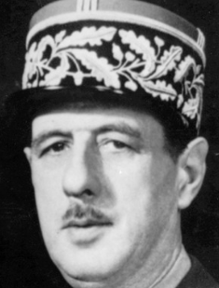
“I grew up to always respect authority and respect those in charge.”
- Charles de Gaulle

Slide 2
The Bible Teaches Us to Respect
Authority and Those In Charge

Slide 3
Many of the Problems of Society
Due to Little or No Respect for Authority
Children misbehave & out of control
Students disrespectful to school officials
Destructive protest
Anti-police marches
Hatred toward government officials
Division within the local church
Churches practice anything that seems good
Lose our children to the world

Slide 4
Without a System of Authority
Utter Chaos
No government
No leadership
No laws – not justice
No protection

Slide 5
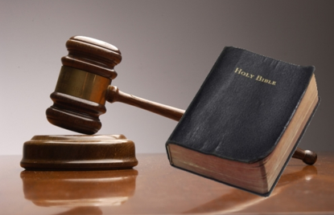
Respect for
Authority
Respect for
Authority
The Foundation of All Authority
The Foundation of All Authority

Slide 6
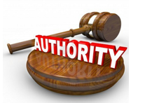
The Foundation of All Authority
God, Because He is God has Authority
  God (Exo. 3:14; Rev. 4:8)
  Creator (Gen. 1:1; Heb. 3:4)
  Infinite wisdom (Isa. 55:8-9)
  Has all authority (Matt. 28:18)

Slide 7
The Foundation of All Authority
God, Because He is God has Authority
God’s Word is Authoritative
  Inspired (2 Tim. 3:16-17)
  Violation of it = sin (1 John 3:4)
  Taught with authority (Tit. 2:15)
  Can’t alter (Rev. 22:18-19)
  Judged by it (John 12:48)

Slide 8
The Foundation of All Authority
God, Because He is God has Authority
God’s Word is Authoritative
Order of Authority

Slide 9
1 Cor 11:3
“But I want you to know that the head of every man is Christ, the head of woman is man, and the head of Christ is God.”
God
(Father)
Christ
(son)
Man
Woman

Slide 10
The Foundation of All Authority
God, Because He is God has Authority
God’s Word is Authoritative
Order of Authority
God’s Authority is the Foundation of All Authority
  Any authority that anyone has – because of God’s authority (i.e. government officials, Rom. 13)
  Respecting or rejecting authority of others – comes back to this foundation.

Slide 11
To Reject / Rebel = Ultimate Rejection of God
Parents
Husband
God
Employer
Civil Auth.
Elders

Slide 12
Respect for
Authority
Respect for
Authority
The Foundation of All Authority
The Areas of Application
The Areas of Application

Slide 13
The Areas of Application
Authority of Christ & His Word (Eph. 5:24)
  As individual Christians – mold our lives to his will
  As churches – must have authority for all we practice
    Col. 3:17
    2 John 9

Slide 14
The Areas of Application
Authority of Christ & His Word (Eph. 5:24)
Authority of Husband (Eph. 5:22-24; 1 Pet. 3:1-6)
Authority of Parents (Eph. 6:1-4; Col. 3:20)
Authority of Employer (Eph. 6:5-8; Col. 3:22-24; Titus 2:9-10; 1 Pet. 2:18)
Authority of Civil Authorities (Rom. 13:1-7; Titus 3:1; 1 Pet. 2:13-17)
  Police, Judge, Government officials, etc.
Authority of Elders
  Have the oversight (Acts 20:28; 1 Pet. 5:1-4)
  Rule over (Heb. 13:7, 17)

Slide 15
Respect for
Authority
Respect for
Authority
The Foundation of All Authority
The Areas of Application
The Resistance to Direction
The Resistance to Direction

Slide 16
The Resistance to Direction
Rebellion Against Moses
  Exo. 17:3-7 – murmured against Moses
  Exo. 32:1, 23 – complain that Moses took too long
  Num. 11:1-ff – complain about food
  Num. 12:1-8 – Miriam & Aaron complain
  Num. 14:1-10 – Attempt to turn back to Egypt
  Num. 16:1-ff – Dathan, Korah, and Abiram rebel against Moses

Slide 17
The Resistance to Direction
Rebellion Against Moses
Disobedience of Saul (1 Sam. 15)
  Instructions (v. 3)
  Didn’t obey (vv. 7-9)
  Claimed to perform (vv. 13, 20)
    Even though he knew & admitted that hadn’t done all
    Thought obeying most of what God said was close enough
  Driven by peer pressure (v. 24)
  Rebellion & stubbornness (v. 23)
  Rejected by God (vv. 11, 19, 23)

Slide 18
Respect for
Authority
Respect for
Authority
The Foundation of All Authority
The Areas of Application
The Resistance to Direction
The Meaning of Submission
The Meaning of Submission

Slide 19
The Meaning of Submission
Does Not Mean:
  One submitting is inferior (1 Cor. 11:1-3, 11-12; 1 Pet. 3:7)
  One submitted to is wiser (1 Pet. 3:1-2)
  Bound to follow without exception (Acts 5:29)

Slide 20
The Meaning of Submission
Does Not Mean:
Does Mean:
  You are submitting to God (Col. 3:23; 1 Pet. 3:1-ff)
  Honor and respect those that lead
    Rom. 13:7 – honor to whom honor
    Eph. 5:33 – wives see reverence husband
    1 Pet. 2:17 – honor the king

Slide 21
Respect for
Authority
Respect for
Authority
The Foundation of All Authority
The Areas of Application
The Resistance to Direction
The Meaning of Submission

