Slide 1
Have you ever been told you were a “pain”?
  Worse: given you nickname “pain”?
  What if named “Pain” by your own mother?
Bible tells about such a man
Only mentioned once
Relatively unknown
What little we do know – is a prayer he offered
His name is Jabez

Slide 2
1 Chronicles 4:9-10
9 Now Jabez was more honorable than his brothers, and his mother called his name Jabez, saying, “Because I bore him in pain.”
10 And Jabez called on the God of Israel saying, “Oh, that You would bless me indeed, and enlarge my territory, that Your hand would be with me, and that You would keep me from evil, that I may not cause pain!” So God granted him what he requested.

Slide 3
1 Chronicles 4:9-10
9 Now Jabez was more honorable than his brothers, and his mother called his name Jabez, saying, “Because I bore him in pain.”
10 And Jabez called on the God of Israel saying, “Oh, that You would bless me indeed, and enlarge my territory, that Your hand would be with me, and that You would keep me from evil, that I may not cause pain!” So God granted him what he requested.
Only place he is mentioned
Easily overlooked – for his name is located in a “dry mass of dead names”
Must have been well known to those for whom Chronicles was intended
“Jabez” (1 Chron. 2:55) is a city (perhaps named after him)
What little we do know – encourages us – worthy of our attention

Slide 4
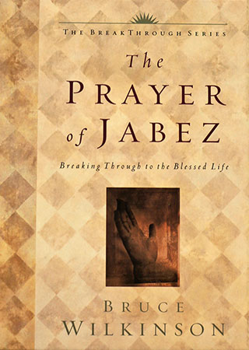
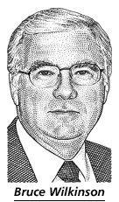
Bruce Wilkinson’s Popular Book
Brought Attention to Jabez
Published 2000

Slide 5
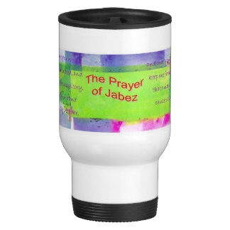
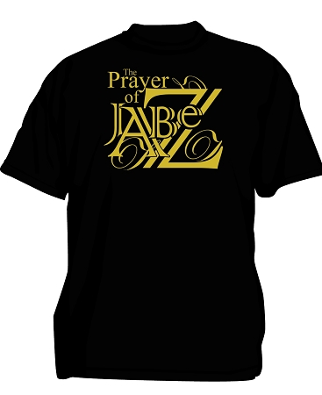
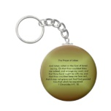
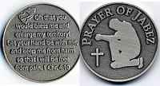
The Book Started A Religious Marketing
Phenomena

Slide 6
Prayer of Jabez
The Man

Slide 7
Named Because of Pain
  NKJV fn: “He will cause pain”
  Must have been far more than normal pain of childbirth (her other children not so named)
    May be that delivery was traumatic
    May be that pain was emotional
  Usually, the sorrow is soon afterwards forgotten – but she wanted to remember
    Perhaps to remember God’s bringing her through this extraordinary experience
    Maybe to teach young Jabez – what he could expect out of life – full of trouble
The Man

Slide 8
Named Because of Pain
Overcame His Difficulty
  Did not allow it to make him a coward – who wallowed in self-pity
  Didn’t seemed to focus all his attention on how terrible he had been done – to justify his lack…
  Didn’t allow his handicap to make him hard & cruel
  Didn’t surrender to bitterness and hate toward man or God
  Did do: brought his handicap to God!
  People who come from past difficulties & hardships – overcome and live honorably
    Turn from past life (1 Cor. 6:9-11)
    Forget the past (Phil. 3:13-14)
    Become different from the past (1 Th. 1:9)
The Man

Slide 9
Named Because of Pain
Overcame His Difficulty
Honorable Man
  Refers to how God viewed him
  Honorable people are long remembered (Prov. 10:7; Psa. 112:6)
  More honorable than his brothers
  Jabez wanted to be more and do more for God
  Qualities of an honorable man:
    Life of prayer
      About all we do know about Jabez
      Phil. 4:6; 1 Thess. 5:17-18
    Up right in dealing with others (1 Pet. 2:12)
    Deep respect for God (Ecc. 12:13)
    Righteous – lives right (Jas. 5:16)
The Man

Slide 10
Prayer of Jabez
The Man
His Prayer

Slide 11
1 Chronicles 4:9-10
9 Now Jabez was more honorable than his brothers, and his mother called his name Jabez, saying, “Because I bore him in pain.”
10 And Jabez called on the God of Israel saying, “Oh, that You would bless me indeed, and enlarge my territory, that Your hand would be with me, and that You would keep me from evil, that I may not cause pain!” So God granted him what he requested.

Slide 12
1 Chronicles 4:9-10
9 Now Jabez was more honorable than his brothers, and his mother called his name Jabez, saying, “Because I bore him in pain.”
10 And Jabez called on the God of Israel saying, “Oh, that You would bless me indeed, and enlarge my territory, that Your hand would be with me, and that You would keep me from evil, that I may not cause pain!” So God granted him what he requested.

Slide 13
Bless Me
  Request for personal blessing / favor
  Nothing wrong with asking God to bless you specifically
  Not selfish to continually ask God – in fact we are taught to ask (Matt. 6:9-13)
  We need to ask for physical blessings (Phil. 4:19)
  We need to ask for spiritual blessings (Acts 3:26)
  “Indeed” adds emphasis – bless me a lot!
  Perhaps one reason – don’t feel blessed as others – we don’t ask (Jas. 4:2)
    Should not confuse “thinking” or “wishing”
    Prayer involves talking to God – expressing our thoughts (Rom. 10:1)
His Prayer

Slide 14
1 Chronicles 4:9-10
9 Now Jabez was more honorable than his brothers, and his mother called his name Jabez, saying, “Because I bore him in pain.”
10 And Jabez called on the God of Israel saying, “Oh, that You would bless me indeed, and enlarge my territory, that Your hand would be with me, and that You would keep me from evil, that I may not cause pain!” So God granted him what he requested.

Slide 15
Bless Me
Enlarge My Territory
  Not a selfish request – to have what others have
  Request for the promise land inheritance (Exo. 34:24; Deut. 12:20)
  Asking for material blessing (cf. Matt. 6:11)
  No promise of “Health & Wealth” if serve God – rather that will be blessed (Matt. 6:33)
  Should ask God to enlarge what he promises to us:
    Material necessities
    Opportunities
    Talents / Abilities
    Wisdom
  Ask to increase the influence of our families (“single most powerful arena on earth”)
His Prayer

Slide 16
1 Chronicles 4:9-10
9 Now Jabez was more honorable than his brothers, and his mother called his name Jabez, saying, “Because I bore him in pain.”
10 And Jabez called on the God of Israel saying, “Oh, that You would bless me indeed, and enlarge my territory, that Your hand would be with me, and that You would keep me from evil, that I may not cause pain!” So God granted him what he requested.

Slide 17
Bless Me
Enlarge My Territory
Hand Be With Me
  Asking for God’s providential hand of protection and guidance (cf. Ezra 7:9; Josh. 4:24)
  First century Christians could hope for God’s hand to help them (Matt. 24:20)
  When we pray it is a request for his hand of guidance (1 Pet. 5:7; Psa. 119:173)
  How he guides:
    Help us to see what word says
    Learn from wisdom of others (Prov. 11:14)
His Prayer

Slide 18
1 Chronicles 4:9-10
9 Now Jabez was more honorable than his brothers, and his mother called his name Jabez, saying, “Because I bore him in pain.”
10 And Jabez called on the God of Israel saying, “Oh, that You would bless me indeed, and enlarge my territory, that Your hand would be with me, and that You would keep me from evil, that I may not cause pain!” So God granted him what he requested.

Slide 19
Bless Me
Enlarge My Territory
Hand Be With Me
Keep Me From Evil
  Not be led into temptation (Matt. 6:13)
  Kept away from:
    Evil influences (Deut 31:20; Prov. 30:8-9)
    Anything / anyone who tempt (Prov. 5:8)
    Those who are not righteous (2 Thess. 3:2)
  One way – grow spiritually stronger (2 Pet. 3:18)
His Prayer

Slide 20
1 Chronicles 4:9-10
9 Now Jabez was more honorable than his brothers, and his mother called his name Jabez, saying, “Because I bore him in pain.”
10 And Jabez called on the God of Israel saying, “Oh, that You would bless me indeed, and enlarge my territory, that Your hand would be with me, and that You would keep me from evil, that I may not cause pain!” So God granted him what he requested.

Slide 21
Bless Me
Enlarge My Territory
Hand Be With Me
Keep Me From Evil
That I Might Not Cause Pain
  As my name prophetically suggest
  Evil leads to pain (Gal. 6:9)
  Cause pain to others (Exo. 34:7)
  Possible that our conduct / behavior causes pain / heartache to others (Gen. 26:35)
  May I not be the cause of another’s heartache!
His Prayer

Slide 22
Prayer of Jabez
The Man
His Prayer
God’s Answer

Slide 23
God Granted His Request (v. 10)
  Blessed
  Territory was enlarged
  Hand of God was with him
  Kept from evil
  Did not cause pain
What a Difference in the Way His Life Began and Turned Out to be!
God’s Answer

Slide 24
God Granted His Request (v. 10)
God Answers Prayer – Powerful Tool
  1 Pet. 3:12
  Jas. 5:16
  Eph. 3:20
  1 John 5:14-15
God’s Answer

Slide 25
Prayer of Jabez
The Man
His Prayer
God’s Answer

