Slide 1
Life is Full of Problems
Job 14:1 – man is of few days and full of trouble
Problems come in a variety of packages
  Sin is the first and greatest problem
  Problem with self
  Family problems
  Sickness, disease, tragedy and death
  Financial problems
  Church problems

Slide 2
Life is Full of Problems
Job 14:1 – man is of few days and full of trouble
Problems come in a variety of packages
Tendency to ask, “Why me Lord?” when dealt bad hand
  “What have I done to deserve this?”
  “Why did God let this happen?”
  “Why am I being punished?”

Slide 3
Life is Full of Problems
Job 14:1 – man is of few days and full of trouble
Problems come in a variety of packages
Tendency to ask, “Why me Lord?” when dealt bad hand
Seldom do we ask:
  “Why not me?” – when it comes to problems
  “Why me?” – when we receive good or are blessed

Slide 4
Why
Me
Lord?

Slide 5
Why Me Lord?
Why
Me
Lord

Slide 6
Why Me Lord?
Why
Me
Lord
Reasons for the Problems

Slide 7
Why
Reasons for the Problems
Consequences of sin in the beginning
  Death & disease came as consequence of sin (Gen. 2:17)
  1 Cor. 15:22, 55-56
  Reason we have sickness, aches, pains, suffering and death is that sin is in the world

Slide 8
Why
Reasons for the Problems
Consequences of sin in the beginning
Consequences of our own sin
  1 Pet. 4: 15-16 – suffer as a murderer, etc.
  Prov. 13:15 – way of transgressor is hard
  Reap what we sow
    Gal. 6:7-9
    Hosea 8:7 sow to wind and reap whirlwind

Slide 9
Why
Reasons for the Problems
Consequences of sin in the beginning
Consequences of our own sin
Consequences of others’ sin
  Exo. 20:5-6 – consequences visited to 3rd & 4th gen.
  Matt. 5:32 – man puts away wife – she can’t remarry
  Ezra 10:44 – children suffered because of parents

Slide 10
Why
Reasons for the Problems
Consequences of sin in the beginning
Consequences of our own sin
Consequences of others’ sin
For the cause of Christ
  1 Pet. 4:16 – suffer as a Christian
  Heb. 12:5-ff – persecution = chastening of Lord
  2 Tim. 3:12 – all that are godly will suffer

Slide 11
Why
Reasons for the Problems
Consequences of sin in the beginning
Consequences of our own sin
Consequences of others’ sin
For the cause of Christ
Violation of natural law
  Gravity is good – yet if fall may get hurt or die
  Fire is good for cooking or heating – yet can burn body or house
  Can’t have good without there also being bad
    If possible to feel good – then possible to feel bad
    If possible have good marriage – then possible bad

Slide 12
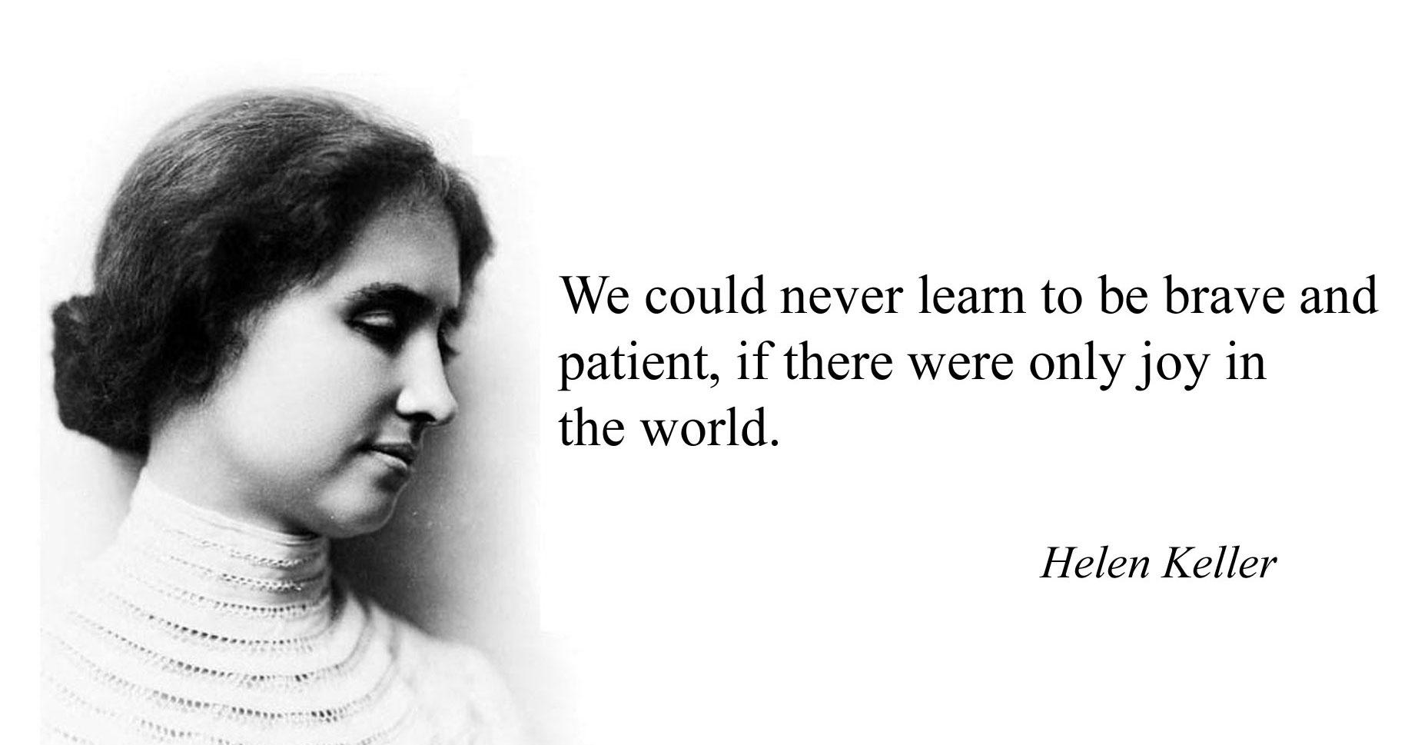

Slide 13
Why
Reasons for the Problems
Consequences of sin in the beginning
Consequences of our own sin
Consequences of others’ sin
For the cause of Christ
Violation of natural law
Natural phenomena
  Earthquake, tornado, hurricane, lightening, and floods are all natural occurrences
  Suffering caused by these are to any and all who are there

Slide 14
Why
Reasons for the Problems
Consequences of sin in the beginning
Consequences of our own sin
Consequences of others’ sin
For the cause of Christ
Violation of natural law
Natural phenomena
Free will of man
  If man has a choice – can make the wrong choice
  Otherwise, we would be robots at God’s direction
  Choices mean there are consequences – that may bring grief and suffering

Slide 15
Why Me Lord?
Why
Me
Lord
Reasons for the Problems
The One Who Suffers

Slide 16
Me
The One Who Suffers
All men suffer
  1 Pet. 4:15-16 – evil doers and Christians
  Rom. 8:22 – whole creation groans

Slide 17
Me
The One Who Suffers
All men suffer
Righteous suffer too
  Job
    Blameless and upright (1:8)
    Yet he suffered:
      Loss of property (1:14, 16, 17)
      Loss of servants (1:15, 18)
      Loss of children (1:18)
      Loss of health (2:1-10)
      Wife no help (2:9)
      Friends turned on him (3 – 42:6)

Slide 18
Me
The One Who Suffers
All men suffer
Righteous suffer too
  Job
  David (Psa. 55:1-7)
  The Lord himself
    Rejected (John 1:11)
    Beaten (Matt. 26:67)
    Ridiculed (Matt. 26:68; 27:31)
    Betrayed (Luke 22:47-53)
    Crucified (Luke 23:26-49)

Slide 19
Me
The One Who Suffers
All men suffer
Righteous suffer too
  Job
  David (Psa. 5:1-7)
  The Lord himself
  Paul
    Persecuted (2 Cor. 11:22-33)
    Thorn in the flesh (2 Cor. 12:7-10)

Slide 20
Me
The One Who Suffers
All men suffer
Righteous suffer too
  Job
  David (Psa. 5:1-7)
  The Lord himself
  Paul
  All Christians
    Heb. 12:6 – scourges every son
    2 Tim. 3:12 – all who live godly will suffer
    Rom. 8:16-18 – children of God will suffer

Slide 21
Why Me Lord?
Why
Me
Lord
Reasons for the Problems
The One Who Suffers
Blaming
God

Slide 22
Lord
Blaming God
God doesn’t want bad for man
  He wants all to be saved (1 Tim. 2:4; 2 Pet. 3:10)
  Gave his only Son for us (John 3:16)

Slide 23
Lord
Blaming God
God doesn’t want bad for man
Why do people blame God?
  Equate problems with punishment for sin
    This is an old misconception
      John 9:1 – disciples thought man blind due to his sin or his parents
      Acts 28:4 – natives of island thought Paul must be a murderer since snake bit him
      Job 3:1-ff – Job’s friends thought he must have done wrong

Slide 24
Lord
Blaming God
God doesn’t want bad for man
Why do people blame God?
  Equate problems with punishment for sin
    This is an old misconception
    Suffering is not due to our own sin
      Luke 13:1-5
      Job
      Heb. 4:15
      1 Pet. 2:19-ff possible to suffer wrongfully

Slide 25
Lord
Blaming God
God doesn’t want bad for man
Why do people blame God?
  Equate problems with punishment for sin
  Too high an opinion of self
    Seen in “What did I do to deserve this…?”
    The “Why me” questions suggest that we think we have lived in a way to deserve better

Slide 26
Lord
Blaming God
God doesn’t want bad for man
Why do people blame God?
  Equate problems with punishment for sin
  Too high an opinion of self
  Selfish
    Focus is only on self
    If others suffer – that’s fine (and understandable) – but not me!

Slide 27
Lord
Blaming God
God doesn’t want bad for man
Why do people blame God?
  Equate problems with punishment for sin
  Too high an opinion of self
  Selfish
  Removes guilt
    As in dealing with others – if we can point a finger of blame, we feel less guilty ourselves
    So here, if I blame God, we remove any responsibility that I have

Slide 28
Why Me Lord?
Why
Me
Lord
Reasons for the Problems
The One Who Suffers
Blaming
God

Slide 29
All men suffer
For various reasons
Cannot blame God

