Slide 1
Does It Matter?
What we believe?
About Authority?
Which Church?
Which Church of Christ?
About Fellowship?

Slide 2
Does It Matter
Which Church?
Common ideas:
  “One church is as good as another”
  “All churches lead to the same place – heaven”
  “I can serve God on my own without attending church”
Most in world – think church is not important at all
  Only 22% of Americans go to church every week (2021)*
  “Don’t need to be a part of organized religion”
  “It is the man – not the plan”
*statista.com

Slide 3
Does It Matter
Which Church?
Why the Church is Important

Slide 4
Why the Church is Important
It is God’s Eternal Purpose
  God has an eternal purpose
    Eph. 1:4, 9-11
    Eph. 3:10-11
  The church is that eternal purpose
    Eph. 3:10-11
    Eph. 2:13, 16 – the church = the saved
    Not: part of God’s eternal purpose – it is his eternal purpose
    God planned it from all eternity

Slide 5
Why the Church is Important
It is God’s Eternal Purpose
What it is
  The saved
    Acts 2:47
Acts 2:47
praising God and having favor with all the people. And the Lord added to the church daily those who were being saved.

Slide 6
Why the Church is Important
It is God’s Eternal Purpose
What it is
  The saved
    Acts 2:47
    Eph. 5:23
    Eph. 2:16

Slide 7
Why the Church is Important
It is God’s Eternal Purpose
What it is
  The saved
  The body of Christ (Col. 1:18; Eph. 1:22-23)
  The bride of Christ (Eph. 5:22-27; Rev. 21:9)
  The kingdom of God (Matt. 16:18-19)

Slide 8
Why the Church is Important
It is God’s Eternal Purpose
What it is
Purchase Price
  Christ gave himself (Eph. 5:25)
  The blood of Christ (Acts 20:28)
  Estimate the value of anything by the price that was paid

Slide 9


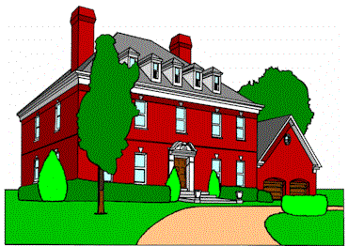
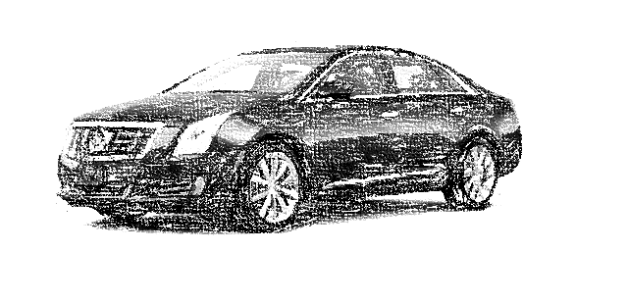
$120,000
$1,000
$750,000
$60,000
$120,000
To Ridicule the House – Ridicule the Price Paid!
To Ridicule the House – Ridicule the One Who Paid!

Slide 10
Why the Church is Important
It is God’s Eternal Purpose
What it is
Purchase Price
Built by Christ
  We buy products on the basis of the company that made the product
  The church was built by Christ
    Matt. 16:18
    Psa. 127:1
    Not by thoughts of man or plans of a group
    God planned it – Jesus established it

Slide 11
Does It Matter
Which Church?
Why the Church is Important
Why it Matters Which Church

Slide 12
Why it Matters Which Church
If it Make a Difference What One Believes
  Because churches teach different (contradictory) doctrines
  Because churches have different (contradictory) practices
  It makes a difference (2 Thess. 2:10-12)

Slide 13
2 Thess. 2:10-12
Lie Truth
Deceived (v.10)
Not love truth (v. 10)
Deluded (v. 11)
Believe lie (v. 11)
Not believe truth (v. 12)
Pleasure in unright. (v. 12)
Love truth (v. 10)
Believe truth (v. 12)
Perish (v. 10)
Condemned (v. 12)
Saved (v. 10)

Slide 14
Why it Matters Which Church
If it Make a Difference What One Believes
If Authority Matters
  Because some churches are doing things that are not authorized
    Teaching doctrines not in the Bible (1 Pet. 4:11)
    Practices not found in the Bible
  Authority matters
    Must have authority for all we teach and practice (Col.3:17)
    Must abide within doctrine of Christ (2 Jno. 9)

Slide 15
Why it Matters Which Church
If it Make a Difference What One Believes
If Authority Matters
There is Just One Church
  Common idea – many churches
    Denominationalism = division
    Idea is one church is as good as another
  The Bible speaks of ONE body
    Eph. 4:4
    Eph. 2:16
    1 Cor. 12:13
    One fold (John 10:16)
    Body = church (Eph. 1:22-23)

Slide 16
Three Simple Points:
Jesus only promised one (Matt. 16:18)
Paul said there is just one (Eph. 4:4)
The Bible is silent about any other!

Slide 17
Why it Matters Which Church
If it Make a Difference What One Believes
If Authority Matters
There is Just One Church
If Not, Any Church (No Matter What) Would Do
  The doctrine would not matter!
  The practice would not matter!
  The name would not matter!
  The head of the church would not matter!
  The organization would not matter!
  The purpose / work would not matter!

Slide 18
Why it Matters Which Church
If it Make a Difference What One Believes
If Authority Matters
There is Just One Church
If Not, Any Church (No Matter What) Would Do
God has a pattern for his church (Heb. 8:5)
  Purpose / mission (1 Tim. 3:15)
  Organization (Phil. 1:1)
  Creed: Christ (Heb. 1:1-2; Matt. 28:18-19)
  Worship (Acts 2:42; Acts 20:7; 1 Cor. 16:1-2)
  Teaching (1 Pet. 4:11; 2 Cor. 4:13)

Slide 19
Does It Matter
Which Church?
Why the Church is Important
Why it Matters Which Church

