Slide 1
Does It Matter?
What we believe?
About Authority?
Which Church?
Which Church of Christ?
About Fellowship?

Slide 2

Does It Matter
About Fellowship?
Common ideas:
  We can fellowship those who teach error – as long as we don’t teach or practice it ourselves
  Fellowship is merely a local church matter
  Fellowship doesn’t suggest agreement
The importance of fellowship

Slide 3
The Importance of Fellowship
Refuse to fellowship those we should
Extend fellowship to those we should not
(3 John 9-11)
(2 John 9-11)

Slide 4
Does It Matter
About Fellowship?
What is Fellowship?

Slide 5
Imperative That We Understand
What Bible Fellowship Is
Can we fellowship those that teach doctrinal error?
Can we fellowship those that practice sin?
Is food and fun fellowship?
Is fellowship merely a local church matter?

Slide 6
What is Fellowship?
The Meaning of Fellowship
  From the Grk: Koinonia
1 John 1:7
But if we walk in the light as He is in the light, we have fellowship with one another, and the blood of Jesus Christ His Son cleanses us from all sin.
κοινωνία

Slide 7
W.E. Vine
1. koinonia (κοινωνία, 2842), (a) “communion, fellowship, sharing in common” (from koinos, “common”), is translated “communion” in 1 Cor. 10:16; Philem. 6, rv, “fellowship,” for kjv, “communication”; it is most frequently translated “fellowship”; (b) “that which is the outcome of fellowship, a contribution,” e.g., Rom. 15:26; 2 Cor. 8:4. See communion, contribution, etc.
Note: In Eph. 3:9, some mss. have koinonia, instead of oikonomia, “dispensation,” rv.
3. koinonos (κοινωνός, 2844) denotes “a partaker” or “partner” (akin to No. 1); in 1 Cor. 10:20 it is used with ginomai, “to become,” “that ye should have communion with,” rv (kjv, fellowship with). See companion, partaker, partner.
Vine, W. E., Unger, M. F., & White, W., Jr. (1996). Vine’s Complete Expository Dictionary of Old and New Testament Words (Vol. 2, p. 233

Slide 8
Thayer’s Lexicon
“fellowship, association, community, communion, joint participation, intercourse; in the N. T. as in class, Grk.
the share which one has in anything, participation; w. gen. of the thing in which he shares:
2. intercourse, fellowship, intimacy: δεξιὰ κοινωνίας, the right hand as the sign and pledge of fellowship (in fulfilling the apostolic office)
3. a benefaction jointly contributed, a collection, a contribution, as exhibiting an embodiment and proof of fellowship
Thayer, J. H. (1889). A Greek-English lexicon of the New Testament (p. 352)

Slide 9
TDNT
κοινωνός means “fellow,” “participant.” It implies fellowship or sharing with someone or in something.
  Kittel, G., Bromiley, G. W., & Friedrich, G. (Eds.). (1964–). Theological dictionary of the New Testament (electronic ed., Vol. 3, p. 797). Grand Rapids, MI: Eerdmans.

Slide 10
Strong’s
κοινωνία kŏinōnia, koy-nohn-ee´-ah; from 2844; partnership, i.e. (lit.) participation, or (social) intercourse, or (pecuniary) benefaction:—(to) communicate (-ation), communion, (contri-) distribution, fellowship
κοινωνός kŏinōnŏs, koy-no-nos´; from 2839; a sharer, i.e. associate:—companion, × fellowship, partaker, partner.
Strong, J. (2009). A Concise Dictionary of the Words in the Greek Testament and The Hebrew Bible (Vol. 1, p. 42). Bellingham,

Slide 11
Dictionary of Biblical Languages
3126 κοινωνία (koinōnia), ας (as), ἡ (hē): n.fem.; ≡ Str 2842; TDNT 3.797—1. LN 34.5 fellowship, close mutual association (1Jn 1:3; 1Co 1:9); 2. LN 57.98 share, participation (2Co 8:4); 3. LN 57.101 willing contribution, gift (Ro 15:26+)
  Swanson, J. (1997). Dictionary of Biblical Languages with Semantic Domains: Greek (New Testament) (electronic ed.). Oak Harbor: Logos Research Systems, Inc.

Slide 12
Lexham Theological
Wordbook
κοινωνία (koinōnia). n. fem. fellowship, communion, sharing, participation. A term that conveys a sense of commonality, solidarity, and shared responsibility among households or individuals.
The most general sense of this term refers to a shared conviction that manifests itself as mutual responsibility and status….
Those who choose to willing engage in mutual responsibility are described as having “partnership” (koinōnia) with the body of Christ (1 Cor 10:16), the gospel (Phil 1:5), the Spirit (Phil 2:1), the sufferings of the Messiah (Phil 3:10), or, negatively, unbelievers (2 Cor 6:14).
Davis, D. L. (2014). Assembly, Religious. D. Mangum, D. R. Brown, R. Klippenstein, & R. Hurst (Eds.), Lexham Theological Wordbook. Bellingham, WA: Lexham Press.

Slide 13
What is Fellowship?
The Meaning of Fellowship
  From the Grk: Koinonia
  How it is translated

Slide 14
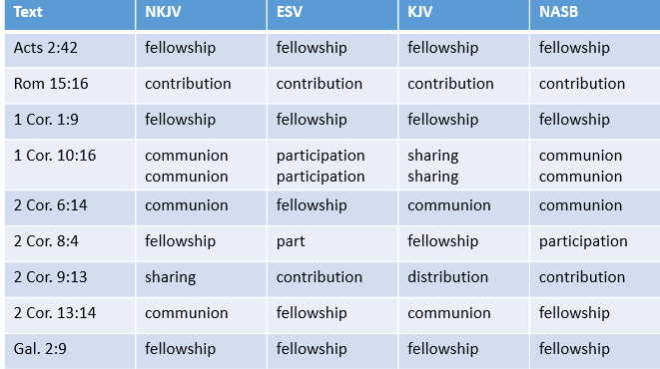

Slide 15
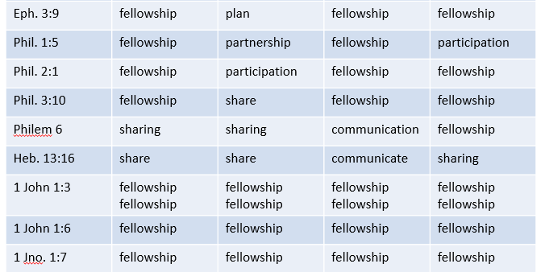

Slide 16
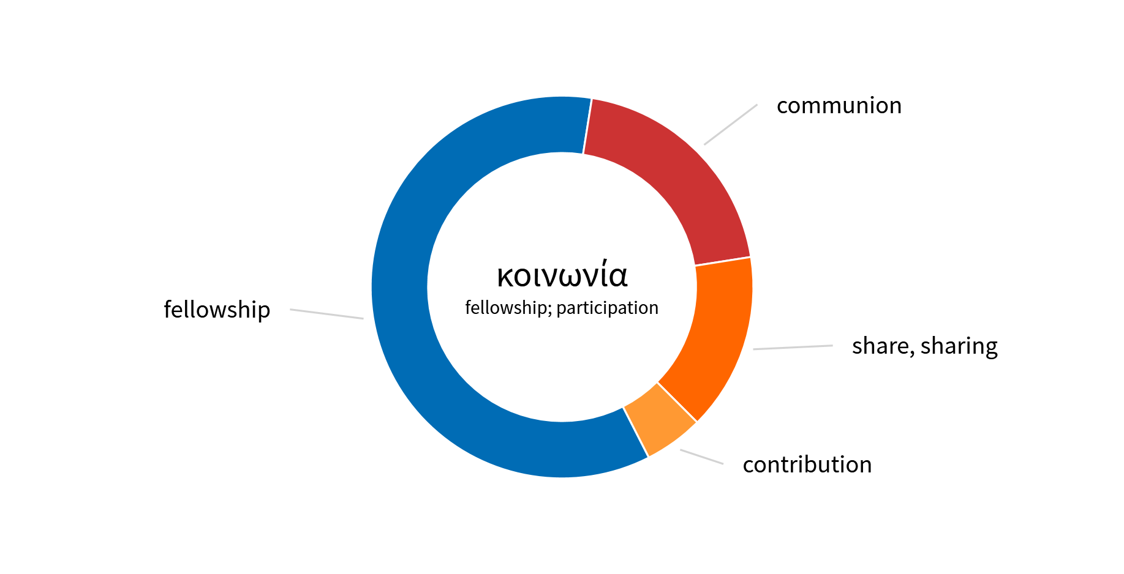
NKJV

Slide 17
Fellowship
Contribution
Communion
Part
Participation
Sharing
Partnership
Distribution
Communicate
KJV
NKJV
ESV
NASB

Slide 18
What is Fellowship?
The Meaning of Fellowship
  From the Grk: Koinonia
  How it is translated
  Summary

Slide 19
Fellowship
(Koinonia)
COMMUNION – Lord’s Supper (1 Cor. 10:16)
COMMUNITY - Sharing of goods (Acts 2:42)
CONTRIBUTION – For poor saints (Rom. 15:26)
COOPERATION – Extending right hand of fellowship (Gal. 2:9)

Slide 20
What is Fellowship?
The Meaning of Fellowship
  From the Grk: Koinonia
  How it is translated
  Summary
  Spiritual association based on agreement in principle

Slide 21
2 Corinthians 6:14–17
¹⁴ Do not be unequally yoked together with unbelievers. For what fellowship has righteousness with lawlessness? And what communion has light with darkness?
¹⁵ And what accord has Christ with Belial? Or what part has a believer with an unbeliever?
¹⁶ And what agreement has the temple of God with idols? For you are the temple of the living God. As God has said: “I will dwell in them And walk among them. I will be their God, And they shall be My people.”
¹⁷ Therefore “Come out from among them And be separate, says the Lord. Do not touch what is unclean, And I will receive you.”

Slide 22
2 Corinthians 6:14–17
¹⁴ Do not be unequally yoked together with unbelievers. For what fellowship has righteousness with lawlessness? And what communion has light with darkness?
¹⁵ And what accord has Christ with Belial? Or what part has a believer with an unbeliever?
¹⁶ And what agreement has the temple of God with idols? For you are the temple of the living God. As God has said: “I will dwell in them And walk among them. I will be their God, And they shall be My people.”
¹⁷ Therefore “Come out from among them And be separate, says the Lord. Do not touch what is unclean, And I will receive you.”
Common Work
Share in Action
koinonia
Harmony of thought
A part together with
others
A union of purpose
Thus:
Agreement in principle
leading to joint or common action in spiritual work

Slide 23
What is Fellowship?
The Meaning of Fellowship
The Direction of Fellowship
  Both vertical and horizontal

Slide 24

Fellowship is Both Vertical and Horizontal
God
1 John 1:3-6
1 John 1:7
Me
Another

Slide 25
What is Fellowship?
The Meaning of Fellowship
The Direction of Fellowship
  Both vertical and horizontal
  Vertical first – then horizontal

Slide 26
Fellowship is First Vertical then Horizontal
God
Before we fellowship another – first determine if they are in fellowship with God
  Acts 9:26-28
  1 Jno. 1:7 (cf. 2 Jno 4; 3 Jno 3)
  1 Jno. 2:4 – keeps commands
1
Me
2
Another

Slide 27
Fellowship is First Vertical then Horizontal
God
Before we fellowship another – first determine if they are in fellowship with God
Any movement / effort to unite without regard to teaching & practice – misses 1 John
Question is not: how can I be united with brethren? – but are we both in fellowship with God?
1
Me
2
Another

Slide 28
Does It Matter
About Fellowship?
What is Fellowship?
The Basis for Fellowship

Slide 29
The Basis for Fellowship
Truth is the Basis for Unity
  John 17:20-21 – Jesus prayed for unity
    Verse 6 – “…kept your word”
    Verse 17 – “Your word is truth”
    Verse 20 – “believe in Me through their word.”

Slide 30
The Basis for Fellowship
Truth is the Basis for Unity
  John 17:20-21 – Jesus prayed for unity
  1 Cor. 1:10 – Answer to division at Corinth
    All speak the same thing
    Same mind (cf. 2:16 – revelation of Christ)
    Same judgment (cf. Acts 20:3 - conclusion)

Slide 31
The Basis for Fellowship
Truth is the Basis for Unity
Truth is the Basis for Fellowship
  1 John 1:1-7
    Verses 1-5 – Rev. delivered by faithful witnesses
    Verse 6 - Rev. basis of truth
    Verse 7 – Rev. basis for fellowship
  1 John 2:3-6 – Commandments (to have fellowship with God)
  1 John 2:7 – Commandment = word
  Abiding in truth (2:24, 28; 3:6, 24; 4:1-6; 2 Jno. 9)

Slide 32
The Basis for Fellowship
Truth is the Basis for Unity
Truth is the Basis for Fellowship
Truth is the Basis for Rejecting
  Rom. 16:17-18 – Contrary to the doctrine
  2 Thess. 3:6, 14 – Does not follow word received
Unity & Fellowship is Dear & Precious
But Should Not be Maintained at the Expense of Truth!

Slide 33
Does It Matter
About Fellowship?
What is Fellowship?
The Basis for Fellowship
Forbidden Fellowship

Slide 34
2 John 9–11
⁹ Whoever transgresses and does not abide in the doctrine of Christ does not have God. He who abides in the doctrine of Christ has both the Father and the Son.
¹⁰ If anyone comes to you and does not bring this doctrine, do not receive him into your house nor greet him;
¹¹ for he who greets him shares in his evil deeds.

Slide 35
¹ The Elder, To the elect lady and her children, whom I love in truth, and not only I, but also all those who have known the truth,
² because of the truth which abides in us and will be with us forever:
³ Grace, mercy, and peace will be with you from God the Father and from the Lord Jesus Christ, the Son of the Father, in truth and love.
⁴ I rejoiced greatly that I have found some of your children walking in truth, as we received commandment from the Father. ⁵ And now I plead with you, lady, not as though I wrote a new commandment to you, but that which we have had from the beginning: that we love one another. ⁶ This is love, that we walk according to His commandments. This is the commandment, that as you have heard from the beginning, you should walk in it.
⁷ For many deceivers have gone out into the world who do not confess Jesus Christ as coming in the flesh. This is a deceiver and an antichrist. ⁸ Look to yourselves, that we do not lose those things we worked for, but that we may receive a full reward.
⁹ Whoever transgresses and does not abide in the doctrine of Christ does not have God. He who abides in the doctrine of Christ has both the Father and the Son. ¹⁰ If anyone comes to you and does not bring this doctrine, do not receive him into your house nor greet him; ¹¹ for he who greets him shares in his evil deeds.
¹² Having many things to write to you, I did not wish to do so with paper and ink; but I hope to come to you and speak face to face, that our joy may be full.
¹³ The children of your elect sister greet you. Amen.
Summary
of all of 1, 2, 3 John
2 John 9
⁹ Whoever transgresses and does not abide in the doctrine of Christ does not have God. He who abides in the doctrine of Christ has both the Father and the Son.
“..a golden text, a New Testament jewel against the progressives, who seek to reinterpret or go beyond the faith once for all delivered to the saints.”
B. H. Carroll, 326

Slide 36
2 John 9–11
⁹ Whoever transgresses and does not abide in the doctrine of Christ does not have God. He who abides in the doctrine of Christ has both the Father and the Son.
¹⁰ If anyone comes to you and does not bring this doctrine, do not receive him into your house nor greet him;
¹¹ for he who greets him shares in his evil deeds.

Slide 37
Forbidden Fellowship
“Doctrine” = revealed truth

Slide 38
2 John
¹ The Elder, To the elect lady and her children, whom I love in truth, and not only I, but also all those who have known the truth,
² because of the truth which abides in us and will be with us forever:
³ Grace, mercy, and peace will be with you from God the Father and from the Lord Jesus Christ, the Son of the Father, in truth and love.
⁴ I rejoiced greatly that I have found some of your children walking in truth, as we received commandment from the Father.

Slide 39
2 John
⁵ And now I plead with you, lady, not as though I wrote a new commandment to you, but that which we have had from the beginning: that we love one another.
⁶ This is love, that we walk according to His commandments. This is the commandment, that as you have heard from the beginning, you should walk in it.
⁷ For many deceivers have gone out into the world who do not confess Jesus Christ as coming in the flesh. This is a deceiver and an antichrist.
⁸ Look to yourselves, that we do not lose those things we worked for, but that we may receive a full reward.

Slide 40
2 John
⁹ Whoever transgresses and does not abide in the doctrine of Christ does not have God. He who abides in the doctrine of Christ has both the Father and the Son.
¹⁰ If anyone comes to you and does not bring this doctrine, do not receive him into your house nor greet him;
¹¹ for he who greets him shares in his evil deeds.
¹² Having many things to write to you, I did not wish to do so with paper and ink; but I hope to come to you and speak face to face, that our joy may be full.
¹³ The children of your elect sister greet you. Amen.

Slide 41
Forbidden Fellowship
“Doctrine” = revealed truth
Argument: “Doctrine of Christ” = about Christ

Slide 42
Argument: “Doctrine of Christ” = Doctrine about Christ, not doctrine he taught
* Thus – broader fellowship – Unity in diversity
Doctrine of Pharisees (Matt. 16:12)
Doctrine of Balaam (Rev. 2:14)
Doctrine of Nicolaitans (Rev. 2:15)
Doctrine of the Lord (Acts 13:12)
Doctrine of God (Tit. 2:10)

Slide 43
“Not the teaching concerning Christ, but the teaching of Christ Himself and of His apostles.”
M. R. Vincent, Word studies in the New Testament, Vol. 2, p. 396
“Not the teaching about Christ, but that of Christ which is the standard of Christian teaching as the walk of Christ is the standard for the Christian’s walk (1 John 2:6).”
A. T. Robertson, Word Pictures in the New Testament (2 Jn 9)

Slide 44
Forbidden Fellowship
“Doctrine” = revealed truth
Argument: “Doctrine of Christ” = about Christ
Argument: Context (v. 7) limits the “doctrine”
  Verse 7 – is one specific application
  Verse 9 – states a general rule – parallel to “truth”
  The error of v. 7 is not the only violation of the doctrine

Slide 45
“Probably the immediate allusion here is to those to whom John so frequently referred as ‘antichrist,’ who denied that Jesus had come in the flesh, ver. 7. At the same time, however, he makes the remark general, that if any one did not hold the true doctrine respecting the Saviour, he had no real knowledge of God.”
Albert Barnes, Notes on the New Testament: James to Jude, 365.

Slide 46
General Principle – Specific Application
Passage | General Prin. | Specific App
1 Cor. 5 | Put away evil person (v. 13) | Fornication (v. 1)
2 Thess. 3 | Withdraw from disorderly (v. 6) | Lazy & busybodies (v. 11)
Gal. 1:8-9 | Another gospel | Judaism
1 Cor. 15:33 | Assoc. with false teachers | Those who deny resurrection
2 John 9 | Doctrine of Christ | Deny Jesus come in the flesh (v. 7)

Slide 47
Forbidden Fellowship
“Doctrine” = revealed truth
Argument: “Doctrine of Christ” = about Christ
Argument: Context (v. 7) limits the “doctrine”
Those condemned:
  One who practices sin / error (v. 9)
  One who teaches error (v. 10)
  One who receives the false teacher (v. 11)

Slide 48
Not Receiving One Who Practices Sin or Teaches Error
Does Not Mean:
We should not be longsuffering (1 Thess. 5:14; 1 Cor. 13:4
We should not love the sinner (1 Thess. 3:12)
Are not to be patient as people grow (Heb. 5:12-14; 1 Thess. 5:14)
That we will divide over every difference (cf. Rom. 14)

Slide 49
Does It Matter
About Fellowship?
What is Fellowship?
The Basis for Fellowship
Forbidden Fellowship
Commended Fellowship

Slide 50
Commended Fellowship
Romans 14
Be united in-spite-of your differences
“Agree to disagree”
Receive him (v. 1)
Don’t dispute (v. 1)
Pursue things that make for peace (v. 19)
Don’t bind your opinion on others (v. 22)
Question:
What is the nature of the issues?

Slide 51
Commended Fellowship
The “weak” brother
  Not weak in faith in God / service
  Not weak in spiritual strength
Weak in Conscience
Verse 1:
“scruples” (ASV)
“opinion” (ESV, NASB, RSV)

Slide 52
Commended Fellowship
The “weak” brother
Two issues

Slide 53

Two Questions / Issues
Eating Meats
Observing Days

Slide 54

Eating of Meat
Jews – Still bothered by the OT restrictions on meat
(Clean & Unclean)
Gentiles – Still associated meat with sacrifice to idol

Slide 55

Observing of Days
“Paul never tolerated the binding of Jewish holy days on Gentile Christians (Col. 2:16; Gal. 4:10-11); however, he permitted the observance of such practices by Jewish Christians so long as they did not bind them on others. Some Jewish Christians could not bring themselves to abandon the observance of Sabbaths and holy days after they were baptized into Christ; not to rest on the sabbath would have violated their consciences.”
- Melvin Curry
Notes:
The Just Shall Live By Faith, Edited by Mike Willis. pp. 68-69

Slide 56
Commended Fellowship
The “weak” brother
Two issues
Deals with matters of liberties / indifference

Slide 57
Romans 14
Doctrine
Faith
Morals
Indifference
Liberty
?
God received him (v. 3)
To the Lord (v. 6)
Not to judge (condemn) him (v. 13)
Not wrong within itself (v. 14)
Keep it to self (v. 22)

Slide 58
Morals and Doctrine Condemned Before and After Romans 14
Before
After
Rom. 13:12-14
Moral Issues
Condemned
Rom. 14
How could this chapter approve fellowship?
Rom. 16:17-18
Doctrinal Issues
Condemned

Slide 59


What’s The Big Deal About Romans 14?
Error!
Abuse Of
Romans 14

Slide 60
What’s The Big Deal About Romans 14?
Sin!
Abuse Of
Romans 14
The Next Generation Will Make Logical Application of the Principles!

Slide 61
Commended Fellowship
The “weak” brother
Two issues
Deals with matters of liberties / indifference
How does it apply today?

Slide 62
The Kind Of Issues That Fit
The Criteria
Matter of indifference
(Rom. 14:14)
Yet – Matter of Conscience (14:1, 23)
Issues Today
Circumcision
Non-Rel. Christmas
Playing Cards
Playing Dice
Eat at rest. with bar
No Movies
Etc.

Slide 63
Two Different Patterns
Romans 14
“Receive Him”
Matters of
Indifference
God receives him
We should too
2 John 9-11
“Do Not Receive Him”
Matters of
Faith / Doctrine
God rejects him
We should too

Slide 64
Does It Matter
About Fellowship?
What is Fellowship?
The Basis for Fellowship
Forbidden Fellowship
Commended Fellowship

