Slide 1
Does It Matter?
What we believe?
About Authority?
Which Church?
Which Church of Christ?
About Fellowship?

Slide 2
Does It Matter
Which Church of Christ?
Common practice: Find a church that has “Church of Christ” on sign – conclude it must be good
When questioned about the soundness of a church:
  “Oh, it’s a church of Christ”
  “They are not institutional – so they are good”

Slide 3
Does It Matter
Which Church of Christ?
Not all churches of Christ are the same
Serious differences in teaching and practice
The differences are not minor or mere matters of judgment
This lesson builds on the foundation: it matters what we believe, about authority, and which church

Slide 4
Does It Matter
Which Church of Christ?
Institutional –vs- Non-Institutional

Slide 5
Institutional –vs- Non-Institutional
Churches of Christ divided in mid 1950’s – mid 1960’s
We need to keep teaching on this division
67 or younger – not even born
77 – only 10 years old at time
87 – only 20 years old at time
1955

Slide 6
Institutional –vs- Non-Institutional
College in church budget

Slide 7
“Colleges Supported by Churches”
Was the first of the
“Institutional”
issues
Today Most Colleges
Among “Brethren”
Are Supported by Churches
David Lipscomb
Freed-Hardeman
Harding
Abilene Christian
Oklahoma Christian

Slide 8
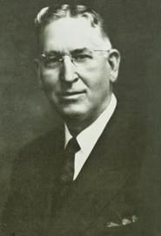
N. B. Hardeman
College
Supported
by Church
Orphan Home
Supported
by Church
Shifted to
“The right to contribute to one is the right to contribute to the other…The same principle that permits one permits the other. They must stand or fall together.”
(Gospel Advocate, 1947, p. 844)

Slide 9




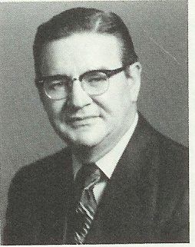


Colleges Accepting Church Contributions
Only One College
Did Not
James R. Cope
President
1949 - 1982
Board Meeting: Spring 1956
Cope being pressured said:
“My soul is not for sale, nor is this college.”
Notes:
FC 50-year book? They have a section on pp.74-75 that describes the series of board meetings (does not quote Cope's statement but places it in spring 1956.

Slide 10
Institutional –vs- Non-Institutional
College in church budget
  Problem: no authority (Col. 3:17)
  Problem: puts church in secular business
  Problem: Organization between the church & the work

Slide 11
Institutional –vs- Non-Institutional
College in church budget
Orphan home
  The most noted of the issues (also carried emotion)
  This was the main dividing issue
    Historians suggest 80/20 split
    Usually, small groups pulled off and started new works
    Exceptions: Louisville, Tampa, Athens, Birmingham

Slide 12
The Benevolent Society
Local
Church
$
Local
Church
Benevolent
Society
“Orphan Home”
$
Care of
Needy
$
Local
Church
$
A Separate Organization Between
The Church And The Work
Local
Church

Slide 13
Institutional –vs- Non-Institutional
College in church budget
Orphan home
  The most noted of the issues (also carried emotion)
  This was the main dividing issue
  Problem:
    No Bible authority (Col. 3:17)
    An organization between the church & work
    Church can do its own work (Acts 6; 1 Tim. 5:16)

Slide 14
Institutional –vs- Non-Institutional
College in church budget
Orphan home
Sponsoring church
  The second major issue

Slide 15
Sponsoring Church
Local
Church
$
Sponsoring
Church
Local
Church
$
Preach
Gospel
$
Local
Church
$
Local
Church

Slide 16
Institutional –vs- Non-Institutional
College in church budget
Orphan home
Sponsoring church
  The second major issue
  The problem
    No Bible authority (Col. 3:17)
    Violates the limitation of elders’ authority (1 Pet. 5:1-4)

Slide 17
Institutional –vs- Non-Institutional
College in church budget
Orphan home
Sponsoring church
Social gospel
  All of these issues were social gospel issues – but it grew by late 1960’s and into the 1970’s
  Included: Fellowship halls, church kitchens, bus ministries, gyms, ball teams, and gimmick to draw crowds

Slide 18
The Social Gospel Defined
A Great Shift
Spiritual
Social
Individual
Church

Slide 19
Institutional –vs- Non-Institutional
College in church budget
Orphan home
Sponsoring church
Social gospel
  No Bible authority (Col. 3:17)
  Puts church in recreation and social work
  Has church involved in work of the individual

Slide 20








A Difference In The
Individual & The Church
1 Tim. 5:16
If any man or woman that believeth have widows, let them relieve them, and let not the church be charged; that it may relieve them that are widows indeed.

Slide 21
Institutional –vs- Non-Institutional
Where it Started
Now Some – Gone Further
College in church budget
Orphan home
Sponsoring church
Social gospel
Instrumental music
Women preachers
Verbal inspiration
Tolerant on many issues
Issues Are Serious & Not Minor:
  Authority
  Work / Mission of the church
  Organization of the church
  Distinction in individual and church

Slide 22
Does It Matter
Which Church of Christ?
Institutional –vs- Non-Institutional
Differences in Non-Institutional Churches

Slide 23
Differences in Non-Institutional Churches
Common idea: If non-institutional – it is a good church
Common practice: Do little investigation about churches – where we place membership – or our family attends

Slide 24
Differences in Non-Institutional Churches
How apostasy develops

Slide 25

Hebrews 2:1
“Therefore we must give the more earnest heed to the things we have heard, lest we drift away” (NKJV)
Therefore we ought to give the more earnest heed to the things which we have heard, lest at any time we should let them slip. (KJV)
Footnote KJV “run out as leaking vessels”

Slide 26
Gradually & Slowly
Heb. 2:1

Slide 27
Gradually & Slowly
Heb. 2:1

Slide 28
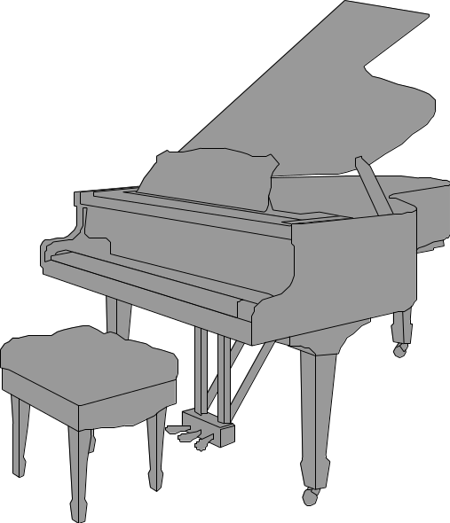
Gradual Steps Toward Apostasy
1. Change in attitude
2. Talk about new
ideas - long before
suggested.
3. Slowly introduce
questionable practices
4. Full innovation
Mid 1800’s
Midway, KY

Slide 29
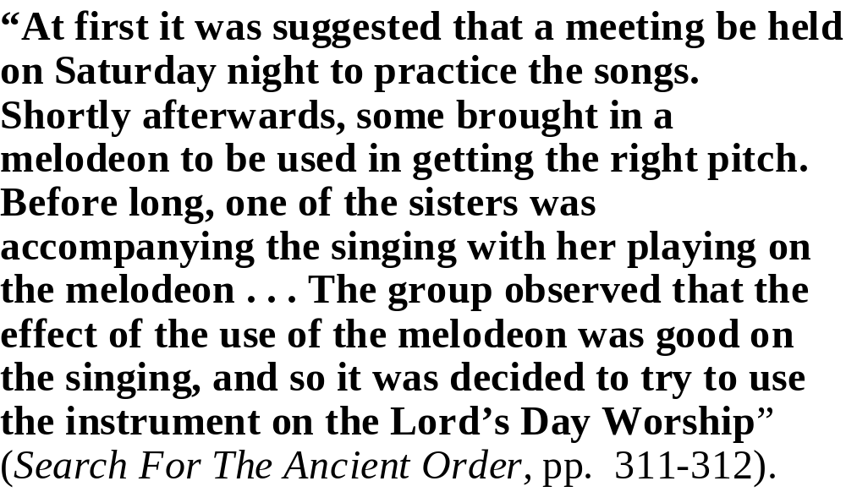
Instrument Introduced Slowly

Slide 30
Differences in Non-Institutional Churches
How apostasy develops
Issues among non-institutional churches
Today the issues are many (not one issue)
Makes the differences harder to identify

Slide 31
Differences in Non-Institutional Churches
How apostasy develops
Issues among non-institutional churches
  Soft preaching

Slide 32
Soft Preaching
Signs:
  Little or no Scripture
  The message says little
  Little or no application
  Not distinctive (could hear same message in denomination)
  Non-offensive message
  Not taking a stand on current issues in the church

Slide 33
Soft Preaching
Signs:
Hard to identify:
  It is NOT error that is being taught
  It is not WHAT is taught that makes the preaching soft
  It is WHAT is NOT taught that is the problem

Slide 34
Soft Preaching
Signs:
Hard to identify:
Some messages may never hear
  Authority
  One NT church
  What is wrong with denominationalism
  Worldliness
  Divorce and remarriage
  Sin that is found in midst of that church

Slide 35
Soft Preaching
Signs:
Hard to identify:
Some messages may never hear
Charge to the preacher:
  Preach the word (2 Tim. 4:2)
  Preach the whole counsel (Acts 20:27)

Slide 36
Differences in Non-Institutional Churches
How apostasy develops
Issues among non-institutional churches
  Soft preaching
  Soft / tolerant on worldliness

Slide 37
Soft / Tolerant on Worldliness
Worldliness:
  Social drinking
  Dance / prom
  Immodesty
  Etc.

Slide 38
Soft / Tolerant on Worldliness
Worldliness:
Soft / Tolerant
  Little or no preaching on the subject
    In some cases – believe it wrong – but not preach on it
    In other cases – see nothing wrong with any of these
  Those who participate are left alone (nothing said to correct)
  Parents, preacher, elders – doing the same

Slide 39
Differences in Non-Institutional Churches
How apostasy develops
Issues among non-institutional churches
  Soft preaching
  Soft / tolerant on worldliness
  Tolerant of error & teachers of error

Slide 40
Tolerant of error & teachers of error
Not that brethren always agree with the error – just tolerant (don’t condemn) and fellowship those who teach the error:
  Example: J. W. McGarvey – believed instrumental music was not authorized, but fellowshipped those who used it
  Example: Agree that brother _________ teaching on D&R is not correct, but use him for meetings, etc.
  When point out that a certain church has repeatedly used men who teach error on ___________ - no one seems to care

Slide 41
Tolerant of error & teachers of error
Not that brethren always agree with the error – just tolerant (don’t condemn) and fellowship those who teach the error:
Argument:
  Romans 14 – says we can agree to disagree on matters of doctrine and faith
  Redefine “false teacher” to mean one who insincere
Those who are warned (condemned) in 2 John 9-11
  One who practices sin or error (v. 9)
  One who teaches error (v. 10)
  One who receives the false teacher (v. 11)

Slide 42
Differences in Non-Institutional Churches
How apostasy develops
Issues among non-institutional churches
  Soft preaching
  Soft / tolerant on worldliness
  Tolerant of error & teachers of error
  Error on divorce and remarriage

Slide 43
Error on divorce & remarriage
Various errors
  Alien is not amenable
  Guilty party can remarry
  Mental divorce
  Adulterers do not have to separate
  Multiple causes for divorce

Slide 44
Error on divorce & remarriage
Various errors
Lord’s teaching is clear (Matt. 19:9)
Serious
  Adultery – lost souls (Gal. 5:19-21)
  Leaven in the church (1 Cor. 5:6)

Slide 45
Differences in Non-Institutional Churches
How apostasy develops
Issues among non-institutional churches
  Soft preaching
  Soft / tolerant on worldliness
  Tolerant of error & teachers of error
  Error on divorce and remarriage
  Modernism

Slide 46
Modernism
Days of creation
  Not literal six days – but could be millions or billions of yrs
  Exo. 31:15-17 – creation week compared to work week
  Psa. 33:6-9 – God spoke it and it was done
  Undermines our belief in rest of book of the book
Flood was not universal
Serpent (Gen. 3) is not literal (cf. 2 Cor. 11:3)

Slide 47
Differences in Non-Institutional Churches
How apostasy develops
Issues among non-institutional churches
  Soft preaching
  Soft / tolerant on worldliness
  Tolerant of error & teachers of error
  Error on divorce and remarriage
  Modernism
  Repeating errors of the past

Slide 48
Repeating errors of the past
Church involved in social matters
Cannot say instrumental music is wrong

Slide 49
Differences in Non-Institutional Churches
  Soft preaching
  Soft / tolerant on worldliness
  Tolerant of error & teachers of error
  Error on divorce and remarriage
  Modernism
  Repeating errors of the past
Issues Are Also Serious & Not Minor:
  Authority
  Encourage worldliness
  Tolerate error – which corrupts
  Undermines our faith

Slide 50
Does It Matter
Which Church of Christ?
Institutional –vs- Non-Institutional
Differences in Non-Institutional Churches

