Slide 1
Acts 5:1-11

Slide 2
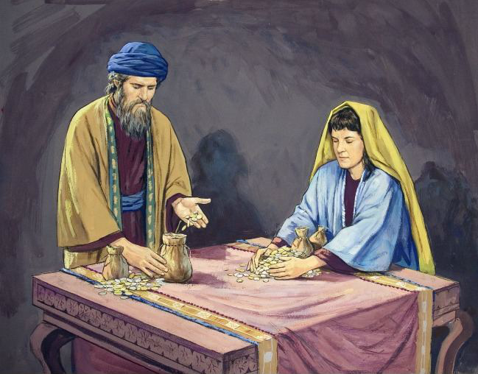
1 But a certain man named Ananias, with Sapphira his wife, sold a possession.
2 And he kept back part of the proceeds, his wife also being aware of it, and brought a certain part and laid it at the apostles' feet.

Slide 3
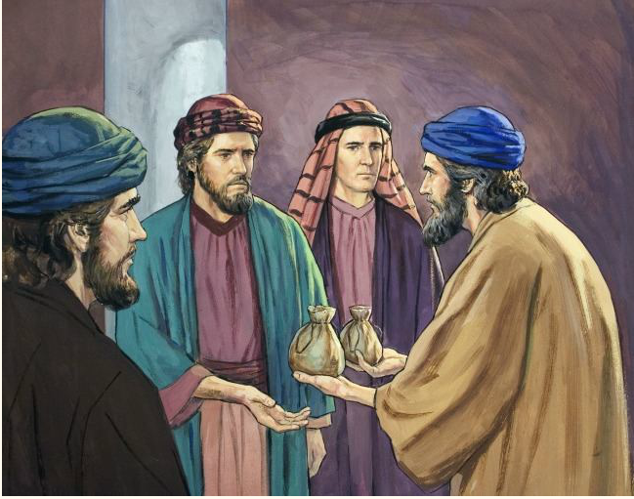
3 But Peter said, "Ananias, why has Satan filled your heart to lie to the Holy Spirit and keep back part of the price of the land for yourself?
4 While it remained, was it not your own? And after it was sold, was it not in your own control? Why have you conceived this thing in your heart? You have not lied to men but to God."

Slide 4
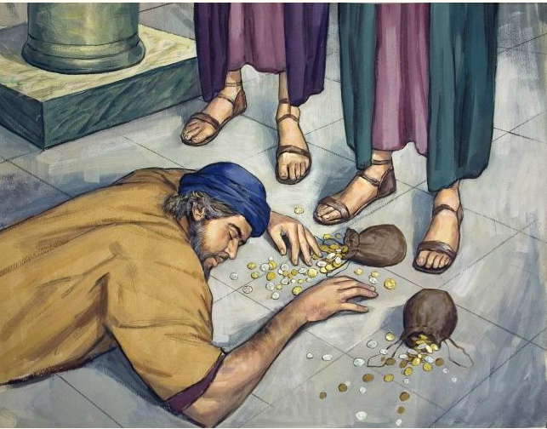
5 Then Ananias, hearing these words, fell down and breathed his last. So great fear came upon all those who heard these things.

Slide 5
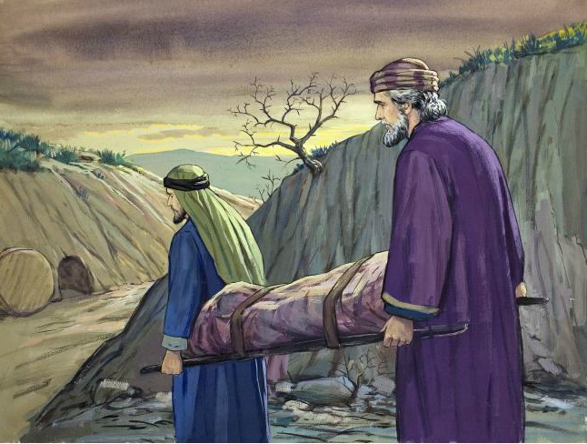
6 And the young men arose and wrapped him up, carried him out, and buried him.

Slide 6
7 Now it was about three hours later when his wife came in, not knowing what had happened.
8 And Peter answered her, "Tell me whether you sold the land for so much?" She said, "Yes, for so much."
9 Then Peter said to her, "How is it that you have agreed together to test the Spirit of the Lord? Look, the feet of those who have buried your husband are at the door, and they will carry you out."
10 Then immediately she fell down at his feet and breathed her last. And the young men came in and found her dead, and carrying her out, buried her by her husband.
11 So great fear came upon all the church and upon all who heard these things.

Slide 7
36 And Joses, who was also named Barnabas by the apostles (which is translated Son of Encouragement), a Levite of the country of Cyprus,
37 having land, sold it, and brought the money and laid it at the apostles' feet.
Acts 5
1 But a certain man named Ananias, with Sapphira his wife, sold a possession.
2 And he kept back part of the proceeds, his wife also being aware of it, and brought a certain part and laid it at the apostles' feet.
Contrast
“The two illustrations here were intended to be brought in contrast, as the conjunction ‘but’ introduces the sentence.”
H. Leo Boles

Slide 8
This is a First
”…but this chapter opens with the account of the first marks of the evil one within the fold.”
- Don De Welt
First case of church trouble
First record of sin among God’s people
First case of hypocrisy

Slide 9

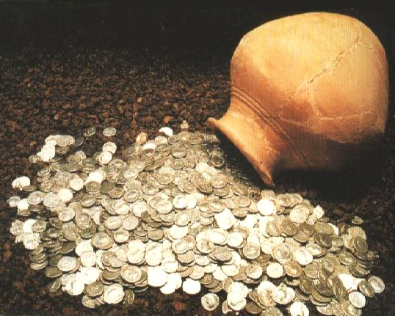
Ananias & Sapphira
Acts 5:1-11

Slide 10
Ananias & Sapphira
Acts 5:1-11
Being Hypocrites

Slide 11


I.
Hypocrites
What is a hypocrite?

Slide 12

Hypocrite
hupokrites NT:5273, corresponding to the above, primarily denotes "one who answers"; then, "a stage-actor"; it was a custom for Greek and Roman actors to speak in large masks with mechanical devices for augmenting the force of the voice; hence the word became used metaphorically of "a dissembler, a hypocrite." It is found only in the Synoptists, and always used by the Lord, fifteen times in Matthew; elsewhere, Mark 7:6; Luke 6:42; 11:44 (in some mss.); 12:56; 13:15.
(W. E. Vine)

Slide 13
Matt 23:13
“Hypocrites hupokritai (NT:5273). This terrible word of Jesus appears first from him in the Sermon on the Mount (Matt 6:2,5,16; 7:5), then in Matt 15:7 and Matt 22:18. Here it appears "with terrific iteration" (Bruce) save in the third of the seven woes (Matt 23:13,15,23,25,27,29). The verb in the active hupokrinoo (NT:5271) meant to separate slowly or slightly subject to gradual inquiry. Then the middle was to make answer, to take up a part on the stage, to act a part. It was an easy step to mean to feign, to pretend, to wear a masque, to act the hypocrite, to play a part.”
(A. T. Robertson)

Slide 14
I.
Hypocrites
What is a hypocrite?
Ananias & Sapphira tried appear more benevolent than they were
Kept Part of Money
But Said They Gave it All

Slide 15
“People run fearful risks when they profess more than their spiritual strength can carry.”
W.G. Moorehead, Preacher’s Homiletic Commentary, Acts, 125

Slide 16
I.
Hypocrites
What is a hypocrite?
Ananias & Sapphira tried appear more benevolent than they were
In the eyes of men their actions looked good
  Looked the same as Barnabas (4:36-37)
  Their concern was only about how look to men (cf. Matt. 23:28)

Slide 17
I.
Hypocrites
What is a hypocrite?
Ananias & Sapphira tried appear more benevolent than they were
In the eyes of men their actions looked good
Impossible to hide one’s sin from God
  Important lesson for the rest to learn (vv. 5, 11)
  All things are naked & open to God (Heb. 4:13)
  May we all be warned – cannot hide from God!

Slide 18
Ananias & Sapphira
Acts 5:1-11
Being Hypocrites
Being Sinners

Slide 19
II.
Sinners
Allowed Satan to fill their heart (v. 3)
  Yielded to temptation
  Peter’s question shows that Ananias ALLOWED Satan to fill his heart.
  Ananias was a free moral agent – he conceived this in his own heart (v. 4).

Slide 20
II.
Sinners
Allowed Satan to fill their heart (v. 3)
Sin against God (vv. 3, 4)
  Hypocrisy focuses on how appear before man
  Peter calls them back to how appear before God
  Not just lying to apostles, but lying to God
  Every sin – is against God (Rom. 8:7)

Slide 21
II.
Sinners
Allowed Satan to fill their heart (v. 3)
Sin against God (vv. 3, 4)
Voluntarily participate (v. 4)
  No compulsion to sell
  No pressure to give
  No demand to give all or even a certain amount
  Willingly sold, gave & pretended to give all
  Thus, they were responsible!

Slide 22
Ananias & Sapphira
Acts 5:1-11
Being Hypocrites
Being Sinners
Being an Accomplice

Slide 23
III.
An Accomplice
Sapphira acted in collusion with Ananias
  Idea was conceived by Ananias (v. 4)
  She was aware of it (v. 2)
  She was not present when Ananias gave, lied and died (vv. 2-7)
  She persisted in covering the matter (vv. 8-9)
  She was still just as guilty (v. 10)

Slide 24
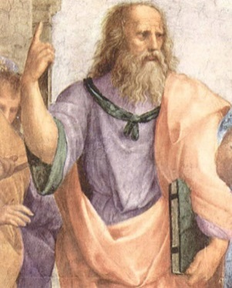
III.
An Accomplice
Sapphira acted in collusion with Ananias
We can be an accomplice to the sin of others
  Fellowship with false teachers (2 John 9-11)
  Fellowship with erroneous practices (Eph. 5:11)
  Consent – say nothing (Psa. 50:16-21)
  Tempting , advising, or encouraging to do something that is wrong (Psa. 1:1; Prov. 1:10-ff)
  Failing to train child (Prov. 29:15)
Seeing a boy misbehave in the street, Plato went to the boys dad and began beating the dad.
When asked why, he explained – “He either learned it from you or you failed to correct him.”

Slide 25
Ananias & Sapphira
Acts 5:1-11
Being Hypocrites
Being Sinners
Being an Accomplice
Being Men Pleasers

Slide 26
IV.
Men Pleasers
Desire for the praise of men – driving force
  Actually greed coupled with desire to please men
  What a contrast to Barnabas
    Barnabas sought to praise God (4:36-37)
    Ananias & Sapphira sought the praises of men (5:1-11)
  Wanted men to think they were truly devoted

Slide 27
IV.
Men Pleasers
Desire for the praise of men – driving force
Matters not only WHAT we do, But WHY we do it
How could we seek to please men?
  Telling them what they want to hear (Gal. 1:10)
  Not telling them what they need (Ezek. 3:16-18)
  Being more concerned how we look to men – than how we look before God (1 Pet. 3:3-5)
  Compromise with friends
  More concerned about making family happy than serving God

Slide 28
Ananias & Sapphira
Acts 5:1-11
Being Hypocrites
Being Sinners
Being an Accomplice
Being Men Pleasers
Being a Holdout

Slide 29
V.
A Holdout
They pretended to be doing more than they were
  Said they were giving all – but only gave some
  Held back – but gave impression doing their best

Slide 30
V.
A Holdout
They pretended to be doing more than they were
Could we be holding back?
“We too may be pretending with a few outward deeds to be giving the Lord the best we have, when in reality we are holding back (Gal. 6:7-8).”
R. Harkrider, Acts, 53

Slide 31
V.
A Holdout
They pretended to be doing more than they were
Could we be holding back?
  Worship – leave impression – that come all we can – yet holding back
  Giving – “I don’t have any to give”
  “I can’t” – “I’m afraid” (Matt. 25)
  “Too busy – don’t have time” – “I work”
  “Let someone else do it”

Slide 32
Ananias & Sapphira
Acts 5:1-11
Being Hypocrites
Being Sinners
Being an Accomplice
Being Men Pleasers
Being a Holdout
Being Disciplined

Slide 33
VI.
Disciplined
This is a case of church discipline – though not withdrawing
  Sin was dealt with
  Some of same results were obtained (1 Cor. 5:6-7)

Slide 34
VI.
Disciplined
This is a case of church discipline – though not withdrawing
Church was purified – cleansed of hypocrisy
Effect – people feared (vv. 5, 11)
  Learn sin will not be tolerated
  Learn that God is not one with whom men can trifle
  Stirs the rest to sincerity of action
  Caused respect in the community (cf. vv. 13-14)

Slide 35
Ananias & Sapphira
Acts 5:1-11
Being Hypocrites
Being Sinners
Being an Accomplice
Being Men Pleasers
Being a Holdout
Being Disciplined

