Slide 2
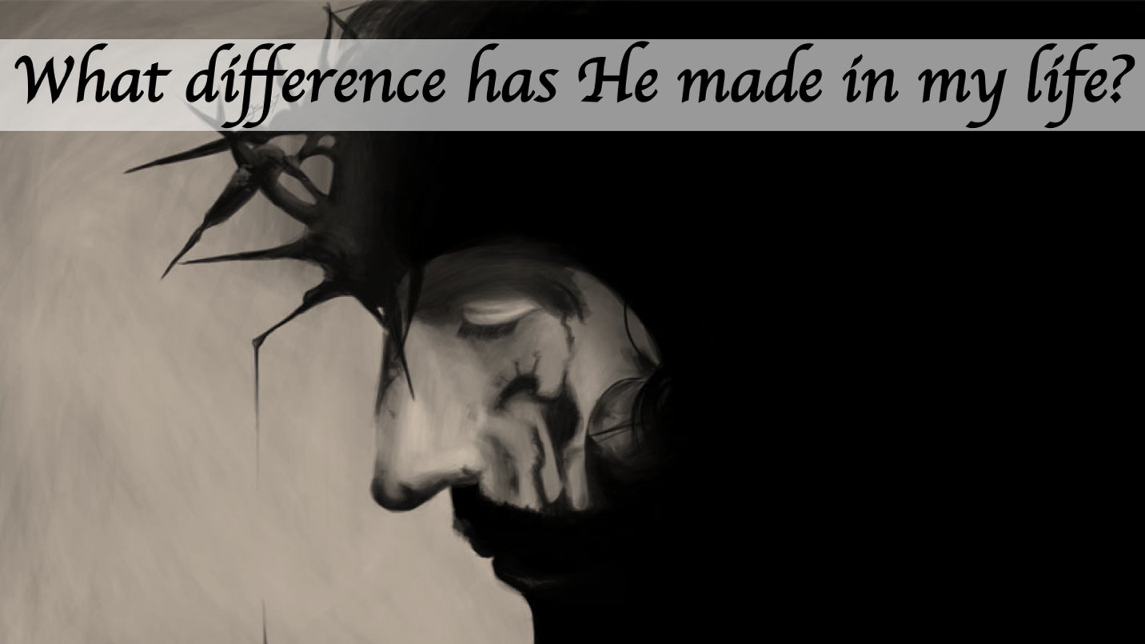
And suddenly, a woman who had a flow of blood for twelve years came from behind and touched the hem of His garment. For she said to herself, if only I may touch His garment, I shall be made well. But Jesus turned around, and when He saw her He said, be of good cheer, daughter; your faith has made you well. And the woman was made well from that hour.
Matthew 9:20-22

Slide 3
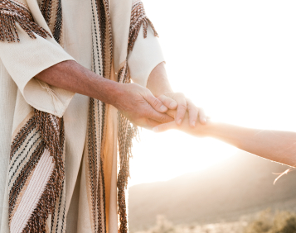
Jesus, moved with compassion, stretched out His hand and touched him (Mk 1:41)
Jesus put out His hand and touched him (Matt 8:3)
So He touched her hand (Matt 8:15)
He went in and took her by the hand (Matt 9:25)
Then He touched their eyes (Matt 9:29)
Jesus came and touched them (Matt 17:7)
Then little children were brought to Him that He might put His hands on them (Matt 19:13)
200 Times

Slide 4
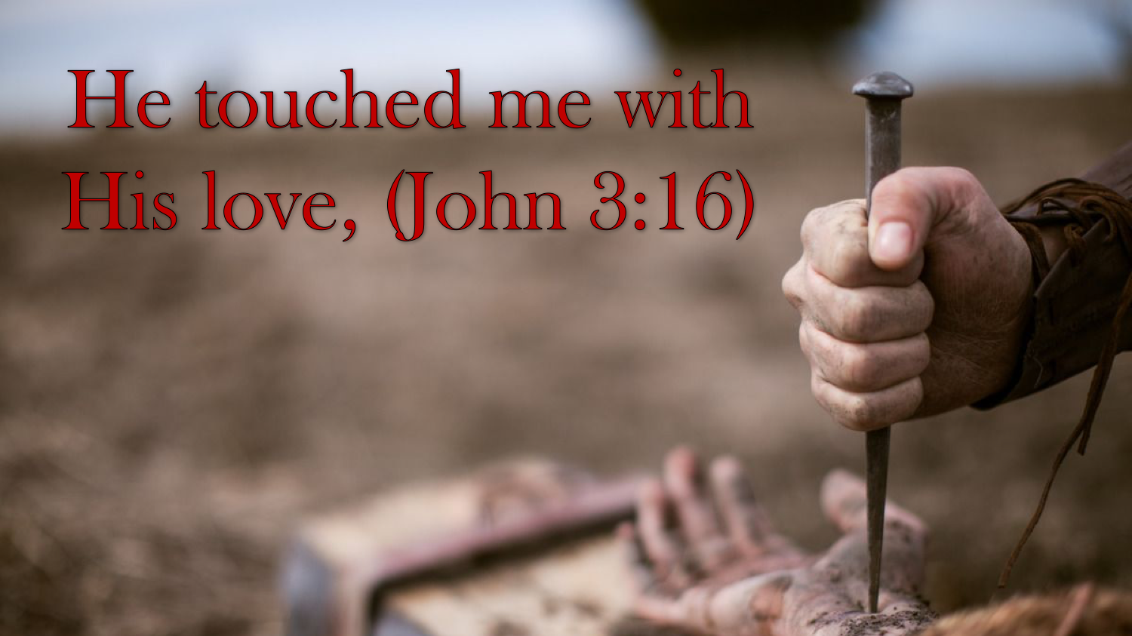
—and His touch taught me to love (Jn 15:13; 13:34-35; 1 Jn 3:16-18; Eph 5:25)

Slide 5
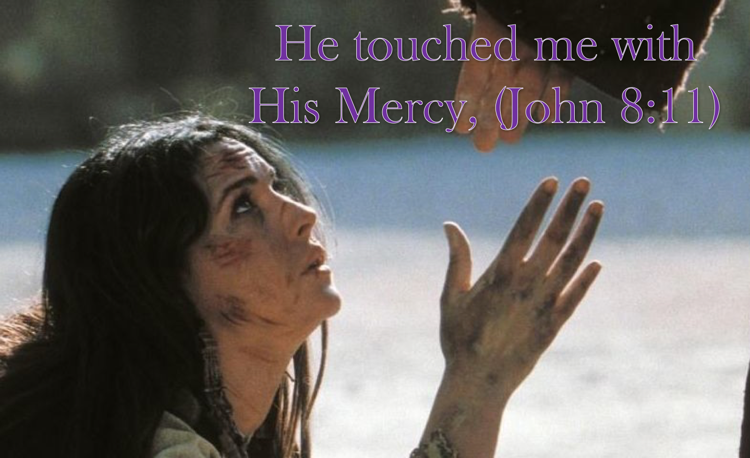
—and His touch taught me to forgive (Lk 23:34; Lk 7:40-43; Matt 18:21-35)

Slide 6
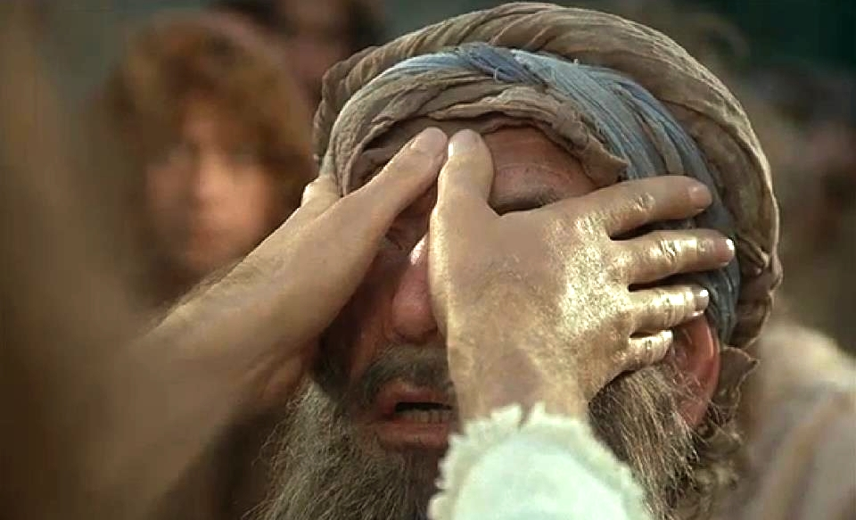

—and His touch taught me kindness (Mk 1:40-41; Eph 4:32; Col 3:12)

Slide 7

—and His touch taught me to hope (Jn 14:1-3; Rom 8:22-24; Heb 11:1)

Slide 8
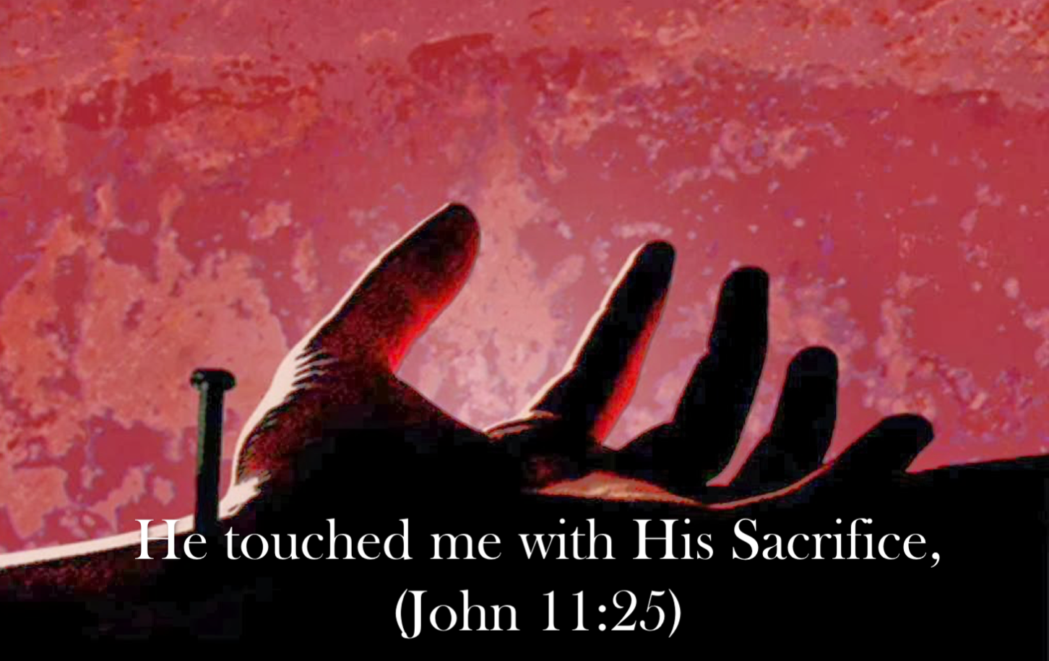
—and His touch taught me to serve (Matt 20:28; Jn 13:13-17; Mk 14:8)

Slide 9
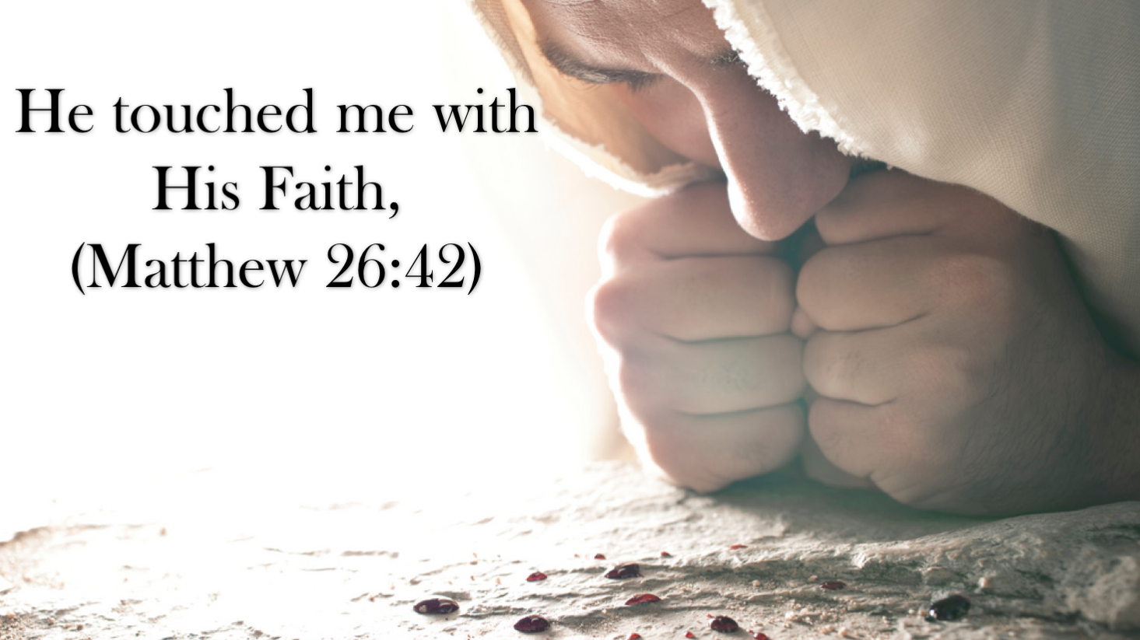
—and His touch taught me to trust (Jn 17:1-5; 1 Tim 4:10; Heb 12:1-2)

Slide 10
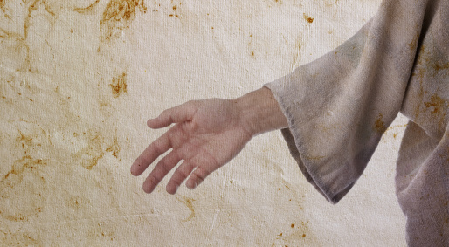

Shackled by a heavy burden, 'Neath a load of guilt and shame.
Then the hand of Jesus touched me, And now I am no longer the same.
Since I met this blessed Savior, Since He cleansed and made me whole,
I will never cease to praise Him; I'll shout it while eternity rolls.
He touched me, Oh He touched me, And oh the joy that floods my soul!
Something happened and now I know He touched me and made me whole.

