Slide 2

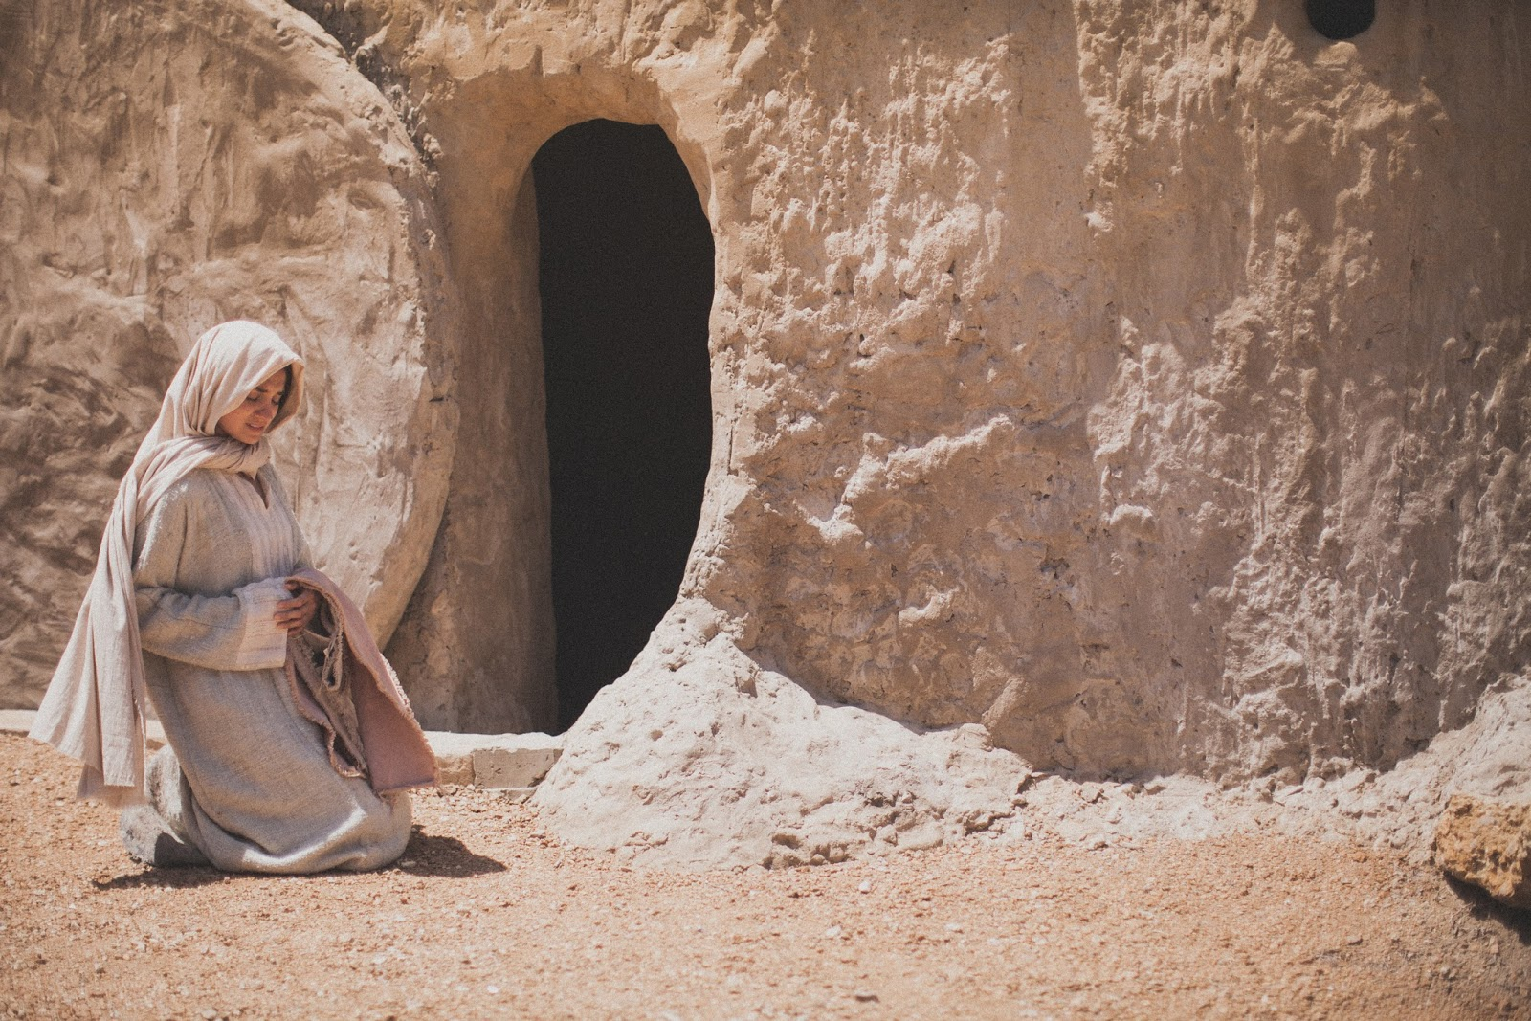
John 20:11-13
But Mary stood outside by the tomb weeping, and as she wept she stooped down and looked into the tomb. And she saw two angels in white sitting, one at the head and the other at the feet, where the body of Jesus had lain. Then they said to her, woman, why are you weeping? She said to them, because they have taken away my Lord, and I do not know where they have laid Him.
Notes:
NOTE:
To change the image on this slide, select the picture and delete it. Then click the Pictures icon in the placeholder to insert your own image.

Slide 3
Was it the Disciples of Jesus?
Was it the Apostles of Jesus?
Was it the Tomb’s Gardener?
Was it the Angels inside the Tomb?
Mary’s Focus was JESUS !
… they have taken away my Lord, and I do not know where they have laid Him.
John 20:13
Notes:
NOTE:
To change the image on this slide, select the picture and delete it. Then click the Pictures icon in the placeholder to insert your own image.

Slide 4

Rom 10:9-10
Hebrews 12:2
Phil 3:7-11
2 Tim 1:12

Slide 5

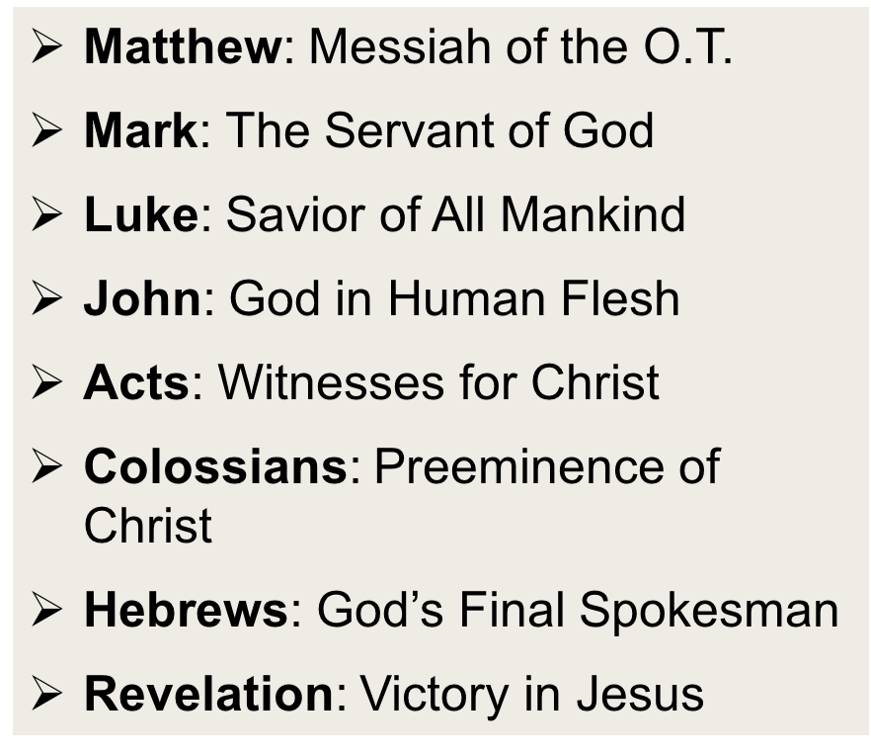
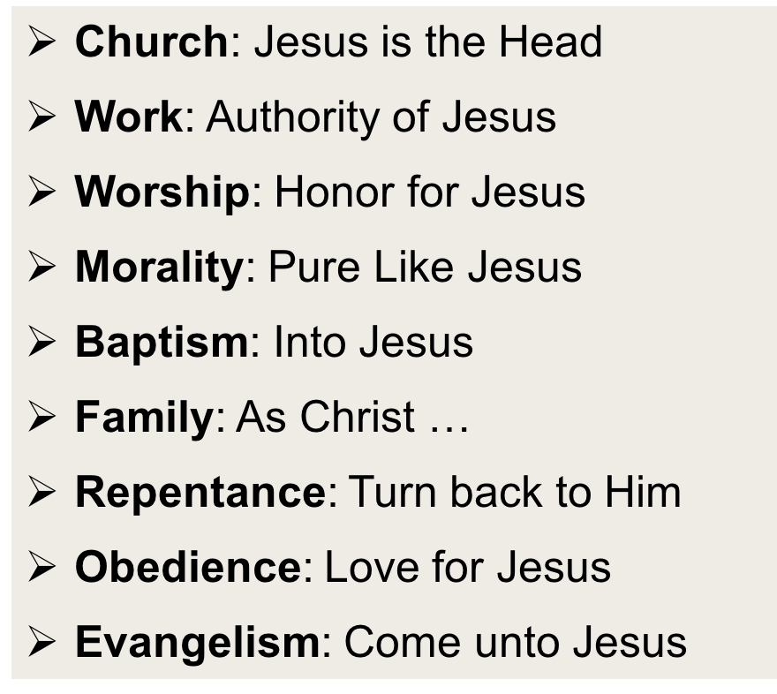
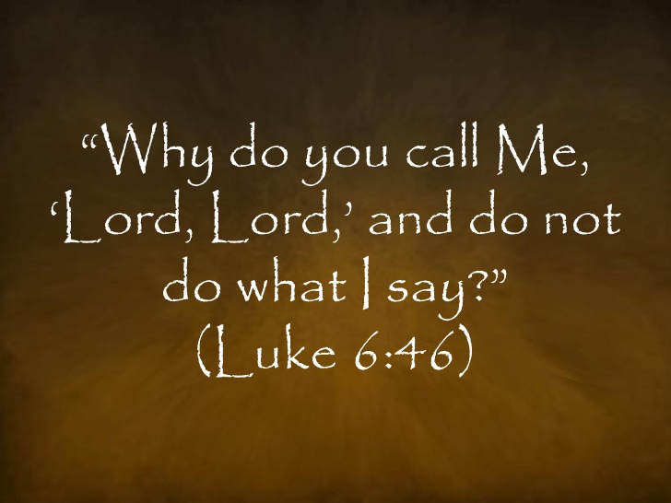

… Of All Revelation
… Of All Gospel Preaching
… Of All Redemption
… Of All Obedience
… Of My Heart/Soul/Life
But we see Jesus, who was made a little lower than the angels, for the suffering of death crowned with glory and honor…
Hebrews 2:9
Notes:
NOTE:
To change the image on this slide, select the picture and delete it. Then click the Pictures icon in the placeholder to insert your own image.

