Slide 2
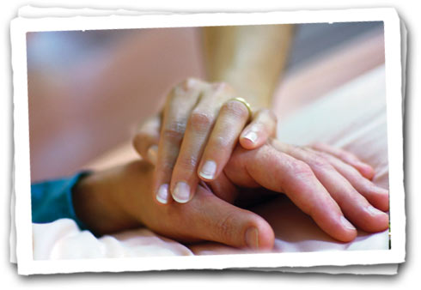

Refuse to think about death.
Take extraordinary measures to prolong life.
Provide for the preservation of the body.

Slide 3
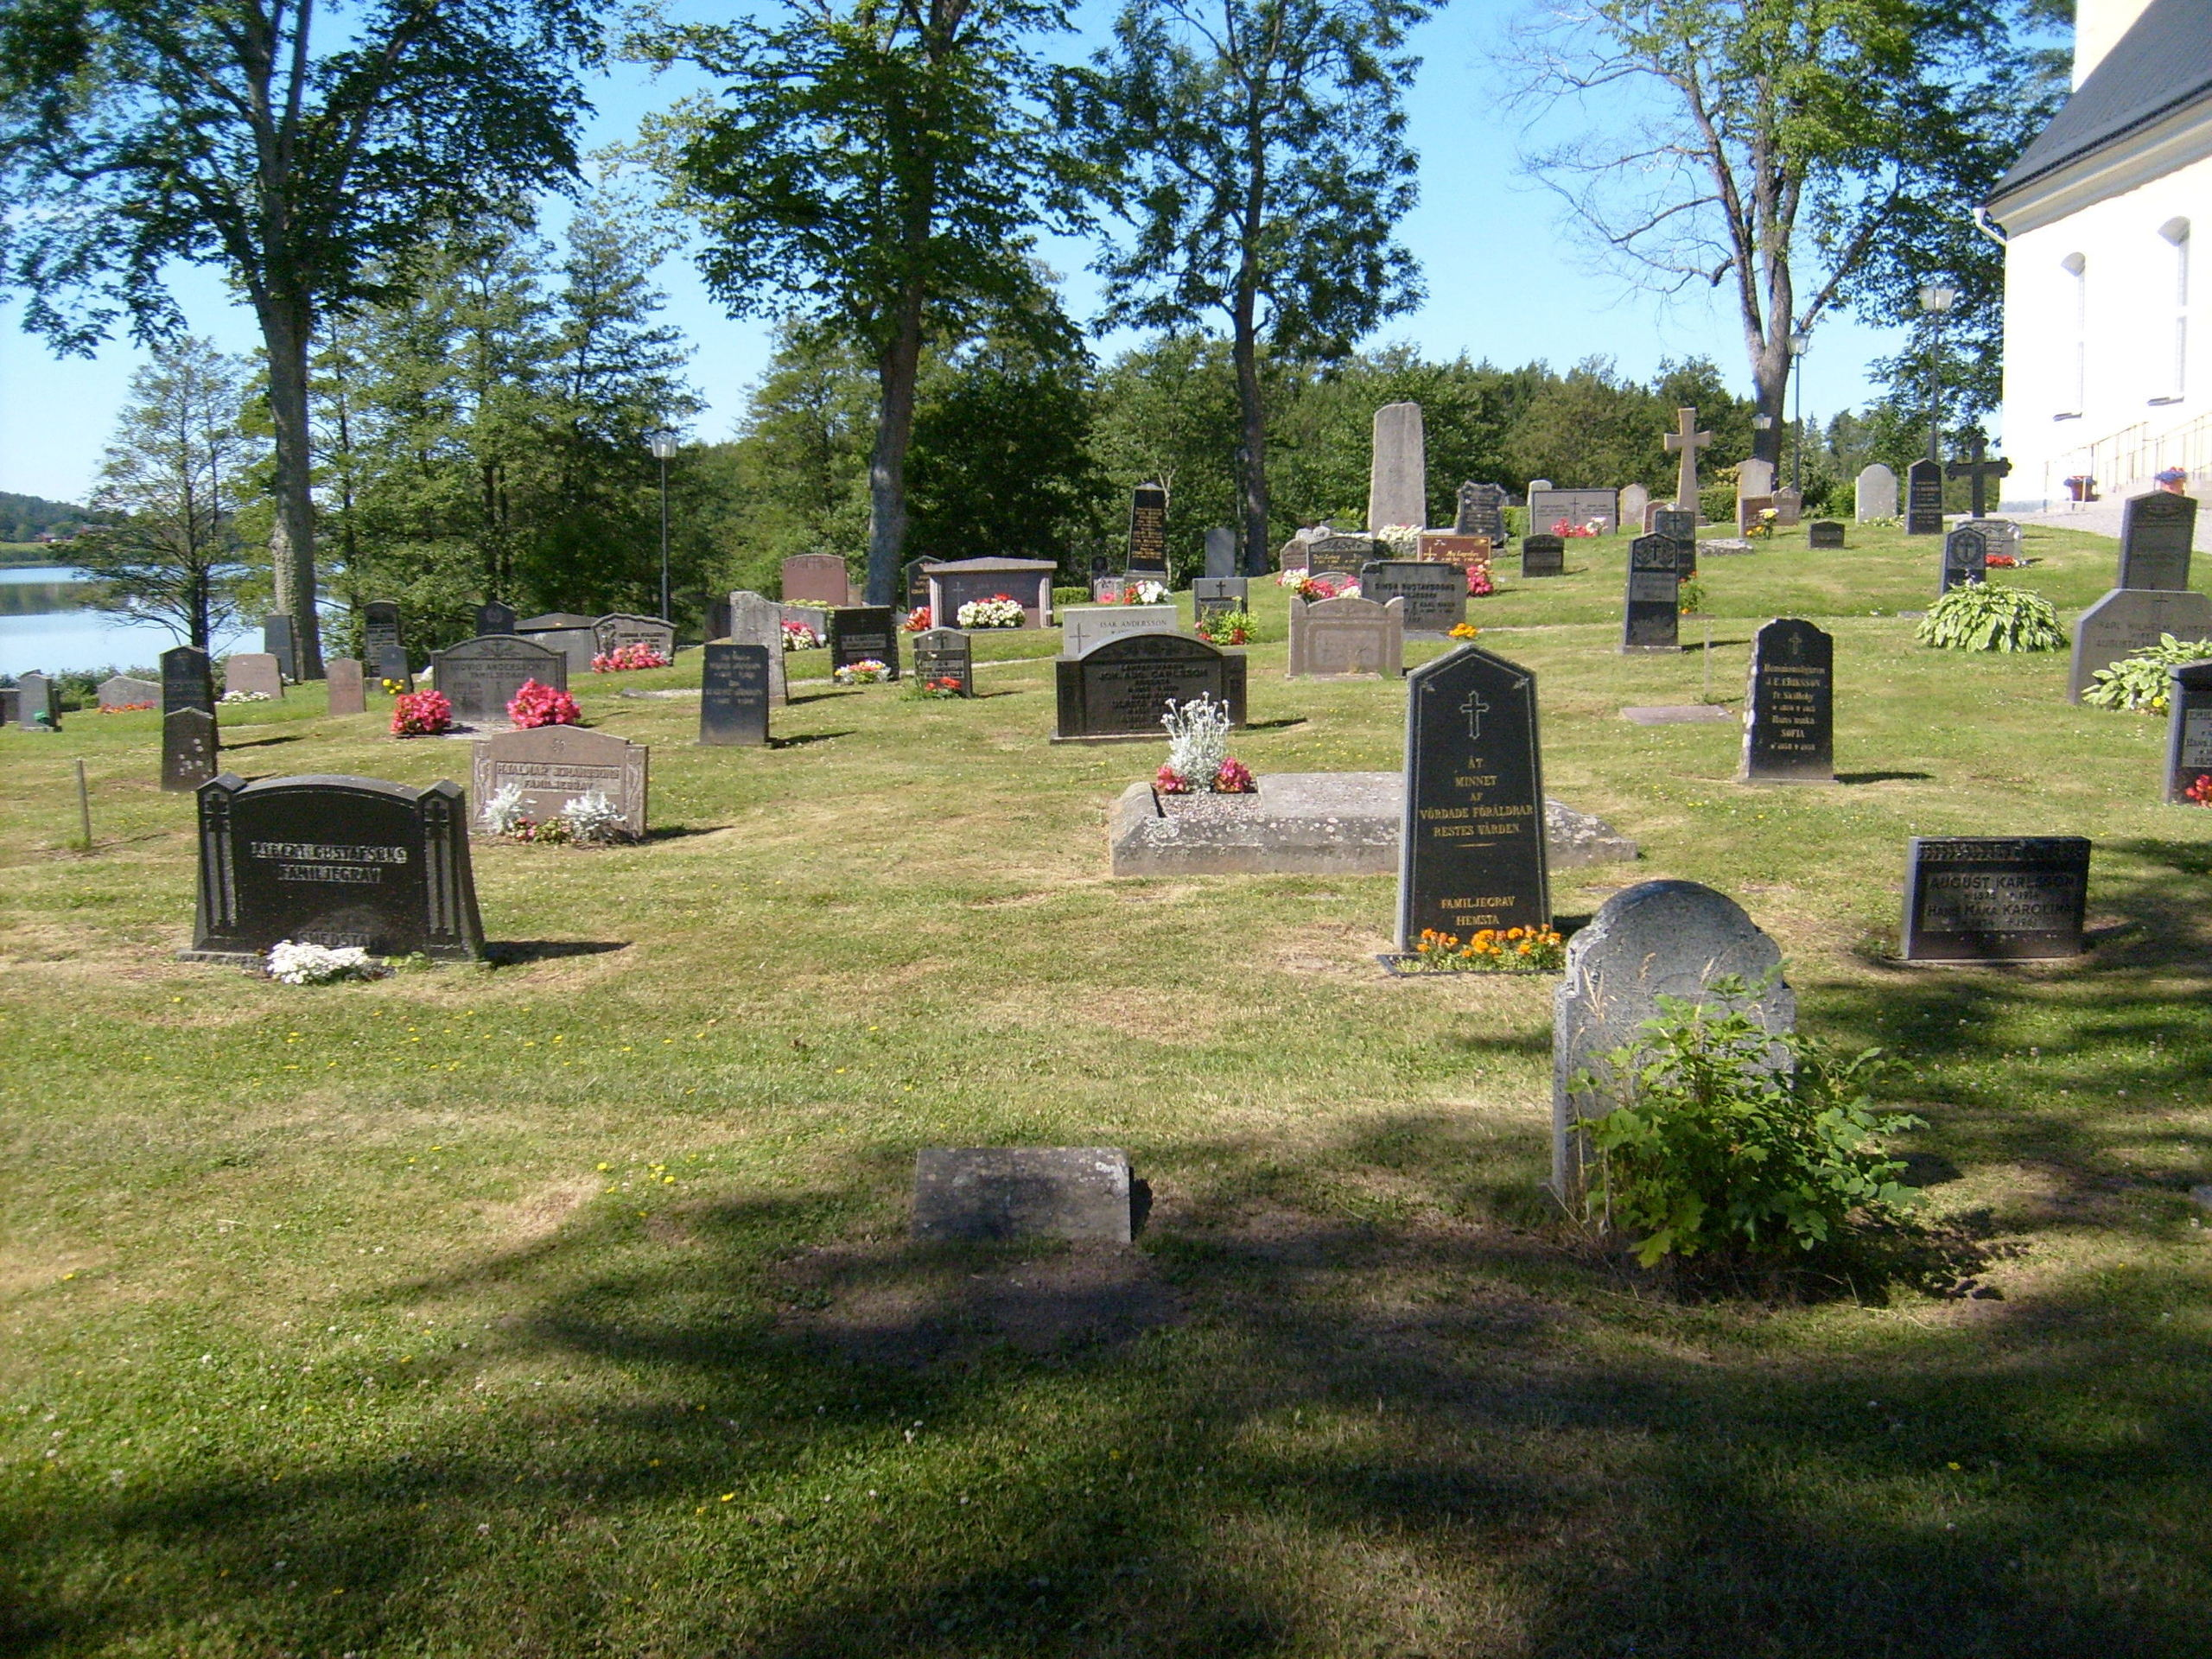
Heb 9:27, And as it is appointed for men to die once . . .
Eccl 9:5, For the living know that they will die . . .
Psa 89:48, What man can live and not see death? Can he deliver his life from the power of the grave?

Slide 4
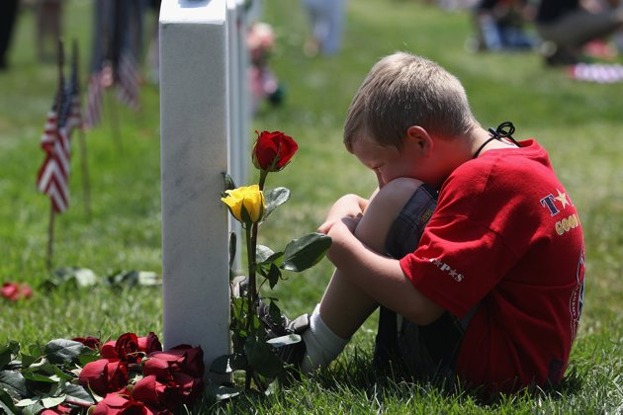
Job 14:14, If a man dies, shall he live again?

Slide 5
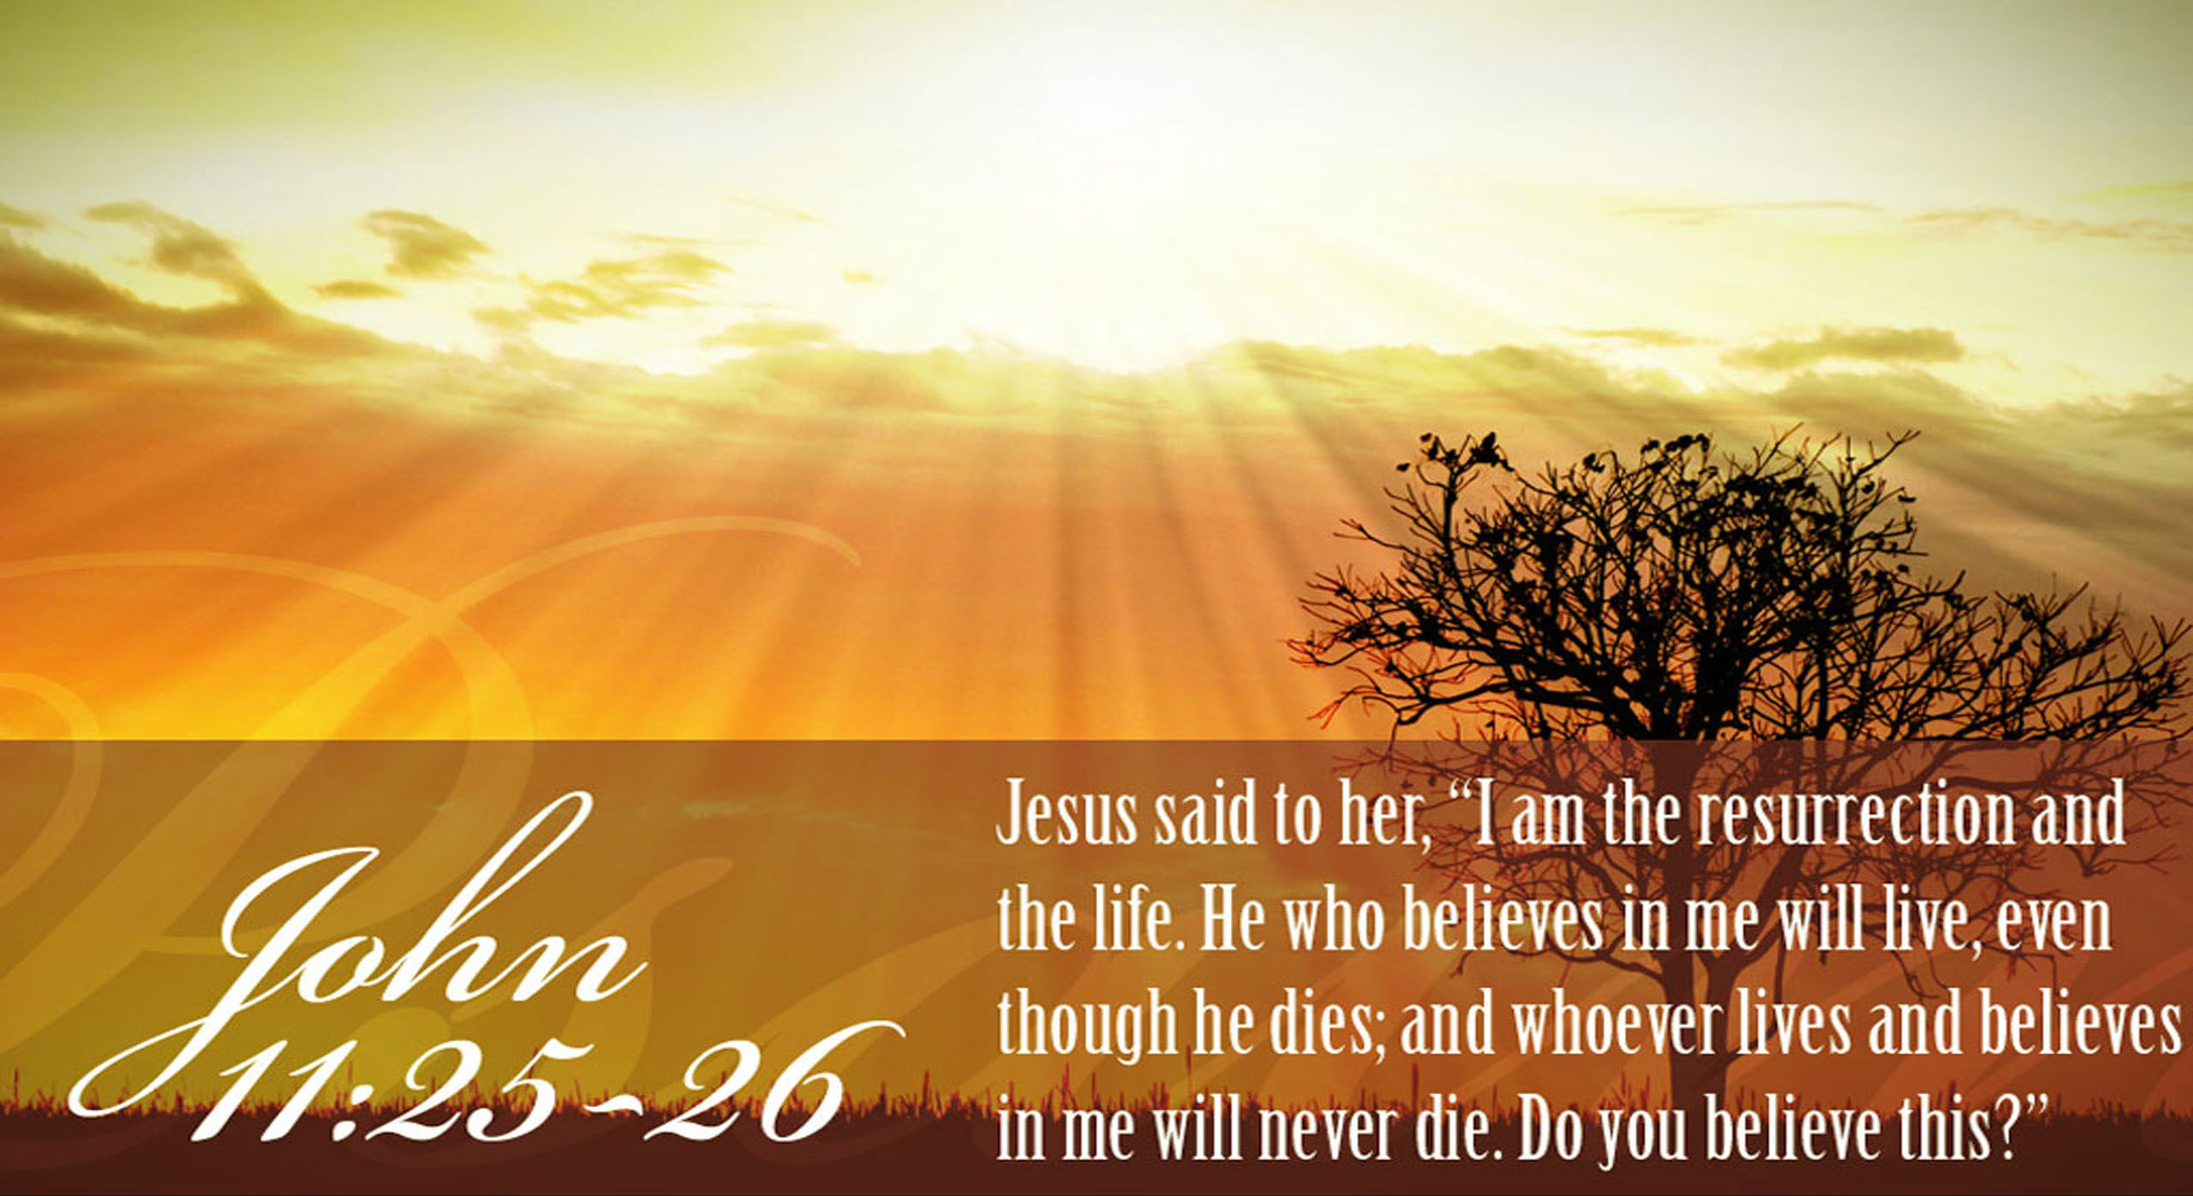

Slide 6
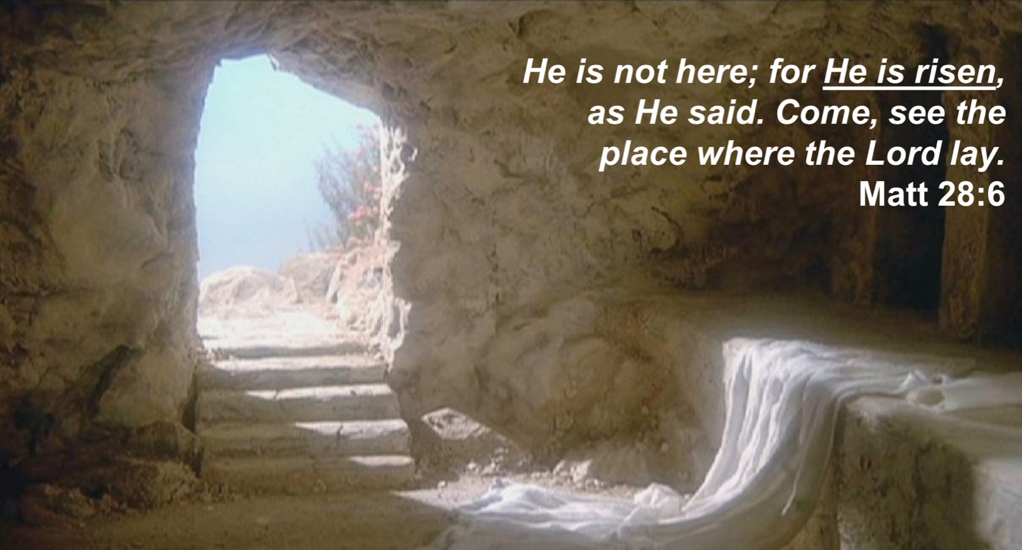

Slide 7
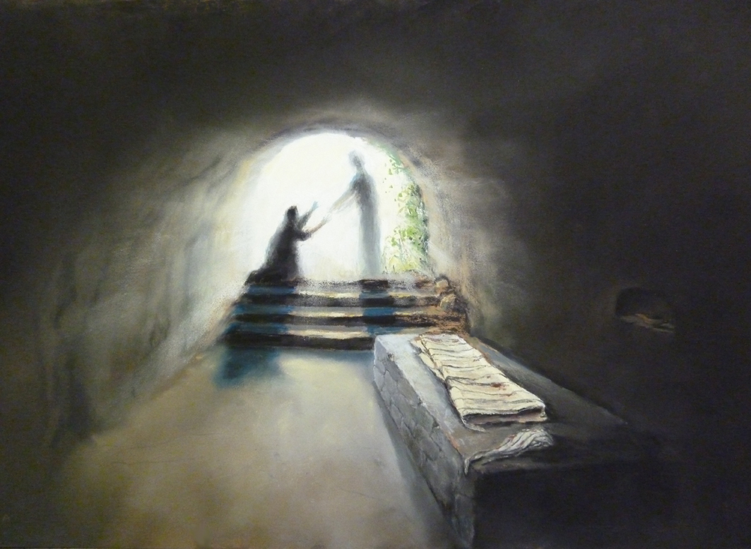
Resurrection of Jesus
Mk 16:6, You seek Jesus of Nazareth, who was crucified. He is risen!
Lk 24:5-6, Why do you seek the living among the dead? He is not here, but is risen!
Acts 2:24, (Jesus) whom God raised up, having loosed the pains of death . . .
1 Cor 15:20, But now Christ is risen from the dead . . .
Heb 7:25, . . . since He always lives to make intercession for them.
Reversed
the
Irreversible

Slide 8
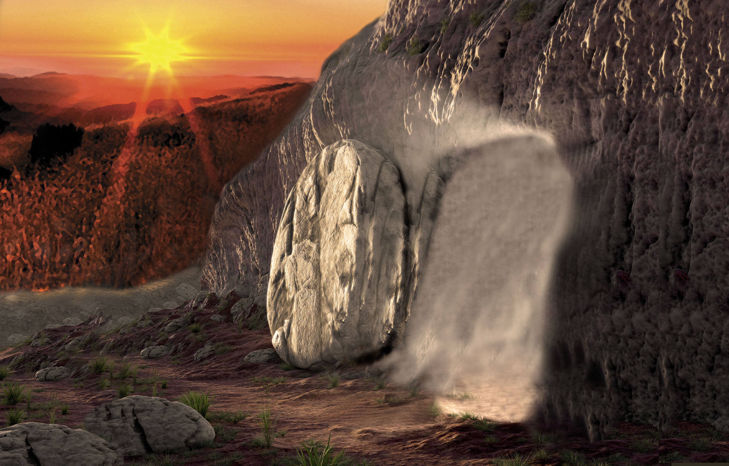
Resurrection of Jesus
1 Cor 15:3-4, For I delivered to you first of all that which I also received: that Christ died for our sins according to the Scriptures, and that He was buried, and that He rose again the third day according to the Scriptures.
1 Cor 15:14, And if Christ is not risen, then our preaching is empty and your faith is also empty.
1 Cor 15:17, And if Christ is not risen, your faith is futile; you are still in your sins!
Rom 10:9, that if you confess with your mouth the Lord Jesus and believe in your heart that God has raised Him from the dead, you will be saved.

Slide 9
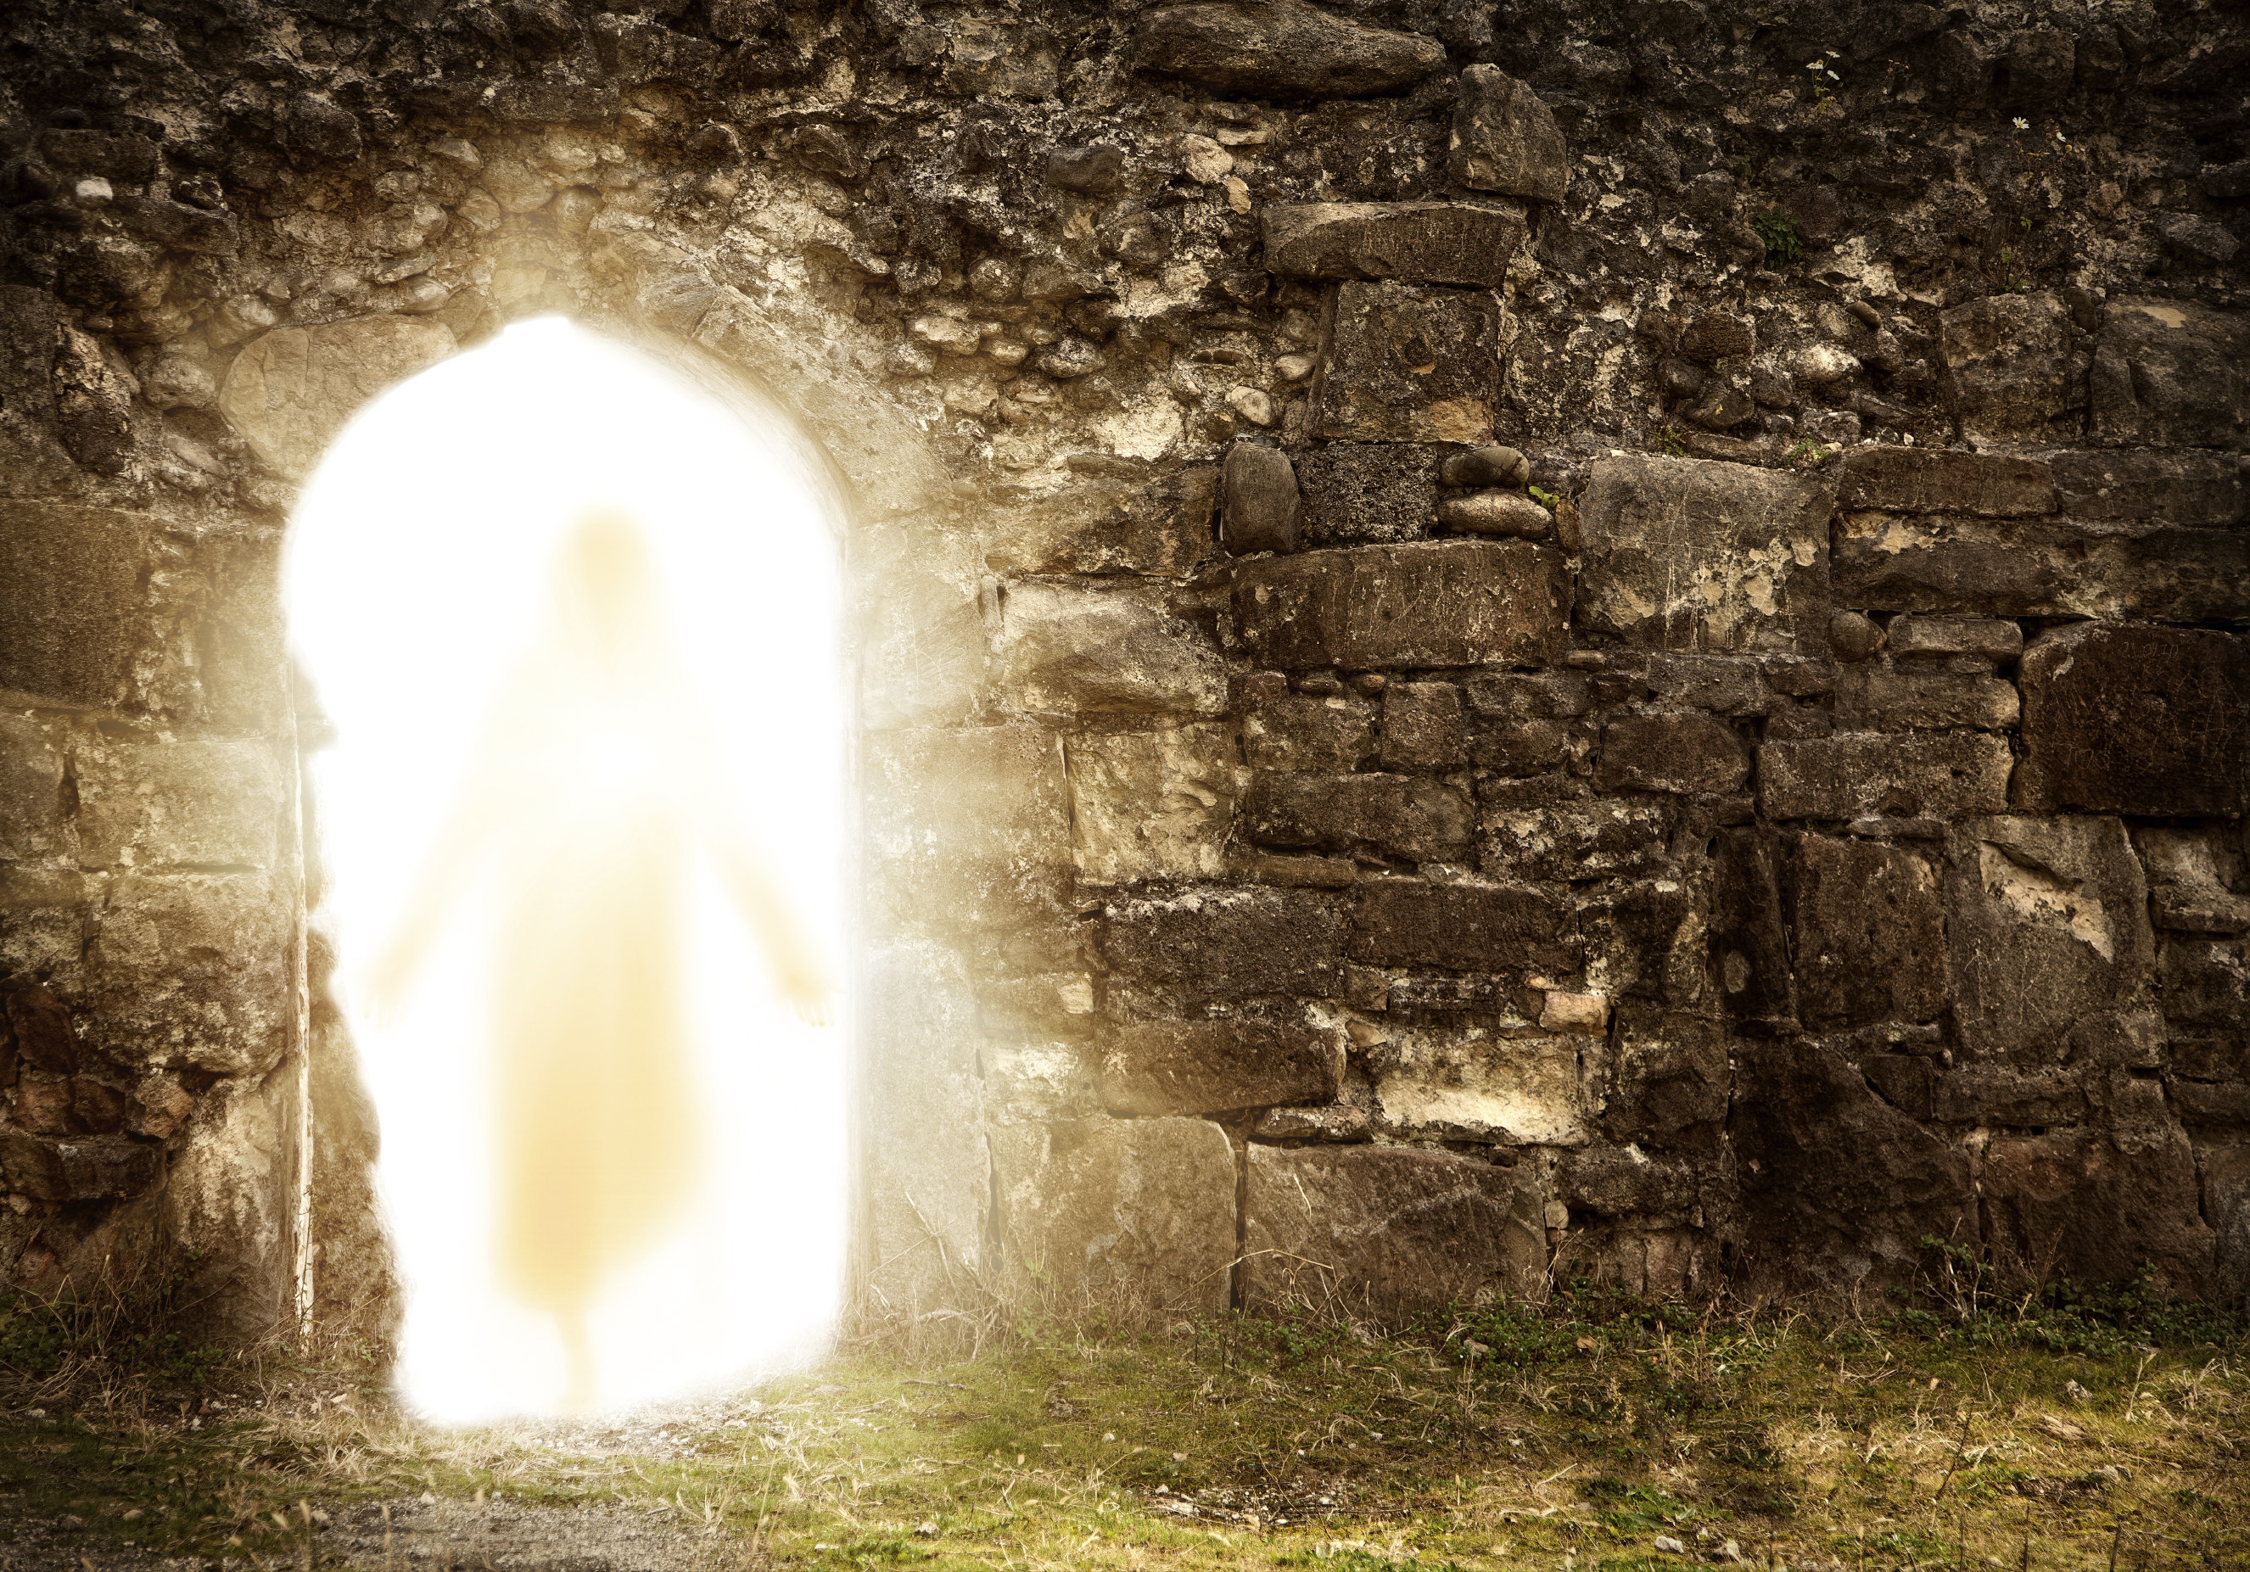
Resurrection of Jesus
PROPHECIED, For You will not leave my soul in Sheol, nor will You allow Your Holy One to see corruption. (Psa 16:10)
FORETOLD BY JESUS, Jesus answered and said to them, destroy this temple, and in three days I will raise it up . . . But He was speaking of the temple of His body. (Jn 2:19-21)
From that time Jesus began to show to His disciples that He must go to Jerusalem, and suffer many things from the elders and chief priests and scribes, and be killed, and be raised the third day. (Matt 16:21)
Therefore My Father loves Me, because I lay down My life that I may take it again. No one takes it from Me, but I lay it down of Myself. I have power to lay it down, and I have power to take it again. (Jn 10:17-18)

Slide 10
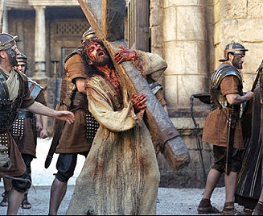

Before His Resurrection
“Jesus said to them, all of you will be made to stumble because of Me this night, for it is written” (Matt 26:31).
Disbelieved (Matt 16:22)
Denied Him (Matt 26:69-75)
Hid in locked rooms (Jn 20:19)
Too fearful to attend His burial (Lk 24:1)
Thought the movement had ended (Lk 24:21)

Slide 11
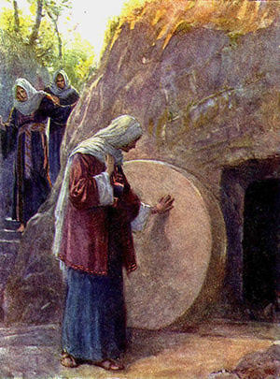
During His Resurrection
“And the guards shook for fear of him, and became like dead men.” (Matt 28:4).
Women reacted with “fear and great joy” (Matt 28:1-8)
Did not believe He had been raised (Mk 16:12)
Thought they were seeing a ghost (Lk 24:37)
Thomas “doubted” (Jn 20:25)
Idle tales of certain women (Lk 24:11, 22-24)

Slide 12
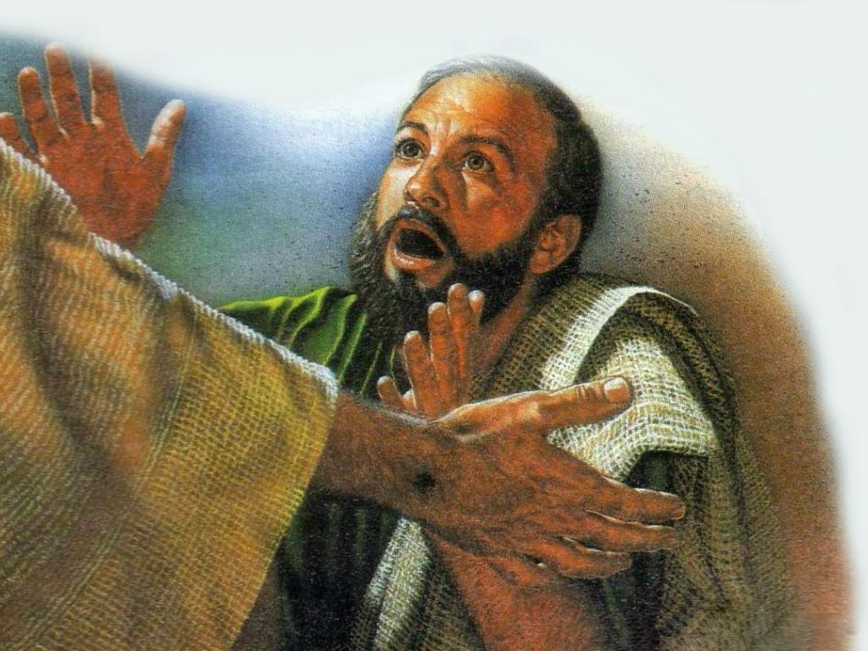
After His Resurrection
“to whom He also presented Himself alive after His suffering by many infallible proofs, being seen by them during forty days . . .” (Acts 1:3).
Jesus made about a dozen appearances (1 Cor 15:1-8)
Declared Him to be the Son of God (Rom 1:4)
So overwhelming—no apostle ever denied Him again (Acts 2:32)
So compelling—they were infused w/courage (Acts 4:19-20; 5:29)
Became the cornerstone of their message (1 Cor 15:3)

Slide 13
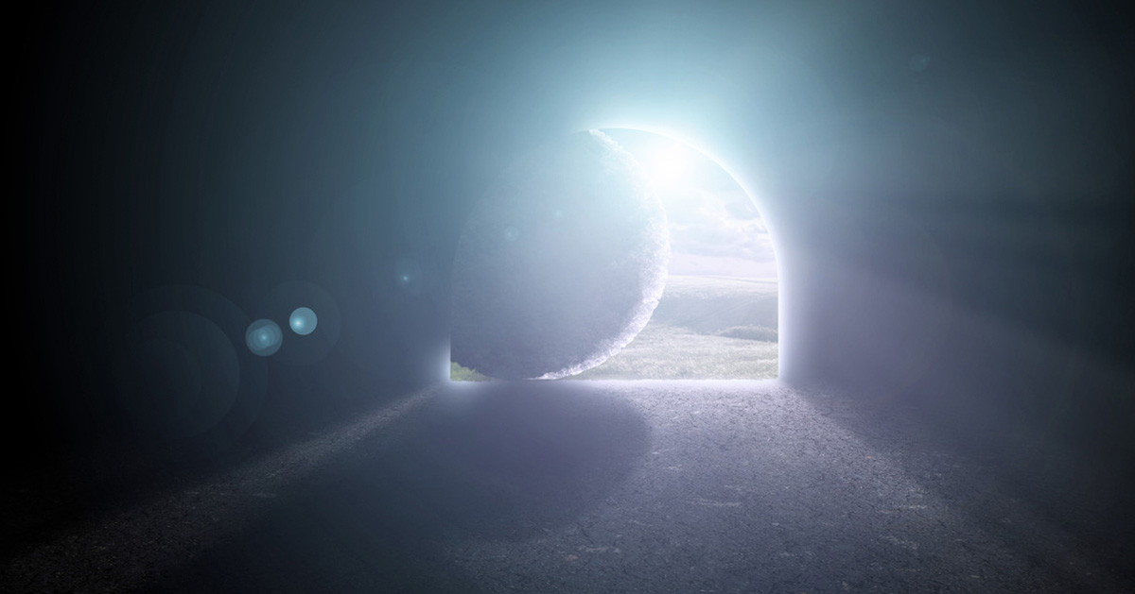

Because of the overwhelming evidence
Because it fits God’s Pattern and Character
Because I desperately need it to be true
Because of His nail scars and wounded side

