Slide 2
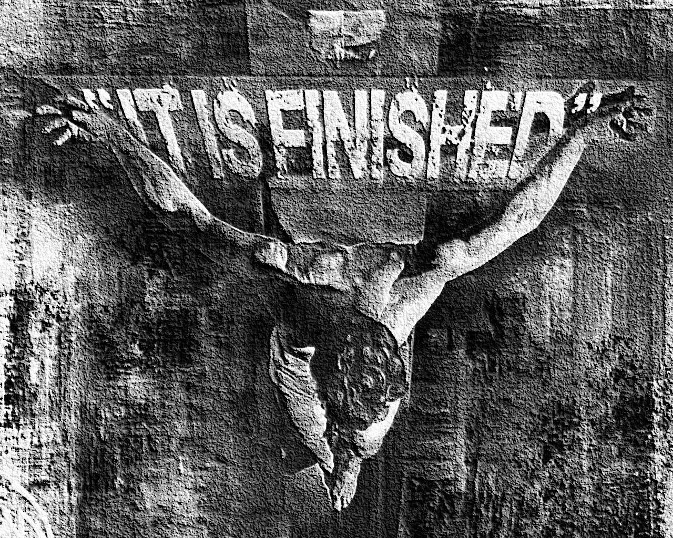
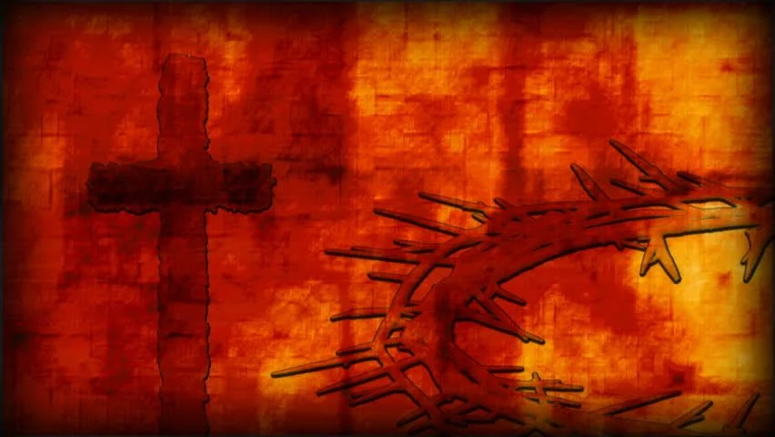
John 19:
²⁸ After this, Jesus, knowing that all things were now accomplished, that the Scripture might be fulfilled, said, “I thirst!” ²⁹ Now a vessel full of sour wine was sitting there; and they filled a sponge with sour wine, put it on hyssop, and put it to His mouth. ³⁰ So when Jesus had received the sour wine, He said, “It is finished!” And bowing His head, He gave up His spirit.

Slide 3

Reveal the Father (Jn 14:9-11)
Bring grace and truth (Jn 1:17)
Become a ransom for many (Matt 20:28)
Seek and save the lost (Lk 19:10)
Call sinners to repentance (Mk 2:17)
Bring light into a dark world (Jn 12:46)
Destroy the works of Satan (1 Jn 3:8)
Do the will of the Father (Jn 6:38)
To give life (Jn 10:10, 28)
Preach the Kingdom of God (Lk 4:43)
Bear our sins on the cross (1 Pet 2:24)
Fulfill the Law and Prophets (Matt 5:17)
Father, forgive them, for they do not know what they do, (Lk 23:34).
Assuredly, I say to you, today you will be with Me in Paradise, (LK 23:43).
Woman, behold your son! … Behold your mother! (JN 19:26-27).
Eli, Eli, lama sabachthani? that is, My God, My God, why have You forsaken Me? (Matt 27:46).
I thirst! (Jn 19:28).
It is finished, (Jn 19:30).
Father, into Your hands I commit My spirit, (Lk 23:46).

Slide 4

Rejected by those He came to save (Jn1:11; Lk 23:34).
Hated, hunted and hounded throughout His life (Jn 15:18).
Heart was touched with grief and pain (Jn 11:35).
Brothers disbelieved (Jn 7:5).
Disciples struggled with doubt, ignorance, unbelief & arguing (Matt 14:31; Lk 22:24).
Betrayed by a “friend” (Matt 26:50).
Forsaken by all (Matt 26:31).
Scourged & Crucified (Matt 27:26-31).

Slide 5
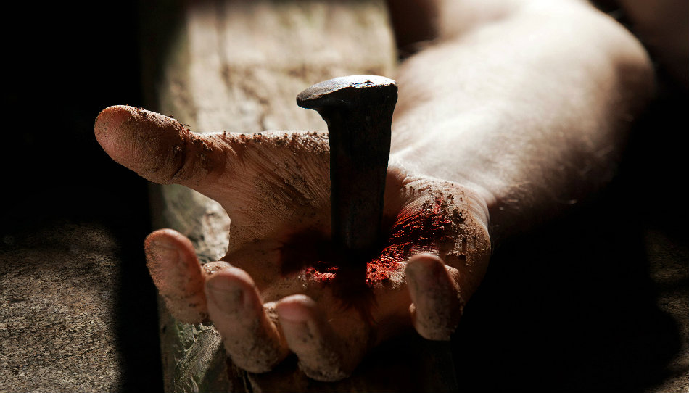

Devil: Avoid the suffering of the cross (Matt 4:1-10).
Peter: This death shall not happen to you (Matt 16:22).
Jesus: He steadfastly set His face to go to Jerusalem, (Lk 9:51).
Jesus: … for this purpose I came to this hour, (Jn 12:27).
Jesus: My food is to do the will of Him who sent Me, and to finish His work, (Jn 4:34).
Jesus: … knew that His hour had come that He should depart from this world to the Father, having loved His own who were in the world, He loved them to the end, (Jn 13:1).
Jesus: I have glorified You on the earth. I have finished the work which You have given Me to do, (Jn 17:4).
Jesus: It is finished, (Jn 19:30).

Slide 6


Don’t YOU give up on your faith (James 1:2-3, 12).
Don’t YOU give up on the church (1 Corinthians 1:11).
Don’t YOU give up on your marriage (Matthew 19:4-6).
Don’t YOU give up on your children (Mark 9:17).
Don’t YOU give in to life’s hardships (2 Timothy 4:7).
Therefore, my beloved brethren, be steadfast, immovable, always abounding in the work of the Lord, knowing that your labor is not in vain in the Lord.
1 Corinthians 15:58

