Slide 2

The Old Rugged Cross
The Way of the Cross leads Home
At the Cross
Near the Cross
Down at the Cross
The Banner of the Cross
Soldiers of the Cross
Kneel at the Cross
When I survey the Wonderous Cross
Beneath the Cross of Jesus
At Calvary
There is a Fountain

Slide 3

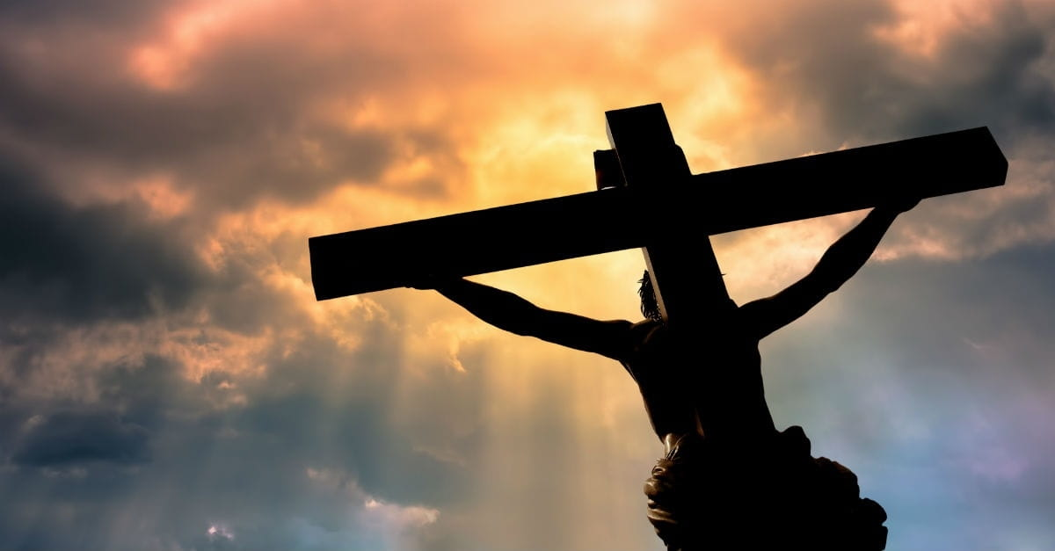
And being found in appearance as a man, He humbled Himself and became obedient to the point of death, even the death of the cross.
Philippians 2:8

Slide 4
From that time Jesus began to show to His disciples that He must go to Jerusalem, and suffer many things from the elders and chief priests and scribes, and be killed, and be raised the third day.
Matthew 16:21
Then they crucified Him, and divided His garments, casting lots, that it might be fulfilled which was spoken by the prophet: They divided My garments among them, and for My clothing they cast lots. Sitting down, they kept watch over Him there.
Matthew 27:35-36

Slide 5
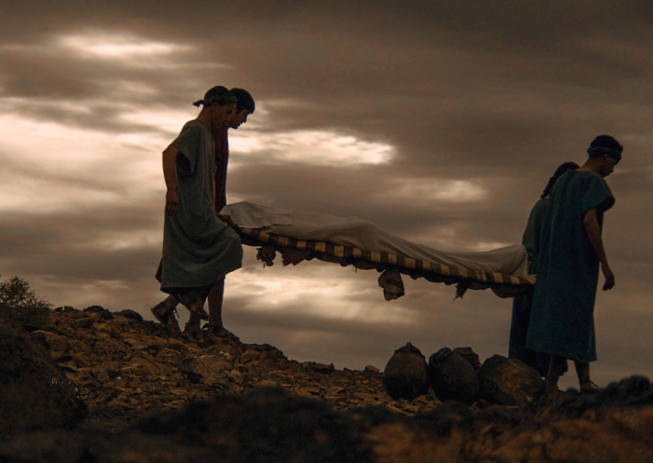
Betrayed by friend (Psa 41:9; Matt 26:23, 47-49)
30 Pieces of silver (Zech 11:12; Matt 26:14-15)
Beaten & spat upon (Isa 50:6; Matt 26:67, Matt 27:30)
Hands & feet pierced (Psa 22:14; Matt 27:31)
Clothes divided (Psa 22:18; Jn 19:23-24)
This is the reason: (Acts 8:35—Isa 53)
…was no misfortune or miscalculation —Even though Jesus was innocent (Jn 19:6)—He was foreordained to die on a cross (1 Pet 1:19-20). “For this purpose, I came to this hour,” (Jn 12:27).

Slide 6
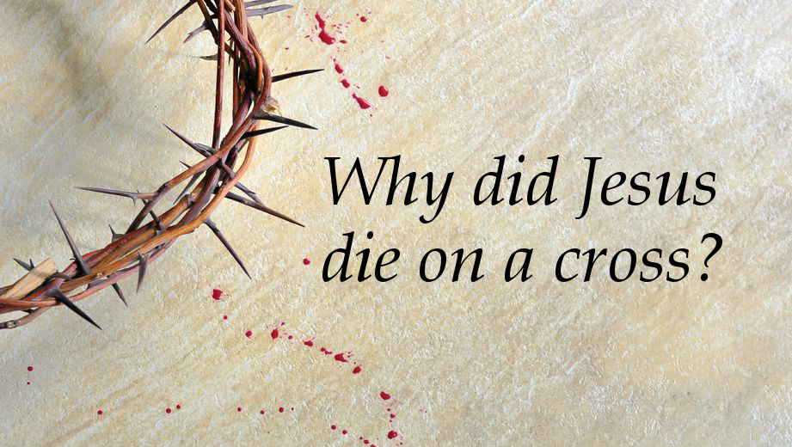

Slide 7

To be our Passover Lamb (Jn 1:29; 1 Cor 5:7).
To be the Propitiation for our sins (1 Jn 2:2).
To bring reconciliation with God (Rom 5:11; 2 Cor 5:18-19).
To provide redemption (Eph 1:7; Col 1:14).
To destroy the works of the devil (1 Jn 3:8; Mk 3: 26-27; Lk 10:18-19)

Slide 8
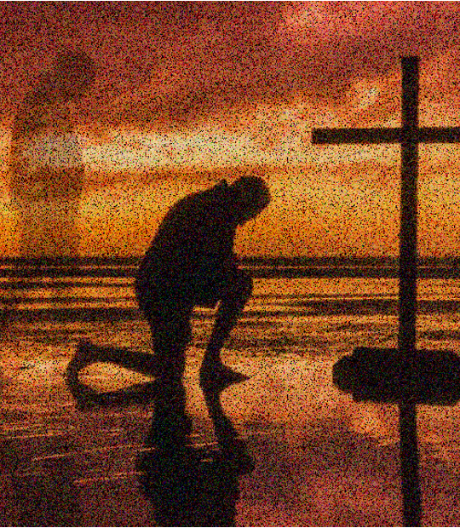

Purge out the leaven of sin, 1Cor 5:7
Live so as NOT to sin, 1 Jn 2:1
Walk pleasingly with God, Heb 11:5
No longer the devil’s pawn, 1 Jn 4:4
I don’t go there anymore, Rom 6:4, 6

