Slide 2
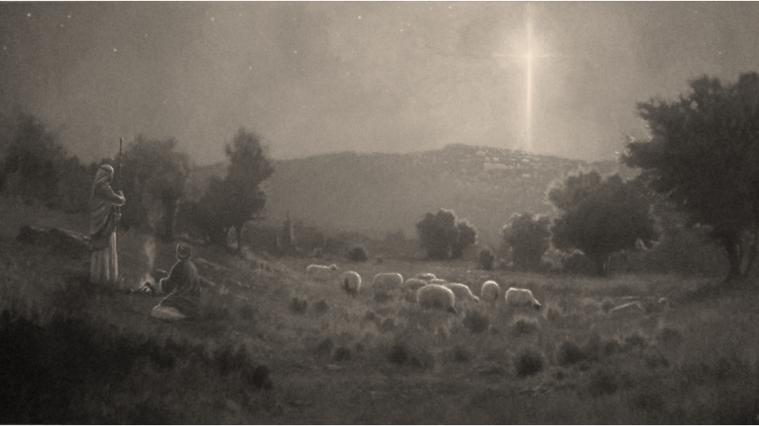
Now there were in the same country shepherds living out in the fields, keeping watch over their flock by night. And behold, an angel of the Lord stood before them, and the glory of the Lord shone around them, and they were greatly afraid. Then the angel said to them, do not be afraid, for behold, I bring you good tidings of great joy which will be to all people. For there is born to you this day in the city of David a Savior, who is Christ the Lord. And this will be the sign to you: You will find a Babe wrapped in swaddling cloths, lying in a manger.
Luke 2:8-12
His name was called Jesus, the name given by the angel before He was conceived in the womb.
Luke 2:21
His name was called Jesus

Slide 3

Jesus: Who can this be…?
Now when they had left the multitude, they took Him along in the boat as He was. And other little boats were also with Him. And a great windstorm arose, and the waves beat into the boat, so that it was already filling. But He was in the stern, asleep on a pillow. And they awoke Him and said to Him, Teacher, do You not care that we are perishing? Then He arose and rebuked the wind, and said to the sea, “Peace, be still!” And the wind ceased and there was a great calm…And they feared exceedingly, and said to one another, “Who can this be, that even the wind and the sea obey Him!”
Mark 4:36-40

Slide 4
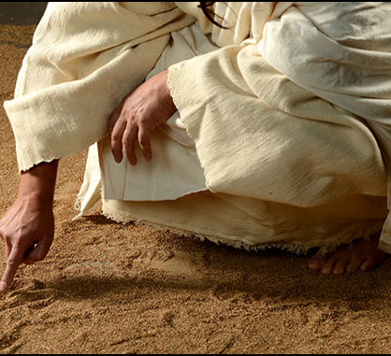
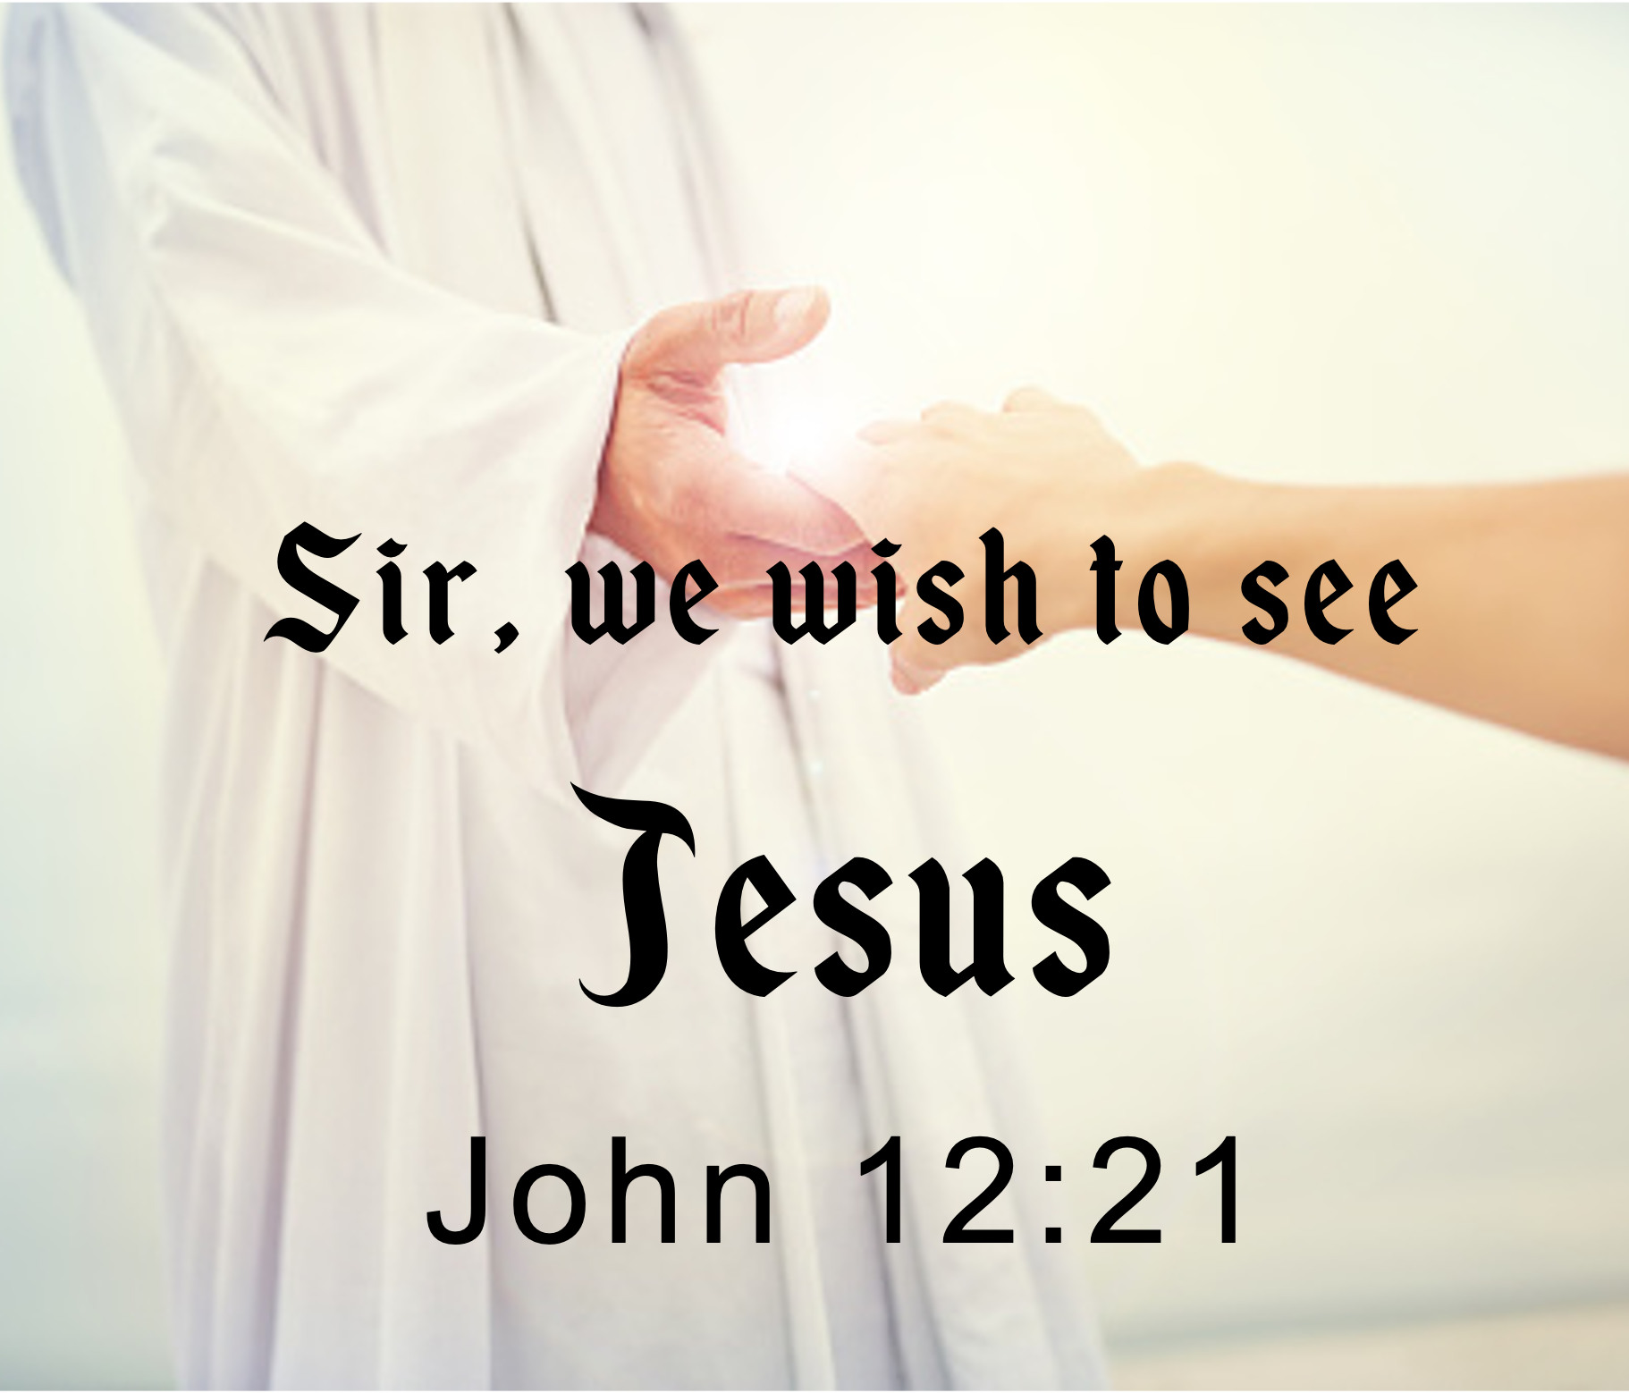
Who can this be…?
But we see Jesus, who was made a little lower than the angels, for the suffering of death crowned with glory and honor, that He, by the grace of God, might taste death for everyone.
Hebrews 2:9

Slide 5


Not a Myth, Allegory or Fable (2 Pet 1:16).
Not “Once upon a time,” “In a far-away Galaxy,” “In a land called Honah-Lee.”
Places: Jerusalem, Bethlehem, Egypt.
People: Herod, Pilate, Caesar Augustus.
Time: “…days that a decree went out…”

Slide 6

Begins with genealogy (Abraham)
An apostle of Jesus

Slide 7

Perhaps the oldest account
Begins with ministry of John

Slide 8

Researched an orderly account
Begins with genealogy (Adam)

Slide 9


Slide 10
Unlike Matthew, Mark and Luke John’s gospel is not biographical—it is theological.
In the beginning was the Word, and the Word was with God, and the Word was God. He was in the beginning with God. All things were made through Him, and without Him nothing was made that was made. (1:1-3)

Slide 11
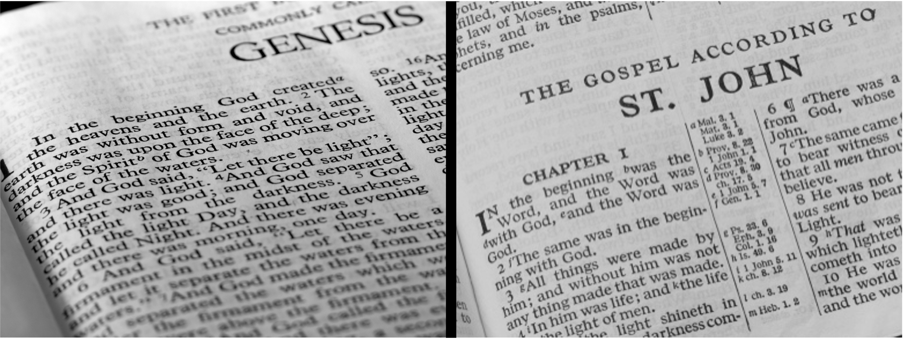
Genesis (Moses) Answers “What happened at the Beginning?” CREATION
Gospel of John Answers “Who was at the Beginning?” JESUS

Slide 12
In the Beginning (arché)
Beginning of creation
Matthew 19:4, 8; 24:21
Was (eimi) Greek verb which expresses being, [i.e., "to be”] (existence, i.e., without explicit limits).
This emphasizes the eternal pre-existence of Jesus—John 8:58; John 1:30.
Who can this be…?

Slide 13
The Word (logos)
Four times logos is found (vv1, 14)
Possibly an allusion to Gen 1:3, Then God said… Also, Psa 33:6.
But we must understand it in terms of John’s use: The person of Jesus Christ—“the only begotten of the Father full of grace and truth” (v14).
Who can this be…?

Slide 14
With (pros)
Face-to-face
The Word/Logos is not a verbal force—rather He is an intelligent being distinct from the Father.
With (pros) indicates a plurality in the Godhead (Gen 1:26; 3:22: 11:7).
John 5:18 (BTW, the Jews understood that claiming to be the Son of God made Him God).
Who can this be…?

Slide 15
God (theos)
Matt 1:23 “God with us…”
Emphasizes Jesus is God, not the Father, but God, nevertheless.
Isa 41:4—Rev 1:8
John 8:58—Exod 3:14
John 6:62—John 17:5
The infinite became finite (1 Tim 3:16)
Who can this be…?

Slide 16
All things made through him
Jesus was the agent of creation (Jn 1:3; Heb 1:2)
Col 1:16-17, For by Him all things were created that are in heaven and that are on earth, visible and invisible, whether thrones or dominions or principalities or powers. All things were created through Him and for Him. And He is before all things, and in Him all things consist.
Who can this be…?

Slide 17
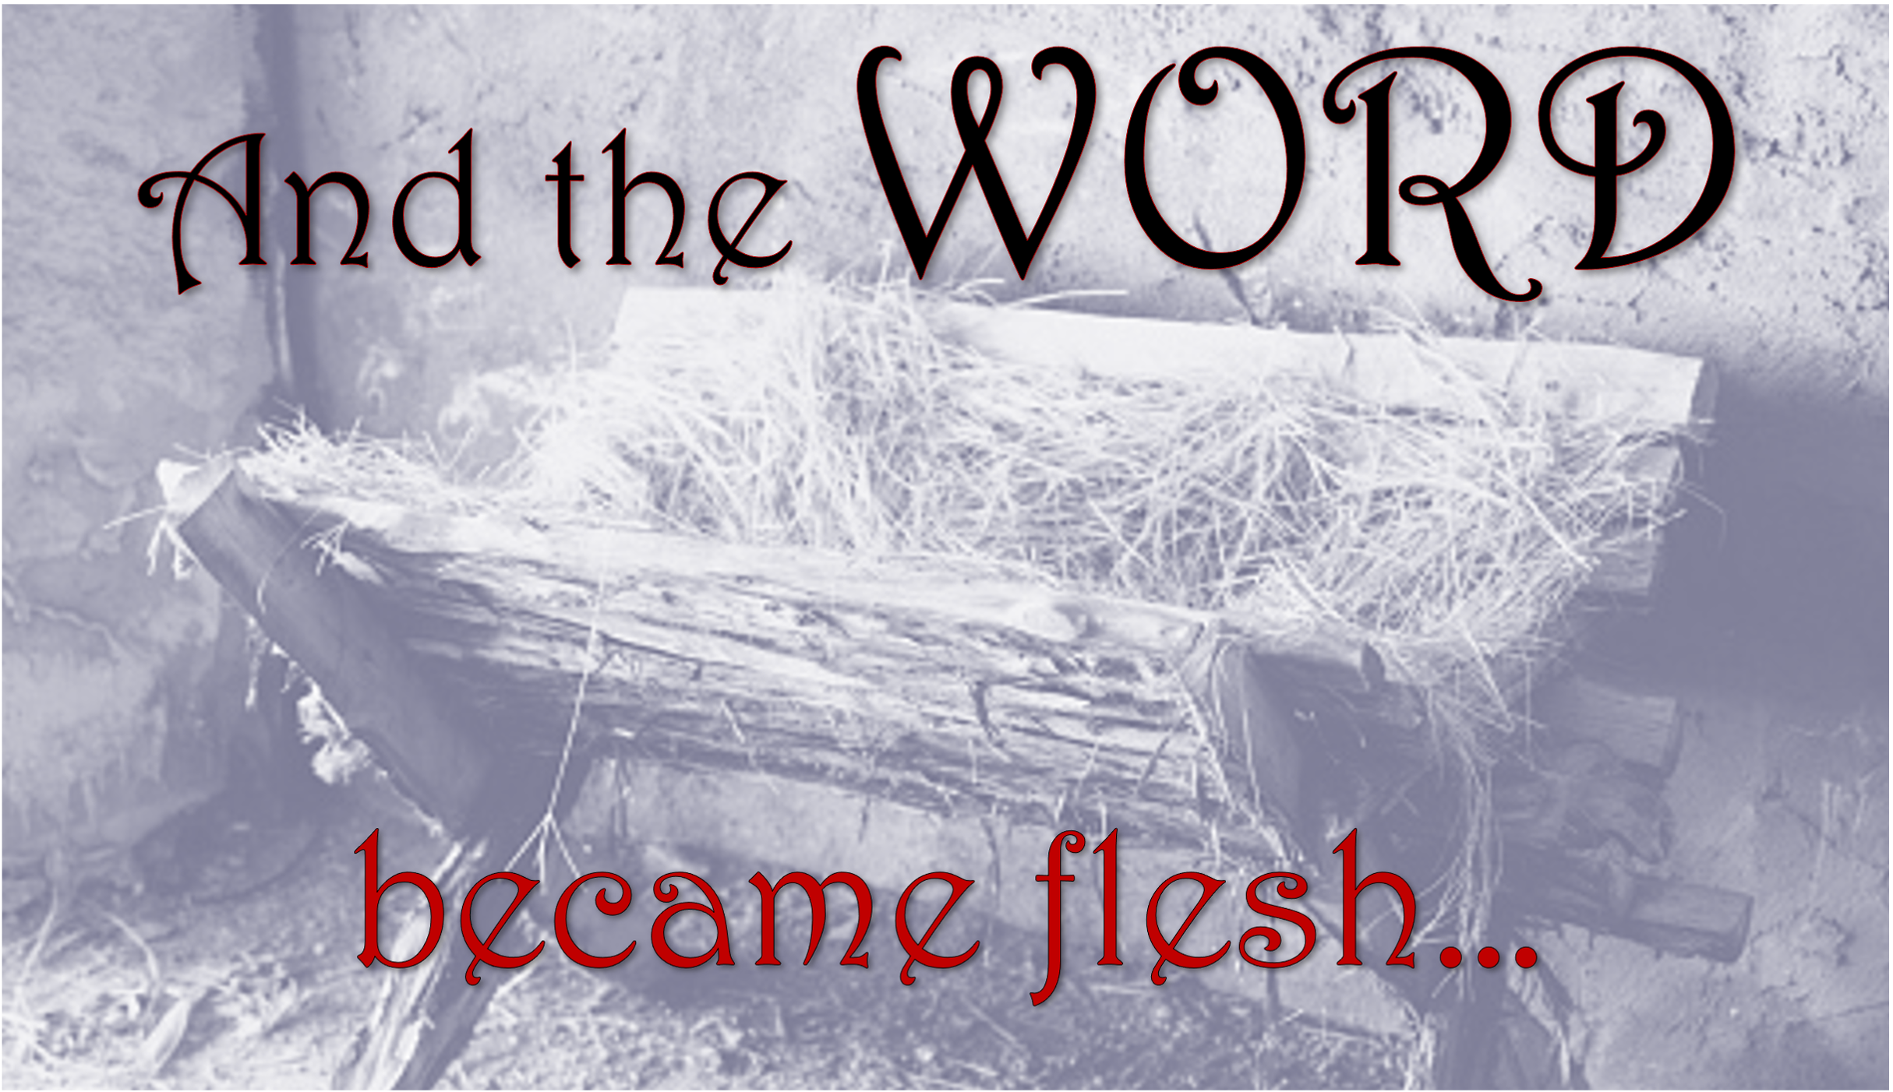
Jesus never relinquished or emptied Himself of His intrinsic deity.
Phil 2:5-7, Let this mind be in you which was also in Christ Jesus, who, being in the form of God, did not consider it robbery to be equal with God, but made Himself of no reputation, taking the form of a bondservant, and coming in the likeness of men.
Who can this be…?

Slide 18
Jesus never relinquished or emptied Himself of His intrinsic deity.
Phil 2:5-7, Who, being in very nature God, did not consider equality with God something to be used to his own advantage; rather, he made himself nothing by taking the very nature of a servant, being made in human likeness. (NIV)
Who can this be…?

Slide 19

At no time did Jesus
divest Himself of Deity
John 20:26-28, A week later his disciples were in the house again, and Thomas was with them. Though the doors were locked, Jesus came and stood among them and said, peace be with you! Then he said to Thomas, put your finger here; see my hands. Reach out your hand and put it into my side. Stop doubting and believe. Thomas said to him, my Lord and my God!

Slide 20
At no time did Jesus
divest Himself of Deity
1 John 5:20, We know also that the Son of God has come and has given us understanding, so that we may know him who is true. And we are in him who is true by being in his Son Jesus Christ. He is the true God and eternal life.

Slide 21
His Miracles
Jn 14:11; Matt 12:22-28; Jn 5:31-40; Acts 2:22
He forgave sins
Mk 2:1-11; Lk 23:43; Jn 8:2-11
He accepted worship
Matt 4:10; Matt 8:2; Jn 9:38; Jn 5:23
Infallible Proofs of the Deity of Jesus

Slide 22


Before sin there was a Savior (1 Peter 1:18-20)
His love is a matchless love (John 3:16; Galatians 2:20)
He has the power to save me (Romans 8:31-39)
He has a plan to save me (1 John 4:9-10; Romans 6:3-4)
I will live with Him in Glory (John 14:1-2; Romans 8:24)

Slide 23
