Slide 2
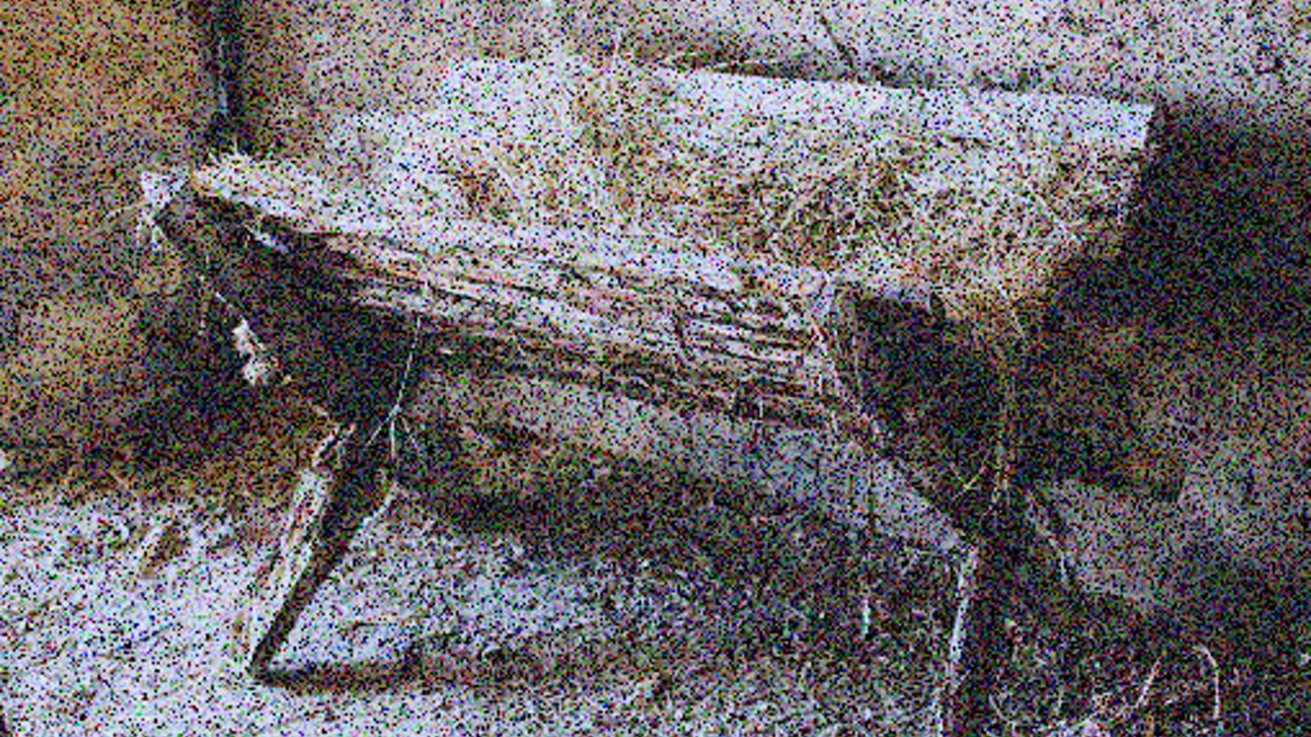

(Luke 1:30-31) Then the angel said to her, do not be afraid, Mary, for you have found favor with God. And behold, you will conceive in your womb and bring forth a Son, and shall call His name…

Slide 3

Infinite, and an infant.
Eternal, and yet born of a woman.
Almighty, and yet nursing on a woman's breast.
Supporting a universe, and yet needing to be carried in a mother's arms.
King of angels, and yet the reputed son of Joseph.
Heir of all things, and yet the carpenter's despised son.
Charles Spurgeon

Slide 4

Who can this be…?
Now when they had left the multitude, they took Him along in the boat as He was. And other little boats were also with Him. And a great windstorm arose, and the waves beat into the boat, so that it was already filling. But He was in the stern, asleep on a pillow. And they awoke Him and said to Him, Teacher, do You not care that we are perishing? Then He arose and rebuked the wind, and said to the sea, “Peace, be still!” And the wind ceased and there was a great calm…And they feared exceedingly, and said to one another, “Who can this be, that even the wind and the sea obey Him!”
Mark 4:36-40

Slide 5


Slide 6

Just another Jew (Jn 4:9)
A “teacher” who came from God (Jn 3:2)
A Sinner (Jn 9:16)
A glutton & a drunk (Lk 7:34)
Reincarnation of John the baptist (Matt 14:2)
Jeremiah, Elijah, one of the prophets (Matt 16:14)
The Son of God (Matt 16:16)
Always been controversy & continues (Jn 7:46-49)

Slide 7

…Bruno Bauer & company
…Modern Judaism
…Islam
…Hinduism
…Buddhism
…Mormonism
…Unitarian Universalism
…Jehovah’s Witnesses
…Liberal Theologians

Slide 8
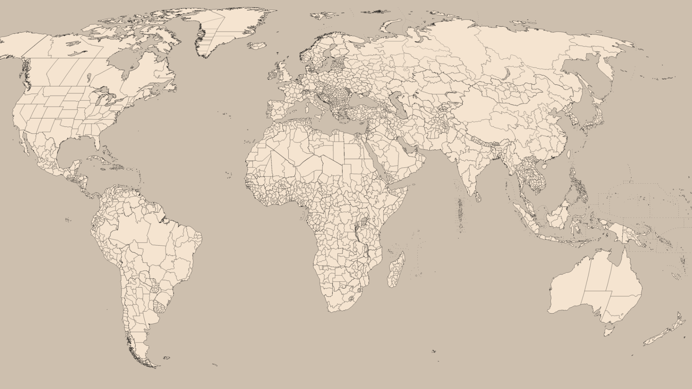
The BC / AD dating system was developed because of Jesus.
More books have been written about Jesus than any other person.
Nearly 150 movies have been produced about Jesus, many trying to correctly portray the gospel accounts of His life.
Nations (including USA) have used His words as bedrocks of their governments.
Schools, hospitals and humanitarian works have been founded upon His teachings.
Women have been elevated to a position of honor because of Him.
Slavery was abolished in Britain and America due to Jesus’ teaching.
Impact of Jesus on the World

Slide 9
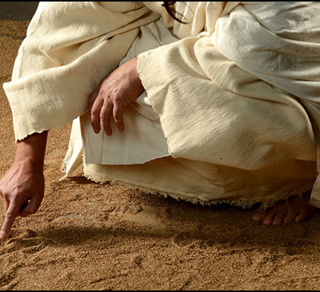

But we see Jesus, who was made a little lower than the angels, for the suffering of death crowned with glory and honor, that He, by the grace of God, might taste death for everyone.
Hebrews 2:9

