Slide 1
Judas betrayed Jesus for 30 pieces of silver
  Matt. 26:14-16; 47-49
  Matt. 27:3-10
  Acts 1:18-19
  Zech. 11:12 – 30 pieces paid to the Prophet as an insult!

Slide 2
Judas betrayed Jesus for 30 pieces of silver
Follows chronologically Judas (and others) resenting the “waste” of the precious ointment
  Matt. 26:6-13
  John 12:1-8 (not the same occasion as Mt. 26 or Mk. 14)
    Judas objected here (vv. 4-5)
    Reason: he was a thief (v. 6)
  What a contrast!
A woman (sinner)
spared no expense
Honoring
Jesus
A disciple plotting to betray Jesus for a measly sum

Slide 3
Judas betrayed Jesus for 30 pieces of silver
Follows chronologically Judas (and others) resenting the “waste” of the precious ointment
Two things that perplex us about Judas
  Why did he do what he did?
  After he did it, why did he feel so guilty?

Slide 4
Why Did Judas Betray Jesus?
“…Judas remains a mystery wrapped inside a riddle” (Ray Pritchard)
On the surface you would not expect it if Judas
  He was personally chosen to be an apostle
  He forsook all and followed the Lord
  He spent 3 ½ years traveling all over Israel with Jesus
  He saw all the miracles Jesus performed
  He heard all the great sermons he delivered
  He was sent out to preach like the others
  He was chosen to be their treasurer (Jno. 12:6)
  He was not less experienced than the others

Slide 5
Why Did Judas Betray Jesus?
“…Judas remains a mystery wrapped inside a riddle” (Ray Pritchard)
On the surface you would not expect it if Judas
So, what was his reason?
  Possible was for money
    He was a thief (Jno. 12:6)
    If greed was his motive – had little to show for his trouble

Slide 6
Why Did Judas Betray Jesus?
“…Judas remains a mystery wrapped inside a riddle” (Ray Pritchard)
On the surface you would not expect it if Judas
So, what was his reason?
  Possible was for money
  Possible that he was disillusioned
    Perhaps looked at Jesus as some kind of political Messiah that would overthrow the yoke of Rome
    Some wanted to make him such a king (John 6:14-15)
    Must notice the change: Popularity & crowds are gone (Jno. 6:66) – now surrounded by opposition and talk of death
    Perhaps he is angry at Jesus’ “failure” in his mission
    May be wants to be on the “winning side” (thinking of self)

Slide 7
Why Did Judas Betray Jesus?
“…Judas remains a mystery wrapped inside a riddle” (Ray Pritchard)
On the surface you would not expect it if Judas
So, what was his reason?
  Possible was for money
  Possible that he was disillusioned
  Possible because he was frightened
    Perhaps he sees the handwriting on the wall – thinking once they capture Jesus – what will they do with his apostles?
    Goes to the high priest to save his own life!

Slide 8
Judas betrayed Jesus for 30 pieces of silver
Follows chronologically Judas (and others) resenting the “waste” of the precious ointment
Two things that perplex us about Judas
Judas was given one last appeal to change his mind
  At the last supper said to him, “What you do, do it quickly” (John 13:27)
  He had once last chance – to change his mind
  Yet – when Jesus blew his cover – Satan entered him (v. 27) – he was determined to press on!

Slide 9
Judas betrayed Jesus for 30 pieces of silver
Follows chronologically Judas (and others) resenting the “waste” of the precious ointment
Two things that perplex us about Judas
Judas was given one last appeal to change his mind
There is something repulsive about a betrayal with a kiss of affection!
  A warm display of affection is reserved for the closest of friends
  Yet – that is how Judas chose to betray his Lord

Slide 10
Judas betrayed Jesus for 30 pieces of silver
Follows chronologically Judas (and others) resenting the “waste” of the precious ointment
Two things that perplex us about Judas
Judas was given one last appeal to change his mind
There is something repulsive about a betrayal with a kiss of affection!
30 pieces of silver was his price!
  That was the payment for a slave gored by an ox (Exo. 21:32)
  That was the insulting pay given to Zechariah (Zech 11:12)
  What is that worth?
    AMP Bible adds at Matt: $21.60 (1965)
    About $200 in 2022

Slide 11
30 Pieces of Silver
30 Pieces of Silver
What would it buy?
What would it not buy?
What lessons come home from this story?
What would it buy?
What would it not buy?
What lessons come home from this story?

Slide 12
30 Pieces of Silver
30 Pieces of Silver
What 30 Pieces of Silver Could Buy

Slide 13
What 30 Pieces of Silver Could Buy
Enough to buy the betrayal of Jesus
  Not what Jesus was worth – though Judas valued the money more than Jesus!
  What a pitiful estimated value of Jesus!
    To think 30 pieces of silver worth more!
    More than the unsearchable riches (Eph. 3:8)
    More a kingdom worth all could pay (Matt. 13:44-46)
  Anything that comes between us and our Lord – means we have devalued our Lord to that price!

Slide 14
What 30 Pieces of Silver Could Buy
Enough to buy the betrayal of Jesus
Enough to buy Judas
  Not what Jesus was worth – but what Judas as worth!
  Tells us the value he placed on himself
    He sold himself!
    He sold his loyalty to his friend
    He sold his reputation
    He sold his soul!
Lost his Lord – Lost his money – Lost his life!

Slide 15
What 30 Pieces of Silver Could Buy
Enough to buy the betrayal of Jesus
Enough to buy Judas
  Not what Jesus was worth – but what Judas as worth!
  Tells us the value he placed on himself
  How many times seen men who sell self for small sum:
    Sells out for shoplifting a small item
    Steal a tool from work
    Choose a small amount of money over the Lord

Slide 16
What 30 Pieces of Silver Could Buy
Enough to buy the betrayal of Jesus
Enough to buy Judas
  Not what Jesus was worth – but what Judas as worth!
  Tells us the value he placed on himself
  How many times seen men who sell self for small sum:
  Any choice (any sin) is price we put on our soul:
    Lie to spare a few minutes of embarrassment
    Outfit you know reveals too much
    Job over the Lord
    Absence from worship
    Moment of a sensual thrill

Slide 17
What 30 Pieces of Silver Could Buy
Enough to buy the betrayal of Jesus
Enough to buy Judas
  Not what Jesus was worth – but what Judas as worth!
  Tells us the value he placed on himself
  How many times seen men who sell self for small sum:
  Any choice (any sin) is price we put on our soul:
  Lesson to learn: Even if God himself is standing in front of you doesn’t make you faithful or loyal!

Slide 18
What 30 Pieces of Silver Could Buy
Enough to buy the betrayal of Jesus
Enough to buy Judas
Enough to buy a potter’s field
  Matt. 27:6-10
  Chief priest had no qualms murdering an innocent man
  But – would not allow “blood money” in the temple!
  Lessons:
    Height of hypocrisy
    How men rationalize terrible sin
    How far men go in searing their conscience

Slide 19
30 Pieces of Silver
30 Pieces of Silver
What 30 Pieces of Silver Could Buy
What 30 Pieces of Silver Could Not Buy
Remember:
Bought the money back
(Matt. 27:3)

Slide 20
What 30 Pieces of Silver Could Not Buy
Could not redeem Christ from his death
  No indication that he intended for this to lead to Christ’s death
  He immediately said, “I have sinned by betraying innocent blood” (Matt. 27:4)
  Nothing he could do to stop the death of Christ!
  Once sin is committed its consequences are out of our control
    Like Judas, many give little thought to consequences of their sin
    “I didn’t intend for that to happen”
    Giving back the money didn’t stop the consequences

Slide 21
What 30 Pieces of Silver Could Not Buy
Could not redeem Christ from his death
Could not buy concern for Judas’ soul from the Jews
  They said, “What is that to us? You see to it.” (Matt. 27:4) – “We couldn’t care less! – That’s your problem!”
  Found out they were willing to go further than he want to go – returning the money didn’t stop them from going all the way!
  There are some who couldn’t care less about you:
    False friends (Psa. 38:10-12; 1 Pet. 4:4)
    False teachers (2 Pet. 2:3)

Slide 22
What 30 Pieces of Silver Could Not Buy
Could not redeem Christ from his death
Could not buy concern for Judas’ soul from the Jews
Could not give Judas the pleasure he was seeking
  Must have given some thought to what he could buy / do with they money
  Soon found that money didn’t bring any happiness – thrust that money from him (Matt. 27:5)
  Sin always promises pleasure but brings pain
    Rom. 6:16
    2 Pet. 2:19

Slide 23
What 30 Pieces of Silver Could Not Buy
Could not redeem Christ from his death
Could not buy concern for Judas’ soul from the Jews
Could not give Judas the pleasure he was seeking
Could not buy a clear conscience
  Judas did not obtain the forgiveness that Peter got (who sinned the same night)
  Returning the money seems to be an attempt to clear his conscience
  Only through the gospel true peace comes (Phil. 4:7)

Slide 24
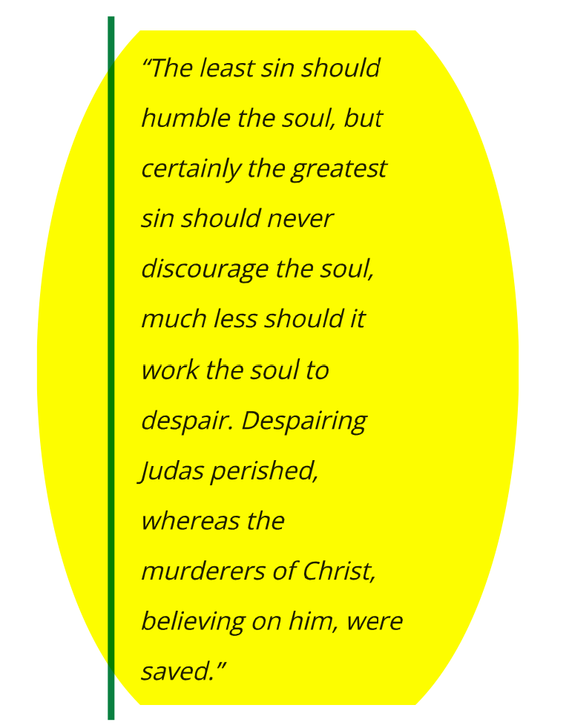
Thomas Brookes

Slide 25
What 30 Pieces of Silver Could Not Buy
Could not redeem Christ from his death
Could not buy concern for Judas’ soul from the Jews
Could not give Judas the pleasure he was seeking
Could not buy a clear conscience
Could not redeem Judas from hell
  They money returned could not save him from hell
  Judas’ destiny is hell (Matt. 26:24; John 17:12)
  If you choose a life that leads to hell - nothing can redeem you
    All the good you’ve done – all good deeds
    The fact that you have been faithful in the past

Slide 26
30 Pieces of Silver
30 Pieces of Silver
What 30 Pieces of Silver Could Buy
What 30 Pieces of Silver Could Not Buy

