Slide 1
Jesus Left Us A Wonderful Example of Praying to Imitate
Mark 1:35
Now in the morning, having risen a long while before daylight, He went out and departed to a solitary place; and there He prayed.
Luke 6:12
Now it came to pass in those days that He went out to the mountain to pray, and continued all night in prayer to God.

Slide 2
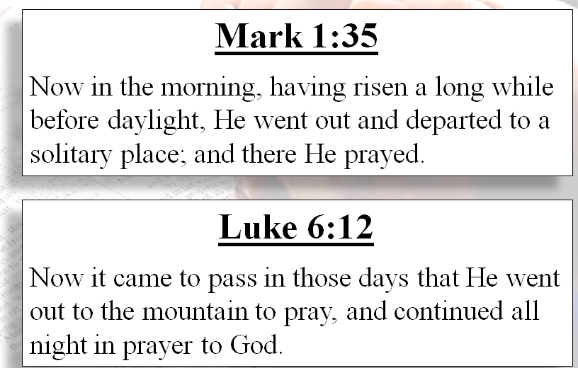
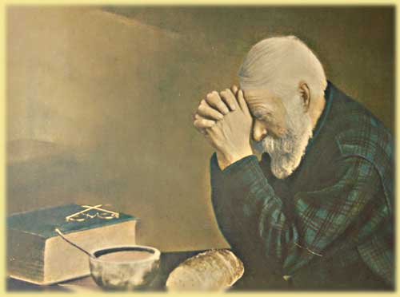
Gives Us An Opportunity To Examine Our Own

Slide 3
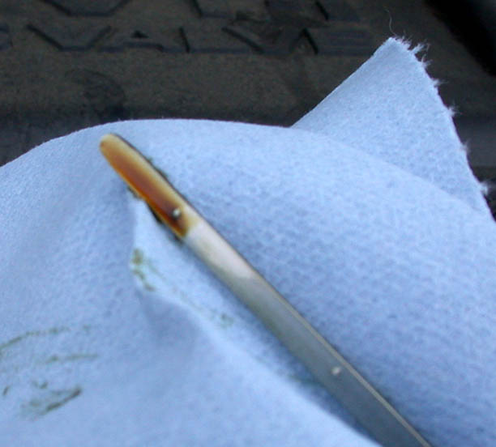
Our Spiritual Life and Maturity
Is Measured by Our Praying
“Dipstick”
To Measure Our Spirituality
May be on “Full” mark / “OK” range
May be lacking – “Add” range
Not likely – Overfilled – Have too much!

Slide 4
Praying Like
Jesus Prayed
Prayed In A Solitary Place

Slide 5
Prayed In A Solitary Place
Mark 1:35
Now in the morning, having risen a long while before daylight, He went out and departed to a solitary place; and there He prayed.
Luke 6:12
Now it came to pass in those days that He went out to the mountain to pray, and continued all night in prayer to God.

Slide 6
Prayed In A Solitary Place
A Quiet Place
  Free from distractions
  Where concentration is easy
  Understood that is must be from the heart
  The place must be conducive (Matt. 6:6)
  Jesus often went to wilderness to pray (Lk. 5:16)

Slide 7
Prayed In A Solitary Place
A Quiet Place
Prayer Was Important Enough To Go To A Place
  Didn’t just happen to be in solitary place
  Didn’t just happen to be in the mountains
  He journeyed to those places for the purpose of prayer
  True: prayer can be offered anywhere & anytime
  Also true: there is value in a place that allows prayer without distraction

Slide 8
Prayed In A Solitary Place
A Quiet Place
Prayer Was Important Enough To Go To A Place
Prayer Is Difficult:
  Noisy place
  Crowded place
  Distractions – mind wonders
  Surrounding makes one “rush”
  TV, phone, doorbell, children playing, etc.

Slide 9
Prayed In A Solitary Place
A Quiet Place
Prayer Was Important Enough To Go To A Place
Prayer Is Difficult:
Where Do You Pray?
  Find a place – solitary – conducive
  Bedroom, basement, office, barn, garage, et. al
  Worth finding a place to pray!

Slide 10
Praying Like
Jesus Prayed
Prayed In A Solitary Place
Made Time For Prayer

Slide 11
Made Time For Prayer
Mark 1:35
Now in the morning, having risen a long while before daylight, He went out and departed to a solitary place; and there He prayed.
Luke 6:12
Now it came to pass in those days that He went out to the mountain to pray, and continued all night in prayer to God.

Slide 12
Made Time For Prayer
There Is A Difference:
  Making time – and – as one has the time or finds time
  Making time – and – because one has time on hand

Slide 13
Made Time For Prayer
There Is A Difference:
Jesus Made Time:
  Got up early – to go pray
  In midst of a very busy schedule!
  So did David (Psa. 55:17)
  So did Daniel (Dan. 6:10)

Slide 14
Made Time For Prayer
There Is A Difference:
Jesus Made Time:
We Are Too Busy Sometimes
  Mornings are busy – getting ready work, school, etc.
  Days are packed full (work, recreation, family activities)
  Night – tired (fall asleep praying)

Slide 15
Made Time For Prayer
There Is A Difference:
Jesus Made Time:
We Are Too Busy Sometimes
Prayer Is Important Enough:
  Lose sleep
  Get up early (or stay up later)
  Make time for prayer (when you are most alert)

Slide 16
Praying Like
Jesus Prayed
Prayed In A Solitary Place
Made Time For Prayer
Had A Lot About Which To Pray

Slide 17
Had A Lot About Which To Pray
Mark 1:35
Now in the morning, having risen a long while before daylight, He went out and departed to a solitary place; and there He prayed.
Luke 6:12
Now it came to pass in those days that He went out to the mountain to pray, and continued all night in prayer to God.

Slide 18
Had A Lot About Which To Pray
Continued All Night
  Was that one continuous prayer all night?
  Was that several prayers offered throughout the night?
  Were thoughts / requests ever repeated?
One Thing For Sure:
That’s a lot of praying!

Slide 19
Had A Lot About Which To Pray
Continued All Night
Does Not Suggest Prayers Must Be Long
  Some prayers were long (Luke 6:12)
  Some prayers were short (Matt. 26:39, 42, 44)

Slide 20
Had A Lot About Which To Pray
Continued All Night
Does Not Suggest Prayers Must Be Long
So Much About Which to Pray
  Various elements (1 Tim. 2:1)
  Specific things (Jas. 5:17-18)
  Specific people (Luke 22:32)

Slide 21
Many Things To Say To God
  Spiritual blessings
    Sacrifice of Son
    Remission of sins
    Hope of eternal life
    Mediator – pleads cause
    Word – clarity & simplicity
    Privilege of prayer
    Freedom have to worship
Thanksgiving

Slide 22
Many Things To Say To God
  Spiritual blessings
  Physical / Material
    Food
    Clothing
    Shelter
    Health
    Transportation
    Modern conveniences
    Money
    Jobs
Thanksgiving

Slide 23
Many Things To Say To God
  Spiritual blessings
  Physical / Material
  Family
    Husband / Wife
    Children
    Parents
    Brothers / Sisters
    Other family members
Thanksgiving

Slide 24
Many Things To Say To God
  Spiritual blessings
  Physical / Material
  Family
  Friends / Brethren
Thanksgiving

Slide 25
Many Things To Say To God
Thanksgiving
  Almighty (Rev. 4:8)
  Great & Awesome (Neh. 1:5)
  One who blesses (Jas. 1:17)
  Holds world in hand (Isa. 40)
  Spoke world into being (Psa. 33)
Praise

Slide 26
Many Things To Say To God
Thanksgiving
  Help
  Strength
  Protection
  Wisdom
  Forgiveness
  Weather
Praise
Requests

Slide 27
Many Things To Say To God
Thanksgiving
  Rulers / Leaders
  Sick
  Alien sinners
  Erring children of God
  Weak in the faith
  Elders
  Deacons
  Preacher
  Those we love / care about
Praise
Requests
Intercession

Slide 28
Had A Lot About Which To Pray
Continued All Night
Does Not Suggest Prayers Must Be Long
So Much About Which to Pray
If The Sinless Son of God Needed to Pray That Much
There Must Be A Need For Us To Pray A Lot!

Slide 29
Praying Like
Jesus Prayed
Prayed In A Solitary Place
Made Time For Prayer
Had A Lot About Which To Pray
Prayed Before An Important Decision

Slide 30
Prayed Before An Important Decision
Jesus Prayed Before A Major Decision

Slide 31
Prayed Before An Important Decision
Luke 6:12
12 Now it came to pass in those days that He went out to the mountain to pray, and continued all night in prayer to God

Slide 32
Prayed Before An Important Decision
Luke 6:12-13
12 Now it came to pass in those days that He went out to the mountain to pray, and continued all night in prayer to God.
13 And when it was day, He called His disciples to Himself; and from them He chose twelve whom He also named apostles:

Slide 33
Prayed Before An Important Decision
Jesus Prayed Before A Major Decision
Time To Ask For Wisdom
  Jas. 1:5
  Opportunities
  Defeat

Slide 34
Prayed Before An Important Decision
Jesus Prayed Before A Major Decision
Time To Ask For Wisdom
We Face Important Decisions
  Getting married
  Having children
  Jobs
  College
  Selecting elders
  Selecting preachers
  Taking on some responsibility

Slide 35
Praying Like
Jesus Prayed
Jesus - Our Example

Slide 36
Jesus - Our Example
“For to this you were called, because Christ also suffered for us, leaving us an example, that you should follow His steps).”
(1 Pet. 2:21)
hupogrammos, hoop-og-ram-mos'
“from a compound of 5259 (hupo) and 1125 (grapho); an underwriting, i.e. copy for imitation (figuratively):--example.” (Strong’s).

Slide 37
Writing Copy
(Example)
ABCEDFGHIJKLM
NOPQRSTUVWXYZ
A

Slide 38
Jesus - Our Example
14 "If I then, your Lord and Teacher, have washed your feet, you also ought to wash one another's feet.
15 "For I have given you an example, that you should do as I have done to you.”
(John 13:14-15)
He who says he abides in Him
ought himself also to walk just as He walked.
(1 John 2:6)
“Imitate me, just as I also imitate Christ.”
(1 Cor. 11:1)
“Now may the God of patience and comfort grant you to be like-minded toward one another, according to Christ Jesus,”
(Rom. 15:5)

Slide 39
Praying Like
Jesus Prayed
Prayed In A Solitary Place
Made Time For Prayer
Had A Lot About Which To Pray
Prayed Before An Important Decision

