Slide 1
Questions
Questions asked – have varying purposes:
  Seeking information that we don’t know
  May answer a question with a question
  Provoke a thought – make us think
Jesus asked & answered many questions

Slide 2
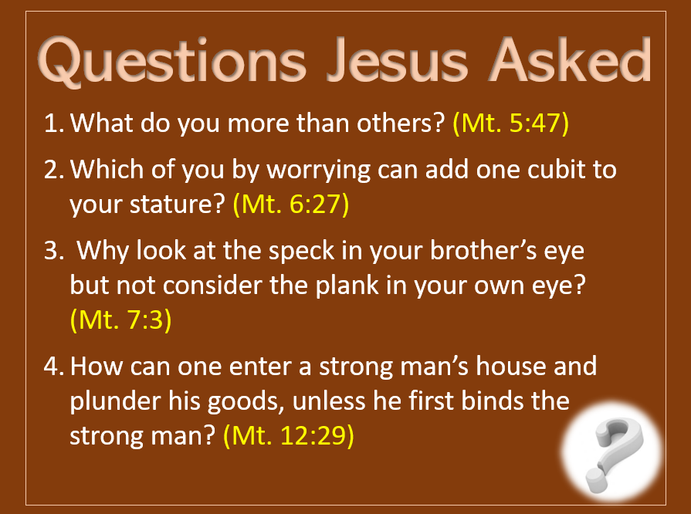
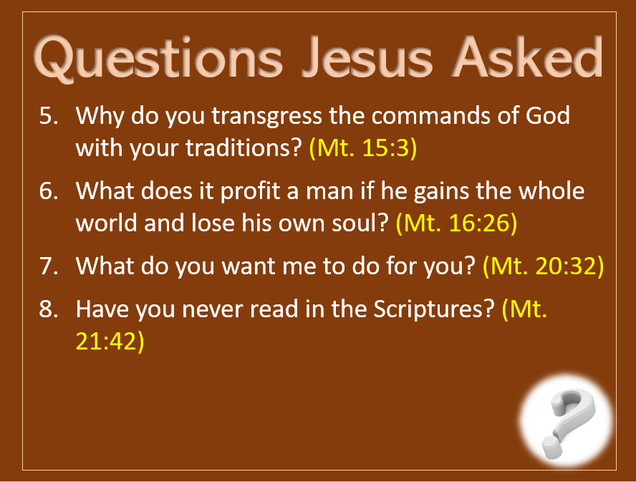
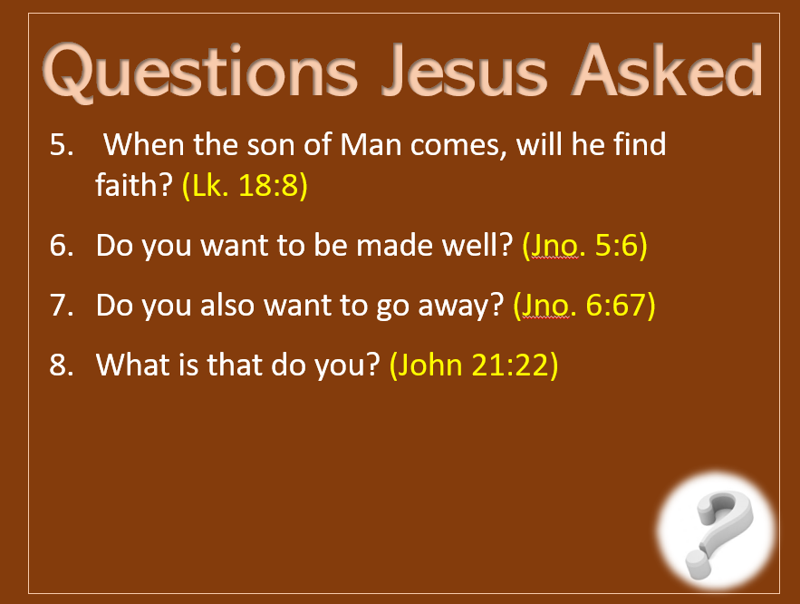
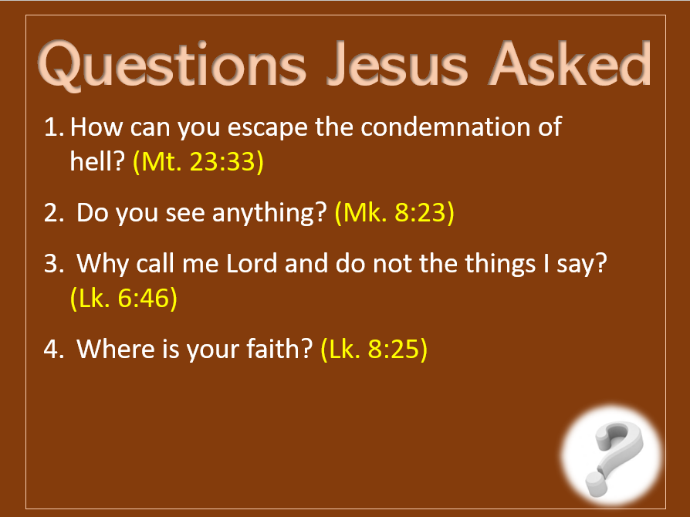

Questions Jesus Asked

Slide 3
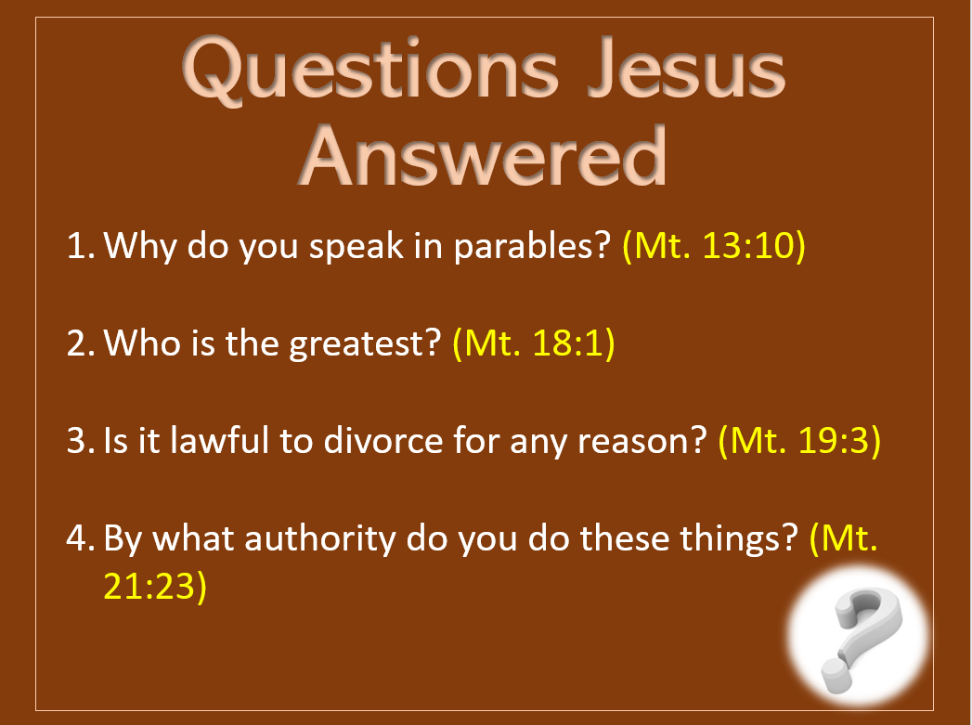
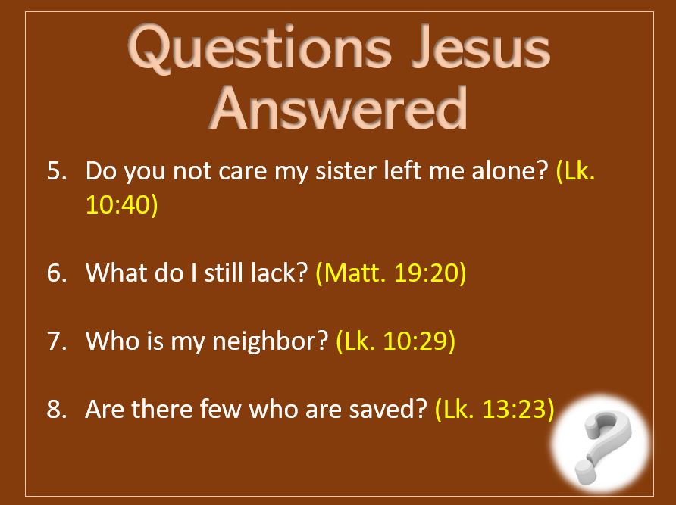
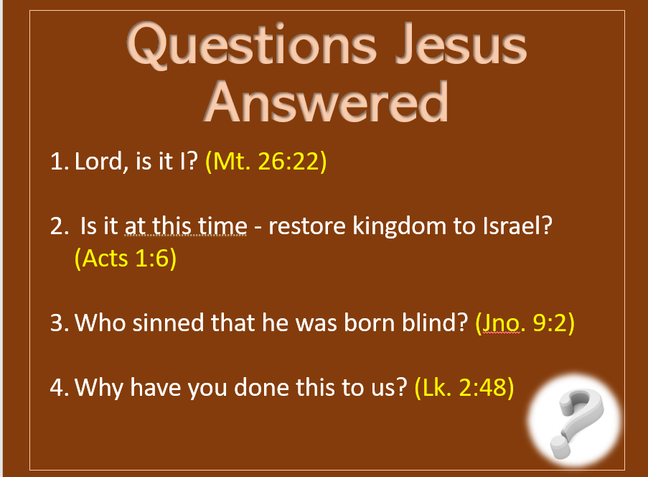
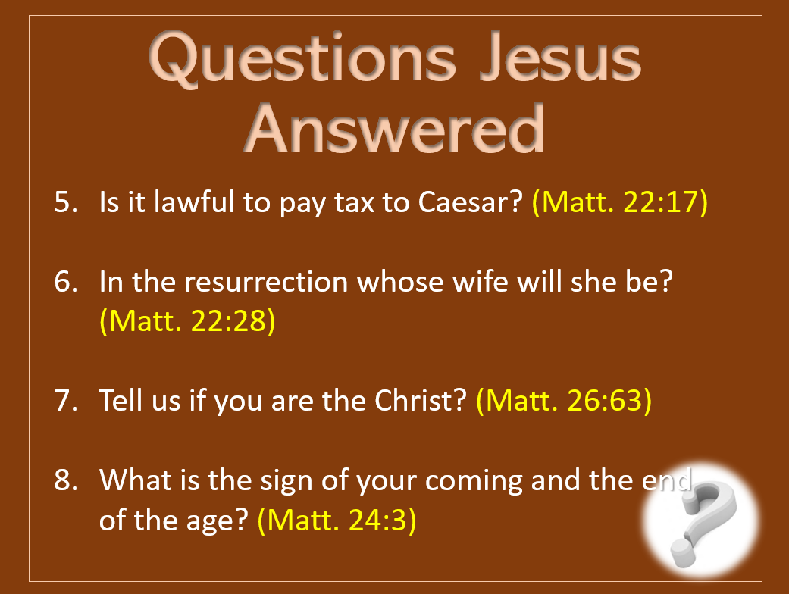
Questions Jesus
Answered

Slide 4
Questions
In
Acts

Slide 5
Questions in Acts
Whatever could this mean? (Acts 2:12)

Slide 6
Whatever could this mean? (Acts 2:12)
Context:
  Day of Pentecost (v. 1)
  Apostles spoke in tongues (vv. 2-4)
  People had gathered from every nation (v. 5)
  The people marvel that these men (being Galileans) are speaking in their language (vv. 6-12)
  Question asked (v. 12)

Slide 7
Whatever could this mean? (Acts 2:12)
Context:
Answer:
  This is the fulfillment of Joel 2 (vv. 16-21)
  Speaking by the power of God (vv. 17-19)
  Thus, what these men preached is the truth

Slide 8
Whatever could this mean? (Acts 2:12)
Context:
Answer:
Application:
  Need to always look beyond the surface and ask, “What does this mean?” “What is implied?”
  Part of meditation (1 Tim. 4:15)
  Need to ask, “How does this apply?”
  Need to ask this question when truth is taught
  Need to ask this question when doctrine of men is taught

Slide 9
Questions in Acts
Whatever could this mean? (Acts 2:12)
What shall we do? (Acts 2:37)

Slide 10
What shall we do? (Acts 2:37)
Context:
  Sermon on Christ – evidence of who he is (vv. 22-36)
  The hearers were convicted of sin (vv. 23, 36)
  The message cut to the heart (v. 37)
  Asked, “What shall we do?” (v. 37)
  Same question asked in Acts 16:30 (Jailer)

Slide 11
What shall we do? (Acts 2:37)
Context:
Answer:
  Repent and be baptized (vv. 38, 41)
  Believe on the Lord and then was baptized (Acts 16:31, 33)

Slide 12
What shall we do? (Acts 2:37)
Context:
Answer:
Application:
  Are conditions of salvation laid down
  Most important question you could ask
  Both cases (Acts 2, 16) was immediate response - urgency

Slide 13
Questions in Acts
Whatever could this mean? (Acts 2:12)
What shall we do? (Acts 2:37)
By power or by what name have you done this? (Acts 4:7)

Slide 14
By power or by what name have you done this? (Acts 4:7)
Context:
  Healing of a lame man (3:1-11)
  Sermon on Christ – by Him the miracle was done (3:16)
  Peter and John arrested and taken before the Sanhedrin counsel (4:1-22)
  Asked by what power or name done this? (v. 7)
    Include the miracle (v. 9)
    Preaching resurrection (vv. 2-3)

Slide 15
By power or by what name have you done this? (Acts 4:7)
Context:
Answer:
  Miracle was possible by the resurrected Christ (vv. 9-10)
  Salvation through Christ (vv. 11-12)
  Boldness: did not bow to pressure (vv. 17-30)

Slide 16
By power or by what name have you done this? (Acts 4:7)
Context:
Answer:
Application:
  To act in one’s name is to act by his authority (cf. Col. 3:17)
  We need to be prepared to answer the question concerning authority of doctrine & practice (1 Pet. 3:15; 4:11)
  Need to ask others about authority for their doctrine & practice

Slide 17
Questions in Acts
Whatever could this mean? (Acts 2:12)
What shall we do? (Acts 2:37)
By power or by what name have you done this? (Acts 4:7)
Why has Satan filled your heart…? Why have you conceived this thing…? (Acts 5:3,4)

Slide 18
Why has Satan filled your heart…? Why have you conceived this thing…? (Acts 5:3,4)
Context:
  Disciples selling and giving for poor saints (4:32-37)
  Ananias and Sapphira sold land and gave money (5:1-11)
    Kept a portion for self (vv. 2, 4) – which was fine
    Lied saying they gave all (v. 3)
  Question – actually, four questions (vv. 3-4)

Slide 19
Why has Satan filled your heart…? Why have you conceived this thing…? (Acts 5:3,4)
Context:
Answer:
  Didn’t give an answer
  Struck dead (vv. 5-8)

Slide 20
Why has Satan filled your heart…? Why have you conceived this thing…? (Acts 5:3,4)
Context:
Answer:
Application:
  When we decide to sin – we allow Satan to fill our hearts
  When we try to hide reality (hypocrisy), what makes us think we can escape?
  Sin is totally without reason – could have chosen another option

Slide 21
Questions in Acts
Do you understand what you are reading? (Acts 8:30)

Slide 22
Do you understand what you are reading?
(Acts 8:30)
Context:
  Conversion of the Eunuch (vv. 26-40)
  Reading Isaiah 53 (vv. 28, 32-35)
  Philip asked if he understood (v. 30)

Slide 23
Do you understand what you are reading?
(Acts 8:30)
Context:
Answer:
  Said, “How can I, unless someone guides me?” (v. 31)
  Asked, “…of whom does the prophet say this, of himself or some other man?” (v. 34)
  Philip explained the text (v. 35)

Slide 24
Do you understand what you are reading?
(Acts 8:30)
Context:
Answer:
Application:
  Difference in reading and understanding
  Times we need some guidance (show what the text means and why)
  A text is meaningless if we don’t know who or what it is about
  Do you try to understand what you read?

Slide 25
Questions in Acts
Do you understand what you are reading? (Acts 8:30)
What hinders me from being baptized? (Acts 8:36)

Slide 26
What hinders me from being baptized?
(Acts 8:36)
Context:
  Conversion of the Eunuch (vv. 26-40)
  Heard preaching about Jesus (v. 35)
    Must have included conditions
    Must have included baptism
  Sees water and asked question (v. 36)

Slide 27
What hinders me from being baptized?
(Acts 8:36)
Context:
Answer:
  If believe may be baptized (v. 37)
  Confessed his faith (v. 37)
  Baptized (v. 38)

Slide 28
What hinders me from being baptized?
(Acts 8:36)
Context:
Answer:
Application:
  Possible to have a legitimate hinderance:
    If don’t believe (Mark 16:16)
    If don’t repent (Acts 2:38)
  Good question: What hinders you?
    Some sin – not ready to quit?
    Fear what friends or family might say?
    Waiting for better time?
    Afraid you can’t be faithful?

Slide 29
Questions in Acts
Do you understand what you are reading? (Acts 8:30)
What hinders me from being baptized? (Acts 8:36)
Why are you persecuting me? (Acts 9:4)

Slide 30
Why are you persecuting me? (Acts 9:4)
Context:
  Saul persecuting the church (7:58; 8:1-3; 9:1)
  On the road to Damascus to persecute (9:2)
  Lord appeared to Saul and asked question (v. 4)
  What he was doing to the church he was doing to Christ

Slide 31
Why are you persecuting me? (Acts 9:4)
Context:
Answer:
  Asked “Who are you Lord?” (v. 5)
  Didn’t fully realize (at this point) who the Lord was
  Came to realize who the Lord is and that what he was doing to the Lord’s people, he was doing to the Lord

Slide 32
Why are you persecuting me? (Acts 9:4)
Context:
Answer:
Application:
  What we do to God’s people, we do to the Lord
  Good question: Why do you:
    Criticize me?
    Ignore me?
    Run we down to people of the world?
    Spend little time with me?
    Want to spend more time with the world?
  Why do you oppose me?

Slide 33
Questions in Acts
What do you want me to do? (Acts 9:6)

Slide 34
What do you want me to do? (Acts 9:6)
Context:
  Lord appeared to Saul (9:1-9)
  Saul asked, “Who are you Lord?” (v. 5)
  Lord answered: “I am Jesus” (v. 5)
  Saul asked question (v. 6)

Slide 35
What do you want me to do? (Acts 9:6)
Context:
Answer:
  Go into the city and will be told what do to (v. 6)
  Ananias told him to arise and be baptized (Acts 22:16)

Slide 36
What do you want me to do? (Acts 9:6)
Context:
Answer:
Application:
  Ought to be asking what the Lord want us to do
  Answer to the question found in the word
  What do you want me to do:
    To be saved?
    To build my faith?
    To worship?
    For my family?
    For my neighbor? Lost?

Slide 37
Questions in Acts
What do you want me to do? (Acts 9:6)
Into what were you baptized? (Acts 19:3)

Slide 38
Into what were you baptized? (Acts 19:3)
Context:
  On 3rd Journey Paul came to Ephesus (1)
  Asked disciples if have received Spirit (v. 2)
  Disciples didn’t know anything about it (v. 2)
  Question (v. 3)

Slide 39
Into what were you baptized? (Acts 19:3)
Context:
Answer:
  John’s baptism (v. 3)
  Baptism of John was not the same as baptism of great commission (v. 4)
  Baptized in the name of Jesus (v. 5)

Slide 40
Into what were you baptized? (Acts 19:3)
Context:
Answer:
Application:
  All baptisms are not the same
    Some think if baptism is essential then if have been “baptized” in any way – should be fine
    Baptism must have the right elements

Slide 41
Person
believer / repents
(Mark 16:16; Acts 2:38)
Person
unbeliever / infant
Action
immersion / burial
(Rom. 6:3-4; Col. 2:12)
Action
sprinkle / pour
Authority
Christ
(Acts 2:38; 19:5)
Authority
Pope / church vote
Purpose
saved / remission
(Mark 16:16; Acts 2:38)
Purpose
are saved / outward sign
Direction
into one body
(1 Cor. 12:13)
Direction
into a denomination

Slide 42
Into what were you baptized? (Acts 19:3)
Context:
Answer:
Application:
  All baptisms are not the same
  Into what were you baptized?
    A denomination?
    Christ? For Remission of sins? Why continue in sin (Rom. 6)
    Salvation? Why talk like those not baptized are saved?
    Being a Christian? Why talk like there are good Christian people who are not members of the church?

Slide 43
Questions
In
Acts

Slide 44
Questions in Acts
Whatever could this mean? (Acts 2:12)
What shall we do? (Acts 2:37)
By power or by what name have you done this? (Acts 4:7)
Why has Satan filled your heart…? Why have you conceived this thing…? (Acts 5:3, 4)

Slide 45
Questions in Acts
Do you understand what you are reading? (Acts 8:30)
What hinders me from being baptized? (Acts 8:36)
Why are you persecuting me? (Acts 9:4)

Slide 46
Questions in Acts
What do you want me to do? (Acts 9:6)
Into what were you baptized? (Acts 19:3)

