Slide 2
Bible Authority

Slide 3
Bible Authority
I. True Source of Authority: Jesus

Slide 4
True Source of Authority: Jesus
Jesus Has All Authority (Matthew 28:18)
Everything is to Be Done By His Name (Colossians 3:17)
He is Head Over All Things to the Church (Ephesians 1:22-23)

Slide 5
Bible Authority
I. True Source of Authority: Jesus
II. How to Establish Authority

Slide 6
How to Establish Authority
Example of Acts 15
  Direct Statement of Scripture (Acts 15:13-21)
  Approved Apostolic Example (Acts 15:12)
  Necessary Inference (Acts 15:8-11)

Slide 7
How to Establish Authority
Example of Acts 15
Example of Lord’s Supper
  What to Partake of: Command (1 Corinthians 1:23-26)
  When to Partake: Approved Apostolic Example (Acts 20:7)
  How Often to Partake: Necessary Inference (Acts 20:7; Exodus 20:8)

Slide 8
Bible Authority
I. True Source of Authority: Jesus
II. How to Establish Authority
III. Generic Versus Specific Authority

Slide 9
Generic Versus Specific Authority
Some Commands Are Specific While Others Are More Generic In Nature
Consider the Following Chart

Slide 10
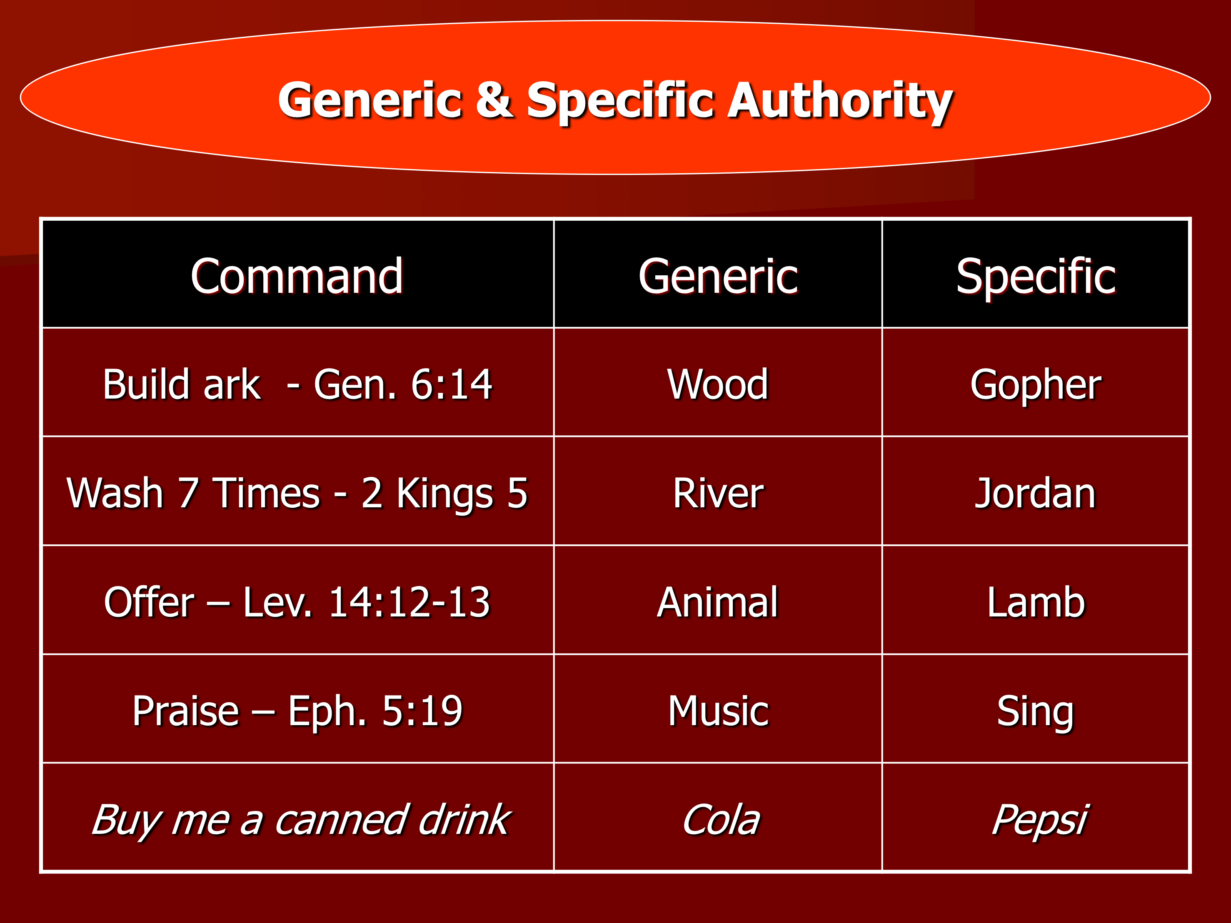

Slide 11
Bible Authority
I. True Source of Authority: Jesus
II. How to Establish Authority
III. Generic Versus Specific Authority
IV. Authority and the Silence of the Scripture

Slide 12
Authority and the Silence of the Scripture
Some Believe the Silence of Scriptures is Permissive
Consider the Following Passages:

Slide 13
Passages Showing Silence of Scriptures Prohibitive
Cannot Go Beyond What is Written (1 Corinthians 4:6)
We Have “All Things That Pertain to Life and Godliness” (2 Peter 1:3)
Scriptures Makes Us “Complete” (2 Timothy 3:16-17)
Cannot Add to Scripture (Revelation 22:18-19)
Must Speak As Oracles of God (1 Peter 4:11)

Slide 14
Authority and the Silence of the Scripture
Some Believe the Silence of Scriptures is Permissive
Consider the Following Passages:
Christ and His Priesthood
  Christ is From Judah (Matthew 1:2-3, 17-18)
  Priest Were From Levi, That Excluded All Other Tribes

