Slide 2
Acts 17:11
These were more fair-minded than those in Thessalonica, in that they received the word with all readiness, and searched the Scriptures daily to find out whether these things were so.

Slide 3
Acts 17:11
Now these Jews were more noble than those in Thessalonica; they received the word with all eagerness, examining the Scriptures daily to see if these things were so.

Slide 4
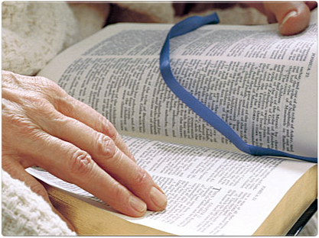
The Noble Bereans

Slide 5
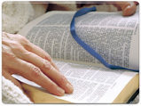
The Noble Bereans
The Background

Slide 6
The Background
The Apostle Paul Was On The Second Preaching Journey (Acts 16-18)
While At Thessalonica The Apostle Was Met With Great Resistance from the Jews
  Paul had gone into the synagogue as was his custom - Acts 17:2
  “some” were persuaded, but the Jews grew envious
  The Jews stir up a riot and Paul is forced to leave Thessalonica

Slide 7
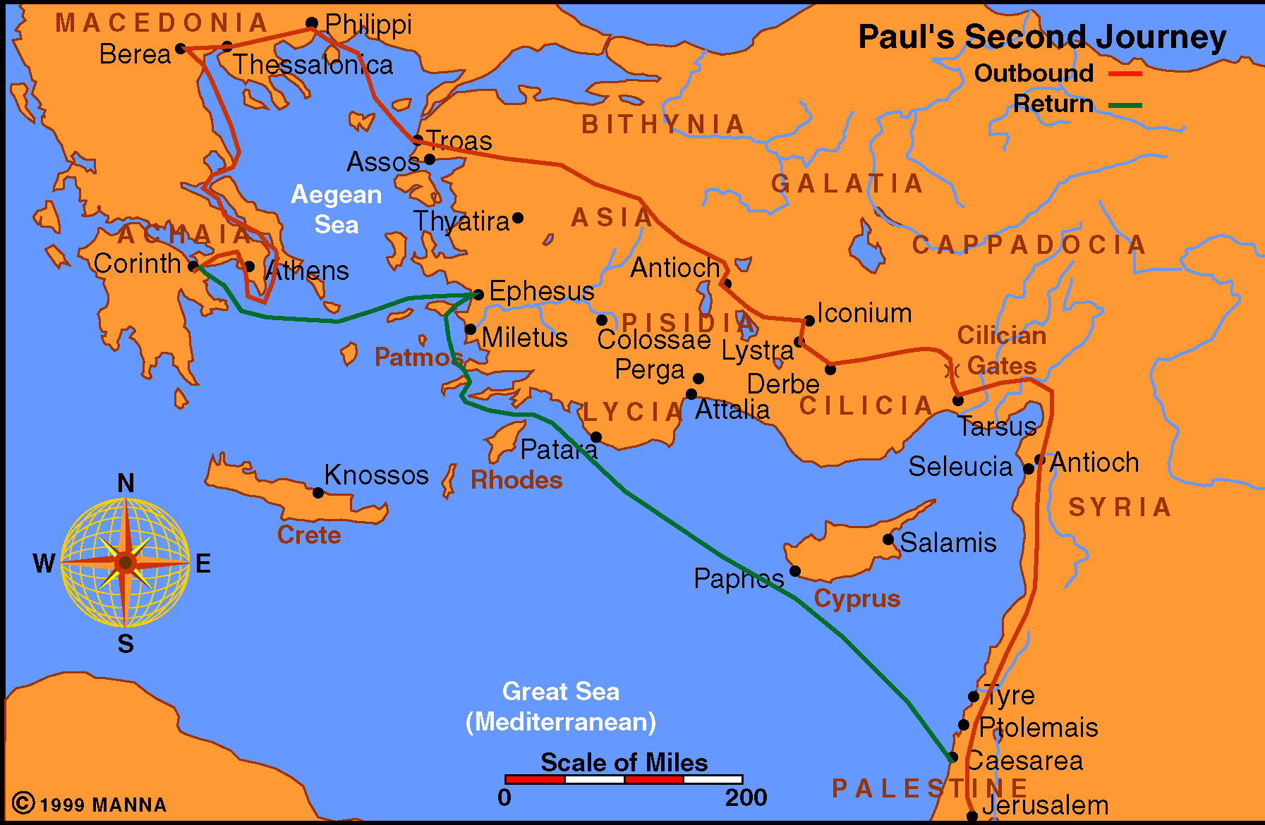
Paul Journey 2

Slide 8
The Background
“‘THESE’ were more fair-minded”
  “THESE” = “THESE JEWS” (ESV)
  It is a contrast between the attitude exhibited in Thessalonica with that of the Bereans

Slide 9
The Noble Bereans
The Background
The Meaning of Noble

Slide 10
The Meaning of Noble
Noble
  Strongs - “well born, that is, high in rank, or figuratively generous: more noble, nobleman”
  Thayer - “well born, of a noble family, noble minded”
It is obviously used here to describe their thinking

Slide 11
The Meaning of Noble
Various Translations
  “These were more fair-minded” - NKJV
  “The people were more open-minded” - CSB
  “These Jews were more receptive than those in Thessalonica” - NRSV

Slide 12
The Noble Bereans
The Background
The Meaning of Noble
What Made Them Noble-minded

Slide 13
What Made Them Noble-minded
They Received the Word
  They were willing to listen to the teaching of Paul and Silas
  Some close their ears to the truth
    Matthew 13:13-15
    Acts 13:44-47
    Acts 22:21-22
  The Bereans Were Open-minded and Willing to Listen
    Quality Needed by Man - James 1:19; Ecc.5:1-2
    Being willing to listen does not mean believing everything you ear

Slide 14
What Made Them Noble-minded
They Received the Word With All Readiness
    ESV - “With eagerness” or “with great eagerness”
    They wanted to know the truth - 2 Thess.2:10-12
      Some want their itch scratched - 2 Tim.4:3
      Some hear simply as a curiosity - Acts 17:16-21
      Some hear to find fault - Acts 17:32
    They intended to obey the truth
      James 1:2, 22-25
      Neh.8:13-18

Slide 15
What Made Them Noble-minded
They Searched the Scriptures
  They Knew Where to Find the Truth
    They Knew the Scriptures Were God’s Word - 2 Tim.3:16-17; 2 Peter 1:20-21
    They Knew God’s Word Was Truth - John 17:17
  They Knew the Value of the Scriptures
    They Knew the Lord Alone Had the Words of Life -Jn.6:68; Gal.1:6-9
    They Knew They Would Be Judged by It - Rev.20:12

Slide 16
What Made Them Noble-minded
Searched the Scriptures DAILY
  Searched
    Thayer - “to investigate, examine, enquire into, scrutinize, sift, question”
    Strongs - “properly, to scrutinize, i.e. (by implication) investigate, interrogate, determine:--ask, question, discern, examine, judge, search.”
  They Were Bible Students
    They did not rely on their religious leaders - They searched for themselves - Eph.3:3-4
    They understood they were responsible for what they believed and accepted - 2 Thess.1:10-12

Slide 17
What Made Them Noble-minded
Searched the Scriptures Daily
    They were diligent in their searching of the scriptures
    2 Tim.2:15
    Bible study was a habit for the Bereans - It was not something that they did only on Sunday
    They longed for the milk of the word - 1 Peter 2:2

Slide 18
What Made Them Noble-minded
To See if the Things Taught Were So
    They realized that it makes a difference what one believes - Rev.22:15
    They realized that false teachers were plentiful - 1 John 4:1
    They knew they had a responsibility to test all things - 1 Thess.5:21

Slide 19
What Made Them Noble-minded
They Received the Word
They Received the Word With All Readiness
They Searched the Scriptures
Searched the Scriptures DAILY
Searched the Scriptures Daily
To See if the Things Taught Were So

Slide 20
The Noble Bereans
The Background
The Meaning of Noble
What Made Them Noble-minded
The Result of Being Noble-minded

Slide 21
The Result of Being Noble
“Therefore many of them believed”
  When one has the right attitude toward the truth - they will find the truth
    Acts 10:1-2; 33,44-48
    Matt.5:6
    John 7:17
  When one has the right attitude toward the truth - they will obey the truth - 2 Thess.2:10-12

Slide 22
The Result of Being Noble
Settled Their Doubts
  They Believed – No longer Had Doubts
  Wisdom From Above is Without Doubting (James 3:13-17)

Slide 23
The Noble Bereans

