Slide 2
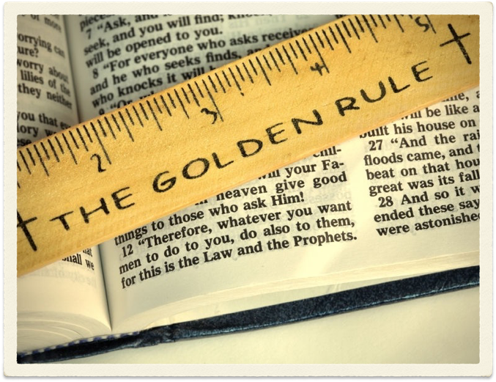
THE GOLDEN RULE
Matthew 7:12

Slide 3
The Golden Rule
I. The Rule

Slide 4
Matthew 7:12
NKJV - “Therefore, whatever you want men to do to you, do also to them, for this is the Law and the Prophets.”
NASB - “In everything, therefore, treat people the same way you want them to treat you, for this is the Law and the Prophets.”

Slide 5
Luke 6:31
NKJV - “And just as you want men to do to you, you also do to them likewise.”
NASB - “Treat others the same way you want them to treat you.”

Slide 6
The Golden Rule is Not:
Treat Others Like They Treat Us
Treat Others As We Think They Deserve to Be Treated
Treat Your Friends As They Treat You

Slide 7
Matthew 7:12
12 Therefore, whatever you want men to do to you, do also to them, for this is the Law and the Prophets.

Slide 8

“For This is the Law and the Prophets”
          Matthew 22:34-40

Slide 9



“ON THESE TWO HANG ALL
THE LAW AND THE PROPHETS”
LOVE THE LORD
LOVE..NEIGHBOR
SACRIFICES
DON’T TAKE
LORD’S NAME
IN VAIN
DON’T KILL
DON’T COVET
SABBATH DAY
NO ADULTERY
NO OTHER GOD’S
DON’T SLANDER

Slide 10
“For This is the Law and the Prophets”
          Matthew 22:34-40
          Galatians 5:14
          Romans 13:8-10

Slide 11
The Golden Rule
I. The Rule
II. The Context

Slide 12
The Context - Matt.7:12
The Sermon on the Mount
Matthew 5-7
I. Citizens in the Kingdom (5:1-16)
II. Righteousness in the Kingdom (5:17-7:12)
III. Invitation - Enter the Kingdom (7:13-7:27)

Slide 13
The Righteousness of the Kingdom (5:17-7:12)
1) Harmonizes with the Old Testament
(5:17-19)
2) Exceeds the Righteousness of the Scribes
and Pharisees (5:20-48)
3) Relationship to God (6:1-34)
4) Relationship to Man (7:1-12)

Slide 14
Relationship to Man (Matt.7:1-12)
Don't Judge Hypocritically (vv.1-5)
Treat Others Like You Want to Be Treated (v.6-12)

Slide 15

7 “ Ask, and it will be given to you; seek, and you will find; knock, and it will be opened to you. 8 For everyone who asks receives, and he who seeks finds, and to him who knocks it will be opened. 9 Or what man is there among you who, if his son asks for bread, will give him a stone? 10 Or if he asks for a fish, will he give him a serpent? 11 If you then, being evil, know how to give good gifts to your children, how much more will your Father who is in heaven give good things to those who ask Him
12 Therefore, whatever you want men to do to you, do also to them, for this is the Law and the Prophets.

Slide 16
The Context - Luke 6:31
1) Love Your Enemies (vv.27-30)
2) Love More Than Those Who Love You (vv.32-34)
3) God Is Kind to the Ungrateful and the Evil (v.35)
4) Be Merciful Like God is Merciful (vv.36)
5) Warning Against Hypocritical Judgment (vv.37-42)

Slide 17
The Golden Rule
I. The Rule
II. The Context
III. Lessons Learned

Slide 18
Lessons Learned
Motivation for Applying the Golden Rule - God’s Goodness Toward Us
  Titus 3:2-4
  Romans 5:6-10
  We Need to Seek to Be Like God - Matthew 5:44-45

Slide 19
Lessons Learned
Breadth of the Golden Rule - Applies in Our Treatment of “EVERYONE”
  Not just friends - Luke 6:33-34
  It Would Apply:
    In the home (spouse, children, parents)

Slide 20
Golden Rule in the Home
Ephesians 5:28, 33
We apply the Golden Rule In:
  Our communication – James 3:9-12; Prov 15:1
  Our Respect – Eph 5:33; 1 Peter 3:7
  Our Purity – 1 Cor 7:2; Matthew 5:28
  Patience - Eph.4:31-32; Eph.4:26-27
  Meeting Each Others Needs – Genesis 2:20; 1 Cor.7:32-33; 1 Cor.7:3-5

Slide 21
Lessons Learned
Breadth of the Golden Rule - Applies in Our Treatment of “EVERYONE”
  Not just friends - Luke 6:33-34
  It Would Apply:
    In the home (spouse, children, parents)
    To Our Brethren

Slide 22
Golden Rule and Our Brethren
Paul Applied It to Brethren in Gal 5:13-15
We Apply the Golden Rule By:
  Rebuking and Correcting One Another - Psa.141:5; - Rev.3:19; James 5:19-20
  Showing Hospitality – 1 Peter 4:8-10
  By Listening – James 1:19-20
  By Not Devouring and Biting One Another – Gal 5:15

Slide 23
Lessons Learned
Breadth of the Golden Rule - Applies in Our Treatment of “EVERYONE”
  Not just friends - Luke 6:33-34
  It Would Apply:
    In the home (spouse, children, parents)
    To Our Brethren
    To the Lost – Titus 3:1-8
    To Our Enemies – Romans 12:17-21

Slide 24
Lessons Learned
It’s Positive Nature
  Not just “don’t do to others what we don’t want done to us”
  We treat others as we want to be treated
    Romans 12:19-21
    “do good” - Luke 6:33

Slide 25
THE GOLDEN RULE
Matthew 7:12

