Slide 2
Dancing
Why Do We Believe Dancing to Be Wrong?
What is Dancing?
What About Attending the Prom if I Don’t Dance?

Slide 3
Shall We Dance?

Slide 4
Shall We Dance?
What is Dancing?

Slide 5
What is Dancing?
Dance is an expression in rhythmic movement of an intensified sense of life, arising from an inner perception that stimulates both mind and body. -Grolier
To move rhythmically to music, using prescribed or improvised steps and gestures. -American Heritage Dictionary

Slide 6
What is Dancing?
Slow Dance
  Close Contact
  Moving in Rhythm With Music
  Romantic Atmosphere

Slide 7
Shall We Dance?
What is Dancing?
What is the Prom?

Slide 8
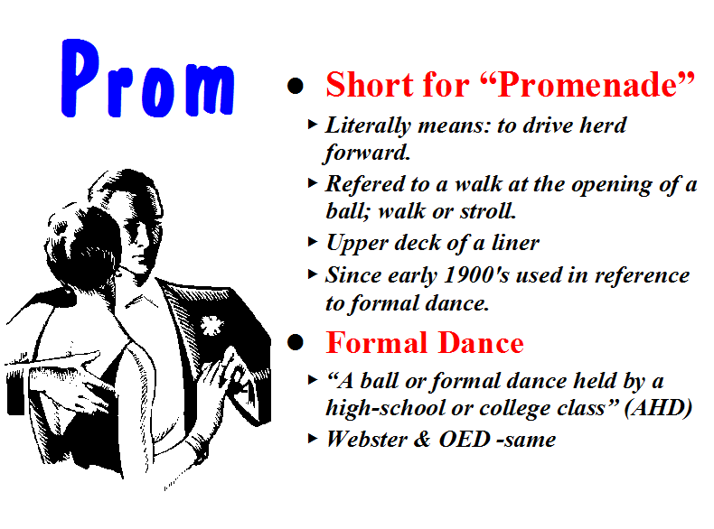

Slide 9
Shall We Dance?
What is Dancing?
What is the Prom?
What is the Appeal of Dancing?

Slide 10
Appeal: Sexual
Quotes From Those of the World

Slide 11

Quotes of the World
J. Edgar Hoover: “Most juvenile crime has its inception in the dance hall, either public or private.”
Prof. W. C. Wilkerson of Chicago University: it is a “system of means, contrived with more than human ingenuity, to excite the instinct of sex action.”
T. A. Vogner, former supervisor of the Dancing Academy in CA: “No woman can waltz well and waltz virtuously.”
J. P. Gibson, MD: “Among those who dance it is noteworthy that very few girls spend much time dancing with other girls. Neither do men dance very much with own wives, nor brothers with their own sisters...the secret of the popularity of dancing (or is it a secret) is the exciting, sexual stimulation resulting from the close embrace of male and female whether it be with music in dancing or without music in petting and necking.”
Homer Hailey: “It is true that only a minority of church members dance, and possibly a small minority; but to whatever degree dancing is tolerated among members of the body, to just that degree the church tends toward the world, and allows the spirit of the world to infiltrate it.”

Slide 12
Quotes of the World
"Another motive for the dance is the sexual motive - the dance has always been used as a means of expressing sexual desire and as a means of wooing...We find this same sex motive in the modern ballroom dance, which has now degenerated into dull and stupid forms, but it is a legitimate opportunity for contact." - Dance We Must (1938, reprinted 1950), p. 6 (from a series of lectures given by Ted Shawn at George Peabody College For Teachers

Slide 13
Quotes of the World
Interview with Arthur Murray: “Why has ballroom dancing declined? Murray responds: ‘Since dancing is based on sexual flirtation and since young people have no problem with sexual flirtation; dancing has taken a back seat to the back seat’. This only confirms what we all know, dancing leads from the ballroom to the bedroom – L.A. radio host Ervin Edwards [Big E.].”
Mark Weisner, Ph.D. in his article “When the Answer is Not Tonight” – “Think about activities that lead to sex. A dark crowded room with whispers of delight, the dance floor, a proven place for the struggling couple. A romantic dinner with a band, candles, and ‘the right foods’.” –

Slide 14
Quotes of the World
“We are all men. We know the natural desires of youth. We know that sex is the strongest impulse Implanted in the human race. You can picture the effect on a boy or girl of eighteen or twenty, when this hunger is the keenest, when knowledge and experience are lacking in formation of judgment, of one of these dances which call for close abdominal contact and frequently brings the cheeks together and entwine the limbs ... There is left but one reason for the popularity of the dance, and that is sex appeal. I hasten to assure you that I do not believe the dancers are always conscious that this is the reason they enjoy this position and the steps that go with it. But this lack of consciousness is merely an added factor of danger ... when you are told that

Slide 15
Quotes of the World
youth of both sexes can survive this experience without mental, moral, or physical pollution, you know the teller lies ... If you can believe youth is the same after this experience as before, then God help your child or your charge, for you are not mentally fit for your responsibility. If you do not believe I have correctly described the modern dances and their effects, you either have not seen them performed or you are willfully blind to their true nature. “ – Louis Guyon, owner and operator of Chicago’s largest dance hall

Slide 16
Quotes of the World
“There can scarcely be any doubt that dancing came about as an adjunct of sexual stimulation” (Medical Review of America)
The drawing power of the discos attributed to its “progressive sexuality” and the promoters pin-pointing “sex-appeal” as the life-blood of the fad (The New York Times Magazine)
"I don't think ballroom dancing will ever return to popularity. People always thought it was a prelude to sex, but people don't need preludes anymore" (Arthur Murray, Chicago Tribune, "No Prelims, All Main Event")

Slide 17
Quotes of the World
"All ballroom dancing in pairs looks toward intercourse. In this respect the Puritans were dead right....The development of no-contact dances has come about because one doesn't now need a social excuse to embrace a girl, but as an excitant it need not involve contact at all - in fact, dances like flamenco or the twist are far more erotic than a clinch because you aren't too close to see one another. At its best this sort of dance is simply intercourse by remote control." – (The Joy Of Sex, Alex Comfort, p. 162, 1972)

Slide 18
Appeal: Sexual
Quotes From Those of the World
One Would Not Approve of the Actions If the Music Were Not Playing
How Would You React to Find Your Kid Engaged In the Same Actions In Your Living Room Without Music?

Slide 19
Shall We Dance?
What is Dancing?
What is the Prom?
What is the Appeal of Dancing?
What Biblical Principles Are Violated?

Slide 20
Biblical Principles Violated
Lasciviousness

Slide 21
Lasciviousness
(aselgeia)
Passages:
Gal. 5:19
1 Pet. 4:3
Rom. 13:13
2 Pet. 2:7
Defined
“Unbridled lust…
wantoness
shamelessness…wanton
(acts or) manners, as
filthy words, indecent
bodily movements,
unchaste handling of
males and females, etc.
(Thayer, p. 79-80)
How Used
Sensuality
Bauer 114
NASV
That which
leads to lust

Slide 22
Biblical Principles Violated
Lasciviousness
Flee Lust
  2 Timothy 2:22
  1 Thessalonians 4:3-6
  Colossians 3:5

Slide 23
Biblical Principles Violated
Lasciviousness
Flee Lust
Flee Sexual Immorality (1 Corinthians 6:12-20)
Revelries

Slide 24
Revelries
“feast and drinking parties that protracted till late at night and indulge in revelry” (Thayer)
“carousal, merrymaking, with music and dancing” (Liddell and Scott Greek Lexicon)
Scott's Bible - "'Revelings' were such feasts, as were accompanied with music and dancing, and whatever could promote hilarity and sensual gratification."

Slide 25
Shall We Dance?
What is Dancing?
What is the Prom?
What is the Appeal of Dancing?
What Biblical Principles Are Violated?
What Arguments Are Made to Justify Dancing?

Slide 26
Arguments Made to Justify Dancing
“Even If It Excites Others Sexually - It Does Not Effect Me That Way – I Can Control My Thinking”
  I doubt that this is usually the case – we sometimes overestimate our strength
  Even if you are not so affected – what about the one you are with?

Slide 27
Arguments Made to Justify Dancing
”I Can’t Control What Others Think”
  We are responsible when we influence a person in the wrong direction

Slide 28
Arguments Made to Justify Dancing
“Men & Women Danced in the Bible”

Slide 29
Dancing In the Bible
Four Categories Of Dancing in the Bible
  “religious” dances of the O.T. – Exo.15:20-21; 2 Sam.6:14
  expression of rejoicing – 1 Sam.18:6
  play of children – Luke 7:32; Job 21:11
  the dance of Salome – Matt.14:6
The First Three Categories Do Not Resemble the Dancing that We Are Talking About

Slide 30
Dancing In the Bible
"While the mode of dancing is not known in detail, it is clear that men and women did not generally dance together, and there is no real evidence that they ever did. Social amusement was hardly a major purpose of dancing, and the modern method of dancing by couples is unknown." - Zondervan Pictorial Encyclopedia Of The Bible, "Dancing“
"Women seemed generally to have danced by themselves... Of the social dancing of couples in the modern fashion there is no trace." – ISBE
"There is no evidence of couples dancing together, however; that was to happen much later, probably in Provence in the 12th Century." - Encyclopedia Britannica, "The Art Of Dance",

Slide 31
Shall We Dance?

