Slide 2
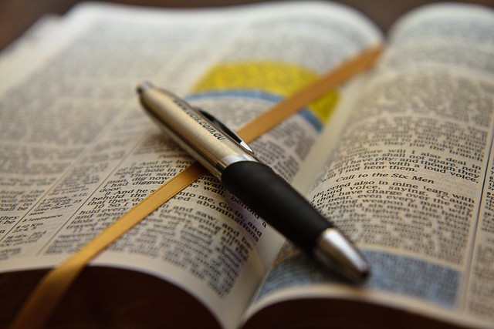
Justified By Faith Only
WHEN…
Hebrews 11:4-19
This Photo by Unknown Author is licensed under CC BY

Slide 3
Justified By Faith Only
WHEN…
We Worship God Acceptably (Hebrews 11:4)
This Photo by Unknown Author is licensed under CC BY

Slide 4
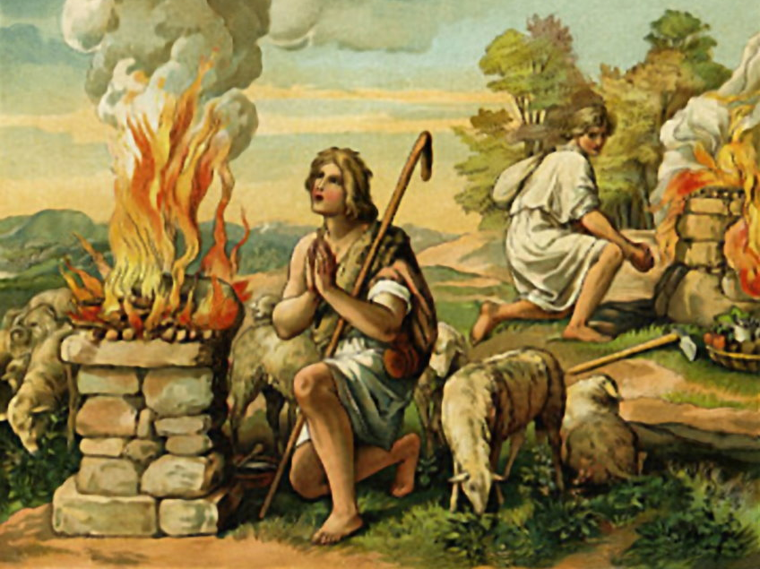
We Worship God Acceptably (Hebrews 11:4)
Abel Offered to God a More Acceptable Sacrifice Than Cain
Because of Abel’s Sacrifice, He Was Commended as Righteousness
Today We Too Must Offer Acceptable Worship to God (Hebrews 12:28-29)
  We Must Worship In Spirit and Truth (John 4:20-24)
  We Should Worship with Gladness (Psalm 122:1)

Slide 5
Justified By Faith Only
WHEN…
We Worship God Acceptably (Hebrews 11:4)
We Walk With God (Hebrews 11:5; Genesis 5:22)
This Photo by Unknown Author is licensed under CC BY

Slide 6
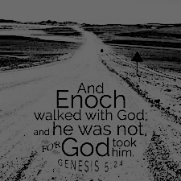
We Walk With God (Hebrews 11:5; Genesis 5:22)
We Often Remember Enoch For Being One of Two Men Never to Die
What We Need to Remember Him More For is His Walk With God (Genesis 5:22)
In Order to Be Pleasing to God We Need to Walk With Him
How Do We Do This? (Ephesians 5:1-21)
  Walk In Love (V.2)
  Walk As Children of Light (v.8)
  Walk Wisely (vv.15-17)
    Making the Best Use of Our Time (v.16)
    Knowing the Will of the Lord (v.17)

Slide 7
Justified By Faith Only
WHEN…
We Worship God Acceptably (Hebrews 11:4)
We Walk With God (Hebrews 11:5; Genesis 5:22)
We Have Godly Fear (Hebrews 11:7)
This Photo by Unknown Author is licensed under CC BY

Slide 8
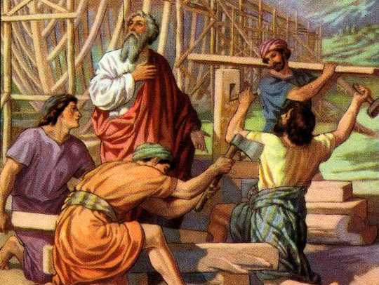
We Have Godly Fear (Hebrews 11:7)
Noah Had A Reverence for God That Caused Him to Act Upon God’s Word (Genesis 6:8, 22)
We Too Must Act With Godly Fear if We Want to Please Him (1 Timothy 4:7-8, 2 Peter 3:11, 2 Peter 1:5-8)
This Photo by Unknown Author is licensed under CC BY-NC

Slide 9
Justified By Faith Only
WHEN…
We Worship God Acceptably (Hebrews 11:4)
We Walk With God (Hebrews 11:5; Genesis 5:22)
We Have Godly Fear (Hebrews 11:7)
We Obey (Hebrews 11:8-17)
This Photo by Unknown Author is licensed under CC BY

Slide 10
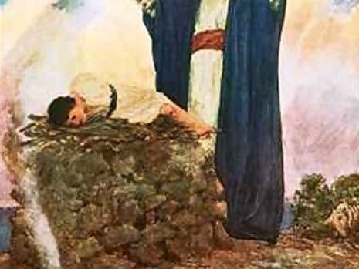
We Obey
Abraham Obeyed God When He Was Told to Leave Ur (Acts 7:1-8)
He Obeyed When He Was Told to Offer Isaac (Genesis 22:1-12)
We Too Must Obey to Be Pleasing to God (Romans 1:5; Romans 6:15-23, Romans 16:26)
This Photo by Unknown Author is licensed under CC BY-NC-ND

Slide 11
Justified By Faith Only
WHEN…
We Worship God Acceptably (Hebrews 11:4)
We Walk With God (Hebrews 11:5; Genesis 5:22)
We Have Godly Fear (Hebrews 11:7)
We Obey (Hebrews 11:8-17)
We Look Toward the City That Has Foundations (Hebrews 11:11)
This Photo by Unknown Author is licensed under CC BY

Slide 12
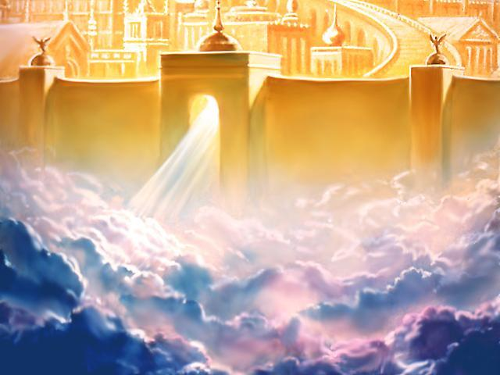
When We Look Forward to the City That Has Foundations (Hebrews 11:11)
Abraham Was Someone Looking For His Eternal Reward (Hebrews 11:13-16)
We Too Have No Lasting City, Therefore We Seek One to Come (Hebrews 13:14)
Therefore, Let Us, Like Abraham, Look to the Reward

Slide 13
Justified By Faith Only
WHEN…
Hebrews 11:4-19
This Photo by Unknown Author is licensed under CC BY

