Slide 2
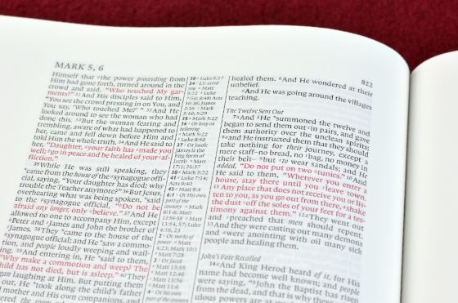
Why Preach the gospel?
This Photo by Unknown Author is licensed under CC BY-NC-ND

Slide 3
Why Preach the Gospel
It is the Power of God to Salvation (Romans 1:16-17)

Slide 4
It is the Power of God Unto Salvation (Romans 1:16-17)
Paul Has Been Discussing His Eagerness to Preach in Rome (vv.8-15)
He Shifts to the Main Theme of the Book (vv.16-17)
Point: Desires to Preach in Rome for the Gospel Saves
The gospel is “of Christ”
  It is Only Through Him We Can Have Salvation (Acts 4:12)
  He is the Only Way (John 14:6)

Slide 5
Why is it the Power of God to Salvation?
It Reveals God’s Righteousness (v.17)
What is God’s Righteousness?
  God’s plan to make man righteous
  Results of our faith - “The righteous shall live by faith” (ESV)
  We therefore must follow God’s righteousness and not our own (Romans 10:3)

Slide 6
Why Preach the Gospel
It is the Power of God to Salvation (Romans 1:16-17)
All Need the Gospel (Romans 3:21-31)

Slide 7
All Need the Gospel (Romans 3:21-31)
The First Three Chapters of Romans Focus on the Need for the Gospel
Romans 1: Gentiles Need Gospel

Slide 8
Romans 1: Gentiles Need Gospel
Wrath of God Revealed (v.18)
They Did Not Glorify God (v.21)
Professing to Be Wise, They Are Fools (v.22)
Pursue Vile Passions (v.26)
Deserving of Death (v.32)

Slide 9
All Need the Gospel (Romans 3:21-31)
The First Three Chapters of Romans Focus on the Need for the Gospel
Romans 1: Gentiles Need Gospel
Romans 2: Jews Need Gospel

Slide 10
Romans 2: Jews Need Gospel
Jews Do Not Judge Gentiles (v.1)
You Are Treasuring Up Wrath For Yourselves (v.5)
God Will Judge My Deeds (v.6)
He is Impartial (v.11)
You Do What You Condemn (vv.21-24)

Slide 11
All Need the Gospel (Romans 3:21-31)
The First Three Chapters of Romans Focus on the Need for the Gospel
Romans 1: Gentiles Need Gospel
Romans 2: Jews Need Gospel
Romans 3: All Need Gospel

Slide 12
Romans 3: All Need Gospel
All Have Sinned (vv.9-20)
  None Righteous (v.9)
  All Have Turned Aside (v.12)
  None Do Good (v.12)
  No Fear of God Before Their Eyes (v.18)
  No Flesh Justified By Law (v.20)

Slide 13
Romans 3: All Need Gospel
All Have Sinned (vv.9-20)
Need for Justification (vv.21-31)
  Righteousness of God Apart From Law Revealed (v.21)
  Available to All, for All Have Sinned (vv.22-23)
  Jesus is the Propitiation for Our Sins (vv.24-25)

Slide 14
All Need the Gospel (Romans 3:21-31)
Sins Separated Us From God (Isaiah 59:1-3)
Sin Results In Eternal Death (Romans 6:21-23)
Therefore, We Needed a Sacrifice (Romans 3:25)
The Scriptures Are About Jesus Sacrifice and Our Need to Serve Him (Acts 8:34-37)

Slide 15
Why Preach the Gospel
It is the Power of God to Salvation (Romans 1:16-17)
All Need the Gospel (Romans 3:21-31)
Without It One Cannot Have Faith (Romans 10:14-17)

Slide 16
Without It One cannot Have Faith (Romans 10:14-17)
We All Know the Importance of Faith
  Hebrews 11:6
  John 8:24
Faith Comes By Hearing God’s Word (Romans 10:17)
One Cannot Hear Without a Preacher (romans 10:14)
Once We Preach the Gospel, Those Who Believe In the Lord Can Call On Them (Romans 10:13)

Slide 17
Why Preach the Gospel
It is the Power of God to Salvation (Romans 1:16-17)
All Need the Gospel (Romans 3:21-31)
Without It One Cannot Have Faith (Romans 10:14-17)

Slide 18
Why Preach the gospel?
This Photo by Unknown Author is licensed under CC BY-NC-ND

