Slide 1
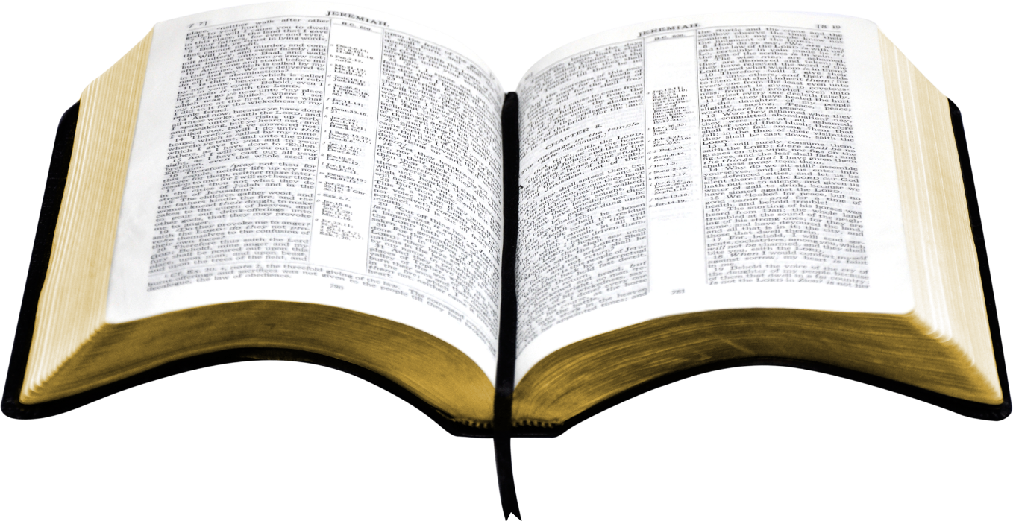
An appeal to the Bible is an appeal to the authority of God
Authority is totally unavoidable
  To reject authority is not a rejection of ALL authority
  Merely a rejection of one authority for another
  All of us follow some system of authority
Wrong to assume that all (who even attend) know about authority and how to apply it
There will be questions and situations arise that will reveal that authority was not clearly understood

Slide 2
Many of the Problems of Society
Due to Little or No Respect for Authority
Children misbehave
Students disrespectful to school officials
Destructive protest
Anti-police marches
Hatred toward government officials
Division within the local church
Lose our children to the world

Slide 3
Respecting Authority
God has Authority over Man
God has Authority over Man

Slide 4
God has Authority over Man
God, because he is God, has authority over man
Characteristics of God
  He is eternal (Exo. 3:14)
  He is the almighty (Rev. 4:8)
  He is creator (Gen. 1:1; Heb. 3:4)
  He is infinite in wisdom (Isa. 55:8-9)
  He has all authority (Matt. 28:18)
To question God’s authority is to question who God is

Slide 5
To Reject / Rebel = Ultimate Rejection of God
Parents
Husband
God
Employer
Civil Auth.
Elders

Slide 6
Respecting Authority
God has Authority over Man
God’s Word is Authoritative

Slide 7
God’s Word is Authoritative
Inspired of God (2 Tim 3:16-17; 1 Cor. 2:13)
Violation of it = sin (1 John 3:4)
Taught with all authority (Titus 2:15)
Can’t alter or change (Rev. 22:18-19)
Will be judged by it (John 12:48)

Slide 8
Respecting Authority
God has Authority over Man
God’s Word is Authoritative
The Need for Authority

Slide 9
The Need for Authority
Order of authority

Slide 10
1 Cor 11:3
“But I want you to know that the head of every man is Christ, the head of woman is man, and the head of Christ is God.”
God
(Father)
Christ
(son)
Man
Woman

Slide 11
The Need for Authority
Order of authority
Man is not his own authority
  Jer. 10:23 – man is not to direct his own footsteps
  Prov. 3:5 – lean not on your own understanding
  Prov. 14:12 – way that seems right leads to death

Slide 12
The Need for Authority
Order of authority
Man is not his own authority
Following authority
  Two men (one who followed authority & one didn’t)

Slide 13
Gen 4:3-5
3 And in the process of time it came to pass that Cain brought an offering of the fruit of the ground to the LORD.
4 Abel also brought of the firstborn of his flock and of their fat. And the LORD respected Abel and his offering,
5 but He did not respect Cain and his offering. And Cain was very angry, and his countenance fell.

Slide 14

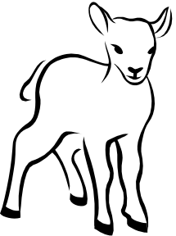

Cain
Abel
Offering:
“Fruit of ground”
Offering:
“firstborn of his flock”
Lord
Did Not Respect
Lord
Respected
Not: “By Faith”
“By Faith”
(Heb. 11:4)
Word
Rom. 10:17

Slide 15
The Need for Authority
Order of authority
Man is not his own authority
Following authority
  Two men (one who followed authority & one didn’t)
  We must follow authority
    Do all in the name of Christ (Col. 3:17)
    Abide within the doctrine of Christ (2 John 9)
    Doctrine & practice limited by word (Gal. 1:6-9)

Slide 16
Respecting Authority
God has Authority over Man
God’s Word is Authoritative
The Need for Authority
Standards of Authority

Slide 17
Standards of Authority
False standards
  Family (Luke 14:26)
  Emotion (Prov. 16:25)
    What seems fair or right
    What makes sense to human reasoning
  Preacher (Gal. 1:6-9)
  Scholar (Gal. 1:6-9)
  Majority (Exo. 23:2; Matt. 7:13-14)

Slide 18
Standards of Authority
False standards
Only standard – Word of God
  It is an objective standard
  Cannot go beyond the word (Num. 22:18)
  Limited / restricted by the word (1 Pet. 4:11)
  Every part is just as authoritative (Jas. 2:10-11)

Slide 19
Respecting Authority
God has Authority over Man
God’s Word is Authoritative
The Need for Authority
Standards of Authority

