Slide 1
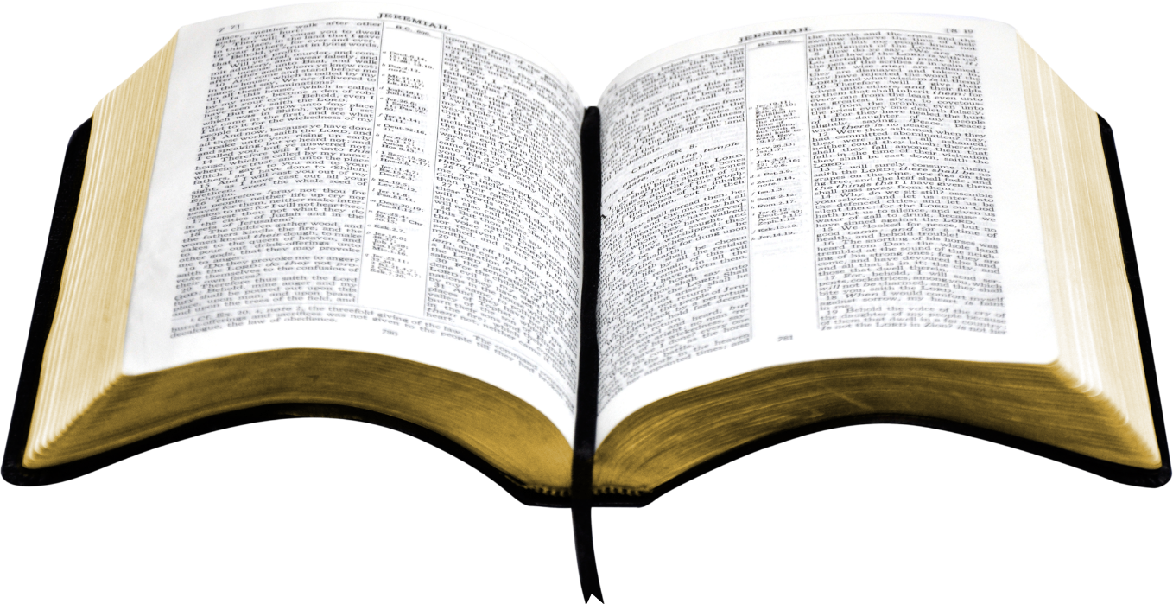
An appeal to the Bible is an appeal to the authority of God
Authority is totally unavoidable
  To reject authority is not a rejection of ALL authority
  Merely a rejection of one authority for another
  All of us follow some system of authority
Wrong to assume that all (who even attend) know about authority and how to apply it
There will be questions and situations arise that will reveal that authority was not clearly understood

Slide 2
Respecting Authority
God has Authority over Man
God’s Word is Authoritative
The Need for Authority
Standards of Authority

Slide 3
Applying Authority
Where Authority Applies
Where Authority Applies

Slide 4
Where Authority Applies
In all doctrine and practice (Col. 3:17)
  Have book, chapter and verse for doctrine.
  Must be able to point to Scripture for practice
Questions that are matters of Bible authority
  What we do in worship (instrumental music)?
  What work the church does (social, recreational)?
  Who has a right to divorce or remarry?
  Role of elders & deacons?
  When and where observe Lord’s Supper?

Slide 5
Applying Authority
Where Authority Applies
Generic and Specific Authority

Slide 6
Confusion Over Authority
Confusion Over Authority
“ We don’t have to have authority for all we do…”
“We do a lot of things without Bible authority”
Problem:
Confusing generic and specific authority
Confusing aids and additions

Slide 7
Generic and Specific Authority
When A Command
Is Left In The
Generic
Can Choose Any
Specific
Within That Generic
When A Command
Is
Specific
Can Not Choose Any
Other Specific
Within That Generic
Generic: Wood
Specific:
Cedar, Oak, Walnut,
Pine, Gopher, Hickory
Specified: Gopher
Eliminates:
Cedar, Oak, Walnut,
Pine, Hickory, etc.

Slide 8
Generic and Specific Authority
Command | Generic | Specific
Buy me a canned drink | Cola | Pepsi
Build ark - Gen. 6:14 | Wood | Gopher
Wash 7 Times - 2 Kings 5 | River | Jordan
Offer – Lev. 14:12-13 | Animal | Lamb
Praise – Eph. 5:19 | Music | Sing

Slide 9


Singing
If God had said: “Music”
X
X
X
Sing
Instrum.
Hum
Whistle
Sing

Slide 10
Applying Authority
Where Authority Applies
Where Authority Applies
Generic and Specific Authority
Aids and Additions

Slide 11
Aids and Additions
Aid
Expedites command
Doing nothing more
No addition
Addition
Another element
Doing more than
commanded

Slide 12
An Addition Involves Another Element Being Added!
Command | Aid | Addition
Buy Me A Pepsi | Car, sack, cooler | Sprite, RC, etc.
Eat Bread – 1 Cor. 11 | Table, plates … | Jam, beef, cola
Baptize – Matt. 28:19 | Baptistry, heater | Sprinkling
Build an ark – Gen. 6:14 | Tool, Animal | Oak, Cedar
Contribute – 1 Cor. 16 | Basket, Account | Mon. / Sat.
Sing – Eph. 5:19 | Books, Tuner | Instrumental Music

Slide 13
Applying Authority
Where Authority Applies
Generic and Specific Authority
Aids and Additions
The Silence of God

Slide 14
Misconceptions About Silence of Scriptures
“God did not say not to”
“There is no passage that says ‘Thou shalt not…”
“Where is the passages that says it is wrong to…?”
Common Thought:
Silence of God gives permission

Slide 15
The Silence of God
1 Cor. 4:6 – forbidden to go beyond things written
Col. 2:22-23 – will worship (kjv)
  Will worship = according to commandments of men
  “voluntarily adopted worship, whether unbidden or forbidden” (W. E. Vine)
Any Passage That Says We Must Have Authority – Says We Must Respect God’s Silence!

Slide 16
The Silence of God
X
Two Mindsets
Permissive
At liberty to do what
is not
condemned
Prohibitive
Forbidden to act
Without authority
Heb. 7:14
For it is evident that our Lord arose from Judah, of which tribe Moses spoke nothing concerning priesthood

Slide 17
God Did Not Say Not To:
Ice Cream with the Lord’s Supper
Handle snakes as an act of worship
Church sponsored sports
Offer a bull or lamb as sacrifice
Count beads as an act of worship
Mechanical Instrum. of music in worship
Church to be in secular business

Slide 18
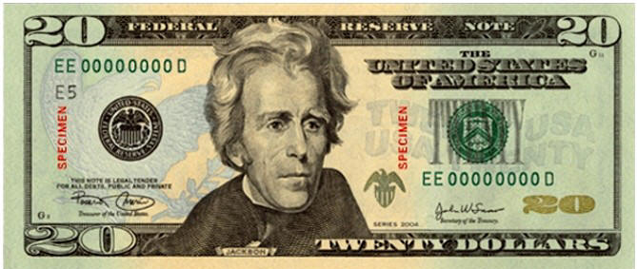
Suppose Someone Sends You To The Store
“Go buy me a gallon of milk & a box of cereal.”
Inherent Authority: One who owns the money
Delegated Authority: You have the authority to spend it
Only
Authorized To
Buy:
Milk & Cereal
“Did not say, ‘Don’t buy candy’”
“Did not say, ‘Don’t buy meat’”
“Did not say, ‘Don’t buy colas’”
“Did not say, ‘Don’t buy magazines’”

Slide 19
Applying Authority
Where Authority Applies
Generic and Specific Authority
Aids and Additions
The Silence of God

