Slide 1
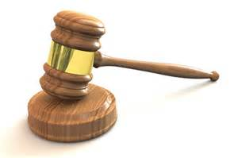
There is a
Judgment Day
Coming
Heb 9:27
“And as it is appointed for men to die once, but after this the judgment.”
Acts 24:25
“Now as he reasoned about righteousness, self-control, and the judgment to come, Felix was afraid and answered, ‘Go away for now; when I have a convenient time I will call for you.’”

Slide 2
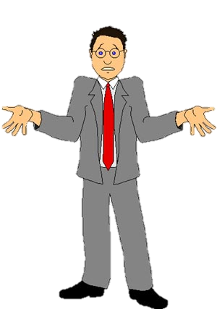
Not Uncommon for People to Think Little or Nothing About the Judgment Day
Romans 2
“Our situation is different” (v. 3)
Think “Goodness is approval” (v. 4)
Don’t fear (v. 5)
Our Attitude Affects How We Live!

Slide 3
The Judgment Day
The Day

Slide 4
The Day
God has appointed a day for judgment (Acts 17:30-31)
Yet future
  Heb. 9:27 – after death
  John 12:48 – in last day (cf. 11:24; 6:40)

Slide 5
The Day
God has appointed a day for judgment (Acts 17:30-31)
Yet future
After second coming and resurrection
  Matt. 13:40
  Matt. 25:31-32
  2 Thess. 1:7-10
  2 Pet. 3:7,9-10

Slide 6
The Day
God has appointed a day for judgment (Acts 17:30-31)
Yet future
After second coming and resurrection
We don’t know when
  Matt. 24:36
  Thus, it behooves us to live like it is today!

Slide 7
The Judgment Day
The Day
The Judge

Slide 8
The Judge
All judgment is with God
  Heb. 11:6
  1 Pet. 1:17
  1 Pet. 2:23

Slide 9
The Judge
All judgment is with God
Committed all judgment to the Son (Jesus Christ)
  John 5:22, 27 – committed all judgment to Son
  Acts 17:30-31- judge world by one raised
  Matt. 25:31-32 – all nations gathered before him
  Acts 10:42 – God ordained him to be the judge
  2 Cor. 5:10 – judgment seat of Christ
  2 Tim. 4:1, 8 – Lord Jesus will judge living & dead

Slide 10
The Judge
All judgment is with God
Committed all judgment to the Son (Jesus Christ)
The perfect judge
  2 Tim. 4:8 – righteous judge
  Heb. 2:17-18 – lived as man –knows suffering and temptation
  Heb. 4:15 – tempted in all points like us

Slide 11
The Judgment Day
The Day
The Judge
The Judged

Slide 12
The Judged
All who ever lived
  John 5:27-29 – all in graves will come forth
  Acts 24:15 - resurrection of just and unjust
  Matt. 25:32 – all nations be gathered before him
  Rom. 2:5-6; 3:6 – each one; world
  Rev. 20:12-13 – all the dead

Slide 13
The Judged
All who ever lived
None are exempt / or will escape
  Rom. 2:3
  God is no respecter of persons (Rom. 2:11)

Slide 14
The Judged
All who ever lived
None are exempt / or will escape
Even angels are included
  2 Pet. 2:4
  Jude 6

Slide 15
The Judged
All who ever lived
None are exempt / or will escape
Even angels are included
Judged as individuals
  Rom. 2:6 – render to each one
  Rom. 14:12 – give an account of himself
  1 Pet. 1:17 – according to each one’s work
  Not as a church (just because in right church)
  Not as a family (just because family godly)

Slide 16
The Judgment Day
The Day
The Judge
The Judged
The Standard

Slide 17
The Standard
Not
  The world’s standard (what world thinks right)
  Own thinking or conscience (Jer. 10:23)
  What brethren think (1 Cor. 4:3-4)

Slide 18
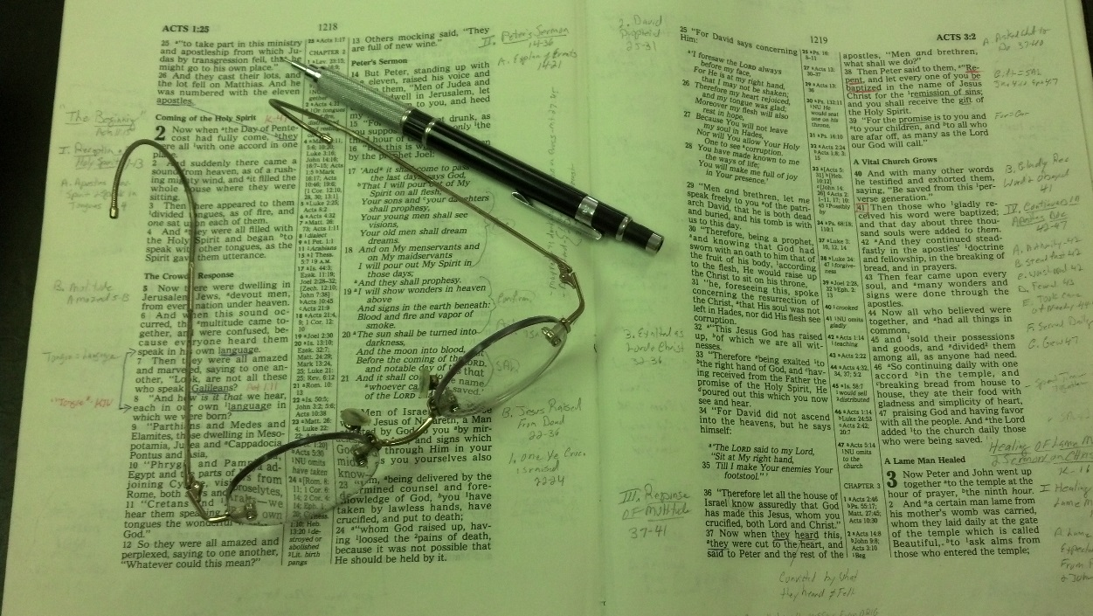
The Standard
Not
Word of God
  John 12:48
  Rom. 2:16
  Rev. 20:11-15
Does not change!

Slide 19
The Judgment Day
The Day
The Judge
The Judged
The Standard
The Deeds

Slide 20
The Deeds
All of our actions
  2 Cor. 5:10 – both good and evil
  Rev. 20:12 – according to their works
  Matt. 25:31-46 – deeds or lack of them
  Eph. 6:8 – what ever good – does – receive same
  Heb. 6:10 – God will not forget work and labor

Slide 21
The Deeds
All of our actions
Our words
  Matt. 12:36-37
  Careful what we say, what we tell
  Jas. 3:1 – careful in our teaching

Slide 22
The Deeds
All of our actions
Our words
Our thoughts
  1 Cor. 4:5 – God will reveal the hidden counsels of the heart
  Why it is important to control our thoughts (2 Cor. 10:5)

Slide 23
The Deeds
All of our actions
Our words
Our thoughts
Our secrets
  Rom. 2:16
  Things kept to self – no one knows

Slide 24
The Judgment Day
The Day
The Judge
The Judged
The Standard
The Deeds
The Purpose

Slide 25
The Purpose
Not at trial or investigation
  Not like a trial – evidence is presented & counter arguments, etc. to determine if one is guilty
  God is all knowing (Heb. 4:12) – thus he already knows who is guilty and who is not.
  Luke 16:19-ff demonstrates that God already knows the destiny of those who have died

Slide 26
The Purpose
Not at trial or investigation
To declare a sentence (Heaven of Hell)
  Matt 25:31-46 – separation
  Rom. 2:3, 5, 8-11 – render to each one - separated
  2 Thess. 1:7-9 – coming to take vengence
  Jude 6, 15 – to execute judgment

Slide 27
The Judgment Day
The Day
The Judge
The Judged
The Standard
The Deeds
The Purpose

