Slide 1

My Servants The Prophets
A Study of the Major Prophets
Ezekiel

Slide 2
Outline of Ezekiel
Judgment on Jerusalem (1-24)
  Call of the prophet (1-3)
  A disobedient nation (4-7)
  Glory departs (8-11)
  Disciplined nation (12-24)
Judgment on the Gentile Nations (25-32)
Restoration of God’s People (33-48)
  Return to their land (33-36)
  New life and unity (37)
  Protected from their enemies (38-39)
  Worship the Lord acceptably (40-48)
Adapted from J. Sidlow Baxter & Warren Weirsbe

Slide 3
Ezekiel
Chapters 33-48

Slide 4
Outline of Ezekiel
Judgment on Jerusalem (1-24)
  Call of the prophet (1-3)
  A disobedient nation (4-7)
  Glory departs (8-11)
  Disciplined nation (12-24)
Judgment on the Gentile Nations (25-32)
Restoration of God’s People (33-48)
  Return to their land (33-36)
  New life and unity (37)
  Protected from their enemies (38-39)
  Worship the Lord acceptably (40-48)
Adapted from J. Sidlow Baxter & Warren Weirsbe

Slide 5
Ezekiel
Chapters 33-48
Two Points:
Remnant will return
Brighter future under the Messiah

Slide 6
Restoration of God’s People (33-48)
Return to their land (33-36)
  Ezekiel’s work as a watchman (33)
    Warns the people (vv.1-9)
    God’s way is fair (vv. 10-20)
    Mess came that Jerusalem had been captured (vv. 21-22)
    Warn about possession of land is not unconditional (vv. 23-29)
    Warn about listening to God, talking about it but no obedience (vv. 30-33)

Slide 7
Restoration of God’s People (33-48)
Return to their land (33-36)
  Ezekiel’s work as a watchman (33)
  The shepherds failed but God does not (34)
    The shepherds of Israel failed (vv. 1-10)
    The Lord as a good shepherd cares for his people (vv. 11-22)
    God will establish a shepherd through David – Messiah (vv. 23-31)

Slide 8
Restoration of God’s People (33-48)
Return to their land (33-36)
  Ezekiel’s work as a watchman (33)
  The shepherds failed but God does not (34)
  Edom does not have a claim on land of Judah (35)
    Edom will be desolate because of ancient hatred (vv. 1-9)
    Edom will be desolate because wrongfully claimed land (vv. 10-15)

Slide 9
Restoration of God’s People (33-48)
Return to their land (33-36)
  Ezekiel’s work as a watchman (33)
  The shepherds failed but God does not (34)
  Edom does not have a claim on land of Judah (35)
  Israel will return to the land (36)
    God will replay enemy nations (vv. 1-7)
    Israel will be reinhabited (vv. 8-15)
    God will bring people back for his own name’s sake (vv. 16-38)

Slide 10
Restoration of God’s People (33-48)
Return to their land (33-36)
New life and unity (37)
  Israel’s restoration like a valley of bones come to life (vv. 1-14)
  Judah and Israel become one (vv. 15-28)
    Illustrated with two sticks (vv. 15-23)
    David will be king – Messianic (vv. 24-28)

Slide 11
Restoration of God’s People (33-48)
Return to their land (33-36)
New life and unity (37)
Protection from their enemies (38-39)
  Gog attempts to attack Israel and plunder it (38:1-17)
  God will bring judgment on Gog (38:18 – 39:29)
    God’s wrath and jealousy poured out (38:18-22)
    God will be magnified (38:23)
    Gog will be destroyed (39:1-10)
    Gog will be buried (39:11-20)
    Israel will return to the land and dwell safely (39:21-29)

Slide 12
Restoration of God’s People (33-48)
Return to their land (33-36)
New life and unity (37)
Protection from their enemies (38-39)
Worship the Lord acceptably (40-48)
Vision (40:2) – the 3rd
Symbolic – not literal

Slide 13
Symbolic & Figurative
Cannot Be Literal
David will be king (37:22-24)
Dwell in land forever (37:25)
Weapons used in war (39:9-10)
Use of “seven” (39:9, 12)
No temple has ever been built to fit description
Animal sacrifices restored (43:19, 20, 21, …)
Circumcision binding (44:9)
God dwell in this temple forever (43:7)
Measuring new temple causes shame (43:10)
Only those of lineage of Zadok offer sac. (43:18-19)
Sacrifices (46:1-8) not harmonize with Num. 28:9-15)
River flowing from the temple (47:1-7)

Slide 14
What is the Point?
“Understand it simply as a picture of glory for the Jew under the Messiah without descending to details and making those details allegorical… I believe that Ezekiel is now telling the beaten Jew that the day was coming when they would enjoy prosperity and glory under the Lord and that he described it in terms with which they were altogether familiar.”
(Jim McGuiggan, 340)

Slide 15
What is the Point?
“Therefore the entire vision Ezekiel portrays in these closing chapters is symbolical of the Gospel Age, and the spiritual temple which is the church of the Lord.”
(R. Harkrider, 99)

Slide 16
What is the Point?
“Now in this section Ezekiel describes the new kingdom of God which is born out of the throes of all this suffering they have endured. A new Jerusalem, a new temple, a new order of worship will be instituted. He uses language with which the Jewish mind is familiar, but in apocalyptic style he symbolizes the new spiritual temple which is holy and must be kept that way. It will be strong to resist any onslaught which can be brought against it.”
(R. Harkrider, 103)

Slide 17
Why the Details of the New Temple?
“The people are being called to holiness the like of which they had not been practicing. The very structure of the temple was calling them to that. That’s why the prophet was going into so many details with regard to the measurements of the temple.”
(Jim McGuiggan, 348)

Slide 18
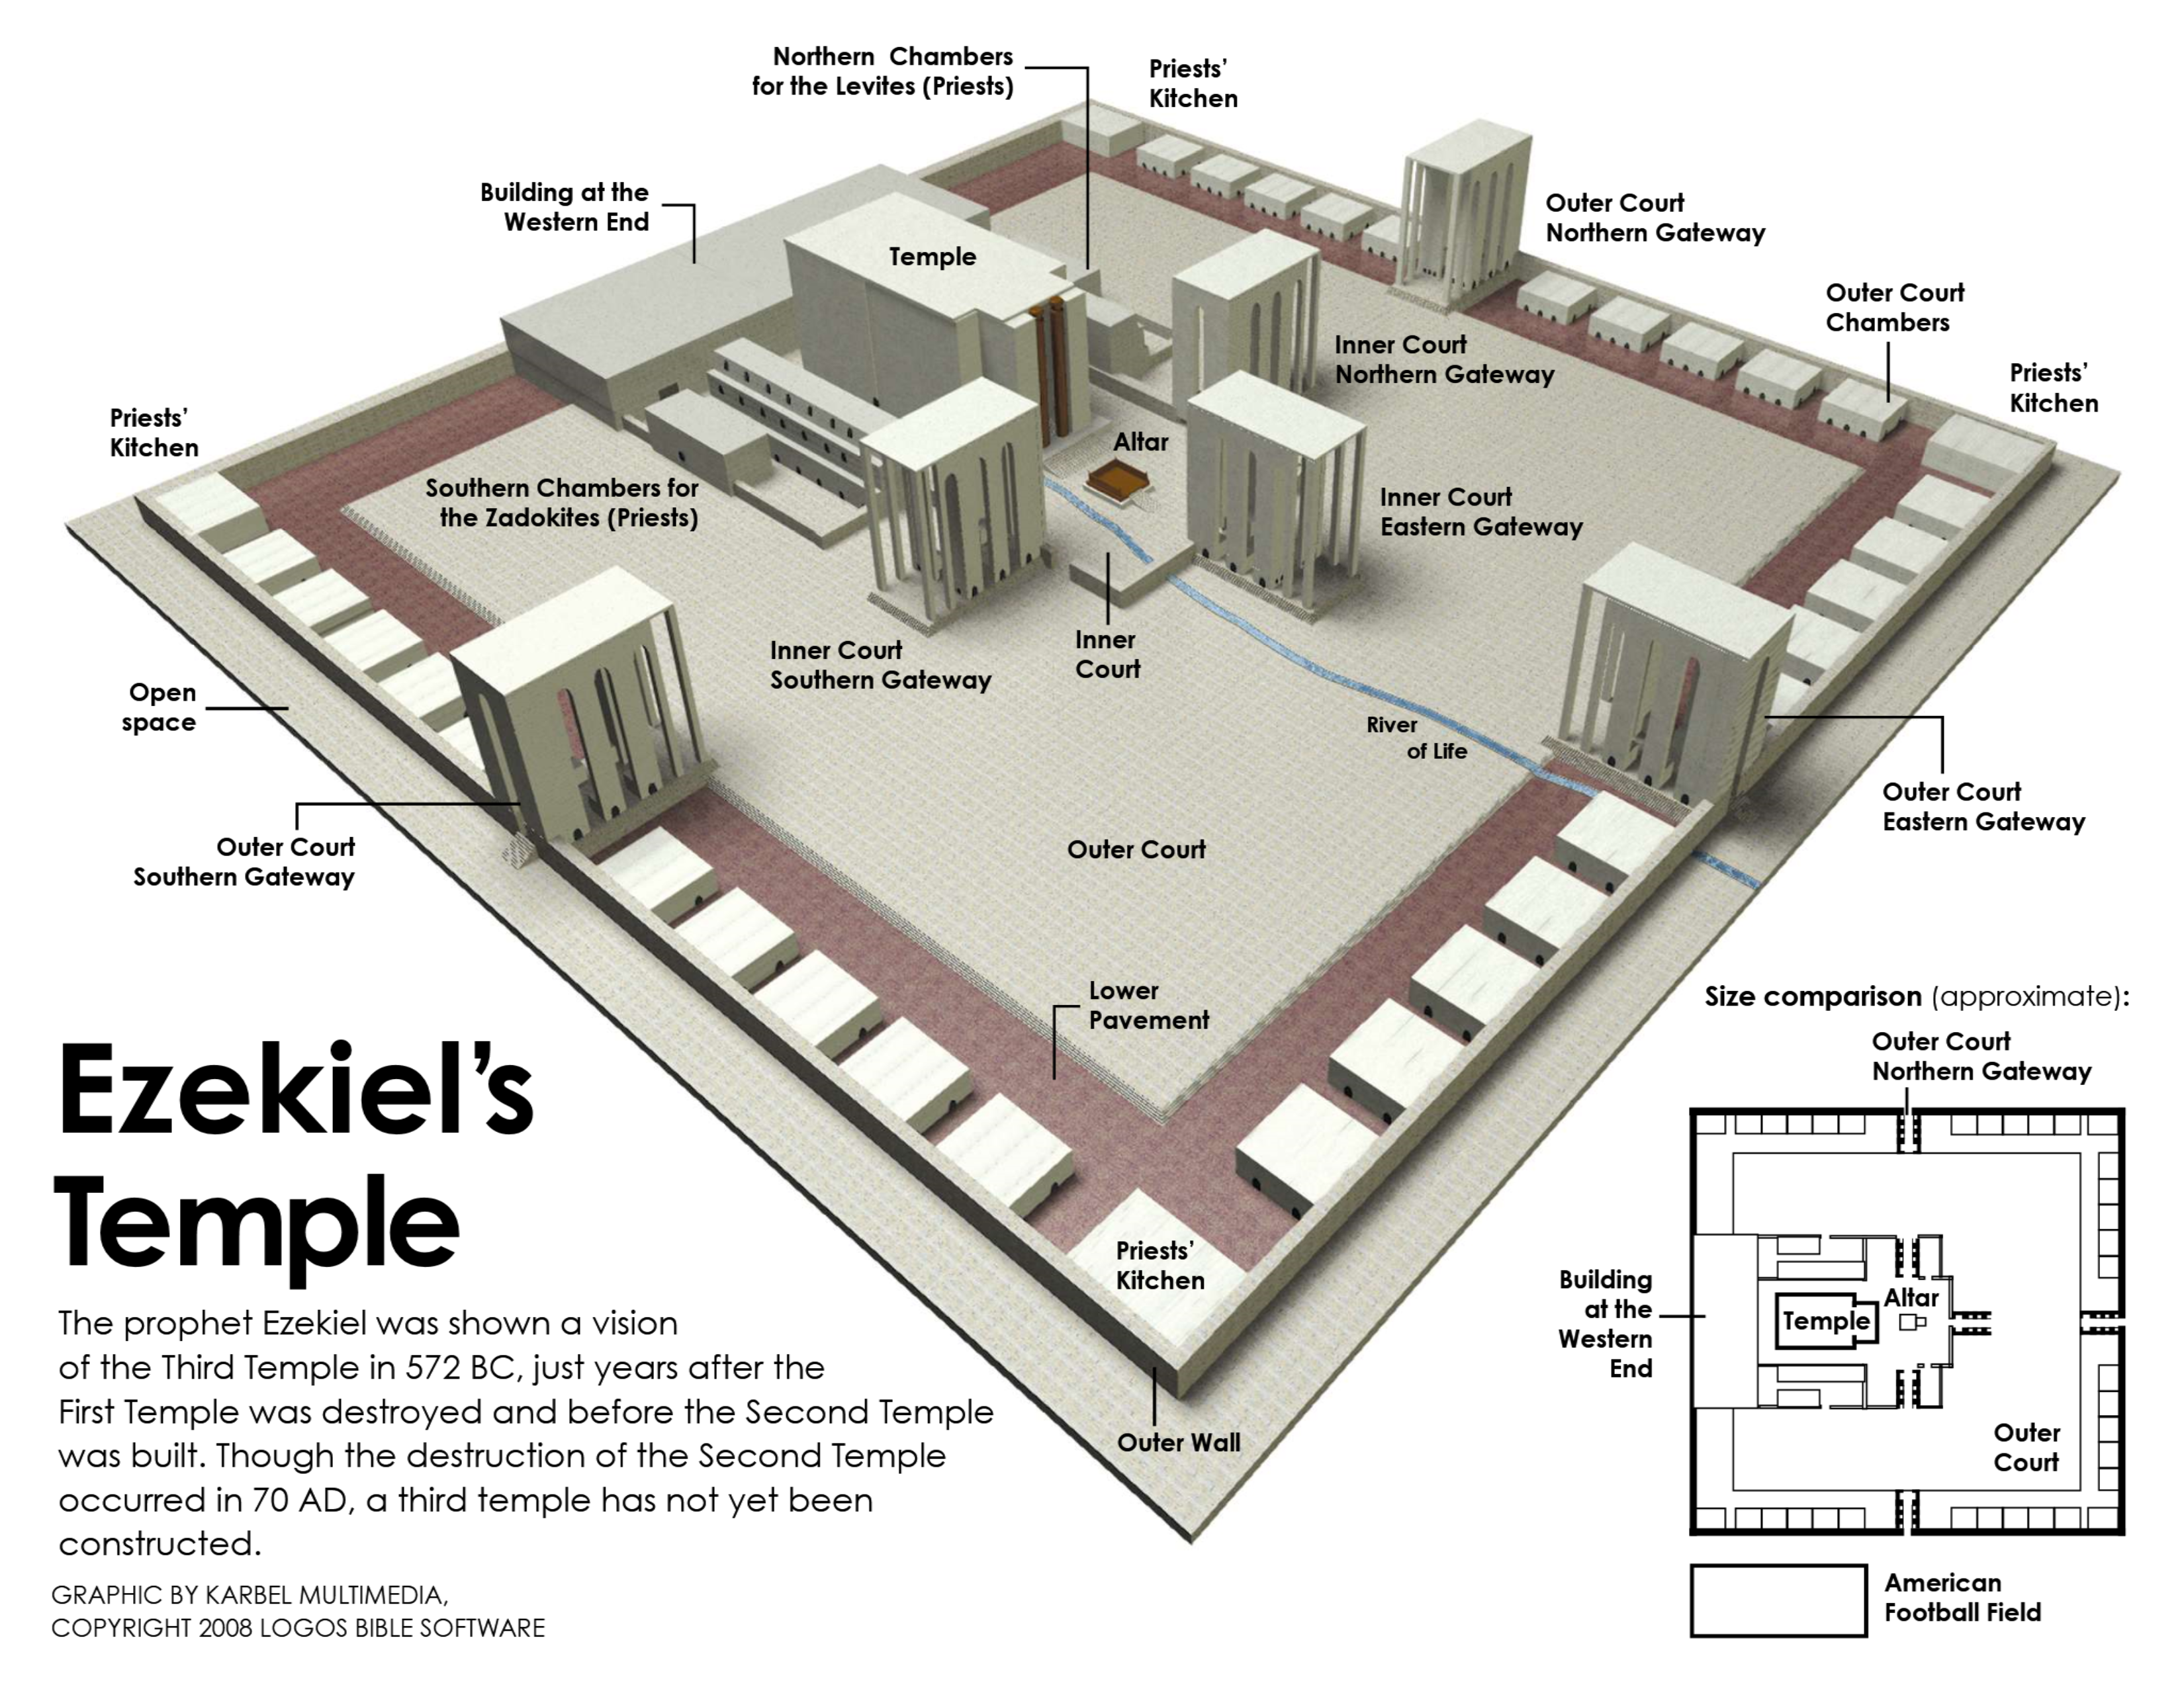

Slide 19
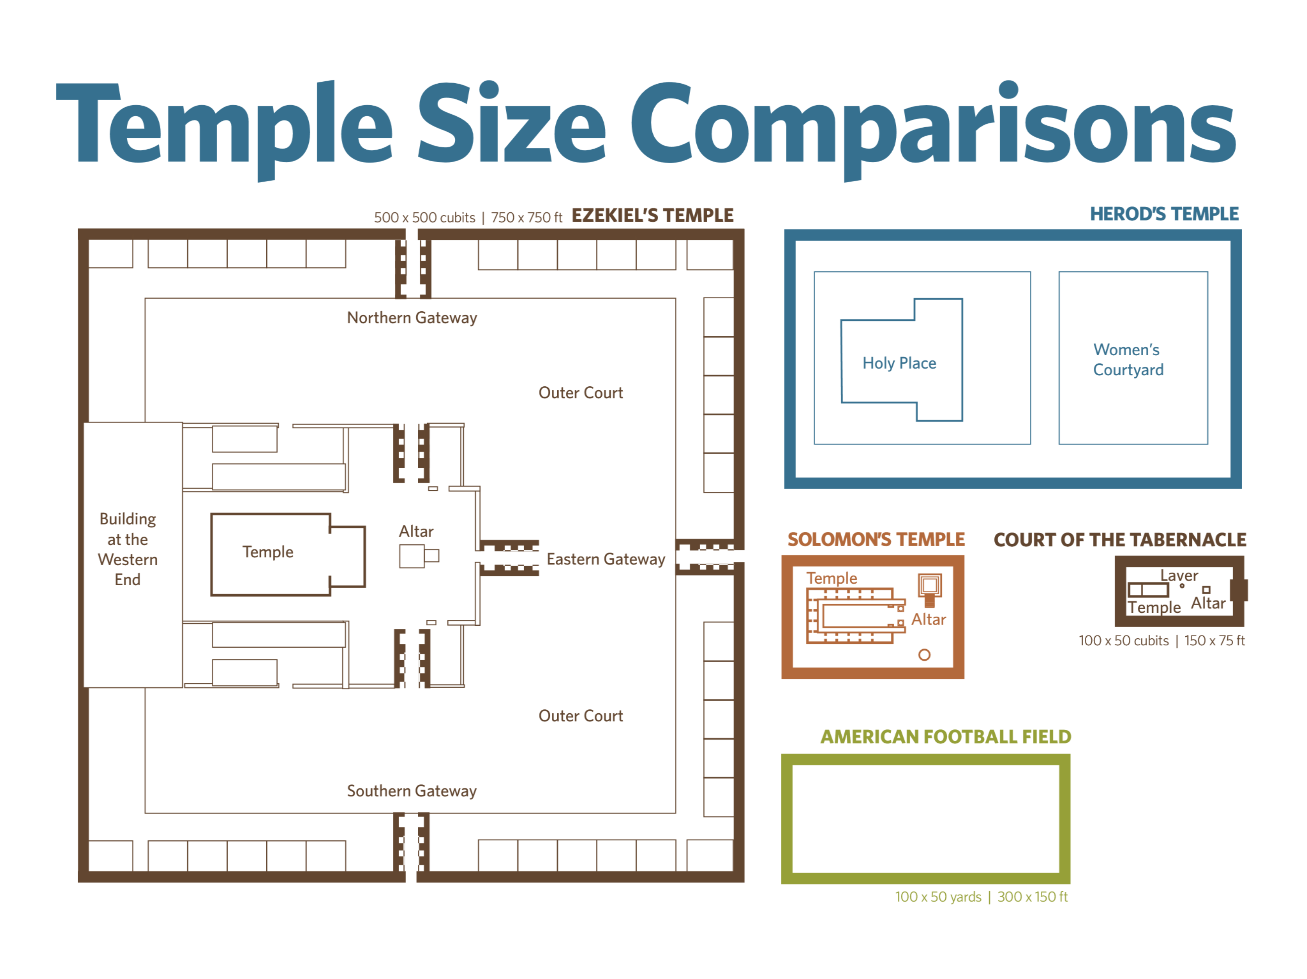

Slide 20
Restoration of God’s People (33-48)
Return to their land (33-36)
New life and unity (37)
Protection from their enemies (38-39)
Worship the Lord acceptably (40-48)
  New temple (40-43)
    Outer court of temple (40)
      Walls (v. 5)
      Gateways (vv. 6-16; 20-27)
      Outer court (vv. 17-19)
      Inner court (vv. 28-49)

Slide 21
Restoration of God’s People (33-48)
Return to their land (33-36)
New life and unity (37)
Protection from their enemies (38-39)
Worship the Lord acceptably (40-48)
  New temple (40-43)
    Outer court of temple (40)
    Temple itself (41)
      Sanctuary & most holy (vv. 1-4)
      Walls and side chambers (vv. 5-11)
      Separate building (v. 12)
      Measurement of temple area (vv. 13-16a)
      Interior of temple (vv. 16b-26)

Slide 22
Restoration of God’s People (33-48)
Return to their land (33-36)
New life and unity (37)
Protection from their enemies (38-39)
Worship the Lord acceptably (40-48)
  New temple (40-43)
    Outer court of temple (40)
    Temple itself (41)
    Priest chambers and total dimensions of temple (42)
      Chambers for priests (vv. 1-14)
      Total dimensions of temple (vv. 15-20)

Slide 23
Restoration of God’s People (33-48)
Return to their land (33-36)
New life and unity (37)
Protection from their enemies (38-39)
Worship the Lord acceptably (40-48)
  New temple (40-43)
    Outer court of temple (40)
    Temple itself (41)
    Priest chambers and total dimensions of temple (42)
    Glory of God returning to temple (43)
      Glory of God enters (vv. 1-12)
      Alter of burnt offerings (vv. 13-27)

Slide 24
Restoration of God’s People (33-48)
Return to their land (33-36)
New life and unity (37)
Protection from their enemies (38-39)
Worship the Lord acceptably (40-48)
  New temple (40-43)
  The temple service (44-46)
    Those allowed in temple (44:1-14)
      Prince of sanctuary (vv. 1-3)
      Foreigner excluded (vv. 4-9)
      Priests (vv. 10-14)

Slide 25
Restoration of God’s People (33-48)
Return to their land (33-36)
New life and unity (37)
Protection from their enemies (38-39)
Worship the Lord acceptably (40-48)
  New temple (40-43)
  The temple service (44-46)
    Those allowed in temple (44:1-14)
    Priests who serve (44:15-45:12)
      Who (44:15-16)
      Garments and conduct (44:17-22)
      Function (44:23-27)
      Inheritance (44:28-31)
      Land for the priests (45:1-8)
      To deal justly (45:9-12)

Slide 26
Restoration of God’s People (33-48)
Return to their land (33-36)
New life and unity (37)
Protection from their enemies (38-39)
Worship the Lord acceptably (40-48)
  New temple (40-43)
  The temple service (44-46)
    Those allowed in temple (44:1-14)
    Priests who serve (44:15-45:12)
    The sacrifices (45:13 – 46:24)

Slide 27
    The sacrifices (45:13 – 46:24)
      Of the people (45:13-17)
      To cleanse sanctuary (45:18-20)
      Passover and feast (45:21-25)
      Sabbath (46:1-8)
      Orderly entrance and exit (46:9-12)
      Daily sacrifice (46:13-15)
      Inheritance of priests (46:16-18)
      Preparation place for offerings (46:19-24)

Slide 28
Restoration of God’s People (33-48)
Return to their land (33-36)
New life and unity (37)
Protection from their enemies (38-39)
Worship the Lord acceptably (40-48)
  New temple (40-43)
  The temple service (44-46)
  The land (47-48)
    River and boundaries of the land (47)
      River of water of life (vv. 1-12)
      Boundaries (vv. 13-23)

Slide 29
Restoration of God’s People (33-48)
Return to their land (33-36)
New life and unity (37)
Protection from their enemies (38-39)
Worship the Lord acceptably (40-48)
  New temple (40-43)
  The temple service (44-46)
  The land (47-48)
    River and boundaries of the land (47)
    Division of the land (48)
      Northern tribes (vv. 1-7)
      Sanctuary and priests (vv. 8-22)
      Southern tribes (vv. 23-29)
      Gates and name (vv. 30-35)

Slide 30
Lessons Learned
Ezekiel
Chapters 33-48
There is hope for the future
There will be a remnant
Glory of God is in the new temple (kingdom)

