Slide 1

My Servants The Prophets
A Study of the Major Prophets
Ezekiel

Slide 2
Outline of Ezekiel
Judgment on Jerusalem (1-24)
  Call of the prophet (1-3)
  A disobedient nation (4-7)
  Glory departs (8-11)
  Disciplined nation (12-24)
Judgment on the Gentile Nations (25-32)
Restoration of God’s People (33-48)
  Return to their land (33-36)
  New life and unity (37)
  Protected from their enemies (38-39)
  Worship the Lord acceptably (40-48)
Adapted from J. Sidlow Baxter & Warren Weirsbe

Slide 3
Ezekiel
Chapters 25-32

Slide 4
Outline of Ezekiel
Judgment on Jerusalem (1-24)
  Call of the prophet (1-3)
  A disobedient nation (4-7)
  Glory departs (8-11)
  Disciplined nation (12-24)
Judgment on the Gentile Nations (25-32)
Restoration of God’s People (33-48)
  Return to their land (33-36)
  New life and unity (37)
  Protected from their enemies (38-39)
  Worship the Lord acceptably (40-48)
Adapted from J. Sidlow Baxter & Warren Weirsbe

Slide 5
Ezekiel
Chapters 25-32
Two Points:
Judgment is coming on the nations
God rules in the kingdoms of men

Slide 6
What Is Accomplished or Learned in the
Nations Section
God is in control of the nations
God is the God of all the nations
God uses nations as “tools”
God is fair in dealing with nations
God working out his purpose – in time
Nations are held accountable
God will strike a nation – yet God will heal a nation
Reason nations are destroyed – sin / rebellion in it

Slide 7
Judgment on the Gentiles Nations (25-32)
Ammon (25:1-7)
  Descendants of Lot (Gen. 19:37-38)
  Because rejoiced at fall of Israel (vv. 1-3, 6)
  Will be delivered to Babylon (vv. 4-5, 7)

Slide 8
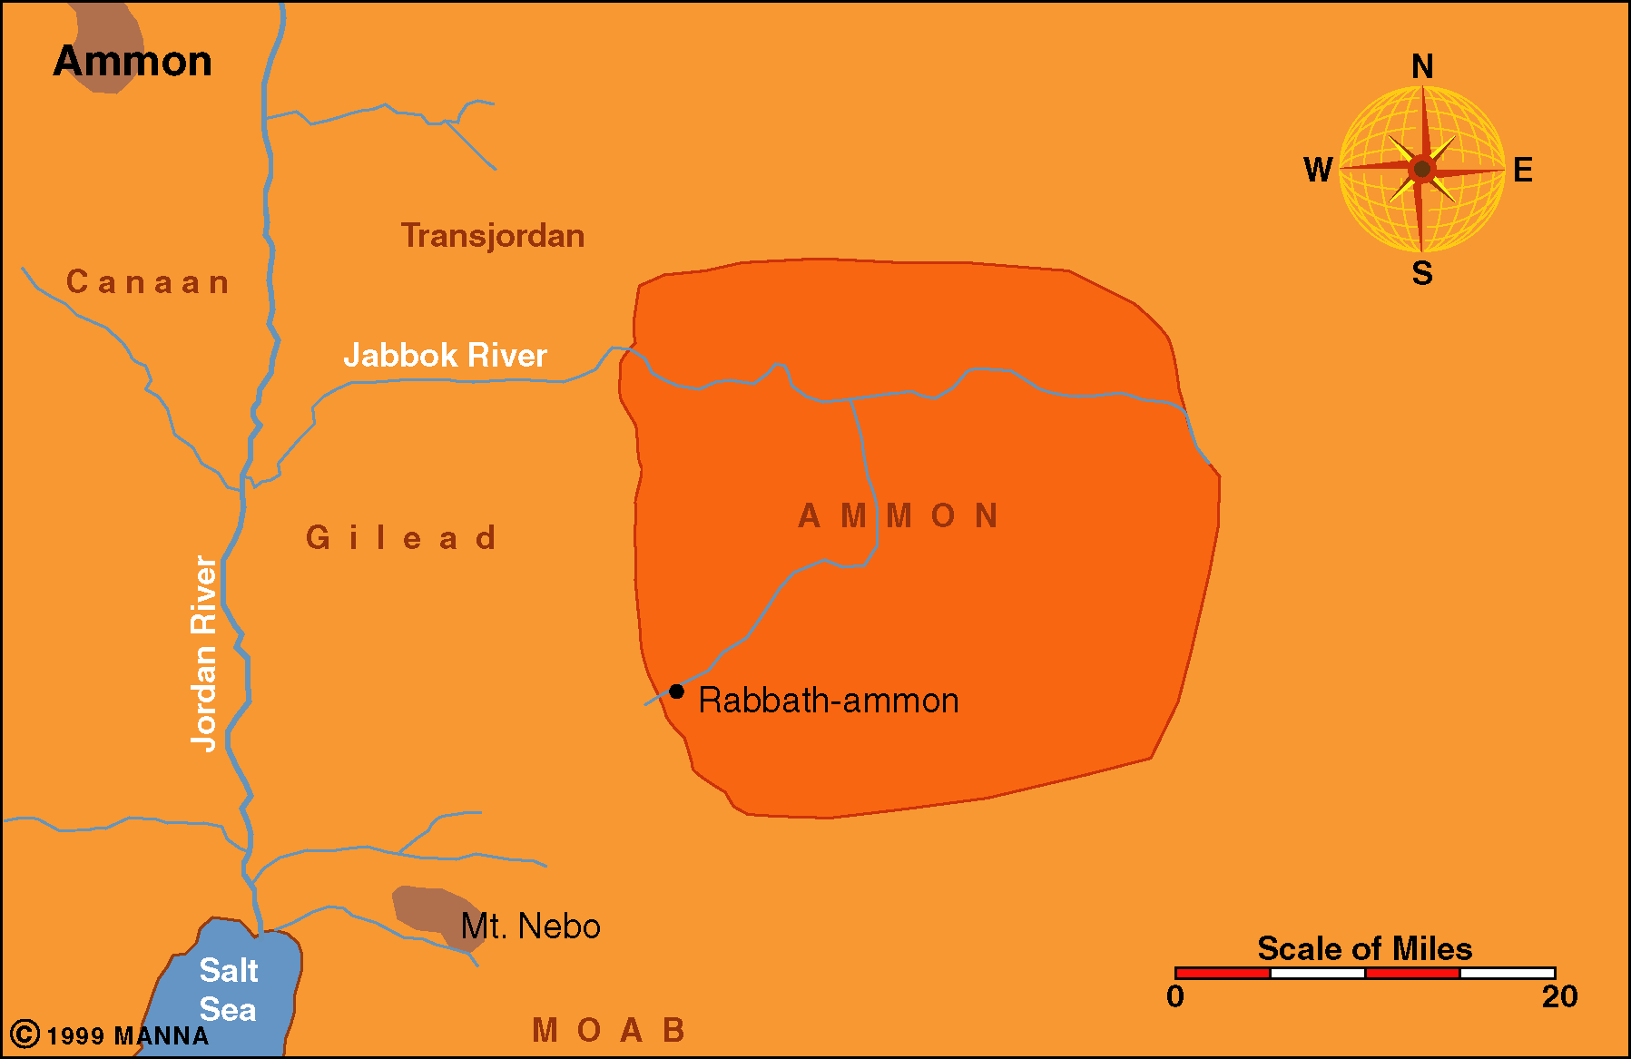

Slide 9
Judgment on the Gentiles Nations (25-32)
Ammon (25:1-7)
Moab (25:8-11)
  Descendants of Lot (Gen. 19:37-38)
  Because ridiculed Judah (v. 8)
  Will be delivered to Babylon (vv. 9-11)

Slide 10
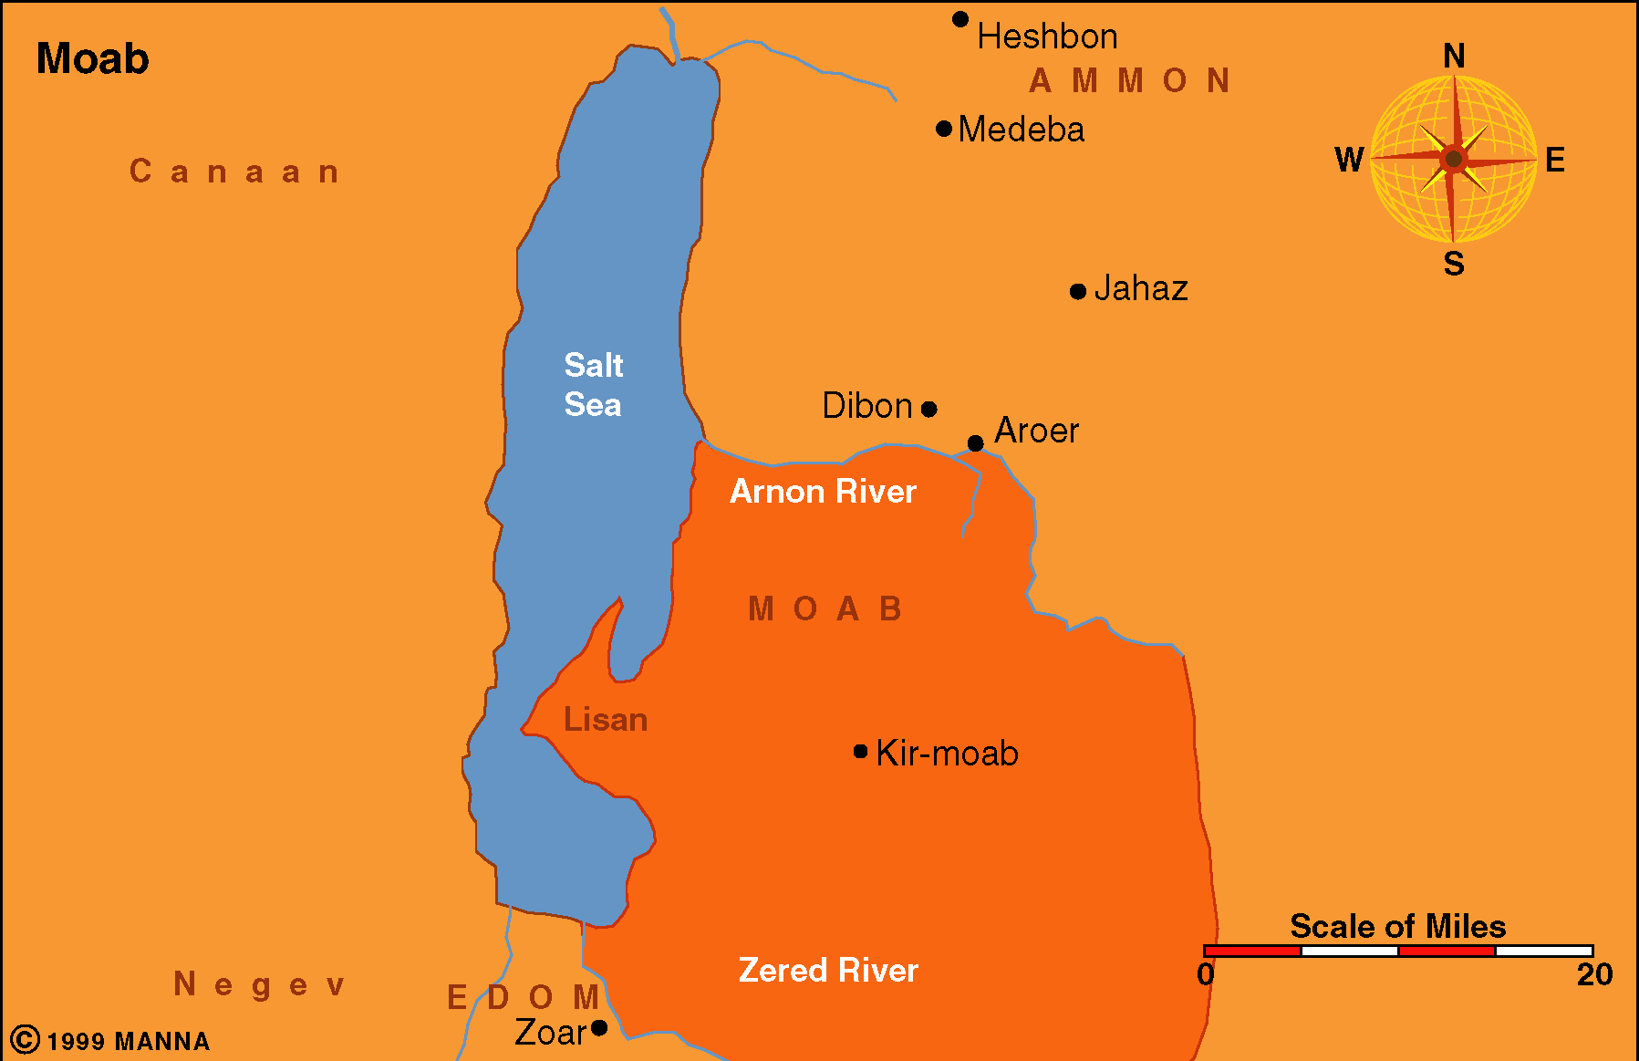

Slide 11
Judgment on the Gentiles Nations (25-32)
Ammon (25:1-7)
Moab (25:8-11)
Edom (25:12-14)
  Descendants of Esau (Gen. 25:30; 36:8-9)
  Because of what Edom did to Judah (12) [Num. 20:14-21)
  God’s hand outstretched against them (vv. 12-14)

Slide 12
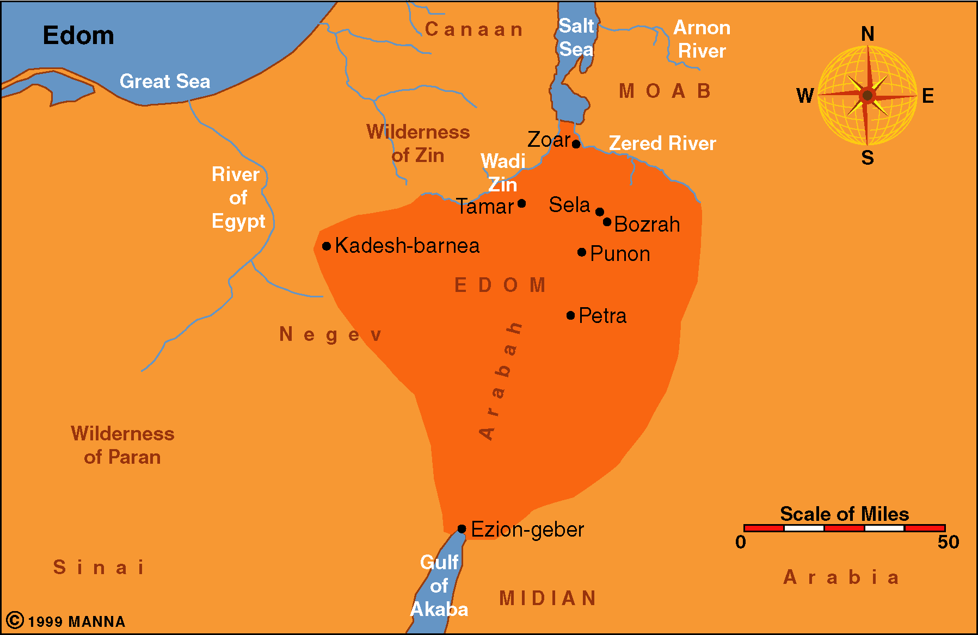

Slide 13
Judgment on the Gentiles Nations (25-32)
Ammon (25:1-7)
Moab (25:8-11)
Edom (25:12-14)
Philistia (25:15-17)
  Because of perpetual hatred (v. 15)
  God will stretch out his hand against them (vv. 16-17)

Slide 14
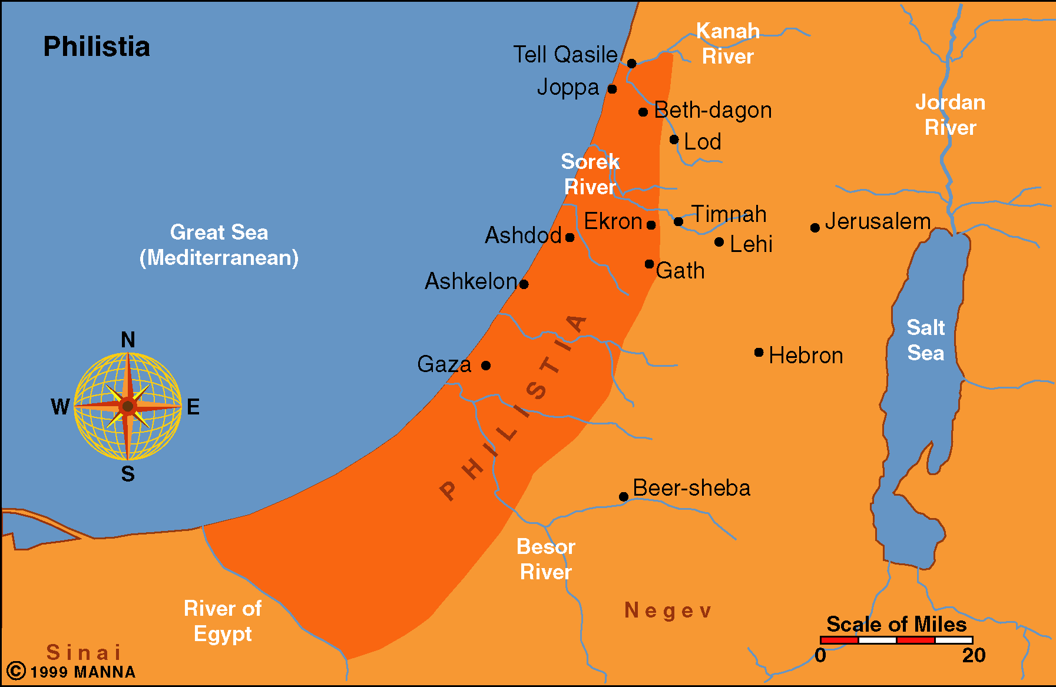

Slide 15
Judgment on the Gentiles Nations (25-32)
Ammon (25:1-7)
Moab (25:8-11)
Edom (25:12-14)
Philistia (25:15-17)
Tyre (26:1 – 28:19)
  Fall of Tyre (26)
  Lamentation for Tyre (27)
    Like a ship that is great (vv. 1-11)
    Trades with others (vv. 12-25)
    Sinks (vv. 26-36)
  Prophecy against the king of Tyre (28:1-19)

Slide 16
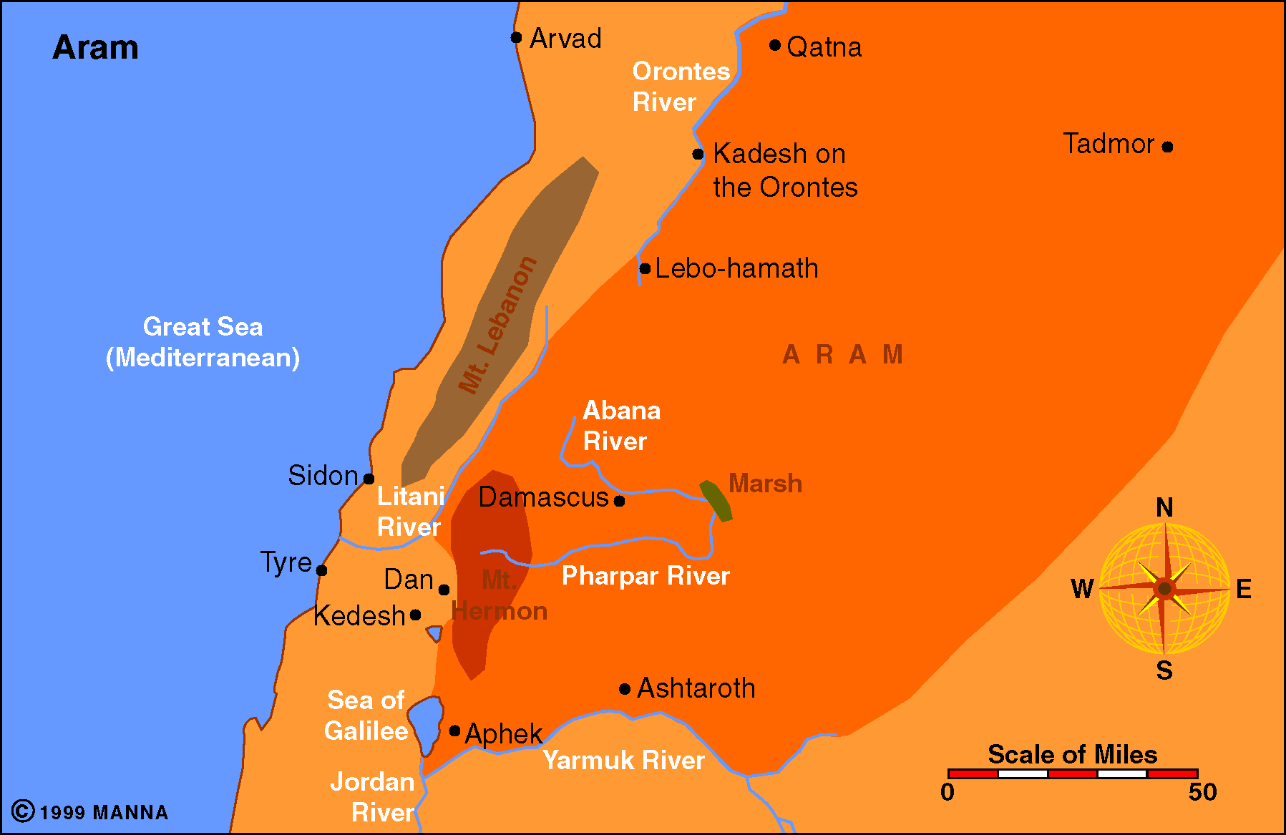
Aram

Slide 17
Judgment on the Gentiles Nations (25-32)
Ammon (25:1-7)
Moab (25:8-11)
Edom (25:12-14)
Philistia (25:15-17)
Tyre (26:1 – 28:19)
Sidon (28:20-26)
  Judgment upon Sidon (vv. 20-23)
  Because been a thorn to Israel (v. 24)

Slide 18
Aram

Slide 19
Remnant to Return (28:25-26)
Encouragement for the future
Thorns around them will be gone (v. 24)
God’s people will dwell safely

Slide 20
Judgment on the Gentiles Nations (25-32)
Ammon (25:1-7)
Moab (25:8-11)
Edom (25:12-14)
Philistia (25:15-17)
Tyre (26:1 – 28:19)
Sidon (28:20-26)
Egypt (29-32)
  Because of her many sins (29:1-16)
  Babylon will conquer Egypt (29:17 – 30:19)
  Arm of king of Egypt broken (30:20-26)
  Egypt will be cut down like Assyria (31)
  Lamentation for the king and the nation (32)
    Pharaoh is like a sea monster I will drag to land (vv. 1-6)
    Egypt’s lights will go out – made desolate (vv. 7-16)
    Egypt cast down into a pit with other failures (vv. 17-32)

Slide 21
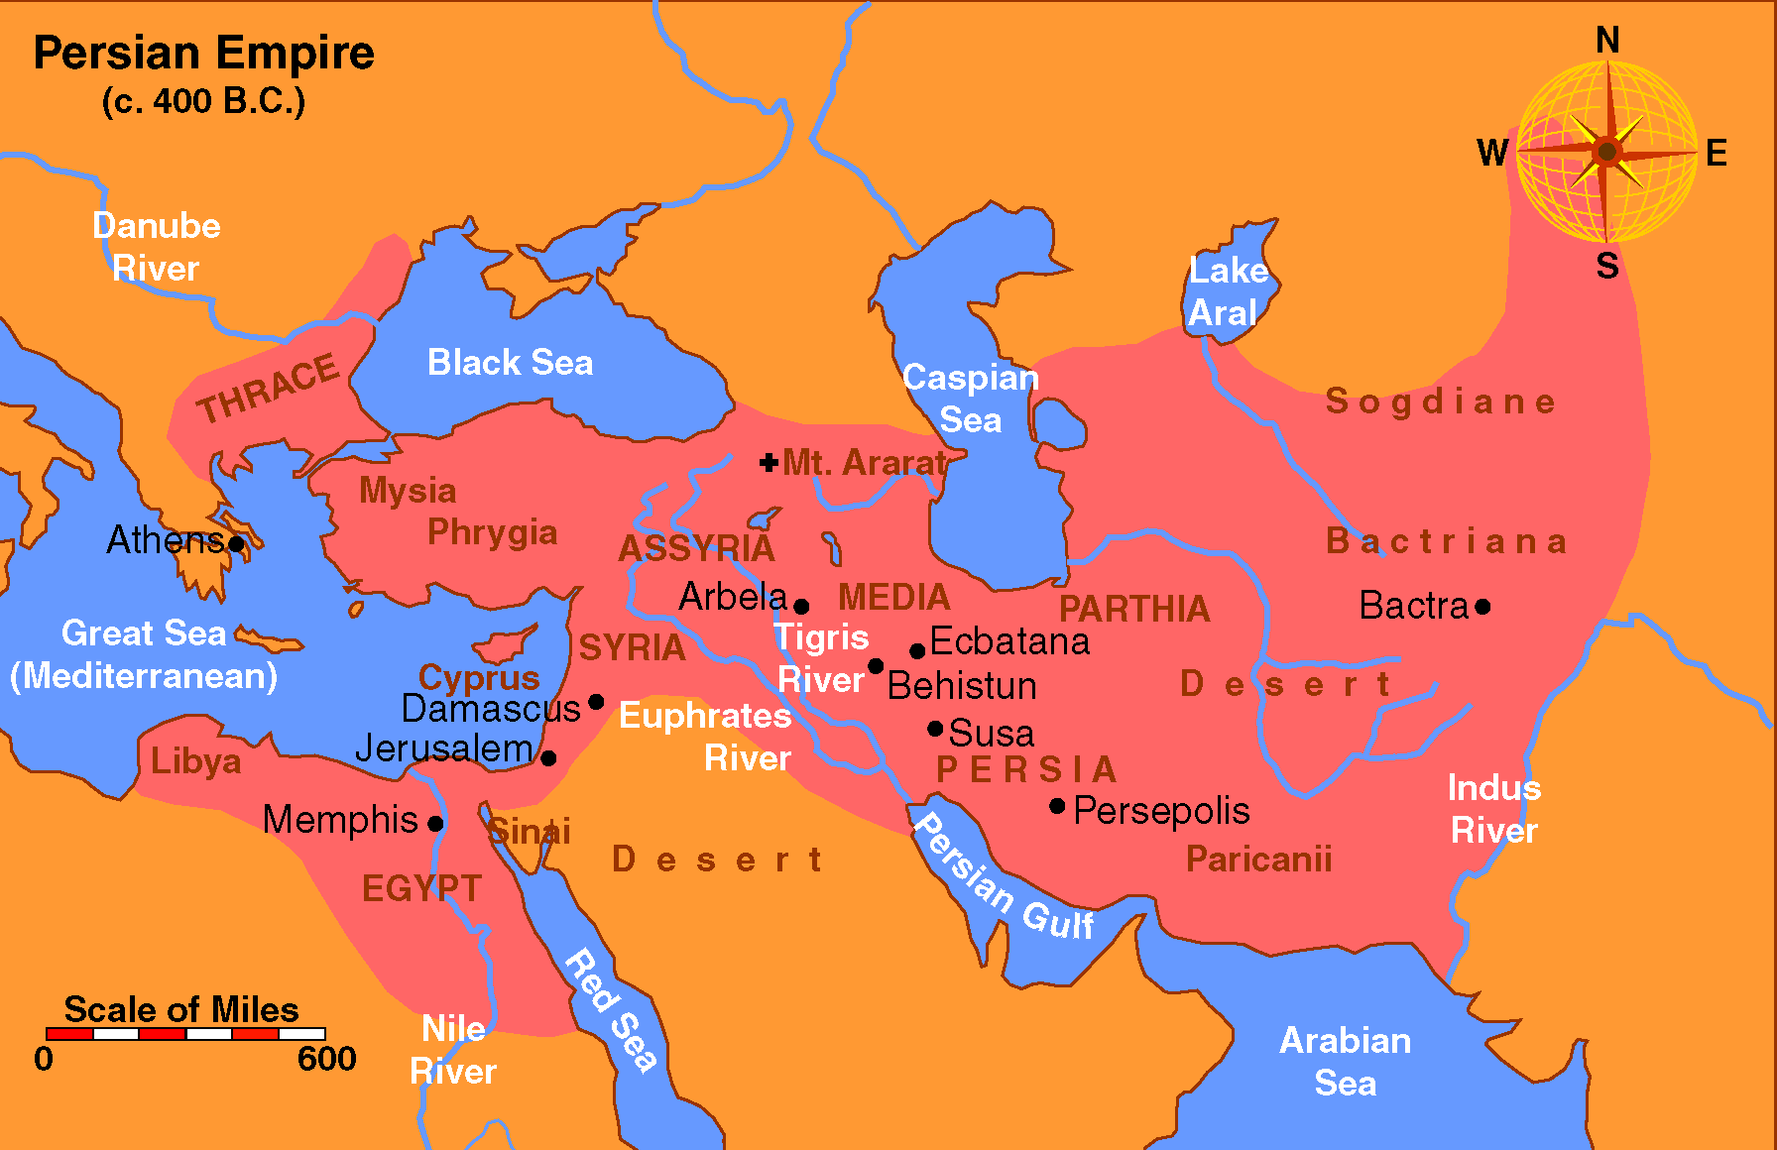

Slide 22
Lessons Learned
Ezekiel
Chapters 25-32
God rules in the kingdoms of men
God is fair in his judgment
The nations will give an account

