Slide 1
Hebrews 2:1–4
2 Therefore we must give the more earnest heed to the things we have heard, lest we drift away.
² For if the word spoken through angels proved steadfast, and every transgression and disobedience received a just reward,
³ how shall we escape if we neglect so great a salvation, which at the first began to be spoken by the Lord, and was confirmed to us by those who heard Him,
⁴ God also bearing witness both with signs and wonders, with various miracles, and gifts of the Holy Spirit, according to His own will?

Slide 2
Hebrews 2:1–4
Context
Giving heed to the things have heard (vv. 1-4)
  Lest we drift away or slip (v. 1)
  Can’t escape punishment – if we neglect (vv. 2-4)
Warning to brethren
  “We” – writer includes self (danger is real)
  Not a warning to the world that ignores salvation

Slide 3
Hebrews 2:3
Neglect
ameleō
Defined:
  BDAG: “be unconcerned”
  Louw-Nida: “to disregard, to pay not attention to”
  Vines: “make light of”
  Strongs: “to be careless of”

Slide 4
Hebrews 2:3
Neglect
ameleō
Defined:
Translated:
  “made light of” (Matt. 22:5)
  “disregarded” (Heb. 8:9)
  “negligent” (2 Pet. 1:12)
  “neglect” (1 Tim. 4:14; Heb. 2:3)

Slide 5
Neglect is enough to ruin a man. A man who is in business need not commit forgery or robbery, to ruin himself; he has only to Neglect his business, and his ruin is certain. A man who is lying on a bed of sickness, need not cut his throat to destroy himself; he has only to Neglect the means of restoration, and he will be ruined. A man floating in a skiff above Niagara, need not move an oar or make an effort to destroy himself; he has only to neglect using the oar at the proper time, and he will certainly be carried over the cataract. Most of the calamities of life are caused by simple neglect. By neglect of education children grow up in ignorance; by neglect a farm grows up to weeds and briars; by neglect a house goes to decay; by neglect of sowing, a man will have no harvest; by neglect of reaping, the harvest would rot in the fields. No worldly interest can prosper where there is neglect; and why may it not be so in religion? There is

Slide 6
nothing in earthly affairs that is valuable that will not be ruined if it is not attended to—and why may it not be so with the concerns of the soul? Let no one infer, therefore, that because he is not a drunkard, or an adulterer, or a murderer, that, therefore, he will be saved. Such an inference would be as irrational as it would be for a man to infer that because he is not a murderer his farm will produce a harvest, or that because he is not an adulterer therefore his merchandise will take care of itself. Salvation would be worth nothing if it cost no effort—and there will be no salvation where no effort is put forth.
  Barnes, A. (1884–1885). Notes on the New Testament: Hebrews, (p. 53)

Slide 7
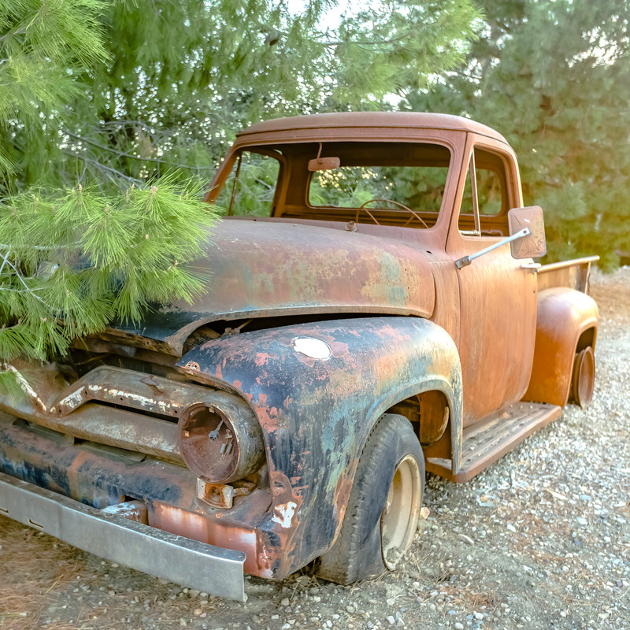
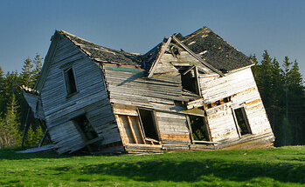
Hebrews 2:3
Neglect
ameleō
Neglect does not require:
    Opposing
    Rejecting
    Setting out to destroy
House
Car / Truck
Health
Animal
Neglect doesn’t create sudden changes

Slide 8
Hebrews 2:3
Neglecting
our Salvation
How could we neglect salvation?

Slide 9
Neglecting
our Salvation
Not Giving Earnest Heed (2:3)

Slide 10
Not Giving Earnest Heed (2:3)
Contrast in the context (v. 3)
Give earnest heed
  “Pay much closer attention” (ESV, NASV)
  Doers and not mere (Jas. 1:22-25)

Slide 11
Not Giving Earnest Heed (2:3)
Contrast in the context (v. 3)
Give earnest heed
Not taking preventative measures
  Like maintenance on car or house
  Like taking care of health
  Watching for dangers (Eph. 6:18; 1 Thess. 5:6)

Slide 12
Not Giving Earnest Heed (2:3)
Contrast in the context (v. 3)
Give earnest heed
Not taking preventative measures
Ignoring problems that need attention
  Like ignoring the knock in the engine
  Like ignoring the water spot on the ceiling
  Like ignoring the pain in your chest
  Times we see a problem and walk away (Jas. 1:23-24)

Slide 13
Not Giving Earnest Heed (2:3)
Contrast in the context (v. 3)
Give earnest heed
Not taking preventative measures
Ignoring problems that need attention
Delay obedience / compliance (3:7, 13)
  Like plans to see about the leak in the bathroom
  Going to… plan to… need to… but just haven’t

Slide 14
Neglecting
our Salvation
Not Giving Earnest Heed (2:3)
Not Being Diligent (4:11)

Slide 15
Not Being Diligent (4:11)
Context:
  Warning not to fail as Israel of old (vv. 1-13)
  Israel heard word – but did not profit (v. 2)
  Point: be diligent lest we fall (v. 11)
  For God sees all and knows all (vv. 12-13)
Diligent
  KJV – “labor” – work, action, effort
  Put every ounce of energy into it
  2 Pet. 1:5, 10
We are neglecting our salvation – if we are not giving it our all

Slide 16
Neglecting
our Salvation
Not Giving Earnest Heed (2:3)
Not Being Diligent (4:11)
Failing to Grow (5:12 – 6:2)

Slide 17
Failing to Grow (5:12 – 6:2)
Fail to grow in knowledge (v.12a)
Fail to retain what we once knew (v. 12b)
Fail to advance beyond the basics (v. 13; 6:1-2)
Fail to grow in use / application (v. 14)
Content to remain as we are
  Not striving to improve / advance (2 Pet. 1:5-10)
  Not striving to know more (2 Pet. 3:18)
  Not striving to be more pleasing (2 Pet. 3:18)
  Not striving to have more wisdom (Jas. 1:5)
  Not striving to be more mature (Heb. 5:14)

Slide 18
Neglecting
our Salvation
Not Giving Earnest Heed (2:3)
Not Being Diligent (4:11)
Failing to Grow (5:12 – 6:2)
Forsaking the Assembly (10:25)

Slide 19
Forsaking the Assembly (10:25)
Don’t have to abandon the assembly to forsake or neglect
  Can be one time or occasional (i.e. Matt. 27:46)
  Could attend more – just don’t
What we miss (neglect)
  Praise / worship of God (Eph 5:19)
  Edification from the word (1 Cor. 14:1-5; Acts 20:32)
  Encouragement from others (Heb. 10:24)
  Uplifted by songs of the saints (Col. 3:16)

Slide 20
Neglecting
our Salvation
Not Giving Earnest Heed (2:3)
Not Being Diligent (4:11)
Failing to Grow (5:12 – 6:2)
Forsaking the Assembly (10:25)
Not Laying Aside Sin (12:1-3)

Slide 21
Not Laying Aside Sin (12:1-3)
Picture of a runner who forgets / neglects to remove things that weigh him down
Sin hinders us
  Separates from God (Jas. 1:15)
  Brings eternal damnation (Rom. 6:23)
  Hinders our influence (Rom. 2:23-24)
  Hinders our prayers (1 Pet. 3:7)
May be a sin – you are having a hard time letting go…
  Example: fornication justified by some at Corinth (1 Cor. 6)
  By failing to let go of some sin….. Neglecting salvation

Slide 22
Neglecting
our Salvation
Not Giving Earnest Heed (2:3)
Not Being Diligent (4:11)
Failing to Grow (5:12 – 6:2)
Forsaking the Assembly (10:25)
Not Laying Aside Sin (12:1-3)
Discouraged (12:12)

Slide 23
Discouraged (12:12)
Context (Book) discouraged by opposition
Point of the book is to encourage
  On the right way (1-9)
  Keep on and don’t give up (10-13)
When we are discouraged:
  Easy to wonder, “what is the use?”
  Easy to forget our responsibilities
  Easy to fail to work hard
  Easy to neglect as would house, car, etc.

Slide 24
Neglecting
our Salvation
Not Giving Earnest Heed (2:3)
Not Being Diligent (4:11)
Failing to Grow (5:12 – 6:2)
Forsaking the Assembly (10:25)
Not Laying Aside Sin (12:1-3)
Discouraged (12:12)

