Slide 1
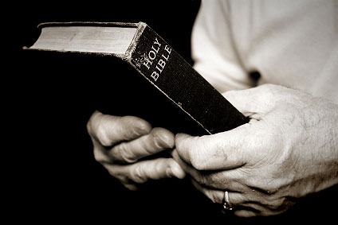
What is that book
you hold in your hand?

Slide 2
To some book of suggestions
To some book of good morals
To some book of great stories
To some book that is outdated
To some book of nonsense
To some book written by man
To some book can’t understand
To some guide for life

Slide 3
What is that book
you hold in your hand?
What is the Bible?
Where did it come from?
How do
you use it?
What does
it tell you?

Slide 4
The best selling book of all times
Most read book - universally
Quoted more frequently
Most everyone has a copy
The most abused book
Misquoted - Misapplied
Undermined by false concepts
Sets on shelf / table - unread
Read it - then ignore it

Slide 5
A Most Notable Book
What is this book?
Why is it so special?
How did we get it anyway?
How are we supposed to use it?

Slide 6
The Bible

Slide 7
The Bible
I. What It Is Called

Slide 8
What
It
Is
Called
The Bible
From biblos - means book
Thus - The Book (The Standard)
Holy Bible - Holy Book
(The book from God)

Slide 9
What
It
Is
Called
The Bible
The Scriptures
2 Tim. 3:15; 2 Pet. 3:16
John 5:39; Acts 17:11
graphe = to write / written
document
Written word - Same as oral

Slide 10
What
It
Is
Called
The Bible
The Scriptures
The Word of God
Rom. 10:17; 1 Thess. 2:13
2 Tim. 4:2; 1 Pet. 1:23, 25
Utterance / Expression of thought
Thus: Expression of mind of God

Slide 11
What
It
Is
Called
The Bible
The Scriptures
The Word of God
The Gospel
Rom. 1:16; 10:15-16
1 Cor. 15:1; Col. 1:23
good news - glad tidings
same as evangelize

Slide 12
What
It
Is
Called
The Bible
The Scriptures
The Word of God
The Gospel
The Oracles of God
1 Pet. 4:11; Rom. 3:2
Heb. 5:12
Utterance - from word for word
Statements From God

Slide 13
What
It
Is
Called
The Bible
The Scriptures
The Word of God
The Gospel
The Oracles of God
The Truth
Gal. 2:14; 2 Thess. 2:10-12
1 Pet. 1:22; 1 Tim. 2:4
That which is right - true
Opposed to fiction / error

Slide 14
What
It
Is
Called
The Bible
The Scriptures
The Word of God
The Gospel
The Oracles of God
The Truth
The Doctrine
2 John 9; Rom. 16:17
Heb. 6:1; Tit. 2:1
Teaching; Instruction
(cf. Tit. 1:9 “taught”)

Slide 15
The Bible
I. What It Is Called
II. How It Came To Us

Slide 16


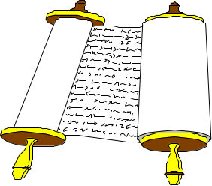
How
It
Came
To Us
Christ
1 Cor. 14:37
John 16:13
Mind of God
Heb. 1:1-2
Holy Spirit
John 14:26
Matt. 10:19
Apostles & Prophets
Eph. 3:3-5
1 Cor. 2:9-13
Original
Writings
Eph. 3:3-5
Translated

Slide 17
The Bible
I. What It Is Called
II. How It Came To Us
III. It Is Inspired

Slide 18
It Is
Inspired
Inspiration
“divinely breathed in”
Thus: Given by the breath of God

Slide 19
David
2 Sam 23:1-2
Now these are the last words of David.Thus says David the son of Jesse; Thus says the man raised up on high,The anointed of the God of Jacob, And the sweet psalmist of Israel: The Spirit of the LORD spoke by me, And His word was on my tongue.
Matt 22:43-44
He said to them, "How then does David in the Spirit call Him 'Lord,' saying: The LORD said to my Lord, "Sit at My right hand, Till I make Your enemies Your footstool" '?

Slide 20
2 Pet. 1:20-21
20 knowing this first, that no prophecy of Scripture is of any private interpretation,
21 for prophecy never came by the will of man, but holy men of God spoke as they were moved by the Holy Spirit.
Prophecy did not owe its origin to man
Prophecy had its origin from God
Use the instrumentality of human authors
“Moved” = borne along as a ship moved by the wind.
Moved by the power of the Holy Spirit

Slide 21
It Is
Inspired
Inspiration
“divinely breathed in”
Thus: Given by the breath of God
Plenary
(All The Bible)
“All Scripture is
given by
inspiration
of God…”
(2 Tim. 3:16)
Verbal
(Every Word)
“not in words
which man's
wisdom teaches
but which
the Holy Spirit
teaches”
(1 Cor. 2:13)

Slide 22
The Bible
I. What It Is Called
II. How It Came To Us
III. It Is Inspired
IV. It Value To Us

Slide 23
Its
Value
To Us
Know God & his will
  Reveals the mind of God (1 Cor. 2:9-13)
  Know that Jesus is real (1 John 5:13, 20)
  Know we have eternal life (1 John 5:13)

Slide 24
Its
Value
To Us
Know God & his will
Tells us how - be saved
  Found in gospel (Rom. 1:16-17)
  Saved by Christ (1 Cor. 15:1-2)
  Saved by word (Jas. 1:21)
  Tells us what to do (Acts 10:6; 11:14)

Slide 25
Its
Value
To Us
Know God & his will
Tells us how - be saved
Know truth from error
  Wonder “what is truth?” (John 18:38)
  Word is truth (John 17:17)
  Test teachings to see if truth (Acts 17:11)

Slide 26
Its
Value
To Us
Know God & his will
Tells us how - be saved
Know truth from error
Guide to live by
  Must live by gospel (Phil. 1:27)
  Gospel has to do with daily conduct – how we treat others (Gal. 2:14)

Slide 27
Its
Value
To Us
Know God & his will
Tells us how - be saved
Know truth from error
Guide to live by
Authority in religion

Slide 28
Its
Value
To Us
False Standards
“I think…” (Prov. 14:12)
Feelings (Jer. 10:23)
Family (Luke 14:26)
Preacher / Pastor (1 John 4:1)
Majority (Exo. 23:2; Matt. 7:13-14)

Slide 29
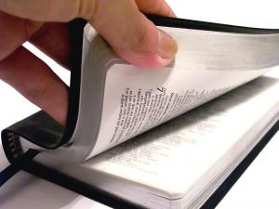
Its
Value
To Us
The True Standard
Word of God
  1 Pet. 4:11
  2 Cor. 4:13
All Sufficient Standard
  All we need (2 Pet. 1:3; 2 Tim. 3:16-17)
  All we teach (1 Pet. 4:11; 2 Cor. 4:13)
  All establishes faith (Rom. 10:17)
  All we need for practice (Col. 3:17)

Slide 30
The Bible
I. What It Is Called
II. How It Came To Us
III. It Is Inspired
IV. It Value To Us

Slide 31
What does
the Bible
mean to you?

