Slide 1

My Servants The Prophets
A Study of the Major Prophets
Jeremiah
Lesson 3
Chapters 46-52

Slide 2
Outline of Jeremiah
Introduction: The prophet’s call (1)
National – Messages to Judah (2-33)
Personal – Jeremiah’s Suffering (34-45)
International – Message to the Nations (46-51)
Conclusion: The prophet’s captivity and release (52)
Warren W. Wiersbe , Wiersbe’s Expository Outlines on the Old Testament, 521

Slide 3
Outline of Jeremiah
Introduction: The prophet’s call (1)
National – Messages to Judah (2-33)
  Condemnation (2-24)
    The nation generally (2-20)
    The leaders specifically (21-24)
  Captivity (25-29)
  Restoration (30-33)
Warren W. Wiersbe , Wiersbe’s Expository Outlines on the Old Testament, 521

Slide 4
Outline of Jeremiah
Introduction: The prophet’s call (1)
National – Messages to Judah (2-33)
Personal – Jeremiah’s Suffering (34-45)
  Before the siege of Jerusalem (34-39)
  After the siege, with the remnant (40-45)
Warren W. Wiersbe , Wiersbe’s Expository Outlines on the Old Testament, 521

Slide 5
Outline of Jeremiah
Introduction: The prophet’s call (1)
National – Messages to Judah (2-33)
Personal – Jeremiah’s Suffering (34-45)
International – Message to the Nations (46-51)
  Egypt (46)
  Philistia (47)
  Moab (48)
  Ammon (49:1-6)
  Edom (49:7-22)
  Syria, Kedar, Elam (49:23-39)
  Babylon (50-51)
Conclusion: The prophet’s captivity and release (52)
Warren W. Wiersbe , Wiersbe’s Expository Outlines on the Old Testament, 521

Slide 6
Jeremiah
Chapters 46-52

Slide 7

The Point of this Section
Three Points:
God will judge the nations
Mighty Babylon will fall
Jeremiah was right about Judah – it fell

Slide 8
What Is Accomplished or Learned in the
Nations Section
God is in control of the nations
God is the God of all the nations
God uses nations as “tools”
God is fair in dealing with nations
God working out his purpose – in time
Nations are held accountable
God will strike a nation – yet God will heal a nation
Reason nations are destroyed – sin / rebellion in it

Slide 9
National – Messages to Judah (2-33)
Personal – Jeremiah’s Suffering (34-45)
International – Message to the Nations (46-52)
  Egypt (46)
  Philistia (47)
  Moab (48)
  Ammon (49:1-6)
  Edom (49:7-22)
  Syria, Kedar, Elam (49:23-39)
  Babylon (50-51)
Conclusion: The prophet’s captivity and release (52)

Slide 10
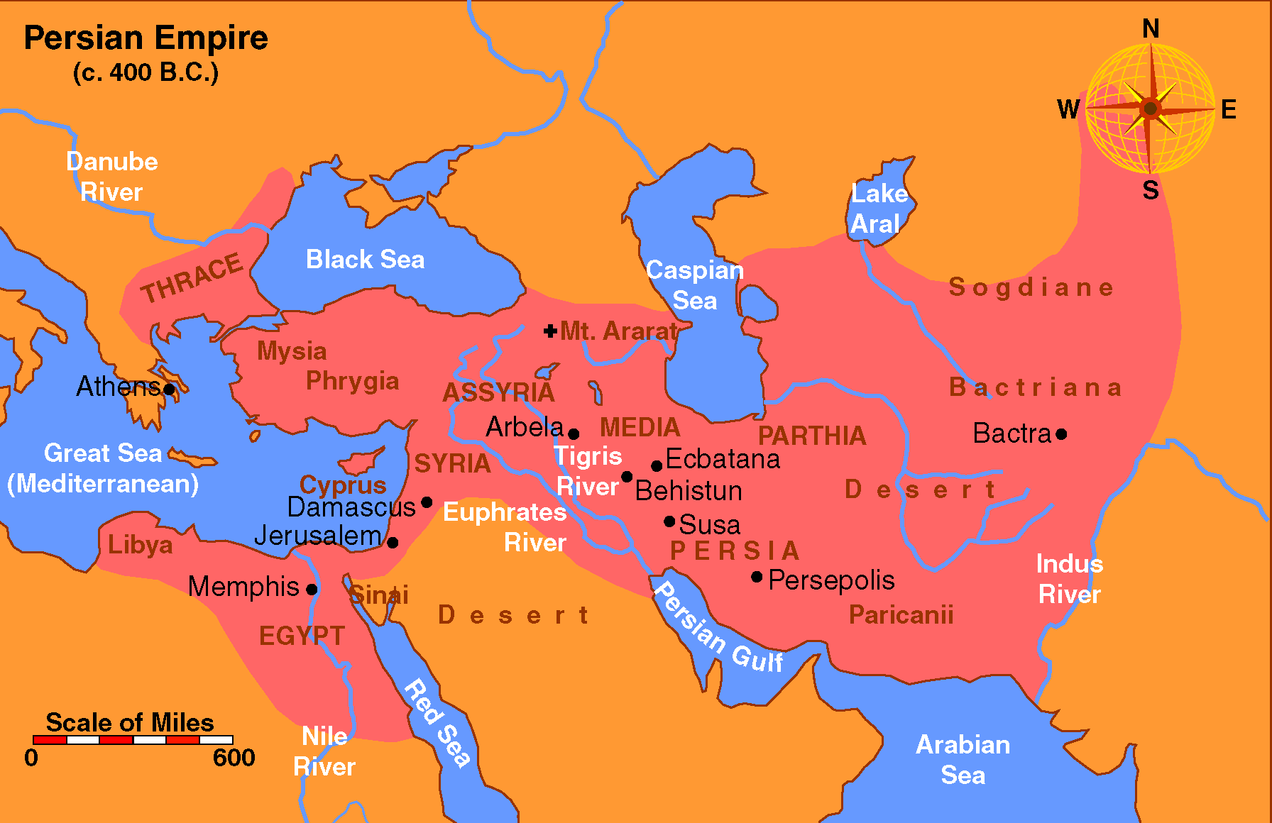

Slide 11
Egypt (46)
  Egypt cannot fend off the coming judgment (vv. 1-12)
  Nebuchadnezzar will strike the land of Egypt (vv. 13-26)
  Assurance to God’s remnant (vv. 27-28)

Slide 12
National – Messages to Judah (2-33)
Personal – Jeremiah’s Suffering (34-45)
International – Message to the Nations (46-52)
  Egypt (46)
  Philistia (47)
  Moab (48)
  Ammon (49:1-6)
  Edom (49:7-22)
  Syria, Kedar, Elam (49:23-39)
  Babylon (50-51)
Conclusion: The prophet’s captivity and release (52)

Slide 13
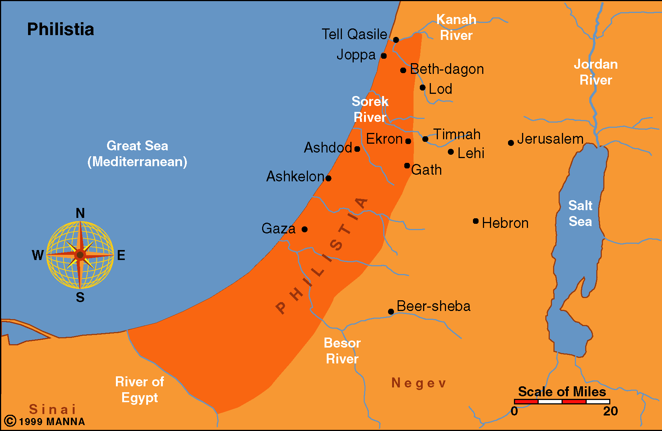

Slide 14
Philistia (47)
  Destruction is coming from the north (vv. 1-4)
  Consequences of the invasion (vv. 5-7)
    Destruction
    Cry for mercy

Slide 15
National – Messages to Judah (2-33)
Personal – Jeremiah’s Suffering (34-45)
International – Message to the Nations (46-52)
  Egypt (46)
  Philistia (47)
  Moab (48)
  Ammon (49:1-6)
  Edom (49:7-22)
  Syria, Kedar, Elam (49:23-39)
  Babylon (50-51)
Conclusion: The prophet’s captivity and release (52)

Slide 16
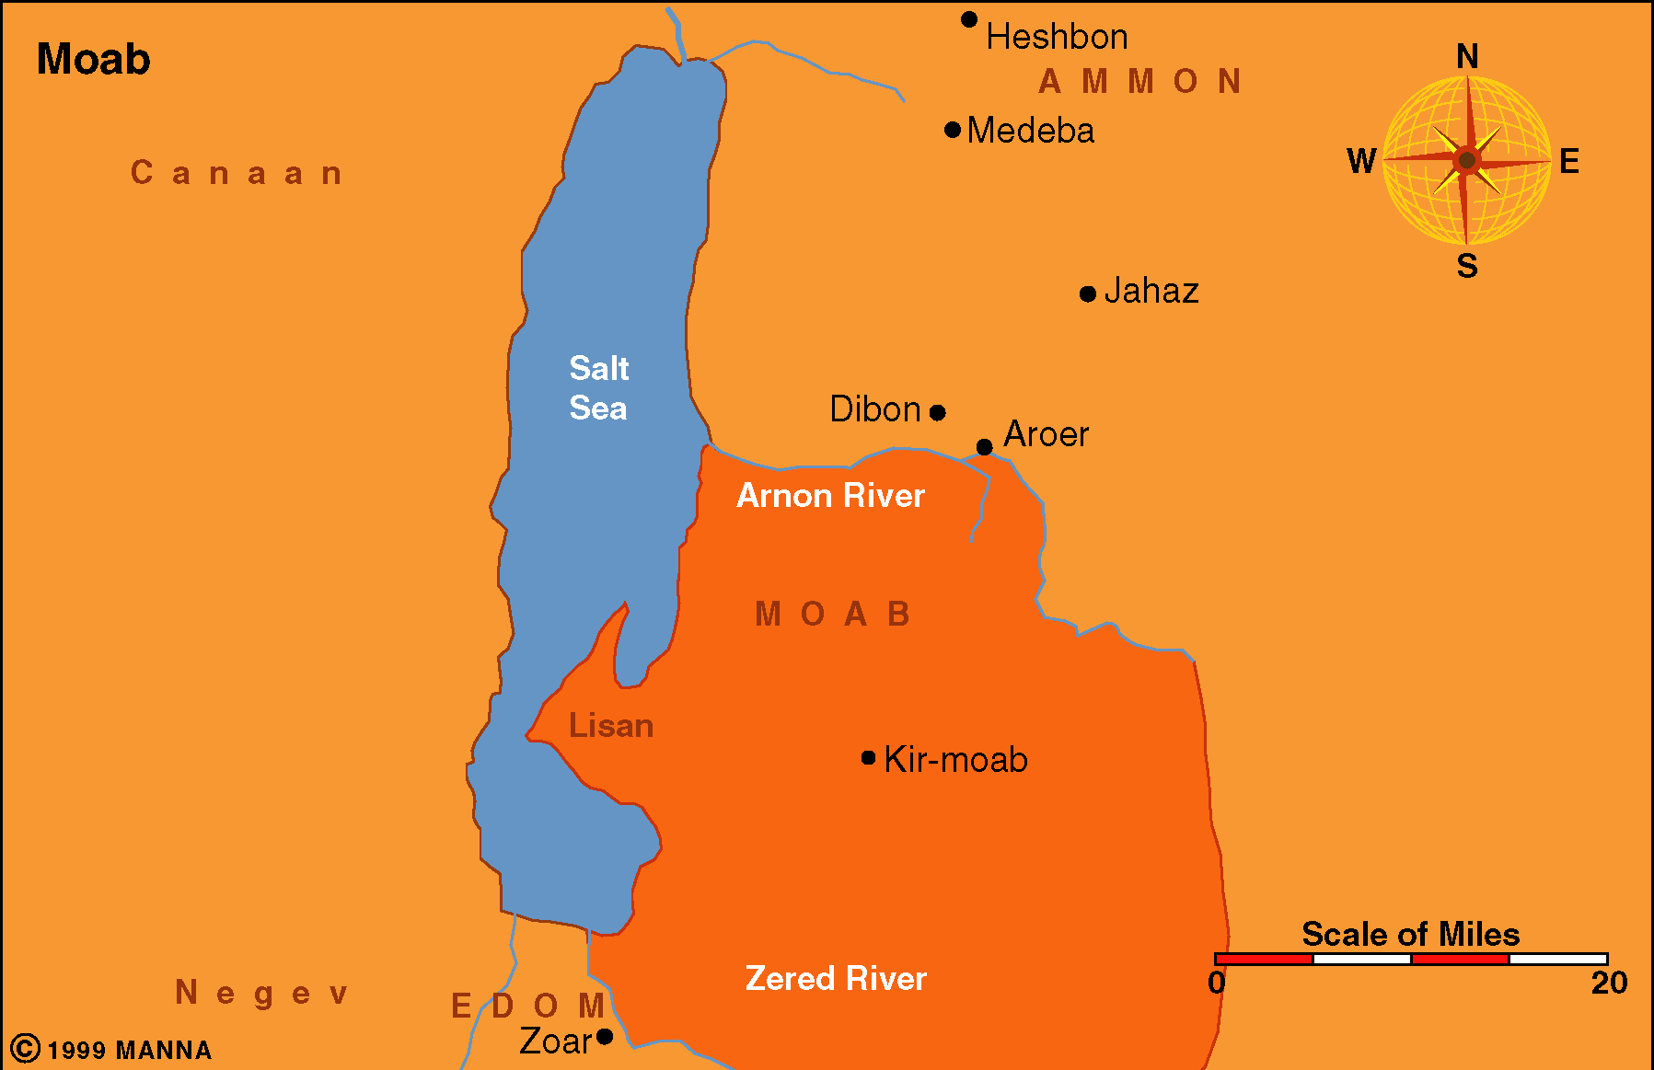

Slide 17
Moab (48)
  Great destruction coming (vv. 1-6)
  Pride and complacency brought this one (vv. 7, 11)
  Moab will be broken and plundered (vv. 14-25)
  Moab magnified himself against the Lord (vv. 26-46)
  Promise of hope (v. 47)

Slide 18
National – Messages to Judah (2-33)
Personal – Jeremiah’s Suffering (34-45)
International – Message to the Nations (46-52)
  Egypt (46)
  Philistia (47)
  Moab (48)
  Ammon (49:1-6)
  Edom (49:7-22)
  Syria, Kedar, Elam (49:23-39)
  Babylon (50-51)
Conclusion: The prophet’s captivity and release (52)

Slide 19
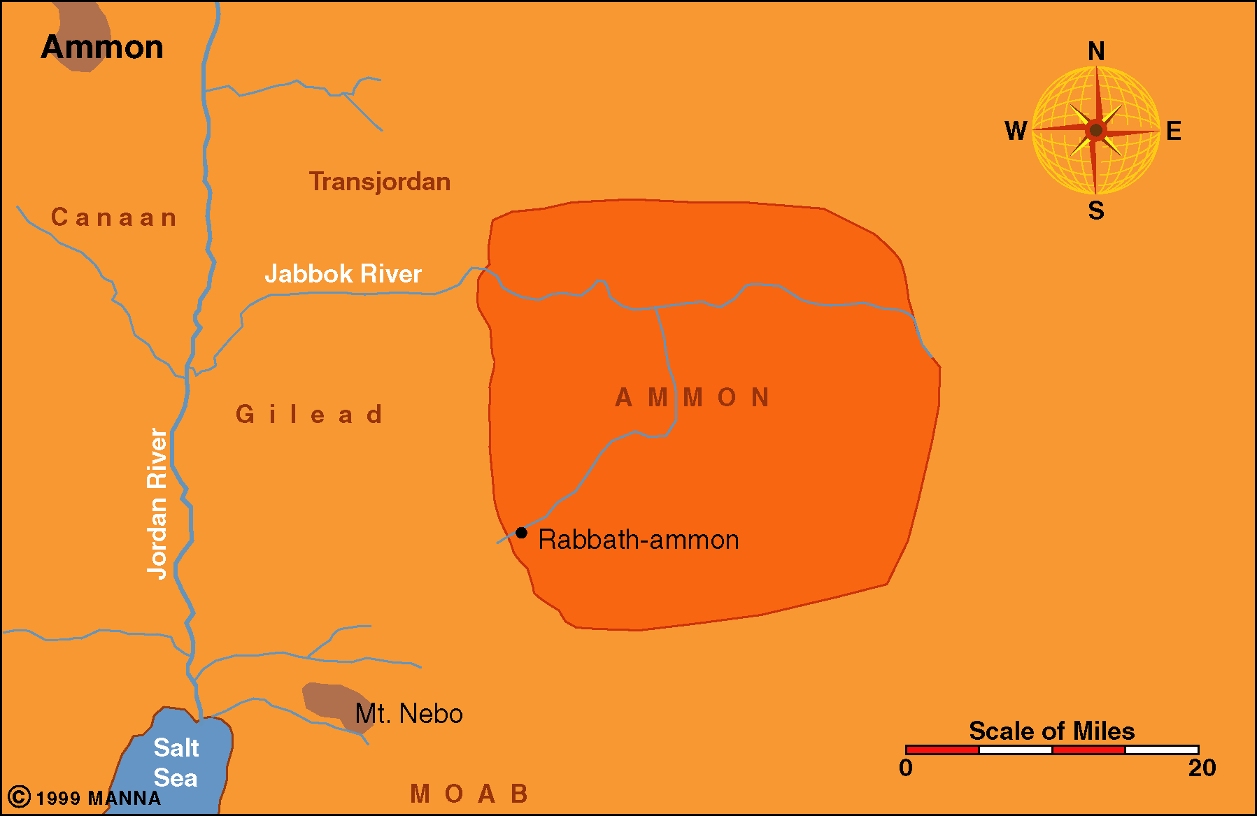

Slide 20
Ammon (49:1-6)
  Will become desolate and plundered (vv. 2, 3)
  They thought they were so powerful they would not fall (v. 4)

Slide 21
National – Messages to Judah (2-33)
Personal – Jeremiah’s Suffering (34-45)
International – Message to the Nations (46-52)
  Egypt (46)
  Philistia (47)
  Moab (48)
  Ammon (49:1-6)
  Edom (49:7-22)
  Syria, Kedar, Elam (49:23-39)
  Babylon (50-51)
Conclusion: The prophet’s captivity and release (52)

Slide 22
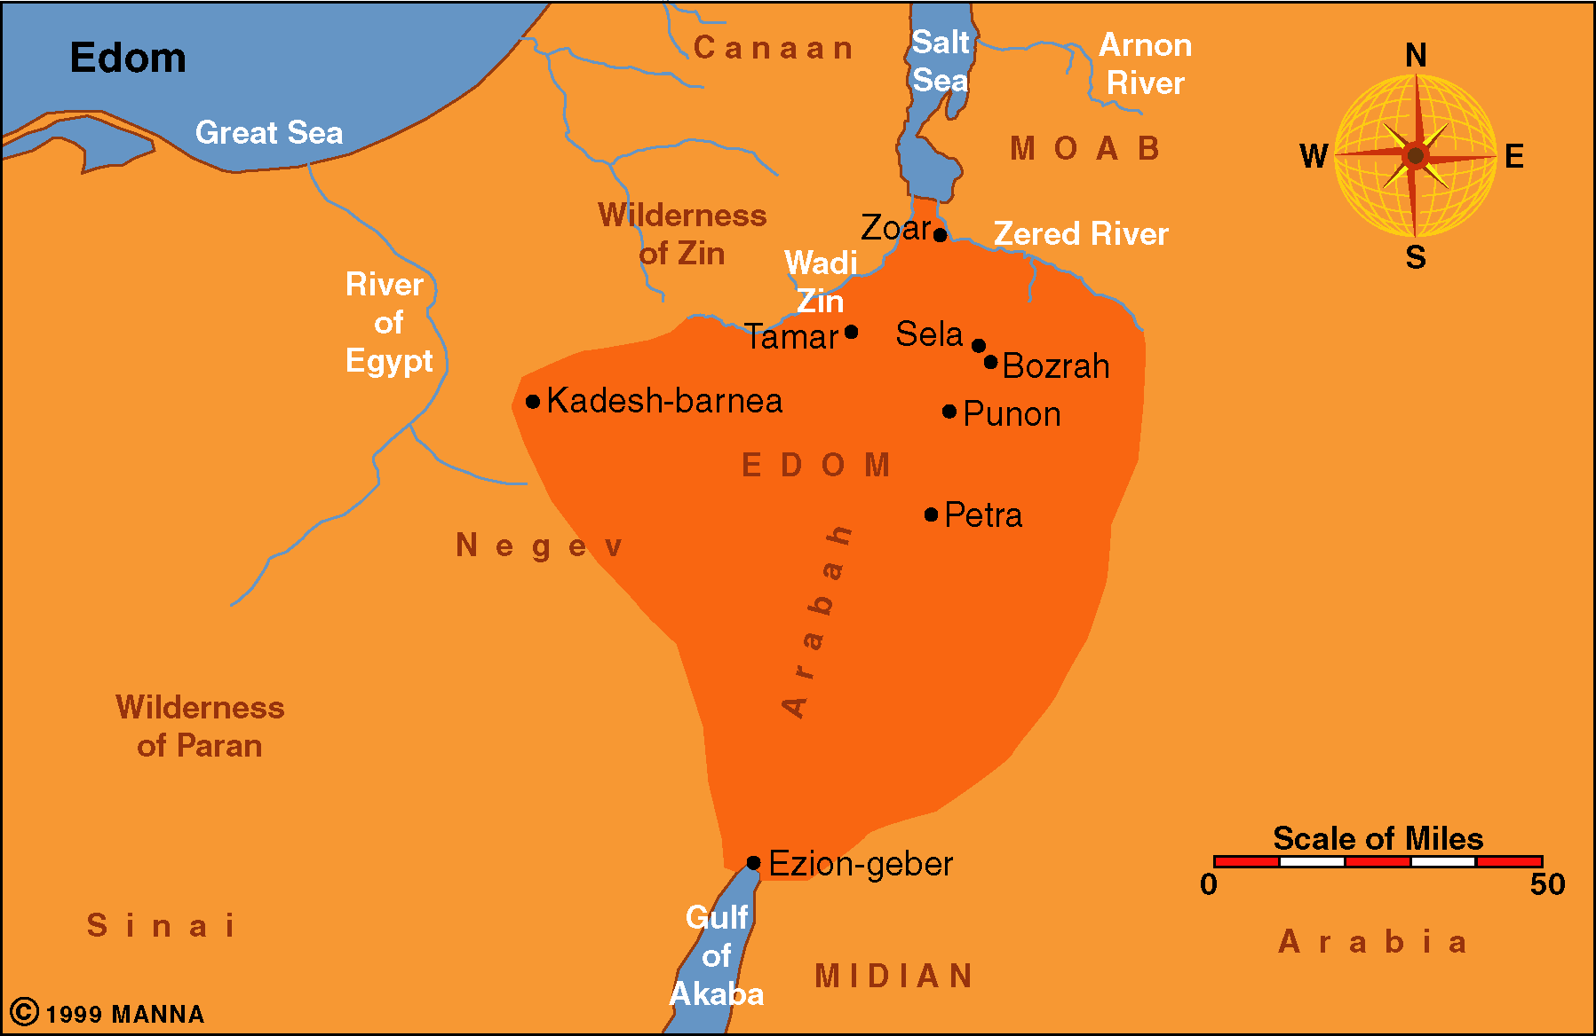

Slide 23
Edom (49:7-22)
  Destruction will be more than thorough (vv. 9-10)
  Will not escape (v. 12)
  Pride is what brought you down (v. 16)
  Who can stand against the Lord (v. 19)?

Slide 24
National – Messages to Judah (2-33)
Personal – Jeremiah’s Suffering (34-45)
International – Message to the Nations (46-52)
  Egypt (46)
  Philistia (47)
  Moab (48)
  Ammon (49:1-6)
  Edom (49:7-22)
  Syria, Kedar, Elam (49:23-39)
  Babylon (50-51)
Conclusion: The prophet’s captivity and release (52)

Slide 26
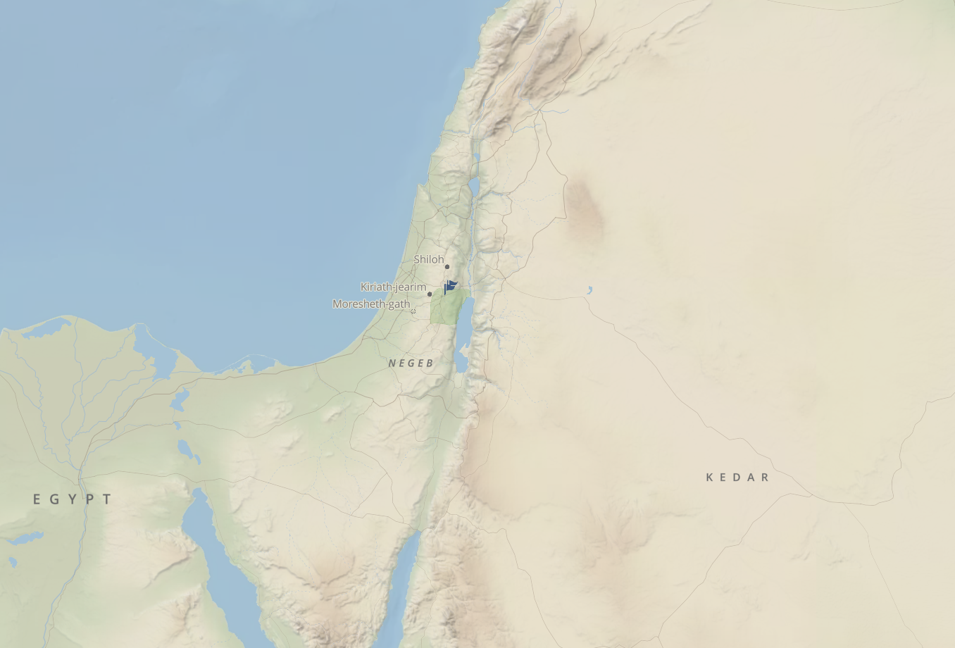
Logos Bible Software

Slide 27
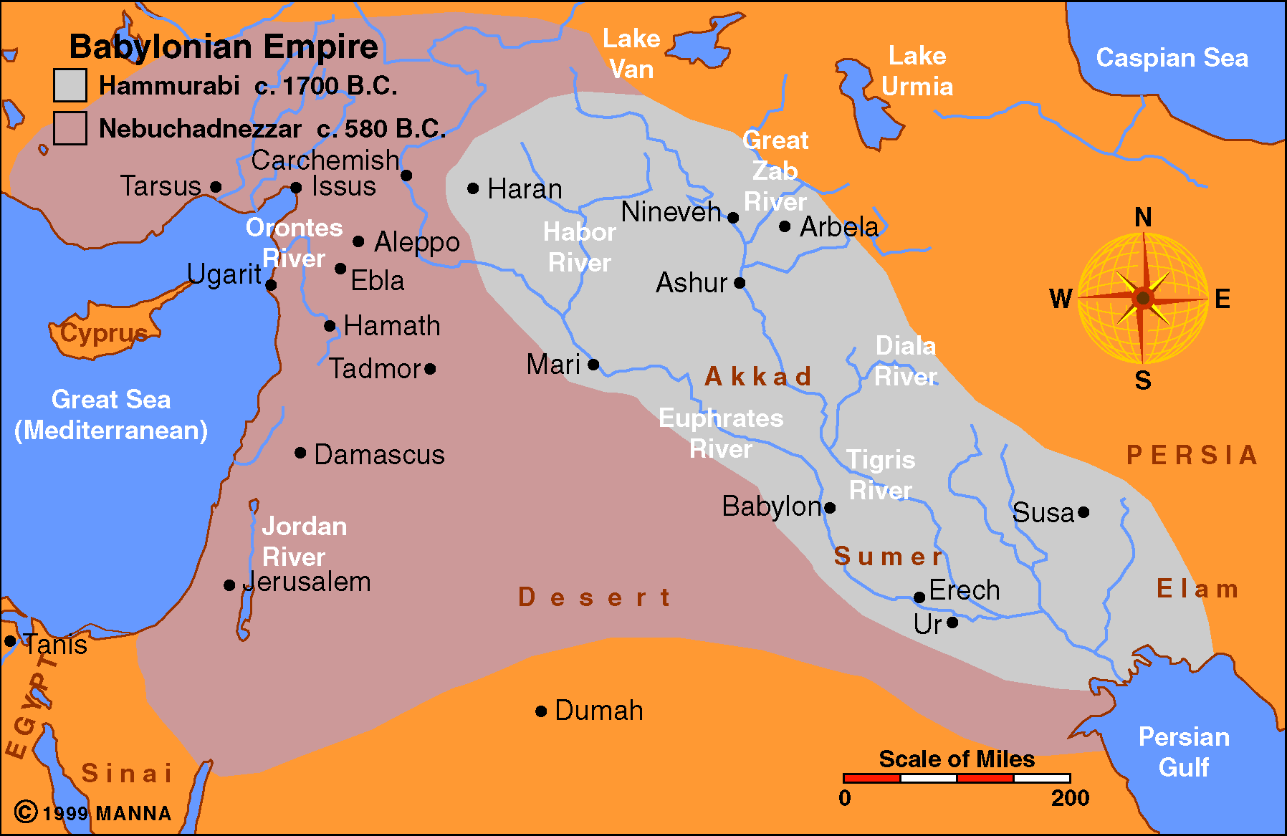

Slide 28
Syria, Kedar, Elam (49:23-39)
  Syria (vv. 23-27)
  Kedar and Hazor (vv. 28-33)
  Elam (vv. 34-39)

Slide 29
National – Messages to Judah (2-33)
Personal – Jeremiah’s Suffering (34-45)
International – Message to the Nations (46-52)
  Egypt (46)
  Philistia (47)
  Moab (48)
  Ammon (49:1-6)
  Edom (49:7-22)
  Syria, Kedar, Elam (49:23-39)
  Babylon (50-51)
Conclusion: The prophet’s captivity and release (52)

Slide 31
Babylon (50-51)
  Babylon will fall (50:1-10)
    Her gods failed (v. 2)
    Fall to enemy nation (v. 3)
    End of captivity (vv. 4-6)
    Babylon will be plundered (v. 10)

Slide 32
Babylon (50-51)
  Babylon will fall (50:1-10)
  Will get what she is has given to others (50:11-20)
    Babylon will be desolate (v. 13)
    Reason (v. 14)
    Get what she has given out (v. 15)
    Promise of return of a remnant (vv. 19-20)

Slide 33
Babylon (50-51)
  Babylon will fall (50:1-10)
  Will get what she is has given to others (50:11-20)
  Babylon’s pride and power crushed (50:21-40)
    Hammer of the earth will be broken (v. 23)
    Contended against the Lord (v. 24)
    Nothing left (v. 26)
    Proud (vv. 29, 31, 32)
    Utter destruction (v. 39)

Slide 34
Babylon (50-51)
  Babylon will fall (50:1-10)
  Will get what she is has given to others (50:11-20)
  Babylon’s pride and power crushed (50:21-40)
  God uses another nation as a tool against Babylon (50:41-46)
    Babylon now fears (v. 43)
    Carrying out the purpose of God (v. 45)

Slide 35
Babylon (50-51)
  Babylon will fall (50:1-10)
  Will get what she is has given to others (50:11-20)
  Babylon’s pride and power crushed (50:21-40)
  God uses another nation as a tool against Babylon (50:41-46)
  The Medes are the tool God uses (51:1-14)
    Babylon was merely a tool (vv. 6-7)
    Babylon was stubborn and sinned (v. 9)
    Medes will be used (v. 11)
    End has come (v. 13)

Slide 36
Babylon (50-51)
  Babylon will fall (50:1-10)
  Will get what she is has given to others (50:11-20)
  Babylon’s pride and power crushed (50:21-40)
  God uses another nation as a tool against Babylon (50:41-46)
  The Medes are the tool God uses (51:1-14)
  God contrasted to idols (51:15-19)
  The Medes are God’s weapon of war (51:20-24)
  Babylon is doomed (51:25-33)
    Taking down a powerful mountain (vv. 25-26)
    Medes are the tool used for God’s purpose (vv. 28-29)
    Bars of the gates are broken (v. 30)
    Terror in the streets (vv. 31-33)

Slide 37
Babylon (50-51)
  Babylon will fall (50:1-10)
  Will get what she is has given to others (50:11-20)
  Babylon’s pride and power crushed (50:21-40)
  God uses another nation as a tool against Babylon (50:41-46)
  The Medes are the tool God uses (51:1-14)
  God contrasted to idols (51:15-19)
  The Medes are God’s weapon of war (51:20-24)
  Babylon is doomed (51:25-33)
  Jerusalem’s cry and the Lord’s answer (51:34-58)
    Jerusalem’s cry (vv. 34-35)
    Lord’s response (vv. 36-58)
      Punish Babylon (vv. 36-45)
      My people delivered (vv. 46-58)

Slide 38
Babylon (50-51)
  Babylon will fall (50:1-10)
  Will get what she is has given to others (50:11-20)
  Babylon’s pride and power crushed (50:21-40)
  God uses another nation as a tool against Babylon (50:41-46)
  The Medes are the tool God uses (51:1-14)
  God contrasted to idols (51:15-19)
  The Medes are God’s weapon of war (51:20-24)
  Babylon is doomed (51:25-33)
  Jerusalem’s cry and the Lord’s answer (51:34-58)
  Jeremiah instructs Seraiah to demonstrate Babylon’s fall (51:59-64)

Slide 39
National – Messages to Judah (2-33)
Personal – Jeremiah’s Suffering (34-45)
International – Message to the Nations (46-52)
  Egypt (46)
  Philistia (47)
  Moab (48)
  Ammon (49:1-6)
  Edom (49:7-22)
  Syria, Kedar, Elam (49:23-39)
  Babylon (50-51)
Conclusion: The prophet’s captivity and release (52)

Slide 40
Conclusion: The prophet’s captivity and release (52)
Not the prophet’s own captivity & release,
But that of which he prophesied
Jerusalem falls and Zedekiah taken (vv. 1-11)
City and temple destroyed (vv. 12-16)
Took all gold, silver, and bronze (vv. 17-23)
Chief officials taken captive (vv. 24-30)
Release of Jehoiachin (vv. 31-34)

Slide 41
The Number of Captives (52:24-30)
4,600
3,023 – in 597 BC
832 – in 586 BC
745 – in 581 BC

Slide 42
The Number of Captives (52:24-30)
“These verses (28-30) are not intended to record all the deportations of the Jews…Also, these verses are not an attempt to record the sum total of all Jews taken by Nebuchadnezzar. The details and circumstances of these deportations are not revealed in the records and, therefore, are unknown to us. The deportations indicated in Daniel, 2 Kings, and 2 Chronicles are not included in these verses”
However, it should be noted that some expositors try to reconcile 2 Kings with these verse in Jeremiah by maintaining that the writer of 2 Kings utilized a different manner of counting and dating from the method used here. For example, some suggest that the record in 2 Kings includes the number of soldiers, while the account here does not.”
John A. Humphries, The Books of Jeremiah and Lamentations, 531

Slide 43
Lessons Learned
Jeremiah
Chapters 34-45
God rules over the nations
God uses nations as tools for his purpose
Judah fell just as the prophet said
Sin is the cause of every nation’s fall

