Slide 1

Ever Wake from a Dream
& for a Few Seconds Wonder
If it is Real?

Slide 2
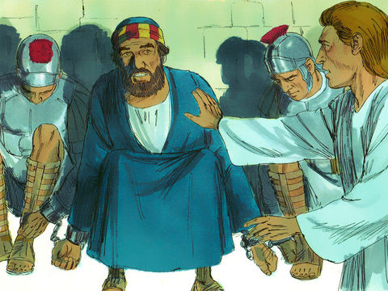
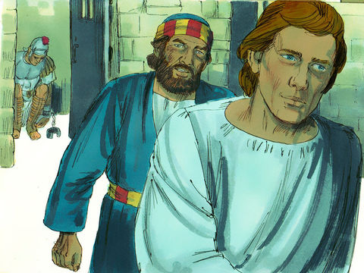
Acts 12:1-19
Peter Imprisoned & Delivered
Peter was arrested (v. 3)
Guarded and secured (vv. 4, 6)
An angel woke him and led him out (vv. 7-9a)

Slide 3
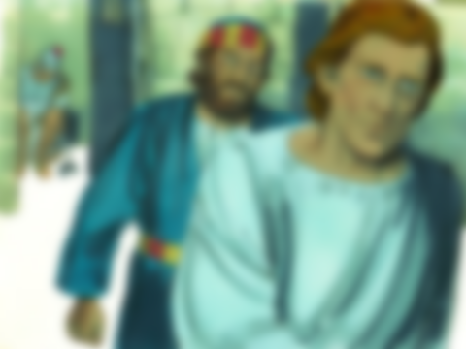
This Was Real!
At first it didn’t seem real (v.9)
If not real – not released – not literally go (just something he is thinking)
If it is real – TOTALLY DIFFERENT SITUATION!

Slide 4
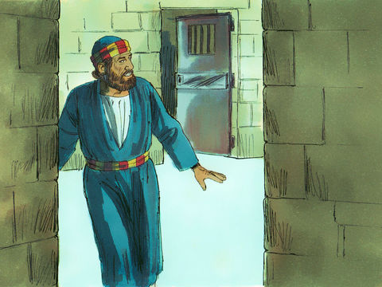
Peter realizes:
“This is real”
(v. 11)

Slide 5
Possible That We are Yet to Realize:
Our Religion is Real!
Claims / professions – do not always prove to be reality
  Claims & theory are easy
  When put to the test – not the same!
  Easily seen in denominational world:
    Claim to believe in miraculous healing
    Yet when sick, hurt and scared they rush to hospital!
    Realize: religion is not real!
Same could be true of any of us
  Claim our religion is real – important – top priority (convinced so)
  When put under pressure – may prove it is not real!

Slide 6
What Makes it Real?
What Makes it Real?

Slide 7
What Makes it Real?
What Makes it Real?
God is real
  Seen in creation (Psa. 19:1; Rom.1:20)
  Eternal (Exo. 3:14)
  Great & awesome (Neh. 1:5)
  Almighty (Rev. 4:8-11)
Notes:
Psa. 19:1 – The heavens declare the glory of God; And the firmament show His Handiwork
Rom. 1:20 - For since the creation of the world His invisible attributes are clearly seen, being understood by the things that are made, even His eternal power and Godhead, so that they are without excuse,

Slide 8
What Makes it Real?
What Makes it Real?
God is real
Eternity is real
  Jesus (who is real & alive - Rom.1:4) – said heaven is real (John 14:1-6)
  Jesus (who is real & alive – Rom. 1:4) – said hell is real (Mark 9:43)
Notes:
Mark 9:43 - If your hand causes you to sin, cut it off. It is better for you to enter into life maimed, rather than having two hands, to go to hell, into the fire that shall never be quenched—

Slide 9
What Makes it Real?
What Makes it Real?
God is real
Eternity is real
Faith is real
  Based upon real evidence (Rom. 10:17)
  Faith is: (Heb. 11:1)
    “Substance of things hoped for”
      “Faith is being sure of things we hope for” (NCV)
      Real faith is being “absolutely certain that what it believes is true” (Barclay, 144)
    “Evidence of things not seen”
      “know that something is real even if we do not see it” (NCV)
      “Faith is that which enables us to treat as real the things that are unseen” (EGNT IV, 352)

Slide 10
What Makes it Real?
What Makes it Real?
God is real
Eternity is real
Faith is real
Priorities are real
  God over family (Matt. 10:37)
  Forsake all to be a disciple (Matt. 4:22; Luke 5:11)
  Don’t wait till bury father (Matt. 8:22)
  Not forsake assembling when persecuted (Heb. 10:25)
Notes:
Matthew 10:37 - He who loves father or mother more than Me is not worthy of Me. And he who loves son or daughter more than Me is not worthy of Me.
Matthew 4:22 - and immediately they left the boat and their father, and followed Him.
Luke 5:11 - So when they had brought their boats to land, they forsook all and followed Him.

Slide 11
What Makes it Real?
For Some it is Real and Some Not
For Some it is Real and Some Not

Slide 12
For Some it is Real and Some Not
For Some it is Real and Some Not
For Some it is Real
  Abraham
    Told to go to strange country (Heb. 11:8)
    Believed would have a son (Rom. 4:18-21)
    Offered his son, Isaac (Heb. 11:17)
Notes:
Hebrews 11:8 - By faith Abraham obeyed when he was called to go out to the place which he would receive as an inheritance. And he went out, not knowing where he was going.
Hebrews 11:17 - By faith Abraham, when he was tested, offered up Isaac, and he who had received the promises offered up his only begotten son,

Slide 13
For Some it is Real and Some Not
For Some it is Real and Some Not
For Some it is Real
  Abraham
  Ezra
    Claimed that God would protect (Ezra 8:22)
    Stuck to his claim!
Notes:
Ezra 8:22 - For I was ashamed to request of the king an escort of soldiers and horsemen to help us against the enemy on the road, because we had spoken to the king, saying, “The hand of our God is upon all those for good who seek Him, but His power and His wrath are against all those who forsake Him.”

Slide 14
For Some it is Real and Some Not
For Some it is Real and Some Not
For Some it is Real
  Abraham
  Ezra
  Jeremiah
    Proclaimed Israel would return in 70 years (25:11)
    Bought a field as proof believed what said (32:6-15)

Slide 15
For Some it is Real and Some Not
For Some it is Real and Some Not
For Some it is Real
  Abraham
  Ezra
  Jeremiah
  Daniel’s three friends
    Told by authorities to bow to image of gold (3:5)
    Reported some who didn’t comply (3:12)
    More pressure (3:15)
    Faith was real – refused to bow (3:17-18)
Notes:
Daniel 3:12 - There are certain Jews whom you have set over the affairs of the province of Babylon: Shadrach, Meshach, and Abed-Nego; these men, O king, have not paid due regard to you. They do not serve your gods or worship the gold image which you have set up.”
Daniel 3:15 - Now if you are ready at the time you hear the sound of the horn, flute, harp, lyre, and psaltery, in symphony with all kinds of music, and you fall down and worship the image which I have made, good! But if you do not worship, you shall be cast immediately into the midst of a burning fiery furnace. And who is the god who will deliver you from my hands?”
Daniel 3:17–18 - If that is the case, our God whom we serve is able to deliver us from the burning fiery furnace, and He will deliver us from your hand, O king. ¹⁸ But if not, let it be known to you, O king, that we do not serve your gods, nor will we worship the gold image which you have set up.”

Slide 16
For Some it is Real and Some Not
For Some it is Real and Some Not
For Some it is Real
  Abraham
  Ezra
  Jeremiah
  Daniel’s three friends
  Polycarp
    Was a follower of John (apostle)
    Thought to be at Smyrna when “be faithful unto death” (Rev. 2:10) was read to the church.
    Refused to bow to pressure

Slide 17
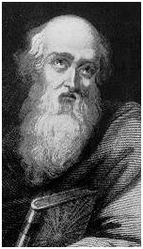
Polycarp
Lived 70 - 155 A.D
Martyred on Saturday, Feb. 23, 155
Charged to worship Caesar & renounce Christ
“Fourscore and six years have I served him, and he has never done me injury; how then can I now blaspheme my King and savior?”
Notes:
https://www.christianhistoryinstitute.org/incontext/article/polycarp-testimony/

Slide 18
Polycarp
Lived 70 - 155 A.D
Martyred on Saturday, Feb. 23, 155
Charged to worship Caesar & renounce Christ
Threatened with fire
“You threaten me with fire which burns for an hour, and is then extinguished, but you know nothing of the fire of the coming judgment and eternal punishment, reserved for the ungodly. Why are you waiting? Bring on whatever you want”
Notes:
https://www.christianhistoryinstitute.org/study/module/polycarp/

Slide 19
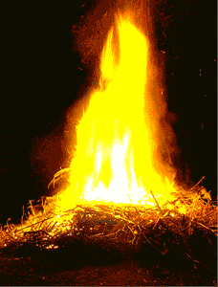
Polycarp
Lived 70 - 155 A.D
Martyred on Saturday, Feb. 23, 155
Charged to worship Caesar & renounce Christ
Threatened with fire
Burned Alive At The Stake

Slide 20
For Some it is Real and Some Not
For Some it is Real and Some Not
For Some it is Real
For Some it is Not
  Rich young ruler (Matt. 19)
    Came running to Jesus (v. 16; Mk. 10:17)
    Showed interest in spiritual things (v. 16)
    Wants eternal life (v. 16)
    Done commands (vv. 17-20)
    Been faithful and consistent (v. 20)
    When told 1 thing – revealed not real (v.22)

Slide 21
For Some it is Real and Some Not
For Some it is Real and Some Not
For Some it is Real
For Some it is Not
  Rich young ruler (Matt. 19)
  Disciples (Luke 8)
    Must have thought of themselves as people of real faith
      Heard his teaching –sermon on mt. (Luke 6)
      Seen his miracles (Luke 7)
      Listened to his parables (Luke 8)
    Storm arose – thought would die (vv. 23-24)
    Jesus asked, “Where is your faith?” (v. 25)

Slide 22
For Some it is Real and Some Not
For Some it is Real and Some Not
For Some it is Real
For Some it is Not
  Rich young ruler (Matt. 19)
  Disciples (Luke 8)
  Peter (Matt. 26:32-35)
    Made claims of how far he would go (vv. 32-35)
    Caved under pressure
      When Jesus was taken – followed at distance (v. 58)
      When asked if disciple – denied the Lord (vv. 69-75)

Slide 23
What Makes it Real?
For Some it is Real and Some Not
Reality Will be Tested
Reality Will be Tested

Slide 24
Reality Will be Tested
Reality Will be Tested
Our Faith Will be Tested
  1 Pet. 1:6-7
  Quite often there is a conflict between what I want and what I know is right (Matt. 26:41)

Slide 25
Reality Will be Tested
Reality Will be Tested
Our Faith Will be Tested
Many Situations / Circumstances – Must Realize “This Is Real”
Ask: “What do we do now?”
Will our actions match our faith?
Will we do what we claim?
We will have hard choices to make
We will have hard decisions
This is not just theory or belief!

Slide 26
Reality Will be Tested
Reality Will be Tested
Our Faith Will be Tested
Many Situations / Circumstances – Must Realize “This Is Real”
  Conflict between God & family
    God says stay (Matt. 19:3-6; 1 Pet. 3:7)
    God says leave (Ezra 10)
    God says submit (Eph 5:22)
    Can have family relationship or God (cf. 1 Cor. 7:15)

Slide 27
Reality Will be Tested
Reality Will be Tested
Our Faith Will be Tested
Many Situations / Circumstances – Must Realize “This Is Real”
  Conflict between God & family
  Been wronged & offender asks for forgiveness
    God says forgive (Matt. 18:35)
    God says forgive multiple times (Luke 17:1-4)

Slide 28
Reality Will be Tested
Reality Will be Tested
Our Faith Will be Tested
Many Situations / Circumstances – Must Realize “This Is Real”
  Conflict between God & family
  Been wronged & offender asks for forgiveness
  Conflict with worship
    God says not forsake assembling (Heb. 10:25)
    Conflict caused by sports
    Conflict caused by offer of overtime
    Conflict caused by friends or family
    Conflict caused by worry

Slide 29
Reality Will be Tested
Reality Will be Tested
Our Faith Will be Tested
Many Situations / Circumstances – Must Realize “This Is Real”
  Conflict between God & family
  Been wronged & offender asks for forgiveness
  Conflict with worship
  Do what promise
    God says do what you promise (Jas. 5:12)
    When given your word – but rather not do what promised…

Slide 30
Reality Will be Tested
Reality Will be Tested
Our Faith Will be Tested
Many Situations / Circumstances – Must Realize “This Is Real”
  Conflict between God & family
  Been wronged & offender asks for forgiveness
  Conflict with worship
  Do what promise
  Take an uncomfortable stand
    Hard for Peter and Barnabas (Gal. 2:11-13)
    May be a stand you know is right – but really don’t want the pressure

Slide 31
Reality Will be Tested
Reality Will be Tested
Our Faith Will be Tested
Many Situations / Circumstances – Must Realize “This Is Real”
  Conflict between God & family
  Been wronged & offender asks for forgiveness
  Conflict with worship
  Do what promise
  Take an uncomfortable stand
  Accept that someone you know & love will be lost
    Jesus brings division among men (Luke 12:51-53)
    Hard time admitting what know the Bible teaches?

Slide 32
Reality Will be Tested
Reality Will be Tested
Our Faith Will be Tested
Many Situations / Circumstances – Must Realize “This Is Real”
  Conflict between God & family
  Been wronged & offender asks for forgiveness
  Conflict with worship
  Do what promise
  Take an uncomfortable stand
  Accept that someone you know & love will be lost
  Persecution

Slide 33
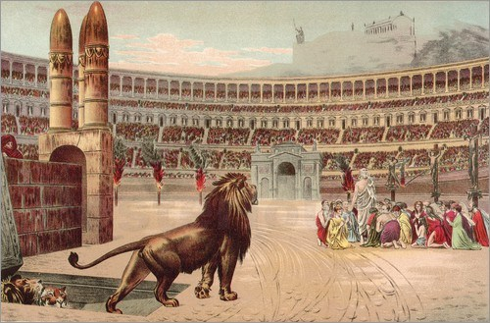
Persecution
Arrested (Acts 4:3; 5:18; 6:12; 8:3; 9:2; 12:3…)
Threatened (Acts 4:16; 9:1)
Interference in doing God’s commands (Acts 4:18)
Beaten (Acts 5:40)
Stoned to death (Acts 7:59-60)
Try to kill (Acts 9:23)
Killed (Acts 12:1-2)
Stoned (Acts 14:5, 19)
Attacked a home (Acts 17:5)
Home ransacked (Heb. 10:34)
What do when are arrested, threatened or stare at end of barrel?
If told to quit teaching?
If told to quit assembling?
If told to accept homosexuals?

Slide 34
Reality Will be Tested
Reality Will be Tested
Our Faith Will be Tested
Many Situations / Circumstances – Must Realize “This Is Real”
  Conflict between God & family
  Been wronged & offender asks for forgiveness
  Conflict with worship
  Do what promise
  Take an uncomfortable stand
  Accept that someone you know & love will be lost
  Persecution
  Crisis (present & any in the future)
    Cast the principles of authority out / at least ignore?
    Are there still divine instructions to follow?

Slide 35
Reality Will be Tested
Reality Will be Tested
Our Faith Will be Tested
Many Situations / Circumstances – Must Realize “This Is Real”
Easy to Lose Focus
  Example of running a race (Heb. 12:1)
  Focus to be fearing God & serving him (Ecc. 12:13)

Slide 36
What Makes it Real?
For Some it is Real and Some Not
Reality Will be Tested

