Slide 1
Mark 9:43-44
43 "If your hand causes you to sin, cut it off. It is better for you to enter into life maimed, rather than having two hands, to go to hell, into the fire that shall never be quenched--
44 "where 'Their worm does not die, And the fire is not quenched.'
Warning!

Slide 2
Mark 9:43-44
Taken Lightly
43 "If your hand causes you to sin, cut it off. It is better for you to enter into life maimed, rather than having two hands, to go to hell, into the fire that shall never be quenched--
44 "where 'Their worm does not die, And the fire is not quenched.'
Warning!
Used In Profanity
Joking Matter
Not Afraid of Hell

Slide 3
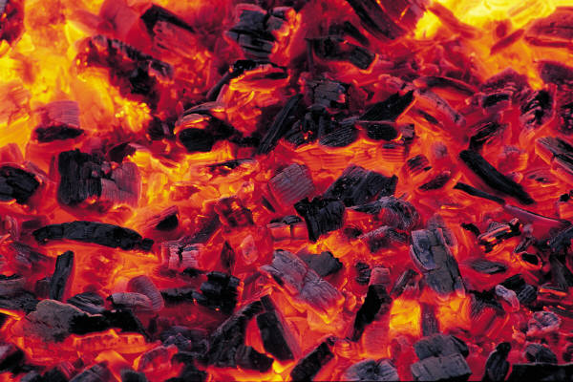
Reasons Hell Is Taken Lightly
Little teaching on Hell
We forget what we have been taught
Think Bible description - overstated
“Hell-Fire & Brimstone” - Out of date

Slide 4


Slide 5
Is Real

Slide 6
Not a fictitious story - used to scare people
Not a condition or state of mind
It is a place - that is real
Hades
Hell
Foretaste
Luke 16:23, 28

Slide 7
Real
Hell
Mt. 25:46
Heaven
Mt. 25:46
Myth
Fictitious

Slide 8
Matthew 10:28
And do not fear those who kill the body but cannot kill the soul. But rather fear Him who is able to destroy both soul and body in hell.
To be feared
Beyond the grave

Slide 9
Is Real
Is Terrible

Slide 10
Gehenna
The Valley of Hinnom
Terrible

Slide 11
Hell - Gehenna
“Besides the above uses, and more in accordance with the modern meaning, the word "hell" is used in the NT in AV as the equivalent of Gehenna (12 t; Mt b 22.29; 10 28, etc). RV in these cases puts "Gehenna" in m. Originally the Valley of Hinnom, near Jerus, Gehenna became among the Jews the synonym for the place of torment in the future life (the "Gehenna of fire," Mt 5 22, etc; see GEHENNA).”
- ISBE p. 1371

Slide 12
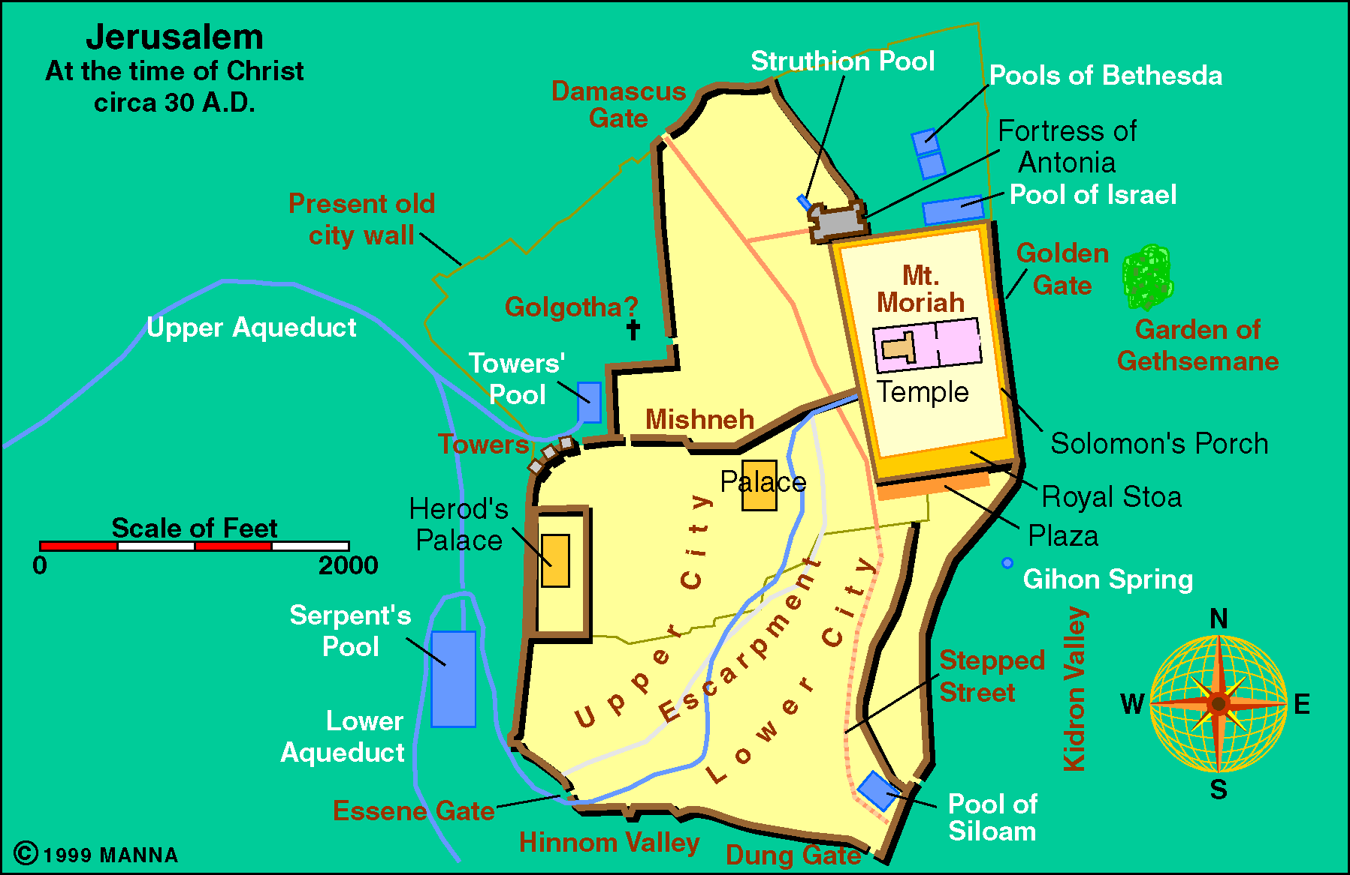

Slide 13
Gehenna
The Valley of Hinnom
The City Incinerator
Terrible

Slide 14
Valley of Hinnom
Into this valley dead bodies were probably cast to be consumed by the dogs, as is done in the Wady er-Rababi today, and fires were here kept burning to consume the rubbish of the city. Such associations led to the Ge-Hinnom (NT "Gehenna") becoming the "type of Hell" (Milton, Paradise Lost, i, 405). See HENNA.
ISBE 1393

Slide 15
Gehenna
The Valley of Hinnom
The City Incinerator
Seat of Worship to Molech
Terrible

Slide 16
Worship to Molech
2 Chron. 28:3
2 Chron. 33:6
Jer. 7:30-31
Jer. 19:5-6
2 Kings 23:10

Slide 17
Molech
The image of Moloch was a human figure with a bull's head and outstretched arms, ready to receive the children destined for sacrifice. The image of metal was heated red hot by a fire kindled within, and the children laid on its arms rolled off into the fiery pit below. In order to drown the cries of the victims, flutes were played, and drums were beaten; and mothers stood by without tears or sobs, to give the impression of the voluntary character of the offering (see Rawlinson s Phoenicia, 113 f, for fuller details).
ISBE 2075

Slide 18
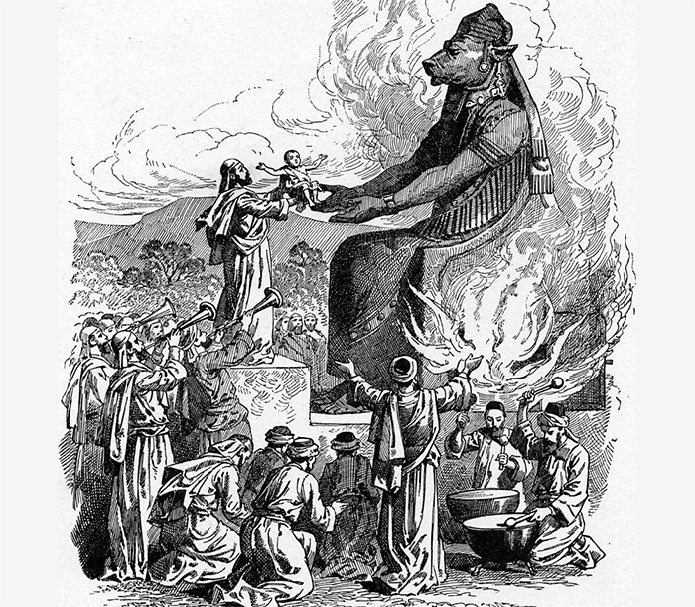

Slide 19
Gehenna
Prepared for The Devil
Terrible

Slide 20

“Then He will also say to those on the left hand, 'Depart from Me, you cursed, into the everlasting fire prepared for the devil and his angels:” (Matt. 25:41)
What punishment is just for him?
Think of what he has done to:
  Mankind
  Lord
  God’s people
He introduced:
  Sin
  Disease
  Death

Slide 21
Gehenna
Prepared for The Devil
A Lake of Fire
Terrible

Slide 22

Lake of fire (Rev. 20:10, 14, 15; 21:8)
Furnace of fire (Matt. 13:42, 50)
Flaming fire (2 Thess. 1:7-9)
Baptism of fire (Matt. 3:11-12)
Unquenchable fire (Mark 9:43, 48)
Brimstone (Rev. 21:8)

Slide 23
Gehenna
Prepared for The Devil
A Lake of Fire
Wailing & Gnashing - Teeth
Terrible

Slide 24

Weeping, Wailing &
Gnashing of Teeth
Matt. 8:12 - Weeping and gnashing
Matt. 13:50 - Wailing and gnashing
Matt. 25:30 - Weeping and gnashing

Slide 25
Gehenna
Prepared for The Devil
A Lake of Fire
Wailing & Gnashing - Teeth
Darkness
Terrible

Slide 26
Matthew 8:12; 25:30
Imagine being in total blackness
of darkness . . .

Slide 27
Gehenna
Prepared for The Devil
A Lake of Fire
Wailing & Gnashing - Teeth
Darkness
Pain
Terrible

Slide 28
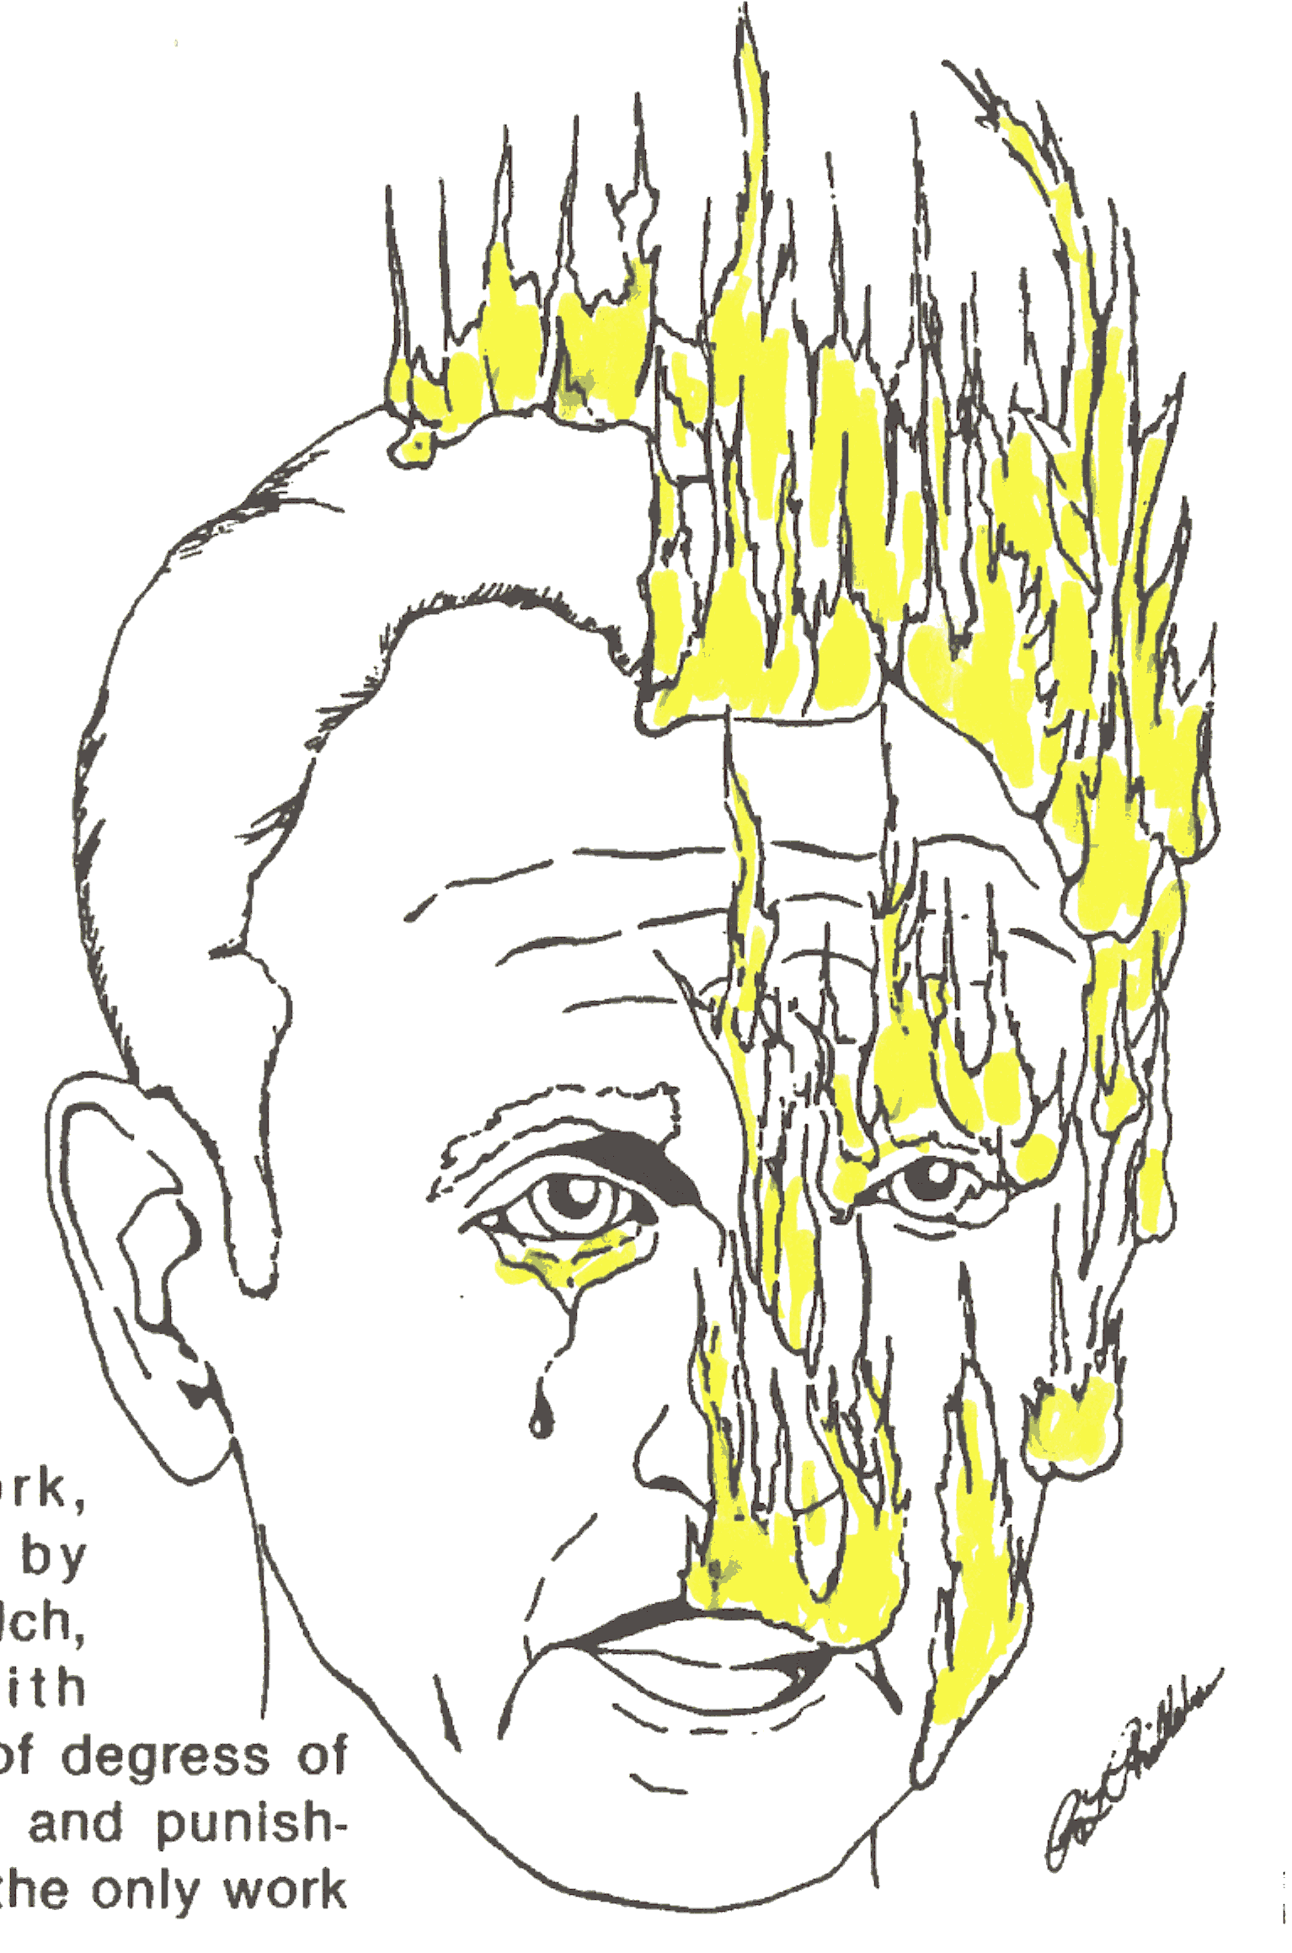
“But the cowardly, unbelieving, abominable, murderers, sexually immoral, sorcerers, idolaters, and all liars shall have their part in the lake which burns with fire and brimstone, which is the second death.”
- Rev. 21:8

Slide 29
Conscious - Luke 16
Tormented -
Rev. 14:10-11
Punishment -
Heb. 10:27-29
Unquenchable Thirst -
Luke 16:24

Slide 30
Is Real
Is Terrible
Is Eternal

Slide 31
Matt. 25:41 – For Devil & Angels
“Then He will also say to those on the left hand, 'Depart from Me, you cursed, into the everlasting fire prepared for the devil and his angels.”
Devil
Rev. 20:10
Tormented
Day & Night
For Ever & Ever
Torment – Not Annihilation
Day & Night - Without Interruption
For Ever & Ever – Without End

Slide 32
Matt. 25:46 – Same As Heaven
“And these will go away into everlasting punishment, but the righteous into eternal life."
Everlasting
Punishment
(Gk: aionios)
Hell
Eternal
Life
(Gk: aionios)
Heaven
What Do
With One
Do With
The Other

Slide 33
Worm Doesn’t Die / Fire Not Quenched
Isa. 66:24; Mark 9:44, 46, 48
Worm Doesn’t Die
Worm eats flesh
of animal
When flesh
is consumed
worm dies
Fire Not Quenched
Burning of trash
When burned
It is consumed
& fire goes out
Does Not End

Slide 34
Rev. 14:10-11 – Torment Forever
“10 he himself shall also drink of the wine of the wrath of God, which is poured out full strength into the cup of His indignation. He shall be tormented with fire and brimstone in the presence of the holy angels and in the presence of the Lamb.
11 And the smoke of their torment ascends forever and ever; and they have no rest day or night, who worship the beast and his image, and whoever receives the mark of his name.”
God Lives
“forever and ever”
(Rev. 4:9)
Endless Future
Torment
“forever and ever”
(Rev. 14:11)
Endless Future

Slide 35
Is Real
Is Terrible
Is Eternal
Is A Motivating Force
2 Cor. 5:11

Slide 36

Preach & teach
Pray & study more
Restore & warn
Rebuke & reprove
Leave world & self
Obey the gospel
Turn from sin
Say “no” to temptation
Get priorities in order
Knowing
there is
a
Hell
Motivates
me to:

Slide 37
Is Real
Is Terrible
Is Eternal
Is A Motivating Force
Is Destiny Of:

Slide 38

Roll Call
Devil and his angels (Matt. 25:41)
Unbelievers (Rev. 21:8)
Liars (Rev. 21:8)
Disobedient (2 Thess. 1:7-9)
Religious (Matt. 7:21-29)
Moral (2 Thess. 1:7-9)
Christians who are:
  Apostates (Heb. 10:27ff)
  Lukewarm (Rev. 3:16)
  Indifferent (Matt. 25:14-30)

Slide 39
Is Real
Is Terrible
Is Eternal
Is A Motivating Force
Is Destiny Of:

